Slide 1
SQL
Structured Query Language

Slide 2
Introduction to SQL
What is SQL?
SQL stands for Structured Query Language
SQL lets you access and manipulate databases
SQL is an ANSI (American National Standards Institute) standard
What Can SQL do?
SQL can execute queries against a database
SQL can retrieve data from a database
SQL can insert records in a database
SQL can update records in a database
SQL can delete records from a database
SQL can create new databases
SQL can create new tables in a database
SQL can create stored procedures in a database
SQL can create views in a database
SQL can set permissions on tables, procedures, and views

Slide 3
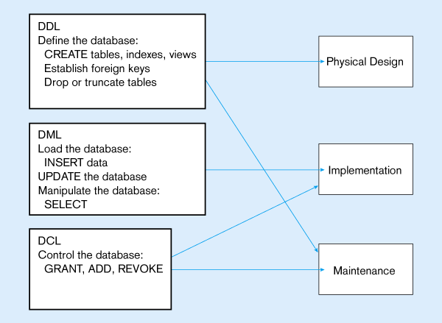

Slide 4
Numeric Data Types:
INT - A normal-sized integer that can be signed or unsigned. If signed, the allowable range is from -2147483648 to 2147483647. If unsigned, the allowable range is from 0 to 4294967295. You can specify a width of up to 11 digits.
TINYINT - A very small integer that can be signed or unsigned. If signed, the allowable range is from -128 to 127. If unsigned, the allowable range is from 0 to 255. You can specify a width of up to 4 digits.
SMALLINT - A small integer that can be signed or unsigned. If signed, the allowable range is from -32768 to 32767. If unsigned, the allowable range is from 0 to 65535. You can specify a width of up to 5 digits.
MEDIUMINT - A medium-sized integer that can be signed or unsigned. If signed, the allowable range is from -8388608 to 8388607. If unsigned, the allowable range is from 0 to 16777215. You can specify a width of up to 9 digits.
BIGINT - A large integer that can be signed or unsigned. If signed, the allowable range is from -9223372036854775808 to 9223372036854775807. If unsigned, the allowable range is from 0 to 18446744073709551615. You can specify a width of up to 20 digits.

Slide 5
Numeric Data types
FLOAT(M,D) - A floating-point number that cannot be unsigned. You can define the display length (M) and the number of decimals (D). This is not required and will default to 10,2, where 2 is the number of decimals and 10 is the total number of digits (including decimals). Decimal precision can go to 24 places for a FLOAT.
DOUBLE(M,D) - A double precision floating-point number that cannot be unsigned. You can define the display length (M) and the number of decimals (D). This is not required and will default to 16,4, where 4 is the number of decimals. Decimal precision can go to 53 places for a DOUBLE. REAL is a synonym for DOUBLE.
DECIMAL(M,D) - An unpacked floating-point number that cannot be unsigned. In unpacked decimals, each decimal corresponds to one byte. Defining the display length (M) and the number of decimals (D) is required. NUMERIC is a synonym for DECIMAL.

Slide 6
Date and Time Types:
DATE - A date in YYYY-MM-DD format, between 1000-01-01 and 9999-12-31. For example, December 30th, 1973 would be stored as 1973-12-30.
DATETIME - A date and time combination in YYYY-MM-DD HH:MM:SS format, between 1000-01-01 00:00:00 and 9999-12-31 23:59:59. For example, 3:30 in the afternoon on December 30th, 1973 would be stored as 1973-12-30 15:30:00.
TIMESTAMP - A timestamp between midnight, January 1, 1970 and sometime in 2037. This looks like the previous DATETIME format, only without the hyphens between numbers; 3:30 in the afternoon on December 30th, 1973 would be stored as 19731230153000 ( YYYYMMDDHHMMSS ).
TIME - Stores the time in HH:MM:SS format.
YEAR(M) - Stores a year in 2-digit or 4-digit format. If the length is specified as 2 (for example YEAR(2)), YEAR can be 1970 to 2069 (70 to 69). If the length is specified as 4, YEAR can be 1901 to 2155. The default length is 4.

Slide 7
String Types:
CHAR(M) - A fixed-length string between 1 and 255 characters in length (for example CHAR(5)), right-padded with spaces to the specified length when stored. Defining a length is not required, but the default is 1.
VARCHAR(M) - A variable-length string between 1 and 255 characters in length; for example VARCHAR(25). You must define a length when creating a VARCHAR field.
BLOB or TEXT - A field with a maximum length of 65535 characters. BLOBs are "Binary Large Objects" and are used to store large amounts of binary data, such as images or other types of files. Fields defined as TEXT also hold large amounts of data; the difference between the two is that sorts and comparisons on stored data are case sensitive on BLOBs and are not case sensitive in TEXT fields. You do not specify a length with BLOB or TEXT.

Slide 8
String Types
TINYBLOB or TINYTEXT - A BLOB or TEXT column with a maximum length of 255 characters. You do not specify a length with TINYBLOB or TINYTEXT.
MEDIUMBLOB or MEDIUMTEXT - A BLOB or TEXT column with a maximum length of 16777215 characters. You do not specify a length with MEDIUMBLOB or MEDIUMTEXT.
LONGBLOB or LONGTEXT - A BLOB or TEXT column with a maximum length of 4294967295 characters. You do not specify a length with LONGBLOB or LONGTEXT.
ENUM - An enumeration, which is a fancy term for list. When defining an ENUM, you are creating a list of items from which the value must be selected (or it can be NULL). For example, if you wanted your field to contain "A" or "B" or "C", you would define your ENUM as ENUM ('A', 'B', 'C') and only those values (or NULL) could ever populate that field.

Slide 9
SQL Database Tables
A database most often contains one or more tables. Each table is identified by a name (e.g. "Customers" or "Orders"). Tables contain records (rows) with data.
Below is an example of a table called "Persons":
LastName
FirstName
Address
City
Hansen
Ola
Timoteivn 10
Sandnes
Svendson
Tove
Borgvn 23
Sandnes
Pettersen
Kari
Storgt 20
Stavanger

Slide 10
SQL Data Definition Language (DDL)
The Data Definition Language (DDL) part of SQL permits database tables to be created or deleted. We can also define indexes (keys), specify links between tables, and impose constraints between database tables.
The most important DDL statements in SQL are:
CREATE TABLE - creates a new database table
ALTER TABLE - alters (changes) a database table
DROP TABLE - deletes a database table
CREATE INDEX - creates an index (search key)
DROP INDEX - deletes an index

Slide 11
The CREATE TABLE Statement
The CREATE TABLE statement is used to create a table in a database.
SQL CREATE TABLE Syntax
CREATE TABLE table_name
(
column_name1 data_type,
column_name2 data_type,
column_name3 data_type,
....
)

Slide 12
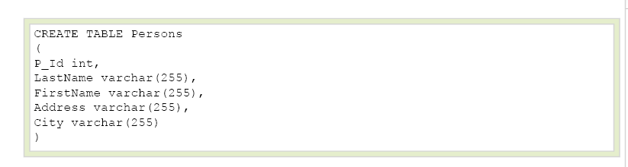
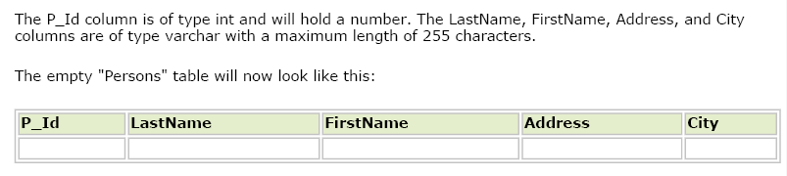

Slide 13
SQL Constraints
Constraints are used to limit the type of data that can go into a table.
Constraints can be specified when a table is created (with the CREATE TABLE statement) or after the table is created (with the ALTER TABLE statement).
We will focus on the following constraints:
NOT NULL
UNIQUE
PRIMARY KEY
FOREIGN KEY
CHECK
DEFAULT

Slide 14
SQL NOT NULL Constraint
The NOT NULL constraint enforces a column to NOT accept NULL values.
The NOT NULL constraint enforces a field to always contain a value. This means that you cannot insert a new record, or update a record without adding a value to this field.
The following SQL enforces the "P_Id" column and the "LastName" column to not accept NULL values:
CREATE TABLE Persons
(
P_Id int NOT NULL,
LastName varchar(255) NOT NULL,
FirstName varchar(255),
Address varchar(255),
City varchar(255)
)

Slide 15
SQL UNIQUE Constraint on CREATE TABLE
The UNIQUE constraint uniquely identifies each record in a database table.
The UNIQUE and PRIMARY KEY constraints both provide a guarantee for uniqueness for a column or set of columns.
A PRIMARY KEY constraint automatically has a UNIQUE constraint defined on it.
Example
CREATE TABLE Persons
(
P_Id int NOT NULL UNIQUE,
LastName varchar(255) NOT NULL,
FirstName varchar(255),
Address varchar(255),
City varchar(255)
)

Slide 16
To allow naming of a UNIQUE constraint, and for defining a UNIQUE constraint on multiple columns, use the following SQL syntax:
CREATE TABLE Persons
(
P_Id int NOT NULL,
LastName varchar(255) NOT NULL,
FirstName varchar(255),
Address varchar(255),
City varchar(255),
CONSTRAINT uc_PersonID UNIQUE (P_Id,LastName)
)

Slide 17
SQL PRIMARY KEY Constraint
The PRIMARY KEY constraint uniquely identifies each record in a database table.
Primary keys must contain unique values.
A primary key column cannot contain NULL values.
Each table should have a primary key, and each table can have only ONE primary key.

Slide 18
CREATE TABLE Persons
(
P_Id int NOT NULL PRIMARY KEY,
LastName varchar(255) NOT NULL,
FirstName varchar(255),
Address varchar(255),
City varchar(255)
)

Slide 19
To allow naming of a PRIMARY KEY constraint, and for defining a PRIMARY KEY constraint on multiple columns, use the following SQL syntax:
CREATE TABLE Persons
(
P_Id int NOT NULL,
LastName varchar(255) NOT NULL,
FirstName varchar(255),
Address varchar(255),
City varchar(255),
CONSTRAINT pk_PersonID PRIMARY KEY (P_Id,LastName)
)

Slide 20

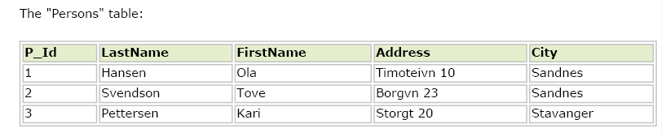
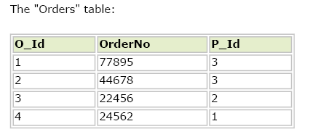
The "P_Id" column in the "Persons" table is the PRIMARY KEY in the "Persons" table.
The "P_Id" column in the "Orders" table is a FOREIGN KEY in the "Orders" table.
The FOREIGN KEY constraint is used to prevent actions that would destroy links between tables.
The FOREIGN KEY constraint also prevents that invalid data form being inserted into the foreign key column, because it has to be one of the values contained in the table it points to.

Slide 21
CREATE TABLE Orders
(
O_Id int NOT NULL PRIMARY KEY,
OrderNo int NOT NULL,
P_Id int FOREIGN KEY REFERENCES Persons(P_Id)
)

Slide 22
To allow naming of a FOREIGN KEY constraint, and for defining a FOREIGN KEY constraint on multiple columns, use the following SQL syntax:
  CREATE TABLE Orders
  (
  O_Id int NOT NULL,
  OrderNo int NOT NULL,
  P_Id int,
  PRIMARY KEY (O_Id),
  CONSTRAINT fk_PerOrders FOREIGN KEY (P_Id)
  REFERENCES Persons(P_Id)
  )

Slide 23
SQL CHECK Constraint
The CHECK constraint is used to limit the value range that can be placed in a column.
If you define a CHECK constraint on a single column it allows only certain values for this column.
If you define a CHECK constraint on a table it can limit the values in certain columns based on values in other columns in the row.

Slide 24
CREATE TABLE Persons
(
P_Id int NOT NULL CHECK (P_Id>0),
LastName varchar(255) NOT NULL,
FirstName varchar(255),
Address varchar(255),
City varchar(255)
)
To allow naming of a CHECK constraint, and for defining a CHECK constraint on multiple columns, use the following SQL syntax:
CREATE TABLE Persons
(
P_Id int NOT NULL,
LastName varchar(255) NOT NULL,
FirstName varchar(255),
Address varchar(255),
City varchar(255),
CONSTRAINT chk_Person CHECK (P_Id>0 AND City='Sandnes')
)

Slide 25
SQL DEFAULT Constraint
The DEFAULT constraint is used to insert a default value into a column.
The default value will be added to all new records, if no other value is specified.
The DEFAULT constraint can also be used to insert system values, by using functions like GETDATE():
CREATE TABLE Orders
(
O_Id int NOT NULL,
OrderNo int NOT NULL,
P_Id int,
OrderDate date DEFAULT GETDATE()
)

Slide 26
The ALTER TABLE Statement
The ALTER TABLE statement is used to add, delete, or modify columns in an existing table.
SQL ALTER TABLE Syntax
To add a column in a table, use the following syntax:
ALTER TABLE table_name
ADD column_name datatype
To delete a column in a table, use the following syntax (notice that some database systems don't allow deleting a column):
ALTER TABLE table_name
DROP COLUMN column_name

Slide 27
To change the data type of a column in a table, use the following syntax:
My SQL / SQL Server / MS Access:
ALTER TABLE table_name
ALTER COLUMN column_name datatype
Oracle:
ALTER TABLE table_name
MODIFY column_name datatype

Slide 28
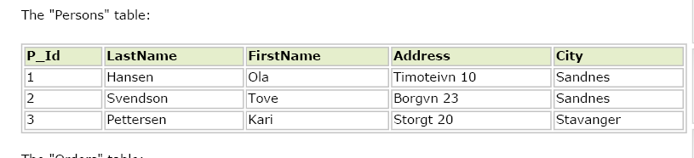
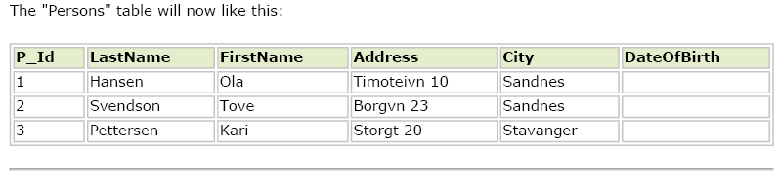
we want to add a column named "DateOfBirth" in the "Persons" table.
We use the following SQL statement:
ALTER TABLE Persons ADD DateOfBirth date

Slide 29


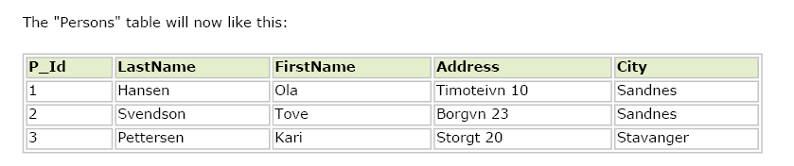

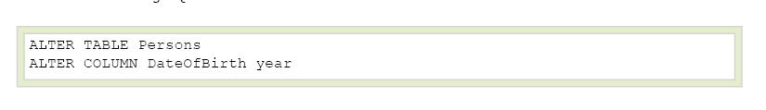

Slide 30
SQL UNIQUE Constraint on ALTER TABLE
To create a UNIQUE constraint on the "P_Id" column when the table is already created, use the following SQL:
ALTER TABLE Persons
ADD UNIQUE (P_Id)
To allow naming of a UNIQUE constraint, and for defining a UNIQUE constraint on multiple columns, use the following SQL syntax:
ALTER TABLE Persons
ADD CONSTRAINT uc_PersonID UNIQUE (P_Id,LastName)
To DROP a UNIQUE Constraint
ALTER TABLE Persons
DROP CONSTRAINT uc_PersonID

Slide 31
SQL PRIMARY KEY Constraint on ALTER TABLE
To create a PRIMARY KEY constraint on the "P_Id" column when the table is already created, use the following SQL:
ALTER TABLE Persons
ADD PRIMARY KEY (P_Id)
To allow naming of a PRIMARY KEY constraint, and for defining a PRIMARY KEY constraint on multiple columns, use the following SQL syntax:
ALTER TABLE Persons
ADD CONSTRAINT pk_PersonID PRIMARY KEY (P_Id,LastName)
To DROP a PRIMARY KEY Constraint
To drop a PRIMARY KEY constraint, use the following SQL:
ALTER TABLE Persons
DROP CONSTRAINT pk_PersonID

Slide 32
SQL FOREIGN KEY Constraint on ALTER TABLE
To create a FOREIGN KEY constraint on the "P_Id" column when the "Orders" table is already created, use the following SQL:
ALTER TABLE Orders
ADD FOREIGN KEY (P_Id) REFERENCES Persons(P_Id)
To allow naming of a FOREIGN KEY constraint, and for defining a FOREIGN KEY constraint on multiple columns, use the following SQL syntax:
ALTER TABLE Orders
ADD CONSTRAINT fk_PerOrders FOREIGN KEY (P_Id) REFERENCES Persons(P_Id)
To DROP a FOREIGN KEY Constraint
To drop a FOREIGN KEY constraint, use the following SQL:
ALTER TABLE Orders
DROP CONSTRAINT fk_PerOrders

Slide 33
SQL CHECK Constraint on ALTER TABLE
To create a CHECK constraint on the "P_Id" column when the table is already created, use the following SQL:
ALTER TABLE Persons
ADD CHECK (P_Id>0)
To allow naming of a CHECK constraint, and for defining a CHECK constraint on multiple columns, use the following SQL syntax:
ALTER TABLE Persons
ADD CONSTRAINT chk_Person CHECK (P_Id>0 AND City='Sandnes')
To DROP a CHECK Constraint
To drop a CHECK constraint, use the following SQL:
ALTER TABLE Persons
DROP CONSTRAINT chk_Person

Slide 34
SQL DEFAULT Constraint on ALTER TABLE
To create a DEFAULT constraint on the "City" column when the table is already created, use the following SQL:
ALTER TABLE Persons
MODIFY City DEFAULT 'SANDNES‘
To DROP a DEFAULT Constraint
To drop a DEFAULT constraint, use the following SQL:
ALTER TABLE Persons
ALTER COLUMN City DROP DEFAULT

Slide 35
The DROP TABLE Statement
The DROP TABLE statement is used to delete a table.
DROP TABLE table_name
The TRUNCATE TABLE Statement
to delete the data inside the table
TRUNCATE TABLE table_name

Slide 36
SQL Data Manipulation Language (DML)
SQL (Structured Query Language) is a syntax for executing queries. But the SQL language also includes a syntax to update, insert, and delete records.
These query and update commands together form the Data Manipulation Language (DML) part of SQL:
  SELECT - extracts data from a database table
  UPDATE - updates data in a database table
  DELETE - deletes data from a database table
  INSERT INTO - inserts new data into a database table

Slide 37

Basic Queries in SQL
SELECT-FROM-WHERE : Example queries on company relational schema

Slide 38

Basic Queries in SQL
SELECT-FROM-WHERE : Example queries on company relational schema
Populated Database

Slide 39
SQL The INSERT INTO Statement

Slide 40
INSERT, DELETE, AND UPDATE
STATEMENTS IN SQL
In SQL, three commands can be used to modify the database: INSERT, DELETE, and UPDATE.
The INSERT Command :
  INSERT is used to add a single tuple to a relation.
  The values should be listed in the same order in which the corresponding attributes were specified in the CREATE TABLE command.

Slide 41
The INSERT INTO Statement
The INSERT INTO statement is used to insert new rows into a table.
Syntax
INSERT INTO table_name
VALUES (value1, value2,....)
You can also specify the columns for which you want to insert data:
INSERT INTO table_name (column1, column2,...)
VALUES (value1, value2,....)

Slide 42
Insert a New Row
LastName
FirstName
Address
City
Pettersen
Kari
Storgt 20
Stavanger
And this SQL statement:
INSERT INTO Persons
VALUES (‘Harrish', ‘Raymond', ‘Sector 24', ‘Noida')
LastName
FirstName
Address
City
Pettersen
Kari
Storgt 20
Stavanger
Harrish
Raymond
Sector 24
Noida

Slide 43
INSERT, DELETE, AND UPDATE
STATEMENTS IN SQL
Another form of the INSERT Command :
  A second form of the INSERT statement allows the user to specify explicit attribute names that correspond to the values provided in the INSERT command.
  Attributes with NULL allowed or DEFAULT values are the ones that can be left out.

Slide 44
Insert Data in Specified Columns
LastName
FirstName
Address
City
Pettersen
Kari
Storgt 20
Stavanger
Harrish
Raymond
Sector 24
Noida
And This SQL statement:
INSERT INTO Persons (LastName, Address)
VALUES ('Rasmussen', 'Storgt 67')
LastName
FirstName
Address
City
Pettersen
Kari
Storgt 20
Stavanger
Harrish
Raymond
Sector 24
Noida
Rasmussen
Storgt 67

Slide 45
SQL The UPDATE Statement

Slide 46
The Update Statement
The UPDATE statement is used to modify the data in a table.
Syntax
UPDATE table_name
SET column_name = new_value
WHERE column_name = some_value

Slide 47
Update one Column in a Row
LastName
FirstName
Address
City
Nilsen
Fred
Kirkegt 56
Stavanger
Rasmussen
Storgt 67
We want to add a first name to the person with a last name of "Rasmussen":
UPDATE Person SET FirstName = 'Nina'
WHERE LastName = 'Rasmussen'
LastName
FirstName
Address
City
Nilsen
Fred
Kirkegt 56
Stavanger
Rasmussen
Nina
Storgt 67

Slide 48
Update several Columns in a Row
LastName
FirstName
Address
City
Nilsen
Fred
Kirkegt 56
Stavanger
Rasmussen
Storgt 67
We want to change the address and add the name of the city:
UPDATE Person
SET Address = 'Stien 12', City = 'Stavanger'
WHERE LastName = 'Rasmussen'
LastName
FirstName
Address
City
Nilsen
Fred
Kirkegt 56
Stavanger
Rasmussen
Nina
Stien 12
Stavanger

Slide 49
INSERT, DELETE, AND UPDATE
STATEMENTS IN SQL
The UPDATE Command
Several tuples can be modified with a single UPDATE command. An example is to give all employees in the 'Research' department a 10 percent raise in salary, as shown in U6.
U6: UPDATE EMPLOYEE SET SALARY = SALARY *1.1
WHERE DNO IN ( SELECT DNUMBER
FROM DEPARTMENT
WHERE DNAME='Research');
It is also possible to specify NULL or DEFAULT as the new attribute value.
Notice that each UPDATE command explicitly refers to a single relation only.

Slide 50
SQL The Delete Statement

Slide 51
INSERT, DELETE, AND UPDATE
STATEMENTS IN SQL
The DELETE Command
The DELETE command removes tuples from a relation. It can include WHERE clause to select the tuples to be deleted.
Tuples are explicitly deleted from only one table at a time
The deletion may propagate to tuples in other relations if referential triggered actions are specified in the referential integrity constraints of the DDL
A missing WHERE clause specifies that all tuples in the relation are to be deleted;

Slide 52
The Delete Statement
The DELETE statement is used to delete rows in a table.
Syntax
DELETE FROM table_name
WHERE column_name = some_value

Slide 53
LastName
FirstName
Address
City
Nilsen
Fred
Kirkegt 56
Stavanger
Rasmussen
Nina
Stien 12
Stavanger

Slide 54
Delete a Row
LastName
FirstName
Address
City
Nilsen
Fred
Kirkegt 56
Stavanger
Rasmussen
Nina
Stien 12
Stavanger
"Nina Rasmussen" is going to be deleted:
DELETE FROM Person WHERE LastName = 'Rasmussen'
LastName
FirstName
Address
City
Nilsen
Fred
Kirkegt 56
Stavanger

Slide 55
Basic SQL Query
SELECT [DISTINCT] target-list
FROM relation-list
WHERE qualification
relation-list A list of relation names (possibly with a range-variable after each name).
target-list A list of attributes of relations in relation-list
qualification Comparisons (Attr op const or Attr1 op Attr2, where op is one of <,>,=,<=,>==,like) combined using AND, OR and NOT.
DISTINCT is an optional keyword indicating that the answer should not contain duplicates. Default is that duplicates are not eliminated!

Slide 56
SQL The SELECT Statement
The SELECT statement is used to select data from a table. The tabular result is stored in a result table (called the result-set).
Syntax
SELECT column_name(s)
FROM table_name

Slide 57
To select the columns named "LastName" and "FirstName", use a SELECT statement like this:
SELECT LastName, FirstName FROM Persons
Persons
LastName
FirstName
Address
City
Hansen
Ola
Timoteivn 10
Sandnes
Svendson
Tove
Borgvn 23
Sandnes
Pettersen
Kari
Storgt 20
Stavanger
výsledok
LastName
FirstName
Hansen
Ola
Svendson
Tove
Pettersen
Kari

Slide 58
Select All Columns
To select all columns from the "Persons" table, use a * symbol instead of column names, like this:
SELECT * FROM Persons
LastName
FirstName
Address
City
Hansen
Ola
Timoteivn 10
Sandnes
Svendson
Tove
Borgvn 23
Sandnes
Pettersen
Kari
Storgt 20
Stavanger

Slide 59
The SELECT DISTINCT Statement
The DISTINCT keyword is used to return only distinct (different) values.
The SELECT statement returns information from table columns. But what if we only want to select distinct elements?
With SQL, all we need to do is to add a DISTINCT keyword to the SELECT statement:
Syntax
SELECT DISTINCT column_name(s)
FROM table_name

Slide 60
Using the DISTINCT keyword
To select ALL values from the column named "Company" we use a SELECT statement like this:
SELECT Company FROM Orders
Orders
Company
Company
OrderNumber
Sega
Sega
3412
W3Schools
W3Schools
2312
Trio
Trio
4678
W3Schools
W3Schools
6798

Slide 61
Note that "W3Schools" is listed twice in the result-set.
To select only DIFFERENT values from the column named "Company" we use a SELECT DISTINCT statement like this:
SELECT DISTINCT Company FROM Orders
Orders
Company
Sega
Company
OrderNumber
W3Schools
Sega
3412
Trio
W3Schools
2312
Trio
4678
W3Schools
6798

Slide 62
Select All Columns
The WHERE clause is used to specify a selection criterion.
The WHERE Clause
To conditionally select data from a table, a WHERE clause can be added to the SELECT statement.
Syntax
SELECT column FROM table
WHERE column operator value

Slide 63
With the WHERE clause, the following operators can be used:
Operator
Description
=
Equal
<>
Not equal
>
Greater than
<
Less than
>=
Greater than or equal
<=
Less than or equal
BETWEEN
Between an inclusive range
LIKE
Search for a pattern
Note: In some versions of SQL the <> operator may be written as !=

Slide 64
Using the WHERE Clause
To select only the persons living in the city "Sandnes", we add a WHERE clause to the SELECT statement:
SELECT * FROM Persons
WHERE City='Sandnes'
LastName
FirstName
Address
City
Year
Hansen
Ola
Timoteivn 10
Sandnes
1951
Svendson
Tove
Borgvn 23
Sandnes
1978
Svendson
Stale
Kaivn 18
Sandnes
1980
Pettersen
Kari
Storgt 20
Stavanger
1960
LastName
FirstName
Address
City
Year
Hansen
Ola
Timoteivn 10
Sandnes
1951
Svendson
Tove
Borgvn 23
Sandnes
1978
Svendson
Stale
Kaivn 18
Sandnes
1980

Slide 65
Aggregate functions
SQL aggregate functions return a single value, calculated from values in a column.
Useful aggregate functions:
  AVG() - Returns the average value
  COUNT() - Returns the number of rows
  FIRST() - Returns the first value
  LAST() - Returns the last value
  MAX() - Returns the largest value
  MIN() - Returns the smallest value
  SUM() - Returns the sum

Slide 66
The AVG() Function
The AVG() function returns the average value of a numeric column.
SQL AVG() Syntax
SELECT AVG(column_name) FROM table_name
O_Id | OrderDate | OrderPrice | Customer
1 | 2008/11/12 | 1000 | Hansen
2 | 2008/10/23 | 1600 | Nilsen
3 | 2008/09/02 | 700 | Hansen
4 | 2008/09/03 | 300 | Hansen
5 | 2008/08/30 | 2000 | Jensen
6 | 2008/10/04 | 100 | Nilsen
SELECT AVG(OrderPrice) AS OrderAverage FROM Orders
OrderAverage
950

Slide 67
SQL COUNT() Function
The COUNT() function returns the number of rows that matches a specified criteria.
SELECT COUNT(column_name) FROM table_name
The COUNT(*) function returns the number of records in a table:
SELECT COUNT(*) FROM table_name
The COUNT(DISTINCT column_name) function returns the number of
distinct values of the specified column:
SELECT COUNT(DISTINCT column_name) FROM table_name

Slide 68
The SUM() Function
The SUM() function returns the total sum of a numeric column.
SELECT SUM(column_name) FROM table_name
Example
SELECT SUM(OrderPrice) AS OrderTotal FROM Orders
OrderTotal
5700

Slide 69
Aggregate Functions in SQL
COUNT, SUM, MAX, MIN, and AVG.
QUERY 19
Find the sum of the salaries of all employees, the maximum salary, the minimum salary, and the average salary.
Q19: SELECT SUM (SALARY), MAX (SALARY), MIN (SALARY),AVG (SALARY)
FROM EMPLOYEE;
QUERY 20 : Find the sum of the salaries of all employees of the 'Research' department, as well as the maximum salary, the minimum salary, and the average salary in this department.
Q20: SELECT SUM (SALARY), MAX (SALARY), MIN (SALARY), AVG (SALARY) FROM EMPLOYEE ,DEPARTMENT WHERE DNO=DNUMBER and
DNAME='Research';

Slide 70
Aggregate Functions in SQL
COUNT, SUM, MAX, MIN, and AVG.
QUERIES 21 AND 22
Retrieve the total number of employees in the company (Q21) and the number of employees in the 'Research' department (Q22).
Q21: SELECT COUNT (*) FROM EMPLOYEE;
Q22: SELECT COUNT (*) FROM EMPLOYEE,DEPARTMENT
WHERE DNO=DNUMBER AND DNAME='Research';
Here the asterisk (*) refers to the rows (tuples), so COUNT (*) returns the number of rows in the result of the query

Slide 71
Aggregate Functions in SQL
COUNT, SUM, MAX, MIN, and AVG.
We may also use the COUNT function to count values in a column rather than tuples, as in the next example.
QUERY 23
Count the number of distinct salary values in the database.
Q23: SELECT COUNT (DISTINCT SALARY) FROM EMPLOYEE;
If we write COUNT(SALARY) instead of COUNT(DISTINCT SALARY) in Q23, then
duplicate values will not be eliminated.
Any tuples with NULL for SALARY will not be counted.
In general, NULL values are discarded when aggregate functions are applied to a particular column (attribute).

Slide 72
GROUP BY Syntax
The SQL GROUP BY clause is used in collaboration with the SELECT statement to arrange identical data into groups.
SELECT column name, aggregate function(column name)
FROM table name
WHERE conditions
GROUP BY column name;

Slide 73
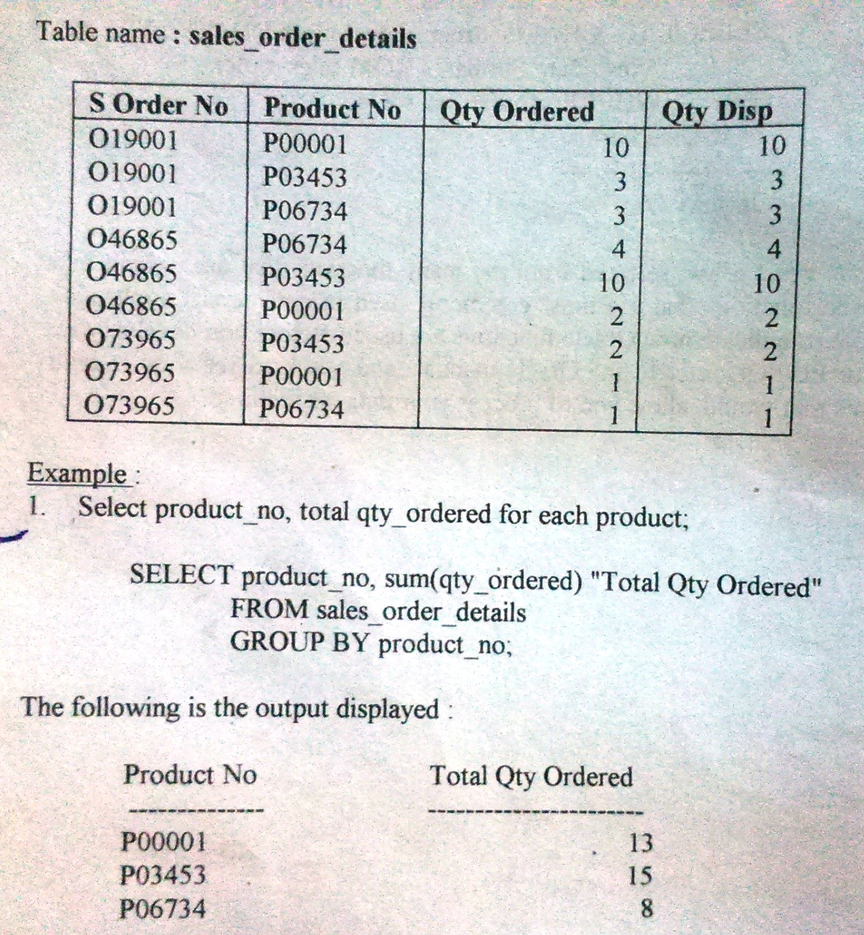

Slide 74
HAVING
The HAVING clause enables you to specify conditions that filter which group results appear in the final results.
The WHERE clause places conditions on the selected columns, whereas the HAVING clause places conditions on groups created by the GROUP BY clause.
The syntax for the HAVING function is:
    SELECT column, SUM(column) FROM table
    GROUP BY column
    HAVING SUM(column) condition value
  Example:
    SELECT Company, SUM(Amount) FROM Sales
    GROUP BY Company
    HAVING SUM(Amount)>10000

