Slide 1
Backtracking

Slide 2
General Concepts
Algorithm strategy
Approach to solving a problem
May combine several approaches
Algorithm structure
Iterative ⇒ execute action in loop
Recursive ⇒ reapply action to subproblem(s)
Problem type
Satisfying ⇒ find any satisfactory solution
Optimization ⇒ find best solutions (vs. cost metric)

Slide 3
A short list of categories
Many Algorithm types are to be considered:
Simple recursive algorithms
Backtracking algorithms
Divide and conquer algorithms
Dynamic programming algorithms
Greedy algorithms
Branch and bound algorithms
Brute force algorithms
Randomized algorithms

Slide 4
Backtracking
Suppose you have to make a series of decisions, among various choices, where
You don’t have enough information to know what to choose
Each decision leads to a new set of choices
Some sequence of choices (possibly more than one) may be a solution to your problem
Backtracking is a methodical way of trying out various sequences of decisions, until you find one that “works”

Slide 5
Backtracking Algorithm
Based on depth-first recursive search
Approach
Tests whether solution has been found
If found solution, return it
Else for each choice that can be made
Make that choice
Recur
If recursion returns a solution, return it
If no choices remain, return failure
Some times called “search tree”

Slide 6
Backtracking [animation]
dead end
?
dead end
dead end
?
start
?
?
dead end
dead end
?
success!

Slide 7
Backtracking
Start
Success!
Success!
Failure
Problem space consists of states (nodes) and actions (paths that lead to new states). When in a node can can only see paths to connected nodes
If a node only leads to failure go back to its "parent" node. Try other alternatives. If these all lead to failure then more backtracking may be necessary.

Slide 8
Backtracking
Construct the state space tree:
Root represents an initial state
Nodes reflect specific choices made for a solution’s components.
Promising and nonpromising nodes
leaves
Explore the state space tree using depth-first search
“Prune” non-promising nodes
dfs stops exploring subtree rooted at nodes leading to no solutions and...
“backtracks” to its parent node

Slide 9
Example: The n-Queen problem
Place n queens on an n by n chess board so that no two of them are on the same row, column, or diagonal

Slide 10
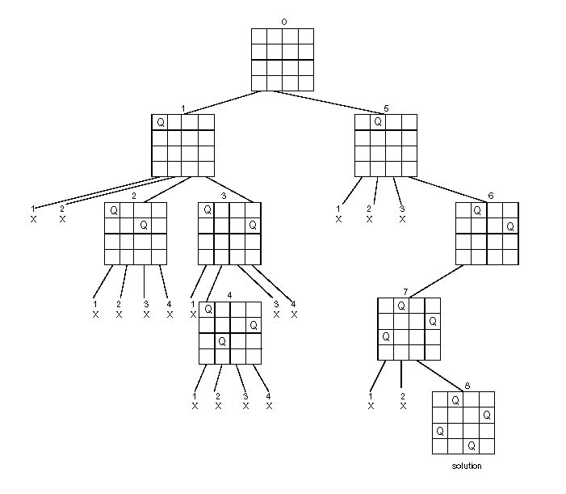
State Space Tree of the Four-queens Problem

Slide 11
/* A recursive utility function to solve N Queen problem */
bool solveNQUtil(int board[N][N], int col)
{ /* base case: If all queens are placed then return true */
if (col >= N)
return true;
/* Consider this column and try placing this queen in all rows one by one */
for (int i = 0; i < N; i++)
{ /* Check if queen can be placed on board[i][col] */
if ( isSafe(board, i, col) )
{ /* Place this queen in board[i][col] */
board[i][col] = 1;
/* recur to place rest of the queens */
if ( solveNQUtil(board, col + 1) )
return true;
/* If placing queen in board[i][col] doesn't lead to a solution, then
remove queen from board[i][col] */
board[i][col] = 0; // BACKTRACK
} }
/* If queen can not be place in any row in this colum col then return false */
return false;
}

Slide 12
bool isSafe(int board[N][N], int row, int col)
{ int i, j;
/* Check this row on left side */
for (i = 0; i < col; i++)
if (board[row][i])
return false;
/* Check upper diagonal on left side */
for (i=row, j=col; i>=0 && j>=0; i--, j--)
if (board[i][j])
return false;
/* Check lower diagonal on left side */
for (i=row, j=col; j>=0 && i<N; i++, j--)
if (board[i][j])
return false;
return true;
}

Slide 13
The backtracking algorithm
Backtracking is really quite simple--we “explore” each node, as follows:
To “explore” node N:
1. If N is a goal node, return “success”
2. If N is a leaf node, return “failure”
3. For each child C of N,
3.1. Explore C
3.1.1. If C was successful, return “success”
4. Return “failure”

Slide 14
Sum of subsets
Problem: Given n positive integers w_{1,} ... w_{n} and a positive integer S. Find all subsets of w_{1,} ... w_{n} that sum to S.
Example: n=3, S=6, and w₁=2, w₂=4, w₃=6
Solutions: {2,4} and {6}

Slide 15
Sum of subsets
We will assume a binary state space tree.
The nodes at depth 1 are for including (yes, no) item 1, the nodes at depth 2 are for item 2, etc.
The left branch includes w_{i}, and the right branch excludes w_{i}.
The nodes contain the sum of the weights included so far

Slide 16
Sum of subset Problem: State SpaceTree for 3 items w₁ = 2, w₂ = 4, w₃ = 6 and S = 6
0
yes
no
i₁
2
0
yes
no
yes
no
i₂
6
2
4
0
yes
no
yes
no
yes
no
yes
no
i₃
12
6
8
2
10
4
6
0
The sum of the included integers is stored at the node.

Slide 17
A Depth First Search solution
Problems can be solved using depth first search of the (implicit) state space tree.
Each node will save its depth and its (possibly partial) current solution
DFS can check whether node v is a leaf.
If it is a leaf then check if the current solution satisfies the constraints
Code can be added to find the optimal solution

Slide 18
A DFS solution
Such a DFS algorithm will be very slow.
It does not check for every solution state (node) whether a solution has been reached, or whether a partial solution can lead to a feasible solution
Is there a more efficient solution?

Slide 19
Backtracking
Definition: We call a node nonpromising if it cannot lead to a feasible (or optimal) solution, otherwise it is promising
Main idea: Backtracking consists of doing a DFS of the state space tree, checking whether each node is promising and if the node is nonpromising backtracking to the node’s parent

Slide 20
Backtracking
The state space tree consisting of expanded nodes only is called the pruned state space tree
The following slide shows the pruned state space tree for the sum of subsets example
There are only 15 nodes in the pruned state space tree
The full state space tree has 31 nodes

Slide 21
Backtracking algorithm
void checknode (node v) { node u if (promising ( v )) if (aSolutionAt( v )) write the solution else //expand the node for ( each child u of v ) checknode ( u )

Slide 22
Checknode
Checknode uses the functions:
promising(v) which checks that the partial solution represented by v can lead to the required solution
aSolutionAt(v) which checks whether the partial solution represented by node v solves the problem.

Slide 23
Sum of subsets – when is a node “promising”?
Consider a node at depth i
weightSoFar = weight of node, i.e., sum of numbers included in partial solution node represents
totalPossibleLeft = weight of the remaining items i+1 to n (for a node at depth i)
A node at depth i is non-promising if (weightSoFar + totalPossibleLeft < S ) or (weightSoFar + w[i+1] > S )
To be able to use this “promising function” the w_{i} must be sorted in non-decreasing order

Slide 24
A Pruned State Space Tree w₁ = 3, w₂ = 4, w₃ = 5, w₄ = 6; S = 13
1
0
3
0
2
3
11
0
4
0
4
0
3
12
4
7
8
3
15
0
5
0
5
0
5
0
13
4
12
5
7
9
8
10
3
9
14
4
6
0
6
13
7
7
- backtrack
Nodes numbered in “call” order

Slide 25
sumOfSubsets ( i, weightSoFar, totalPossibleLeft )
if (promising ( i )) //may lead to solution
then if ( weightSoFar == S ) then print include[ i ] to include[ i ] //found solution else //expand the node when weightSoFar < S include [ i + 1 ] = "yes” //try including sumOfSubsets ( i + 1, weightSoFar + w[i + 1], totalPossibleLeft - w[i + 1] ) include [ i + 1 ] = "no” //try excluding sumOfSubsets ( i + 1, weightSoFar , totalPossibleLeft - w[i + 1] )
boolean promising (i ) return ( weightSoFar + totalPossibleLeft ≥ S) && ( weightSoFar == S || weightSoFar + w[i + 1] ≤ S )
Prints all solutions!
Initial call sumOfSubsets(0, 0, )

Slide 26

Rat in a Maze Problem
Given a maze, find a path from start to finish
At each intersection, you have to decide between choices:
Go straight
Go left
Go right
You don’t have enough information to choose correctly
Each choice leads to another set of choices
One or more sequences of choices may (or may not) lead to a solution

Slide 27
Maze cont.
Can be implemented using a stack
Stack can be implicit in recursive calls
What if we get stuck?
Withdraw the most recent choice
Undo its consequences
Is there a new choice?
If so, try that
If not, you are at another dead-end
S
IN
A | B | C | D | E
F | G | H | I | J
K | L | M | N | O
P | Q | R | S | T
U | V | X | Y | Z
Y
X
Q
O
V
R
OUT
N
U
M
P
L
H
K
G
C
F
B
A
Notes:
Fix animation so that it’s right

Slide 28
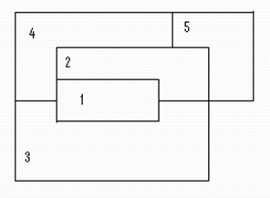
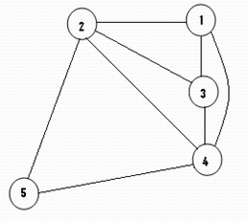
Coloring a map
Problem:
Let G be a graph and m be a given positive integer. We want to discover whether the nodes of G can be colored in such a way that no two adjacent node have the same color yet only m colors are used. This technique is broadly used in “map-coloring”; Four-color map is the main objective.
Consider the following map and it can be easily decomposed into the following planner graph beside it :

Slide 29
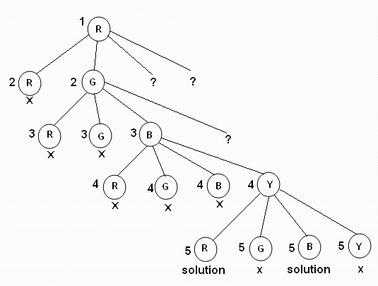
This map-coloring problem of the given map can be solved from the planner graph, using the mechanism of backtracking. The state-space tree for this above map is shown below:

Slide 30
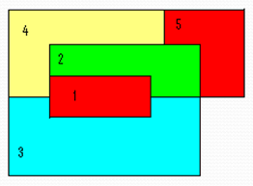

Now the map can be colored as shown here:-
Four colors are chosen as - Red, Green, Blue and Yellow

Slide 31
bool graphColoringUtil(bool graph[V][V], int m, int color[], int v)
{
/* base case: If all vertices are assigned a color then return true */
if (v == V)
return true;
/* Consider this vertex v and try different colors */
for (int c = 1; c <= m; c++)
{ /* Check if assignment of color c to v is fine*/
if (isSafe(v, graph, color, c))
{ color[v] = c;
/* recur to assign colors to rest of the vertices */
if (graphColoringUtil (graph, m, color, v+1) == true)
return true;
/* If assigning color c doesn't lead to a solution then remove it */
color[v] = 0;
}
}
/* If no color can be assigned to this vertex then return false */
return false;
}

Slide 32
bool isSafe (int v, bool graph[V][V], int color[], int c)
{
for (int i = 0; i < V; i++)
if (graph[v][i] && c == color[i])
return false;
return true;
}

Slide 33
Hamiltonian Circuits Problem
A Hamiltonian circuit or tour of a graph is a path that starts at a given vertex, visits each vertex in the graph exactly once, and ends at the starting vertex. Some graphs do not contain Hamiltonian circuits.
v₁
v₂
v₃
v₁
v₂
v₃
v₄
v₅
v₆
v₄
v₅
v₆
A state space tree for this problem is as follows. Put the starting vertex at level 0 in the tree, call this the zero'th vertex on the path. At level 1, consider each vertex other than the starting vertex as the first vertex after the starting one. At level 2, consider each of these vertices as the second vertex, and so on. You may now backtrack in this state space tree.

Slide 34
Sample Problem
v₁
v₂
v₃
v₄
1
state space tree
2
5
v₅
v₆
v₇
v₈
5
7
2
6
graph
6
7
3
3
4
8
:
:
3
8
4
:
:

Slide 35
Input: A 2D array graph[V][V] where V is the number of vertices in graph and graph[V][V] is adjacency matrix representation of the graph. A value graph[i][j] is 1 if there is a direct edge from i to j, otherwise graph[i][j] is 0.
Output: An array path[V] that should contain the Hamiltonian Path. path[i] should represent the ith vertex in the Hamiltonian Path. The code should also return false if there is no Hamiltonian Cycle in the graph.

Slide 36
bool hamCycleUtil(bool graph[V][V], int path[], int pos)
{ /* base case: If all vertices are included in Hamiltonian Cycle */
if (pos == V)
{ // And if there is an edge from the last included vertex to the first vertex
if ( graph[ path[pos-1] ][ path[0] ] == 1 )
return true;
else return false;
}
// Try different vertices as a next candidate in Hamiltonian Cycle. // We don't try for 0 as we included 0 as starting point in in hamCycle()
for (int v = 1; v < V; v++)
{ /* Check if this vertex can be added to Hamiltonian Cycle */
if (isSafe(v, graph, path, pos))
{ path[pos] = v;
/* recur to construct rest of the path */
if (hamCycleUtil (graph, path, pos+1) == true)
return true;
/* If adding vertex v doesn't lead to a solution, then remove it */
path[pos] = -1;
} } /* If no vertex can be added to Hamiltonian Cycle constructed so far,
then return false */
return false;
}

Slide 37
bool isSafe(int v, bool graph[V][V], int path[], int pos)
{
/* Check if this vertex is an adjacent vertex of the previously
added vertex. */
if (graph [ path[pos-1] ][ v ] == 0)
return false;
/* Check if the vertex has already been included.
This step can be optimized by creating an array of size V */
for (int i = 0; i < pos; i++)
if (path[i] == v)
return false;
return true;
}

Slide 38
Travelling Salesman Problem (TSP): Given a set of cities and distance between every pair of cities, the problem is to find the shortest possible route that visits every city exactly once and returns to the starting point.
Difference between Hamiltonian Cycle and TSP
The Hamiltoninan cycle problem is to find if there exist a tour that visits every city exactly once. Here we know that Hamiltonian Tour exists (because the graph is complete) and in fact many such tours exist, the problem is to find a minimum weight Hamiltonian Cycle.

Slide 39
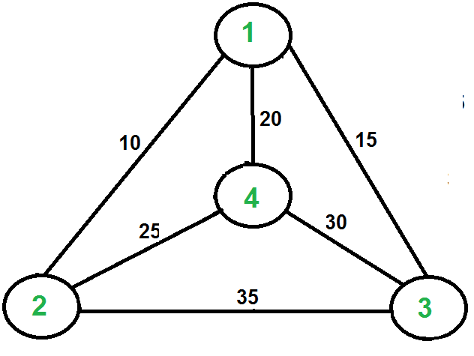

Slide 40
Suppose you want to schedule final exams and, being very considerate, you want to avoid having a student do more than one exam a day. We shall call the courses 1,2,3,4,5,6,7. In the table below a star in entry ij means that course i and j have at least one student in common so you can't have them on the same day. What is the least number of days you need to schedule all the exams? Propose backtracking based algorithm to schedule the exams.

