Slide 1
Structure
Like the binomial heap, a Fibonacci heap is a collection of heap-ordered trees. They do not need to be binomial trees however, this is where the relaxation of some of the binomial heap’s properties comes in.
Each tree has an order just like the binomial heap that is based on the number of children. Nodes within a Fibonacci heap can be removed from their tree without restructuring them, so the order does not necessarily indicate the maximum height of the tree or number of nodes it contains.

Slide 2
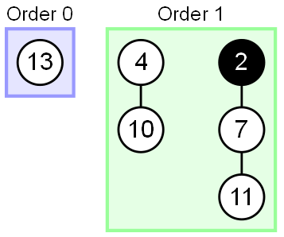
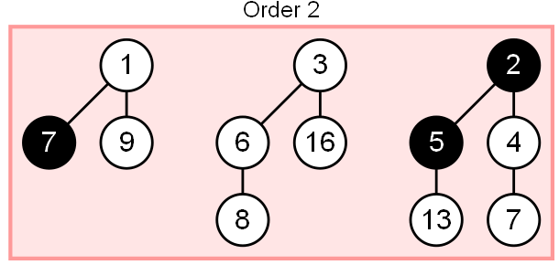

Slide 3
Fibonacci Heaps: Structure
each parent larger than its children
Fibonacci heap.
  Set of heap-ordered trees.
  Maintain pointer to minimum element.
  Set of marked nodes.
roots
heap-ordered tree
17
24
23
7
3
30
26
46
18
52
41
Heap H
35
44
39
Notes:
set -> unordered

Slide 4
Fibonacci Heaps: Structure
Fibonacci heap.
  Set of heap-ordered trees.
  Maintain pointer to minimum element.
  Set of marked nodes.
find-min takes O(1) time
min
17
24
23
7
3
30
26
46
18
52
41
Heap H
35
44
39
Notes:
set -> unordered

Slide 5
Fibonacci Heaps: Structure
Fibonacci heap.
  Set of heap-ordered trees.
  Maintain pointer to minimum element.
  Set of marked nodes.
use to keep heaps flat (stay tuned)
min
17
24
23
7
3
30
26
46
18
52
41
Heap H
35
marked
44
39
Notes:
set -> unordered

Slide 6
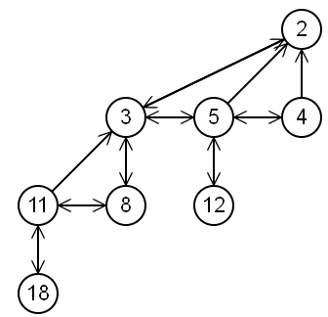
Links
The pointers between nodes in a Fibonacci heap are very similar to that of the binomial heap, only that each node in a Fibonacci heap contains a doubly linked list of all its children. This allows node removal and child list concatenation to both be performed in linear time.
Note that the child node whose parent links to it is always the node with the smallest value among its siblings.

Slide 7
‘Marked’ nodes
An important part of the Fibonacci Heap is how it marks nodes within the trees. The decrease key operation marks a node when its child is cut from a tree, this allows it to track some history about each node.
Essentially the marking of nodes allows us to track whether:
The node has had no children cut (unmarked)
The node has had a single child cut (marked)
The node is about to have a second child cut (removing a child of a marked node)
When a second child is cut from its parent, the parent is moved to the root list. This ensures that the structure of the Fibonacci heap does not stay too far from that of the binomial heap, which is one of the properties that enables the data structure to achieve its amortised time bounds.

Slide 8
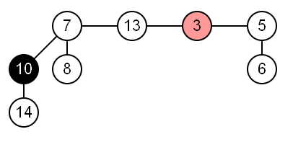
Operations
Find minimum
A pointer to minimum node of the root list is always kept up to date.

Slide 9
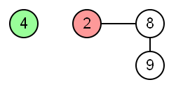
Insert
Insert creates a new tree containing only the new node which is being added to the heap. The total number of nodes in the tree is incremented and the pointer to the minimum value is updated if necessary.
The insert operation of a fibonacci heap does not attempt to consolidate trees of equal order, opting instead to defer until a later time.

Slide 10
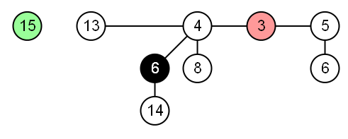
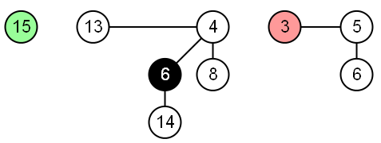
Union
Union concatenates the root lists of two Fibonacci heaps and sets the minimum node to which ever tree’s minimum node is smaller.

Slide 11
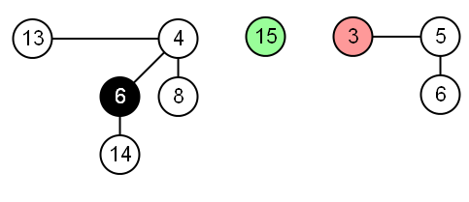
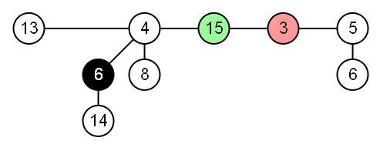

Slide 12
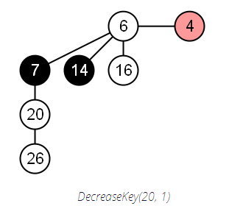
Decrease key
Decrease key lowers the key of a node. The node is then cut from the tree, joining the root list as its own tree. The parent of the node is then cut if it is marked, this continues for each ancestor until a parent that is not marked is encountered, which is then marked. The pointer to the minimum node is then updated if the node’s new value is less than the current minimum.

Slide 13
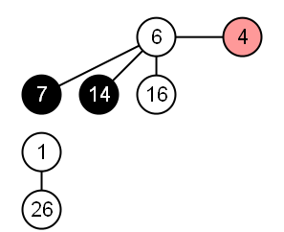
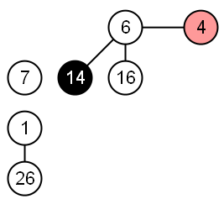
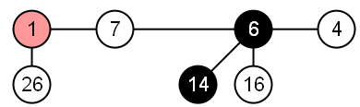
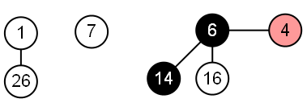

Slide 14
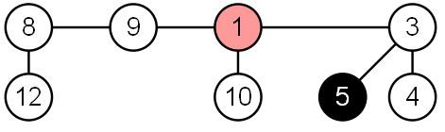
Extract minimum
Extract minimum is the most complex operation of a Fibonacci Heap as it’s where the actions that were deferred by the other operations occur. It starts by removing the minimum node from the root list and adding its children to the root list.

Slide 15
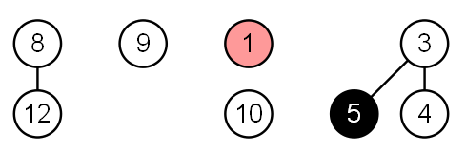
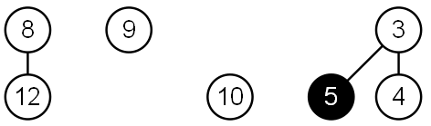
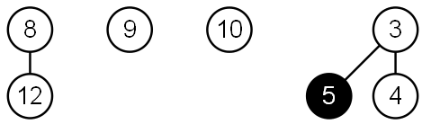
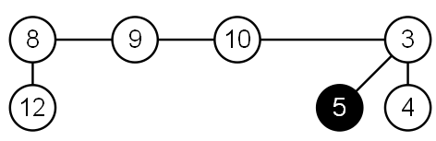

Slide 16
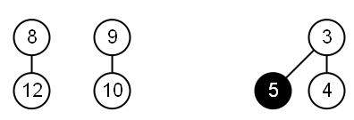
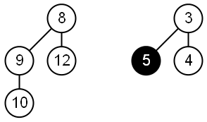
If the minimum was the only node in the root list, the pointer to the minimum node is set to the smallest node in the root list and the operation is completed.
If not, the ‘consolidate’ operation is performed which merges all trees of the same order together until there are no two trees of the same order. The minimum is then set to the smallest node in the root list.

Slide 17
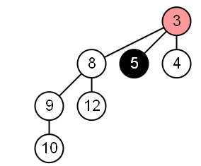

Slide 18
Delete
Delete is performed by calling decrease key to reduce the node to negative infinity which pulls the node to the top of the tree. Extract minimum is then called on the node to remove it from the heap.

Slide 19
Fibonacci Heaps: Notation
Notation.
  n = number of nodes in heap.
  rank(x) = number of children of node x.
  rank(H) = max rank of any node in heap H.
  trees(H) = number of trees in heap H.
  marks(H) = number of marked nodes in heap H.
trees(H) = 5
marks(H) = 3
n = 14
rank = 3
min
17
24
23
7
3
30
26
46
18
52
41
Heap H
35
marked
44
39
Notes:
recall: with binomial heap, at most one tree of rank 0, 1, 2, 3, 4, …
nodes only change mark in Decrease-Key Can basically ignore marks until then.
marks are used to ensure size of heap is exponential in rank

Slide 20
Fibonacci Heaps: Potential Function
Φ(H) = trees(H) + 2 ⋅ marks(H)
potential of heap H
trees(H) = 5
marks(H) = 3
Φ(H) = 5 + 2⋅3 = 11
min
17
24
23
7
3
30
26
46
18
52
41
Heap H
35
marked
44
39

Slide 21
Insert

Slide 22
Fibonacci Heaps: Insert
Insert.
  Create a new singleton tree.
  Add to root list; update min pointer (if necessary).
insert 21
21
min
17
24
23
7
3
30
26
46
18
52
41
Heap H
35
44
39

Slide 23
Fibonacci Heaps: Insert
Insert.
  Create a new singleton tree.
  Add to root list; update min pointer (if necessary).
insert 21
min
17
24
23
7
21
3
30
26
46
18
52
41
Heap H
35
44
39
Notes:
lazy insert - don't consolidate trees when inserting into Fibonacci heap. If k consecutive inserts, the k 1-node trees are created.

Slide 24
Fibonacci Heaps: Insert Analysis
Actual cost. O(1)
Change in potential. +1
Amortized cost. O(1)
Φ(H) = trees(H) + 2 ⋅ marks(H)
potential of heap H
min
17
24
23
7
21
3
30
26
46
18
52
41
Heap H
35
44
39

Slide 25
Linking Operation
Linking operation. Make larger root be a child of smaller root.
larger root
smaller root
still heap-ordered
15
3
3
56
24
18
52
41
15
18
52
41
77
39
44
56
24
39
44
tree T₁
tree T₂
77
tree T'

Slide 26
Fibonacci Heaps: Delete Min
Delete min.
  Delete min; meld its children into root list; update min.
  Consolidate trees so that no two roots have same rank.
min
7
24
23
17
3
30
26
46
18
52
41
35
39
44

Slide 27
Fibonacci Heaps: Delete Min
Delete min.
  Delete min; meld its children into root list; update min.
  Consolidate trees so that no two roots have same rank.
min
7
24
23
17
18
52
41
30
26
46
39
44
35

Slide 28
Fibonacci Heaps: Delete Min
Delete min.
  Delete min; meld its children into root list; update min.
  Consolidate trees so that no two roots have same rank.
min
current
7
24
23
17
18
52
41
30
26
46
39
44
35

Slide 29
Fibonacci Heaps: Delete Min
Delete min.
  Delete min; meld its children into root list; update min.
  Consolidate trees so that no two roots have same rank.
rank
0
1
2
3
min
current
7
24
23
17
18
52
41
30
26
46
39
44
35

Slide 30
Fibonacci Heaps: Delete Min
Delete min.
  Delete min; meld its children into root list; update min.
  Consolidate trees so that no two roots have same rank.
rank
0
1
2
3
min
current
7
24
23
17
18
52
41
30
26
46
39
44
35

Slide 31
Fibonacci Heaps: Delete Min
Delete min.
  Delete min; meld its children into root list; update min.
  Consolidate trees so that no two roots have same rank.
rank
0
1
2
3
min
7
24
23
17
18
52
41
30
26
46
current
39
44
35

Slide 32
Fibonacci Heaps: Delete Min
Delete min.
  Delete min; meld its children into root list; update min.
  Consolidate trees so that no two roots have same rank.
rank
0
1
2
3
min
7
24
23
17
18
52
41
30
26
46
current
39
44
35
link 23 into 17

Slide 33
Fibonacci Heaps: Delete Min
Delete min.
  Delete min; meld its children into root list; update min.
  Consolidate trees so that no two roots have same rank.
rank
0
1
2
3
min
7
24
17
18
52
41
30
26
46
current
23
39
44
35
link 17 into 7

Slide 34
Fibonacci Heaps: Delete Min
Delete min.
  Delete min; meld its children into root list; update min.
  Consolidate trees so that no two roots have same rank.
rank
0
1
2
3
current
min
24
7
18
52
41
26
46
17
30
39
44
35
23
link 24 into 7

Slide 35
Fibonacci Heaps: Delete Min
Delete min.
  Delete min; meld its children into root list; update min.
  Consolidate trees so that no two roots have same rank.
rank
0
1
2
3
current
min
7
18
52
41
24
17
30
39
44
26
46
23
35

Slide 36
Fibonacci Heaps: Delete Min
Delete min.
  Delete min; meld its children into root list; update min.
  Consolidate trees so that no two roots have same rank.
rank
0
1
2
3
current
min
7
18
52
41
24
17
30
39
44
26
46
23
35

Slide 37
Fibonacci Heaps: Delete Min
Delete min.
  Delete min; meld its children into root list; update min.
  Consolidate trees so that no two roots have same rank.
rank
0
1
2
3
current
min
7
18
52
41
24
17
30
39
44
26
46
23
35

Slide 38
Fibonacci Heaps: Delete Min
Delete min.
  Delete min; meld its children into root list; update min.
  Consolidate trees so that no two roots have same rank.
rank
0
1
2
3
current
min
7
18
52
41
24
17
30
39
44
26
46
23
link 41 into 18
35

Slide 39
Fibonacci Heaps: Delete Min
Delete min.
  Delete min; meld its children into root list; update min.
  Consolidate trees so that no two roots have same rank.
rank
0
1
2
3
current
min
7
52
18
24
17
30
41
39
26
46
23
44
35

Slide 40
Fibonacci Heaps: Delete Min
Delete min.
  Delete min; meld its children into root list; update min.
  Consolidate trees so that no two roots have same rank.
rank
0
1
2
3
current
min
7
52
18
24
17
30
41
39
26
46
23
44
35

Slide 41
Fibonacci Heaps: Delete Min
Delete min.
  Delete min; meld its children into root list; update min.
  Consolidate trees so that no two roots have same rank.
min
7
52
18
24
17
30
41
39
26
46
23
44
stop
35

Slide 42
Fibonacci Heaps: Delete Min Analysis
Delete min.
Actual cost. O(rank(H)) + O(trees(H))
  O(rank(H)) to meld min's children into root list.
  O(rank(H)) + O(trees(H)) to update min.
  O(rank(H)) + O(trees(H)) to consolidate trees.
Change in potential. O(rank(H)) - trees(H)
  trees(H' ) ≤ rank(H) + 1 since no two trees have same rank.
  ΔΦ(H) ≤ rank(H) + 1 - trees(H).
Amortized cost. O(rank(H))
Φ(H) = trees(H) + 2 ⋅ marks(H)
potential function
Notes:
O(rank(H)) work adding min's children since at most rank(H) children of min
O(rank(H) + trees(H)) work updating min since at most this many resulting root nodes
O(rank(H) + trees(H)) to consolidate trees since number of roots decreases by 1 after each merging, and there at most rank(H) + trees(H) roots at beginning
trees(H') <= rank(H) + 1 since at worst the roots have degrees 0, 1, 2, …, rank(H)
can scale units in potential function to dominate cost hidden in O(trees(H))
number of marked nodes marked(H) does not increase [Note: you unmark a root y when it is linked to another root, though this case does not arise in the example]

Slide 43
Fibonacci Heaps: Delete Min Analysis
Q. Is amortized cost of O(rank(H)) good?
A. Yes, if only insert and delete-min operations.
  In this case, all trees are binomial trees.
  This implies rank(H) ≤ lg n.
A. Yes, we'll implement decrease-key so that rank(H) = O(log n).
we only link trees of equal rank
B₀
B₁
B₂
B₃
Notes:
if no decrease-key, our data structure is a lazy version of a binomial queue
decrease key will not preserve property that all trees are binomial trees, but it will be close enough to bound maximum degree by O(log n)

Slide 44
Decrease Key

Slide 45
Fibonacci Heaps: Decrease Key
Intuition for deceasing the key of node x.
  If heap-order is not violated, just decrease the key of x.
  Otherwise, cut tree rooted at x and meld into root list.
  To keep trees flat: as soon as a node has its second child cut,
  cut it off and meld into root list (and unmark it).
min
7
18
38
marked node:
one child already cut
24
17
23
21
39
41
26
46
30
52
35
88
72
Notes:
If decreasing the key of node i makes it violate heap order property, we can cutout subtree rooted at i and meld it into heap.
To keep trees bushy, we limit the number of cuts among the children of any vertex to 2.
Use the mark of a node to designate whether or not it has had one child cut off

Slide 46
Fibonacci Heaps: Decrease Key
Case 1. [heap order not violated]
  Decrease key of x.
  Change heap min pointer (if necessary).
min
7
18
38
24
17
23
21
39
41
26
46
29
30
52
x
35
88
72
decrease-key of x from 46 to 29

Slide 47
Fibonacci Heaps: Decrease Key
Case 1. [heap order not violated]
  Decrease key of x.
  Change heap min pointer (if necessary).
min
7
18
38
24
17
23
21
39
41
26
29
30
52
x
35
88
72
decrease-key of x from 46 to 29

Slide 48
Fibonacci Heaps: Decrease Key
Case 2a. [heap order violated]
  Decrease key of x.
  Cut tree rooted at x, meld into root list, and unmark.
  If parent p of x is unmarked (hasn't yet lost a child), mark it;
  Otherwise, cut p, meld into root list, and unmark
  (and do so recursively for all ancestors that lose a second child).
min
7
18
38
24
17
23
21
39
41
p
26
29
30
52
15
x
35
88
72
decrease-key of x from 29 to 15

Slide 49
Fibonacci Heaps: Decrease Key
Case 2a. [heap order violated]
  Decrease key of x.
  Cut tree rooted at x, meld into root list, and unmark.
  If parent p of x is unmarked (hasn't yet lost a child), mark it;
  Otherwise, cut p, meld into root list, and unmark
  (and do so recursively for all ancestors that lose a second child).
min
7
18
38
24
17
23
21
39
41
p
26
15
30
52
x
35
88
72
decrease-key of x from 29 to 15

Slide 50
Fibonacci Heaps: Decrease Key
Case 2a. [heap order violated]
  Decrease key of x.
  Cut tree rooted at x, meld into root list, and unmark.
  If parent p of x is unmarked (hasn't yet lost a child), mark it;
  Otherwise, cut p, meld into root list, and unmark
  (and do so recursively for all ancestors that lose a second child).
x
min
15
7
18
38
72
24
17
23
21
39
41
p
26
30
52
35
88
decrease-key of x from 29 to 15

Slide 51
Fibonacci Heaps: Decrease Key
Case 2a. [heap order violated]
  Decrease key of x.
  Cut tree rooted at x, meld into root list, and unmark.
  If parent p of x is unmarked (hasn't yet lost a child), mark it;
  Otherwise, cut p, meld into root list, and unmark
  (and do so recursively for all ancestors that lose a second child).
x
min
15
7
18
38
72
24
24
17
23
21
39
41
mark parent
p
26
30
52
35
88
decrease-key of x from 29 to 15

Slide 52
Fibonacci Heaps: Decrease Key
Case 2b. [heap order violated]
  Decrease key of x.
  Cut tree rooted at x, meld into root list, and unmark.
  If parent p of x is unmarked (hasn't yet lost a child), mark it;
  Otherwise, cut p, meld into root list, and unmark
  (and do so recursively for all ancestors that lose a second child).
min
15
7
18
38
72
24
24
17
23
21
39
41
p
26
30
52
35
88
decrease-key of x from 35 to 5
x
5

Slide 53
Fibonacci Heaps: Decrease Key
Case 2b. [heap order violated]
  Decrease key of x.
  Cut tree rooted at x, meld into root list, and unmark.
  If parent p of x is unmarked (hasn't yet lost a child), mark it;
  Otherwise, cut p, meld into root list, and unmark
  (and do so recursively for all ancestors that lose a second child).
min
15
7
18
38
72
24
24
17
23
21
39
41
p
26
30
52
x
5
88
decrease-key of x from 35 to 5

Slide 54
Fibonacci Heaps: Decrease Key
Case 2b. [heap order violated]
  Decrease key of x.
  Cut tree rooted at x, meld into root list, and unmark.
  If parent p of x is unmarked (hasn't yet lost a child), mark it;
  Otherwise, cut p, meld into root list, and unmark
  (and do so recursively for all ancestors that lose a second child).
min
x
15
5
7
18
38
72
24
24
17
23
21
39
41
p
26
30
52
88
decrease-key of x from 35 to 5

Slide 55
Fibonacci Heaps: Decrease Key
Case 2b. [heap order violated]
  Decrease key of x.
  Cut tree rooted at x, meld into root list, and unmark.
  If parent p of x is unmarked (hasn't yet lost a child), mark it;
  Otherwise, cut p, meld into root list, and unmark
  (and do so recursively for all ancestors that lose a second child).
min
x
15
5
7
18
38
72
24
24
17
23
21
39
41
second child cut
p
26
30
52
88
decrease-key of x from 35 to 5

Slide 56
Fibonacci Heaps: Decrease Key
Case 2b. [heap order violated]
  Decrease key of x.
  Cut tree rooted at x, meld into root list, and unmark.
  If parent p of x is unmarked (hasn't yet lost a child), mark it;
  Otherwise, cut p, meld into root list, and unmark
  (and do so recursively for all ancestors that lose a second child).
min
x
p
15
5
26
7
18
38
88
24
72
24
17
23
21
39
41
30
52
decrease-key of x from 35 to 5

Slide 57
Fibonacci Heaps: Decrease Key
Case 2b. [heap order violated]
  Decrease key of x.
  Cut tree rooted at x, meld into root list, and unmark.
  If parent p of x is unmarked (hasn't yet lost a child), mark it;
  Otherwise, cut p, meld into root list, and unmark
  (and do so recursively for all ancestors that lose a second child).
min
x
p
15
5
26
7
18
38
88
24
72
p'
24
17
23
21
39
41
30
52
second child cut
decrease-key of x from 35 to 5

Slide 58
Fibonacci Heaps: Decrease Key
Case 2b. [heap order violated]
  Decrease key of x.
  Cut tree rooted at x, meld into root list, and unmark.
  If parent p of x is unmarked (hasn't yet lost a child), mark it;
  Otherwise, cut p, meld into root list, and unmark
  (and do so recursively for all ancestors that lose a second child).
min
x
p
p'
p''
15
5
26
24
7
18
38
72
88
don't mark
parent if
it's a root
17
23
21
39
41
30
52
decrease-key of x from 35 to 5
Notes:
Note: when a root is linked into another root (in delete-min consolidation phase), we unmark it
Q. How can a root node ever be marked?
A. In delete-min we delete a root node, but promote all of its (potentially) marked children to be roots.

Slide 59
Fibonacci Heaps: Decrease Key Analysis
Decrease-key.
Actual cost. O(c)
  O(1) time for changing the key.
  O(1) time for each of c cuts, plus melding into root list.
Change in potential. O(1) - c
  trees(H') = trees(H) + c.
  marks(H') ≤ marks(H) - c + 2.
  ΔΦ ≤ c + 2 ⋅ (-c + 2) = 4 - c.
Amortized cost. O(1)
Φ(H) = trees(H) + 2 ⋅ marks(H)
potential function
Notes:
When marked node y is cut by cascading cut, its mark bit is cleared (2 units of potential).
One unit pays for cut, the other for unit increase in potential due to y becoming a root.
marks(H') <= marks(H) - c + 2: each cut (except first) unmarks a node; last cut may or may not mark a node
Can scale units of potential to dominate cost hidden in O(c) term

Slide 60
Union

Slide 61
Fibonacci Heaps: Union
Union. Combine two Fibonacci heaps.
Representation. Root lists are circular, doubly linked lists.
min
min
23
24
17
7
3
21
30
26
46
18
52
41
Heap H'
35
Heap H''
44
39

Slide 62
Fibonacci Heaps: Union
Union. Combine two Fibonacci heaps.
Representation. Root lists are circular, doubly linked lists.
min
23
24
17
7
3
21
30
26
46
18
52
41
35
Heap H
44
39

Slide 63
Fibonacci Heaps: Union
Actual cost. O(1)
Change in potential. 0
Amortized cost. O(1)
Φ(H) = trees(H) + 2 ⋅ marks(H)
potential function
min
23
24
17
7
3
21
30
26
46
18
52
41
35
Heap H
44
39

Slide 64
Delete

Slide 65
Fibonacci Heaps: Delete
Delete node x.
  decrease-key of x to -∞.
  delete-min element in heap.
Amortized cost. O(rank(H))
  O(1) amortized for decrease-key.
  O(rank(H)) amortized for delete-min.
Φ(H) = trees(H) + 2 ⋅ marks(H)
potential function

Slide 66
Priority Queues Performance Cost Summary
Operation
Linked
List
Binary
Heap
Binomial
Heap
Fibonacci
Heap †
Relaxed
Heap
make-heap
1
1
1
1
1
is-empty
1
1
1
1
1
insert
1
log n
log n
1
1
delete-min
n
log n
log n
log n
log n
decrease-key
n
log n
log n
1
1
delete
n
log n
log n
log n
log n
union
1
n
log n
1
1
find-min
n
1
log n
1
1
n = number of elements in priority queue
† amortized
Notes:
main improvement: decrease-key is now O(1)
we'll emphasize the first 5 ops

