Slide 1
Crafting Efficient Compilers: Building an Intermediate Code Generator and Optimizer in C
By Ramanathan.S
Akash.B
Ajay.A

Slide 2
Abstract:
Intermediate code generation and optimization are critical phases in the compilation process that bridge the gap between high-level source code and machine code.
This paper explores the techniques and strategies used in generating intermediate code and optimizing it to enhance the performance and efficiency of the final executable.
By leveraging various optimization techniques, the intermediate code can be refined to improve execution speed, reduce memory usage, and ensure better utilization of hardware resources.
These are the crucial steps in the compilation process, transforming high-level source code into an efficient, executable machine code.

Slide 3
Introduction:
Intermediate code serves as a platform-independent representation of source code, making it easier to perform optimizations and transformations before generating machine code.
This paper discusses the role of intermediate code in the compilation process, the methods used for its generation, and the importance of optimizing this code to produce efficient executables.
Emphasizing the significance of intermediate code generation and optimization, this paper provides insights into how these processes contribute to overall program performance and The importance of optimizing it.
Highlighting the impact of these processes on program performance, the paper provides insights into the techniques used in intermediate code generation and optimization.

Slide 4
Objectives:
Objective 1: To understand the principles and techniques of intermediate code generation.
Objective 2: To explore various intermediate code representations such as three-address code, abstract syntax trees (AST), and control flow graphs (CFG).
Objective 3: To identify and apply optimization techniques to intermediate code for enhancing performance
Objective 4 : To understand the fundamental principles of intermediate code generation.
Objective 5: To apply optimization techniques to intermediate code for performance enhancement.
Objective 6: To investigate the impact of intermediate code optimization on overall compiler performance

Slide 5
Applications:
Financial Institutions
Healthcare Organizations
E-commerce Platforms
Government Agencies
Educational Institutions
Telecommunications Companies
Retail Companies
Cloud Service Providers
Energy and Utility Companies
Media and Entertainment Companies

Slide 6
Problem:
Generating efficient intermediate code is a complex task that requires balancing between readability and performance.
primary challenge lies in producing intermediate code that is both easy to optimize and capable of being transformed into efficient machine code.
Additionally, optimizing intermediate code involves various techniques that must be carefully applied to avoid introducing errors or significantly increasing compilation time.
Ensuring the generated code is optimal while maintaining correctness is a key problem in this process
Generating intermediate code that is both readable and optimized for performance is a challenging task.
Balancing between ease of optimization and the efficiency of the final machine code is critical

Slide 7
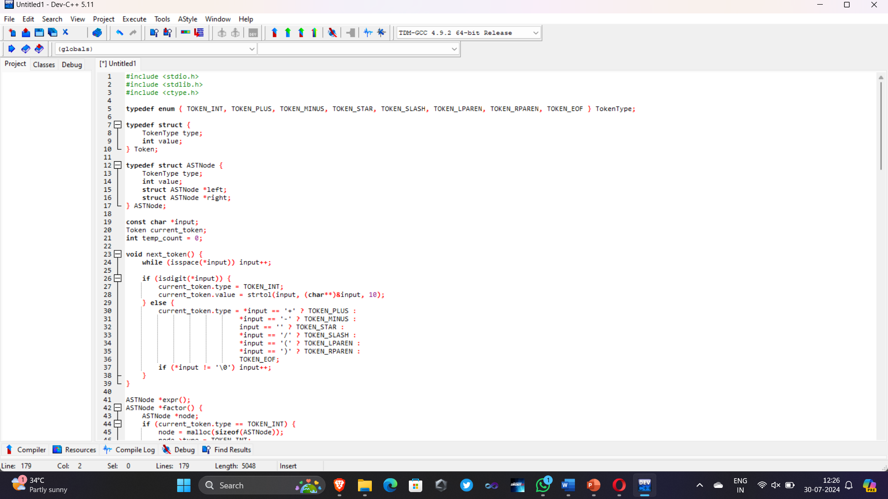
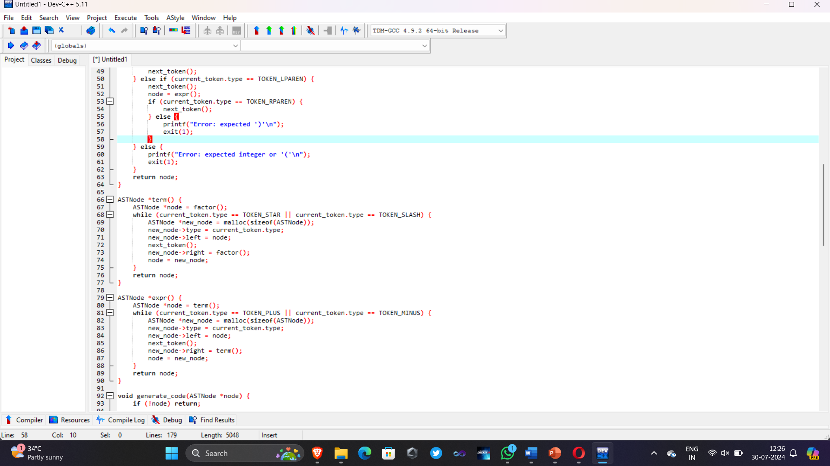
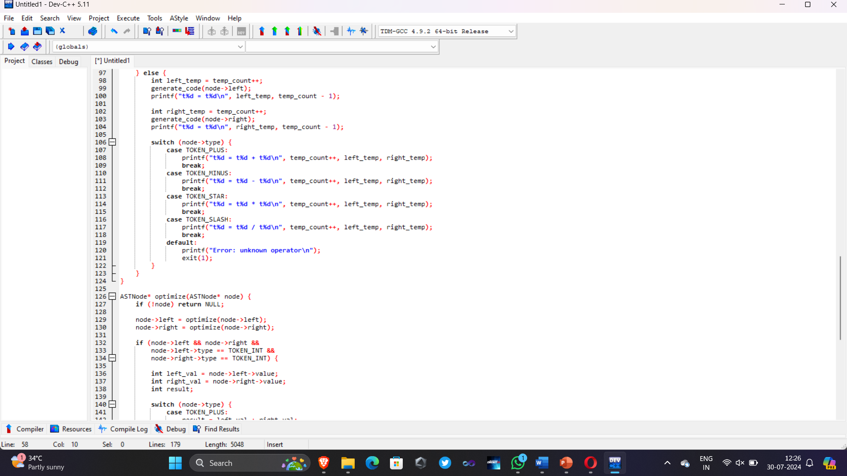
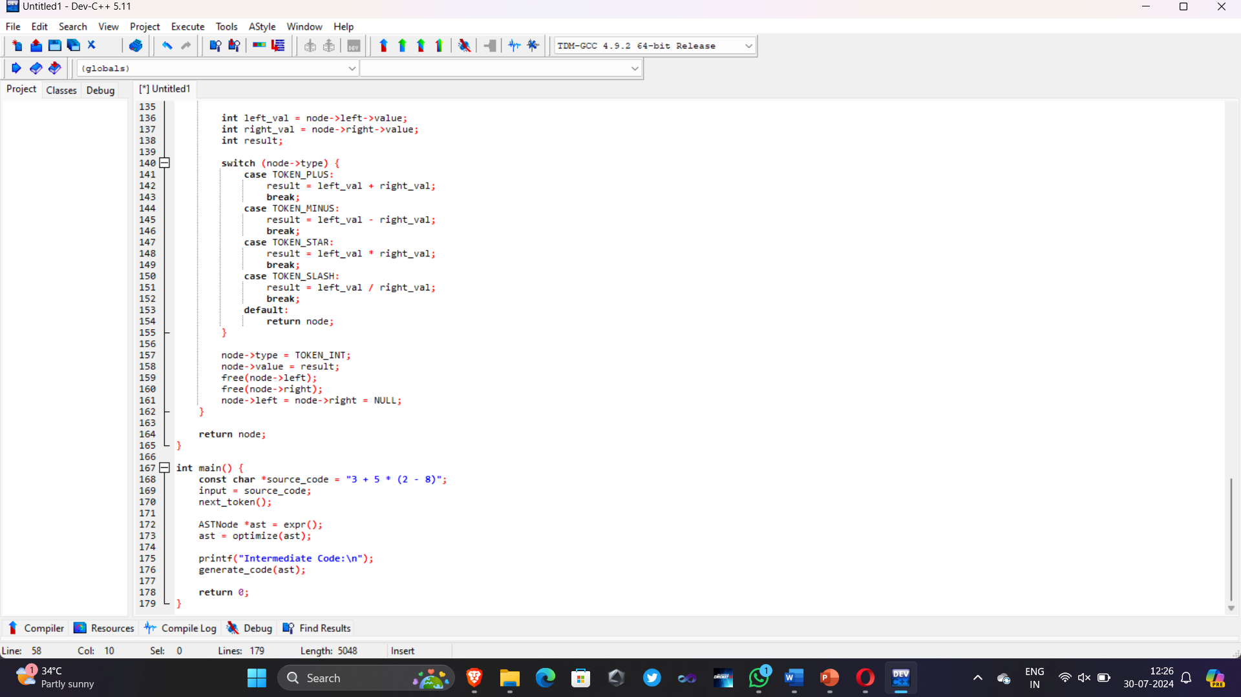
Code:

Slide 8
Features:
Platform Independence: Intermediate code serves as a platform-independent representation, facilitating cross-compilation.
Optimization-Friendly: Designed to enable various optimization techniques such as constant folding, loop optimization, and dead code elimination.
Abstract Representation: Uses abstract syntax trees (AST) and control flow graphs (CFG) for structured representation of code.
Resource Efficiency: Aims to improve execution speed and reduce memory usage.
Modularity: Allows separate compilation and optimization of different program modules.

Slide 9
Working Procedure:
Parsing: The source code is parsed to create a high-level intermediate representation such as an abstract syntax tree (AST).
Intermediate Code Generation: The AST is traversed to generate intermediate code, typically in the form of three-address code or other representations.
Control Flow Analysis: Control flow graphs (CFG) are constructed to represent the flow of control within the program.
Data Flow Analysis: Data dependencies and variable usage are analyzed to inform optimization decisions.

Slide 10
Conclusion:
Intermediate code generation and optimization play a vital role in the compilation process, impacting the performance and efficiency of the final executable
By understanding and applying effective intermediate code representations and optimization techniques, compilers can produce high-performance machine code.
Future work in this area may focus on developing more advanced optimization algorithms and exploring new intermediate code representations to further enhance compilation efficiency and program execution
Intermediate code generation and optimization are crucial steps in the compilation process, transforming high-level source code into an efficient, executable machine code.
the intermediate code can be fine-tuned to improve execution speed, minimize memory usage, and better leverage hardware capabilities.

Slide 11
THANK YOU
Have a nice day!

