Slide 1
BRIEFLY DESCRIBE .
Introducing the virtual assistant which can handle the whole desktop via voice recognition can lead to beneficial to them all purpose for not or optional to using the external devices like keyboard and mouse and can be beneficial in industrial area to reduce the time and a great opportunity to handicap people to survive in digital world.
Our research aims at developing intelligent conversational systems that can support human learning via apprenticeship. Apprenticeship learning is process of acquiring knowledge within the actual, physical context of practice, This presentation introduces “H.I.D.A.Y.” (HUMAN INTELLIGENT DIGITAL ASSISTANT YOUTH) - Just an Augmented Reality/Virtual Instruction System - that can guide people as they are performing new, physical tasks.
Conversational systems are becoming pervasive in our world they support us in accessing information, performing tasks,and communicating with other people. As strides are madein AI, ML, and NLP algorithms, it is reasonable to expectthat intelligent conversational systems will become more so phisticated and will integrate seamlessly with our physicaland online worlds, assisting us in a variety of tasks.

Slide 2
WORKING MODEL .

Slide 3
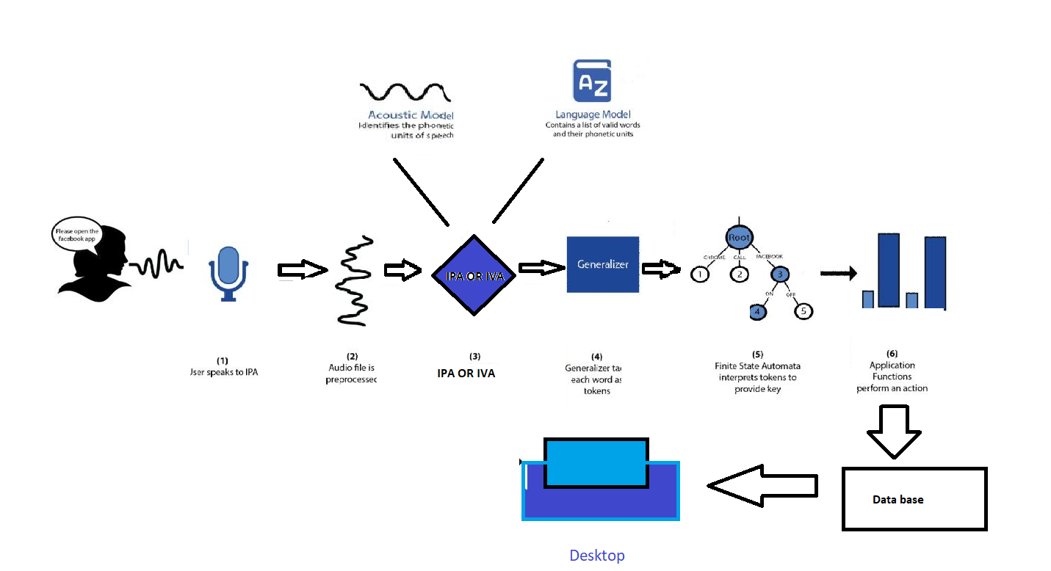
DESIGN .

Slide 4
EFFECTIVE COST .
import pyttsx3

Slide 5
Flow Chart or Block diagram

Slide 7
Start
No
End
Open Software
Decision
yes
Loop Limit
Request Sending
(Voice Command)
Multiple Files
Process
Display
Database
Running Request
Output

