Slide 1

PROPOSAL FOR SCHOOL SEMINAR
Proposal To Conduct A
Student Seminar
A short and practical session to help students
understand competitive exams, smart preparation, and
how DCAM Classes can support them.
Seminar Focus
DCAM Classes
• Academic awareness for students
• Simple introduction to
structured preparation
• Clear understanding of what DCAM
offers
Online platform for courses,
live batches, mock tests,
practice, and student
guidance.
dcamclasses.in
DCAM Classes Seminar Proposal

Slide 2
EXAMS COVERED
02 / 10
Competitive Exams Covered
In The Seminar
A clean overview of major entrance exams students should know before they choose a preparation path.
National Engineering
University Engineering
JEE Main
JEE Advanced
BITSAT
VITEEE
SRMJEEE
MET
KIITEE
State & CET Exams
Other Important Entrances
WBJEE
MHT CET
KCET
CUET
NEET
COMEDK UGET
AP EAPCET
TS EAMCET
Other Engineering Exams
The seminar helps students understand exam options, preparation direction, and where structured guidance is needed.
dcamclasses.in
DCAM Classes Seminar Proposal

Slide 3
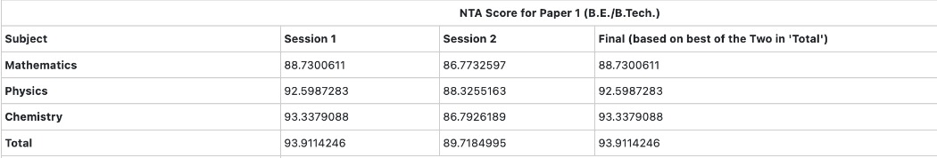
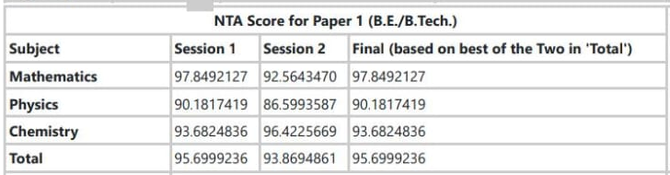
STUDENT RESULT PROOF
03 / 10
DCAM Students Are Producing
JEE Main Results
Recent JEE Main 2026 outcomes from students studying at DCAM Classes, added as proof for the school seminar proposal.
LUVYA SURI
ARCHISMAN CHAKRABARTI
93.911
AIR (CRL)
95.700
AIR (CRL)
94,953
67,680
Final NTA Score
Eligible for JEE Advanced
Final NTA Score
Eligible for JEE Advanced
JEE Main 2026 Session 2 score table
JEE Main 2026 Session 2 score table
Score sections are shown for readability; original result screenshots can be provided by DCAM if required.
dcamclasses.in
DCAM Classes Seminar Proposal

Slide 4
WHY THIS SEMINAR
04 / 10
Why This Seminar Matters For
Students
Students often know they want to prepare, but they do not always know where
to start or how to stay consistent.
E
Exam Awareness
R
Right Direction
B
Better Motivation
Students get a clearer idea
of exam paths, preparation
stages, and the value of
starting early.
They understand how learning,
practice, mock tests, and
guidance fit into one proper
plan.
A focused seminar can improve
seriousness, confidence, and
preparation discipline.
The seminar is simple, informative, and useful for students at the school level.
dcamclasses.in
DCAM Classes Seminar Proposal

Slide 5
DCAM STUDENT OFFERING
05 / 10
Everything DCAM Classes Offers
A Student
DCAM brings the full preparation journey into one connected platform so
students do not have to manage learning through scattered tools.
Courses
Crash Courses
Live Batches
Practice
Sessions
Mock Tests
Custom Mock
Tests
Find Teachers
Doubts Support
Chat &
Communication
Notice Board
Exam Bulletin
Dashboard &
Progress
This is the full student ecosystem that can be introduced during the seminar.
dcamclasses.in
DCAM Classes Seminar Proposal

Slide 6
LEARNING OPTIONS
06 / 10
Structured Learning Options
For Students
DCAM supports different study formats so students can continue learning
according to their level and schedule.
C
Courses
C
Crash Courses
L
Live Batches
Students can continue
structured courses from one
place through My Learning.
Short revision-focused
programs help students
prepare quickly before exams.
Teacher-led batches and
scheduled sessions support
discipline and continuity.
Students get both guided learning and flexible revision support.
dcamclasses.in
DCAM Classes Seminar Proposal

Slide 7
PRACTICE & TESTS
07 / 10
Practice And Testing Tools
That Build Exam Confidence
DCAM helps students practise regularly and also prepare in an exam-style
environment.
P
Practice Sessions
M
Mock Tests
C
Custom Mock Tests
Students can start
topic-based practice sessions
from the DCAM question bank.
Teacher-created mock tests
support timed attempts,
review, and analysis.
Students can create their own
mock tests according to exam
and subject needs.
This helps students improve consistency, accuracy, and test readiness.
dcamclasses.in
DCAM Classes Seminar Proposal

Slide 8
GUIDANCE & SUPPORT
08 / 10
Guidance, Communication, And
Updates
Students prepare better when they can ask questions, connect with teachers,
and stay updated on important academic information.
F
Find Teachers
D
Doubts And Chat
N
Notice Board &
Bulletin
Students can discover
teachers according to exam,
curriculum, and subject fit.
They can ask doubts and stay
connected through in-platform
communication.
Students can track important
notices, deadlines, and
exam-related updates.
DCAM supports students beyond content by keeping guidance and information in reach.
dcamclasses.in
DCAM Classes Seminar Proposal

Slide 9
SEMINAR FORMAT
09 / 10
Simple Seminar Format For The
School
The session can be hosted easily without disturbing the academic schedule.
D
Duration
T
Topics Covered
B
Basic Setup
A 45 to 60 minute session is
enough for awareness,
explanation, and Q and A.
Competitive exams, smart
preparation, practice
methods, and what DCAM offers
students.
A projector and classroom or
auditorium space are enough
for the session.
The seminar is easy to arrange and can fit the school's convenience.
dcamclasses.in
DCAM Classes Seminar Proposal

Slide 10
APPROVAL REQUEST
10 / 10
Request For Permission To
Conduct The Seminar
We would be glad to conduct this student seminar at a date and time
convenient to the school.
Value To The School
What We Request
• Students gain clearer exam
awareness.
• The school adds an academic
guidance opportunity.
• The session supports
disciplined preparation
habits.
• Approval for a seminar slot.
• Suitable student group
allocation.
• A venue with projector access.
After approval, the session flow, venue, and student-group details can be coordinated quickly.
dcamclasses.in
DCAM Classes Seminar Proposal

