Slide 1
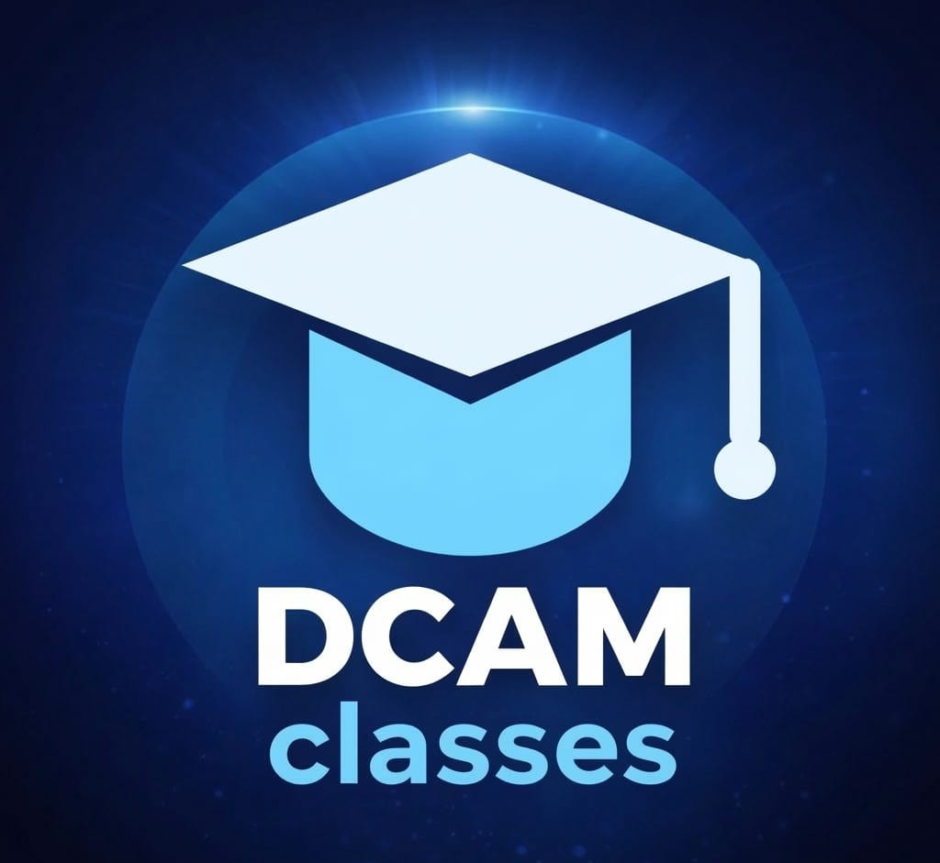
STUDENT SEMINAR
Welcome Students To
DCAM Classes
In this seminar, you will understand what DCAM is,
how it can help your preparation, and how to use it
step by step.
Today You Will Learn
DCAM Classes
1. What DCAM Classes does
2. What students can use on the
platform
3. How to start after this
seminar
One place for learning,
practice, tests, and
support.
dcamclasses.in
Student Seminar Guide

Slide 2
ENTRANCE EXAM MAP
02 / 12
Entrance Exams You
Should Know
We will learn the names, purpose, and preparation focus for the most important exams after Class 12.
National Engineering
University Engineering
JEE Main
JEE Advanced
BITSAT
VITEEE
SRMJEEE
MET
KIITEE
State & CET Exams
Other Important Entrances
WBJEE
MHT CET
KCET
CUET
NEET
COMEDK UGET
AP EAPCET
TS EAMCET
Other Engineering Exams
Know the exam list first. Then build the right routine for learning, practice, tests, and revision.
dcamclasses.in
Student Seminar Guide

Slide 3
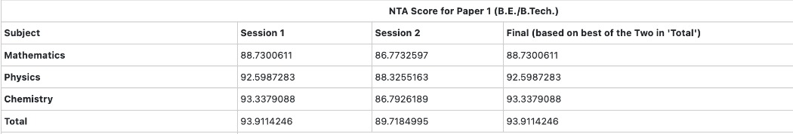
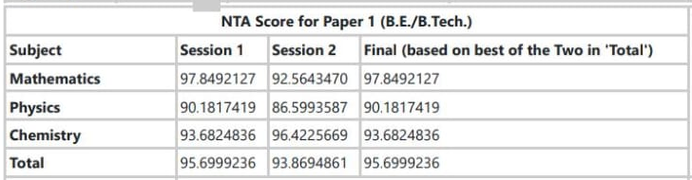
REAL DCAM RESULTS
03 / 12
Students Like You Are Already
Moving Ahead
Two DCAM students earned strong JEE Main 2026 scores. The same discipline, testing, and guidance can shape your preparation too.
LUVYA SURI
ARCHISMAN CHAKRABARTI
93.911
AIR (CRL)
95.700
AIR (CRL)
94,953
67,680
Final NTA Score
Eligible for JEE Advanced
Final NTA Score
Eligible for JEE Advanced
JEE Main 2026 Session 2 score table
JEE Main 2026 Session 2 score table
JEE Main 2026 result screenshots from students studying at DCAM Classes, shown in a readable score format.
dcamclasses.in
Student Seminar Guide

Slide 4
WHAT IS DCAM
04 / 12
DCAM Classes Is A Simple Online
Study Platform
It keeps learning, practice, testing, and support in one place so students
can study in a more organized way.
L
Learn
P
Practice
S
Stay Guided
Use courses, crash courses,
and live batches to study
with better structure.
Use practice sessions, mock
tests, and custom mock tests
to improve speed and
confidence.
Use teachers, doubts, chat,
notices, and progress tools
so you do not study alone.
DCAM is meant to make preparation easier to continue every day.
dcamclasses.in
Student Seminar Guide

Slide 5
STUDENT TOOLS
05 / 12
What Students Can Use On DCAM
You do not need to use every tool on day one, but it helps to know what is
available.
Courses
Crash Courses
Live Batches
Practice
Sessions
Mock Tests
Custom Mock
Find Teachers
Doubts
Chat
Notice Board
Exam Bulletin
Progress Tools
Start with the tools you need most, then add more as your preparation grows.
dcamclasses.in
Student Seminar Guide

Slide 6
STEP 1
06 / 12
Create Your Account And Open
Dashboard
Before using any learning tools, first set up your account correctly.
1
Open Signup Or
Login
2
Choose Student
3
Open Dashboard
4
Check Profile
Visit DCAM Classes and
choose Signup if you
are new or Login if
you already have an
account.
Select Student and
fill your name, email,
phone number, and
password, or use
Google login.
After login, go to
Dashboard. This is
your main starting
page for student
tools.
Keep your details
correct so your study
record stays clear and
organized.
Your Dashboard is the first page you should understand well.
dcamclasses.in
Student Seminar Guide

Slide 7
STEP 2
07 / 12
Choose What You Need First
Do not try everything together. Start with the feature that matches your
need.
1
If You Want
Classes
2
If You Want
Self-Study
3
If You Want
Practice
4
Use Exam And
Subject Fit
Open Find Teachers,
Courses, or Explore
Batches to discover
guided learning
options.
Use My Learning or
Crash Courses to
continue content at
your own pace.
Open Practice Session
or Mock Tests to start
solving questions and
testing yourself.
Choose your exam,
class, curriculum, and
subject so the content
matches your level.
Start with one clear purpose, then use more features later.
dcamclasses.in
Student Seminar Guide

Slide 8
STEP 3
08 / 12
Learn Daily On DCAM
Use learning tools to build a simple and regular study routine.
M
My Learning
L
Live Batches
C
Crash Courses
Continue enrolled courses,
resume modules, and keep your
course study in one place.
Join scheduled classes and
stay disciplined with
teacher-led learning.
Use short revision-focused
courses when you need faster
exam preparation.
Learning works best when you return every day, even for a short time.
dcamclasses.in
Student Seminar Guide

Slide 9
STEP 4
09 / 12
Practice And Test Yourself
Real improvement happens when you practise and review, not only when you
read.
1
Use Practice
Session
2
Use Mock Tests
3
Use Custom Mock
4
Review Weak
Areas
Open Practice Session
for topic-wise
question practice from
the question bank.
Open Mock Tests for a
fuller exam-style
experience with timed
attempts and analysis.
Create your own custom
mock test when you
want practice for a
chosen exam or
subject.
Check reports,
results, and your
practice history to
know what to improve
next.
Study plus practice plus review is the best preparation combination.
dcamclasses.in
Student Seminar Guide

Slide 10
STEP 5
10 / 12
Ask For Help And Stay Updated
Use support tools so you do not stay confused or miss important information.
1
Open Doubts
2
Use Chat
3
Check Notice
Board
4
Track Exam
Bulletin
Use Doubts when you
get stuck on a
question, topic, or
concept.
Use Chat to stay
connected inside the
platform and follow
student communication.
Use Notice Board for
student notices and
important academic
updates.
Use Exam Bulletin to
stay aware of
important exam
deadlines and notices.
Good students do not hide confusion. They ask, connect, and stay informed.
dcamclasses.in
Student Seminar Guide

Slide 11
BY CLASS LEVEL
11 / 12
How To Use DCAM From Class 9 To
12
Students from different classes can use the same platform in different ways.
If You Are In Class 9 Or 10
If You Are In Class 11 Or 12
1. Build basics and study habits.
2. Use courses and simple practice
regularly.
3. Learn concepts properly before
rushing into heavy test
pressure.
1. Use batches, practice, and mock
tests more seriously.
2. Track weak areas every week.
3. Use doubts, notices, and exam
updates regularly.
Start at your level and use DCAM according to your stage of preparation.
dcamclasses.in
Student Seminar Guide

Slide 12
SIMPLE ROUTINE
12 / 12
A Good Weekly Routine After
This Seminar
A small routine followed regularly is better than a big plan you cannot
continue.
L
Learn
P
Practice
R
Review
Use courses or live batches
on most days of the week to
stay connected to your
syllabus.
Do a few practice sessions
and at least one test or mini
test every week.
Ask doubts, check updates,
and improve one weak area
every week.
Start small, stay regular, and use DCAM as your study partner.
dcamclasses.in
Student Seminar Guide

