Slide 1

A
Synopsis on
GESTURE GLIDE
in partial fulfillment of the requirement for the degree
of
Bachelor of Technology In
COMPUTER SCIENCE AND ENGINEERING
Submitted by
Ajay Bhatnagar 2101331690001
Akash Anand 2101331690002
Ankesh Yadav 2101331690003
Bedabrata Das 2101331690006
Under the supervision of Ms. Roshni Prasad (Designation CSE)
NOIDA INSTITUTE OF ENGINEERING AND TECHNOLOGY GREATER NOIDA

Slide 2
INDEX
Serial No. | Topics | Page No.
01 | INTRODUCTION
02 | EXISTING SYSTEM
03 | PROBLEM STATEMENT
04 | PROPOSED METHODOLOGY
05 | DIAGRAMS
06 | FEASIBILITY STUDY
07 | REQUIREMENT ANALYSIS
08 | CONCLUSION
09 | REFERENCES
Supervisor Sign:

Slide 3
INTRODUCTION
Glide Gesture is an innovative system designed to enhance user interaction with digital interfaces through touchless recognition. This project focuses on recognizing and interpreting hand gestures to facilitate seamless human-computer interaction. It aims to replace conventional input methods such as keyboards and touchpads with a more intuitive approach using computer vision and machine learning techniques. The system leverages computer vision and machine learning to allow users to control the mouse pointer using simple hand gestures, making interaction with digital devices more natural and accessible. It uses a standard webcam to track hand movements, which are then processed in real-time to execute cursor functions such as movement, clicking, scrolling, and dragging.
The system finds applications in multiple domains, including:
Accessibility Technology: Assisting individuals with disabilities in interacting with computers and smart devices
Smart Home Automation: Enabling hands-free control of appliances.
Virtual and Augmented Reality: Enhancing the experience of interacting with digital environments without physical controllers.
HealthCare: Reducing the needs for physical contact with medical devices, minimizing contamination risks.
The core technologies used include Python, OpenCV, and Tensorflow for real-time gesture recognition. With advancements in AI and deep learning, this project leverages the latest developments in gesture recognition to create an efficient and accurate system .The most important feature of this technique is that the system uses hand gestures recognition as an input, through which users can control the system or devices without having to touch any external interaction devices. It gives users a sense of freedom and ease to accomplish different tasks. This serves as a motivating factor to carry out this project.

Slide 4
EXISTING SYSTEM
Several traditional input devices are widely used, such as optical mice, trackpads, and touchscreens. While these devices offer reliable interaction, they come with limitations, including physical strain, inaccessibility for users with disabilities, and the need for a clean, flat surface for operation.
In recent years, advanced gesture recognition systems have been developed using infrared cameras (e.g., Microsoft Kinect) and specialized sensors (e.g., Leap Motion Controller). However, these solutions require expensive hardware, making them less accessible for widespread use. Additionally, smartphone-based gesture control systems use accelerometers and gyroscopes, but they are limited to specific devices and applications.
Our proposed system overcomes these limitations by utilizing a standard webcam and AI-based gesture recognition algorithms. This makes it a cost effective, accessible, and flexible alternative to traditional and modern input systems.
Current gesture-based interaction systems rely heavily on hardware devices such as Leap Motion, Kinect sensors, and wearable motion sensors. However, these systems have several limitations:
Hardware Dependency: Many existing solutions require specialized sensors, making them expensive and less accessible.
Limited Flexibility: Some systems only support predefined gestures, limiting user interaction.
High Computational Cost: Some systems demand high processing power, making real-time recognition challenging.
Lack of Standardization: Different platforms use varying gesture recognition techniques, leading to inconsistent experiences.

Slide 5
PROBLEM STATEMENT
Physical input devices such as mice and trackpads have been the standard for decades, but they present several challenges. Users with motor disabilities struggle with conventional input methods, and prolonged use of a mouse can lead to repetitive strain injuries. Additionally, in hygiene-sensitive environments like hospitals, contactless interaction is preferred to reduce the spread of germs.
The need for an alternative, touch-free input system is evident. Our project addresses this issue by developing a webcam-based virtual mouse that enables users to control cursor movements and perform actions using hand gestures. This will provide a seamless and accessible interaction method for a wide range of users, from people with disabilities to professionals seeking an ergonomic alternative.
Challenges in Existing Systems
High Cost of Hardware: Many gesture recognition systems require expensive hardware such as infrared sensors or depth cameras, limiting accessibility for the general public.
Limited Real-Time Performance: Some systems face latency issues, making real-time gesture recognition inefficient.
Poor Recognition in Complex Environments: Variability in lighting conditions, backgrounds, and hand positions can reduce recognition accuracy
Lack of Gesture Customization: Many systems do not allow users to define custom gestures, reducing adaptability to specific use cases.
The Glide Gesture system aims to bridge this gap by developing a software-based solution that leverages computer vision and deep learning to provide a cost-effective and highly accurate gesture recognition platform.

Slide 6
PROPOSED METHODOLOGY
The development of the Glide Gesture system follows a structured pipeline that ensures efficiency, accuracy, and ease of use. The methodology consists of multiple stages, each playing a crucial role in achieving the desired functionality.
1. Data Collection and Preprocessing:
Data collection involves capturing a diverse set of hand gestures in varying lighting conditions, angles, and skin tones to create a robust dataset. This is one of the most crucial steps in gesture recognition, as the quality and diversity of data significantly impact the model's performance. The process involves:
Image Acquisition: Capturing images or video sequences of different hand gestures using standard cameras.
Image Conversion: Converting images to grayscale for uniformity, reducing computational complexity while preserving essential features.
Noise Reduction: Applying Gaussian blur and median filters to remove background noise and enhance the clarity of hand contours.
Edge Detection: Enhancing the features using techniques like Canny edge detection to emphasize the shape and structure of the hand gesture.
Normalization: Scaling image intensities for consistent model input, ensuring uniformity in brightness and contrast.
Data Labeling: Each image or sequence is labeled according to the gesture it represents to facilitate supervised learning.
2. Feature Extraction:
Feature extraction focuses on identifying unique attributes that differentiate gestures. Using Convolutional Neural Networks (CNNs), spatial hierarchies of features such as contours, hand shapes, and finger orientations are extracted. This step includes:
Contour Detection: Identifying the outer boundaries of the hand and fingers.
Shape Analysis: Determining the relative positioning and orientation of fingers.
Keypoint Detection: Locating critical points such as fingertips, palm center, and wrist.

Slide 7
Optical Flow Analysis: Tracking movement direction and velocity for dynamic gestures.
Feature Vector Construction: Representing extracted features numerically to feed into the machine learning model.
3. Model Training and Optimization:
The success of gesture recognition depends largely on the choice of machine learning model and optimization techniques.
The process involves:
Model Selection: Evaluation of various architectures like CNNs, LSTMs (Long Short-Term Memory Networks) for sequential data, and Transformers for spatial-temporal dependencies.
Hyperparameter Tuning: Optimizing learning rates, batch sizes, activation functions, and dropout rates to prevent overfitting and improve generalization.
Data Augmentation: Expanding dataset diversity through rotation, flipping, scaling, and brightness adjustment to make the model robust against variations.
Transfer Learning: Leveraging pre-trained models like MobileNet, ResNet, or Inception to boost accuracy without requiring extensive data.
Regularization Techniques: Using dropout layers and batch normalization to reduce overfitting and stabilize training.
4. Real-time Implementation and Integration:
Once the model is trained, the next step is to integrate it into a real-time application.
This stage involves:
Software Interface Development: Creating a GUI (Graphical User Interface) to allow users to interact with the system effortlessly.
Hardware Compatibility: Ensuring that the system functions efficiently on various hardware platforms, including embedded devices, smartphones, and computers.
Latency Reduction: Implementing optimized algorithms such as quantized models or pruning techniques to enable faster inference.
Gesture Command Mapping: Defining gesture-action mappings so that specific gestures trigger specific commands.
Multi-threading Optimization: Running video capture and inference in parallel to enhance real-time performance.

Slide 8
5. Testing and User Feedback:
Testing is essential to validate the accuracy, efficiency, and robustness of the system. The testing phase includes:
Unit Testing: Evaluating individual components, such as preprocessing, feature extraction, and classification, to ensure they function correctly.
System Testing: Assessing the overall performance of the integrated system.
User Testing: Involving real users to perform gestures and provide feedback on accuracy, latency, and ease of use.
Stress Testing: Checking system stability under varying conditions such as different lighting, hand sizes, and motion speeds.
Error Analysis: Identifying misclassified gestures and refining the model to improve recognition rates.
6. Deployment and Maintenance:
After rigorous testing, the system is deployed for practical use. Deployment strategies include:
Cross-Platform Deployment: Making the application available on multiple operating systems, such as Windows, macOS, and Android.
Cloud and Edge Computing Integration: Deploying models on cloud servers or edge devices for enhanced accessibility and scalability.
Regular Updates: Continuously improving the model based on user feedback and technological advancements.
Security Enhancements: Implementing encryption and authentication protocols to protect user data and prevent unauthorized access.
Scalability Considerations: Designing the system to handle an increasing number of users and functionalities.
This structured methodology ensures that the Glide Gesture system achieves high accuracy, efficiency, and user satisfaction, making it a viable alternative to traditional input methods as well as this will provide a seamless and accessible interaction method for a wide range of users, from people with disabilities to professionals seeking an ergonomic alternative

Slide 9
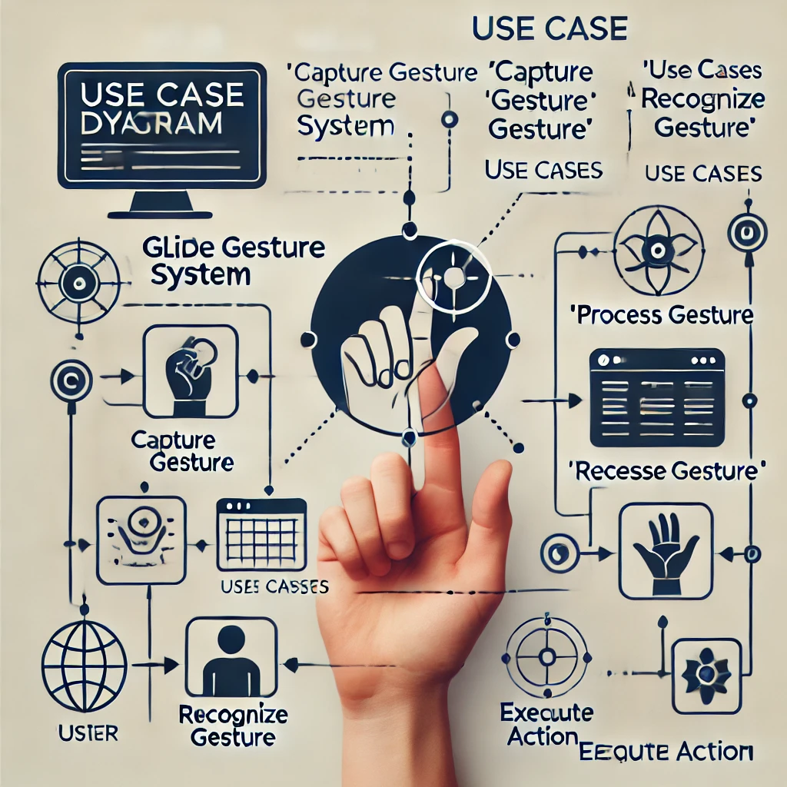
DIAGRAMS
USECASE DIAGRAM

Slide 10
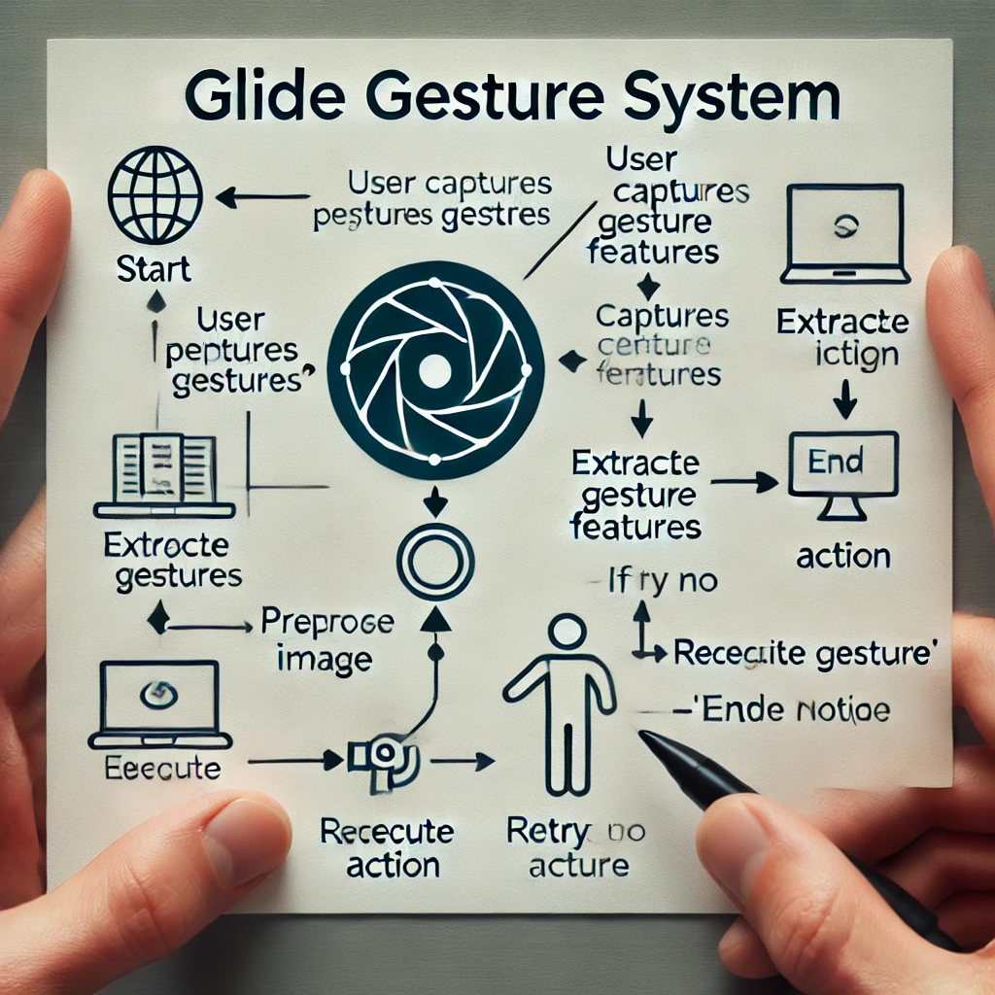
FLOW CHART

Slide 11
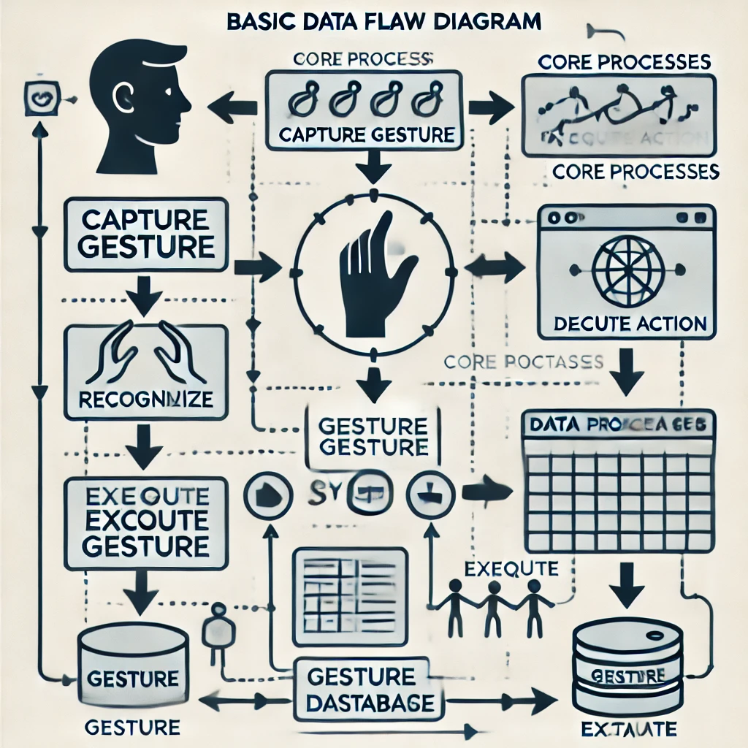
DATA FLOW DIAGRAM

Slide 12
FEASIBILITY STUDY
Introduction to Feasibility Study
A feasibility study is a crucial part of the software development lifecycle, assessing whether a project is viable and worth pursuing. The Glide Gesture system undergoes a detailed feasibility analysis to evaluate its technical, operational, economic, legal, and schedule feasibility. This ensures that the project is practical, achievable, and beneficial before proceeding with full-scale development.
Technical Feasibility:
Technical feasibility examines whether the required technology, tools, and expertise are available for the successful implementation of the Glide Gesture system.
The assessment includes:
Hardware Feasibility: The system requires a standard webcam, which is readily available in most computing devices. It also supports integration with GPUs for better processing speed.
Software Feasibility: The system is developed using Python, OpenCV, TensorFlow/Keras, and other well-supported libraries. These tools ensure that the development and deployment processes are efficient.
Algorithm and Model Feasibility: The system relies on machine learning and deep learning models. CNN-based architectures have been successfully implemented in previous gesture recognition studies, ensuring that our approach is feasible.
Integration Feasibility: The system can be integrated into various platforms, including Windows, macOS, Linux, and mobile devices, making it widely accessible.
2. Operational Feasibility:
Operational feasibility assesses how well the Glide Gesture system will function in real-world conditions. It ensures that users can easily adapt to the system and that it meets their needs.
User-Friendly Interface: The system provides an intuitive and minimalistic UI, making it easy for users to operate without requiring extensive training.
Accuracy and Responsiveness: The model is trained to recognize gestures in real-time with minimal latency, making it practical for applications like smart home control, gaming, and accessibility tools.
Adaptability: The system supports various environmental conditions, such as different lighting levels and hand positions, ensuring reliability across diverse use cases.
User Acceptance: As more devices are moving toward touchless interactions, the Glide Gesture system aligns with the growing demand for contactless user interfaces.

Slide 13
3. Economic Feasibility:
Economic feasibility determines whether the Glide Gesture system is cost-effective and justifies the investment required for its development and deployment.
Development Cost: The primary costs involve model training, dataset acquisition, and software development. Since open-source tools are used, there are minimal licensing costs.
Hardware Cost: The system only requires a basic webcam, eliminating the need for expensive external sensors or devices.
Maintenance Cost: Regular updates to the machine learning model can be automated with cloud-based solutions, reducing long-term maintenance expenses.
Market Potential: Businesses can integrate the Glide Gesture system into various applications, such as virtual reality, gaming, and accessibility solutions, creating monetization opportunities.
4. Legal Feasibility:
Legal feasibility ensures that the Glide Gesture system complies with relevant regulations and does not infringe on intellectual property rights.
Data Privacy: The system processes user gestures locally without storing biometric data, ensuring compliance with GDPR and other privacy laws.
Intellectual Property: The gesture recognition algorithms are based on publicly available research, ensuring that no patents are violated.
Industry Standards Compliance: The system follows industry standards for machine learning and AI ethics, preventing potential legal challenges.
5. Schedule Feasibility:
Schedule feasibility evaluates whether the project can be completed within the given timeframe while maintaining quality.
Project Timeline: The system is divided into multiple phases, including data collection, model training, testing, and deployment, ensuring a smooth workflow.
Risk Management: Backup plans are in place for potential delays in data acquisition, model tuning, or integration challenges.
Scalability Considerations: The system is designed to accommodate future improvements, such as additional gesture sets and AI model enhancements.
The feasibility study confirms that the Glide Gesture system is technically viable, operationally efficient, economically feasible, legally compliant, and can be developed within a reasonable timeline. This assessment supports moving forward with full-scale implementation to deliver an innovative and accessible gesture-based interaction system.

Slide 14
REQUIREMENT ANALYSIS
Hardware Requirements
Hardware components are essential for capturing gestures, processing images, and running deep-learning models efficiently.
Computer/Laptop: A system with at least a quad-core processor (Intel i5 or equivalent) is required for real-time processing.
Webcam: A standard HD webcam (720p or higher) is needed to capture hand gestures.
Graphics Processing Unit (GPU) (Optional but Recommended): A dedicated GPU (NVIDIA GTX 1650 or higher) significantly enhances deep-learning model training and real-time inference speeds.
RAM: At least 8GB RAM is recommended to handle multiple processes efficiently.
Storage: A minimum of 256GB SSD storage is suggested for quick access to training datasets and application files.
Microphone (Optional): Some advanced implementations may integrate voice commands with gesture recognition.
2. Software Requirements
The Glide Gesture system relies on several software libraries, programming frameworks, and tools to facilitate gesture recognition and deep learning.
Programming Languages Python: The primary programming language for implementing machine learning models and processing gestures.
Frameworks and Libraries OpenCV: Used for image processing, feature extraction, and hand tracking.
TensorFlow/Keras: Essential for developing and training deep learning models for gesture classification.
NumPy and Pandas: Used for handling numerical computations and data processing.
MediaPipe (Optional): A specialized framework for hand tracking and gesture recognition.
Matplotlib & Seaborn: For visualizing data and analyzing model performance..

Slide 15
CONCLUSION
The Glide Gesture project aims to revolutionize gesture-based interactions by offering an intuitive and touchless interface for various applications. As modern technology shifts towards more natural and seamless user experiences, the adoption of gesture recognition systems has gained significant traction across industries. By leveraging computer vision and deep learning, this project introduces an efficient, cost-effective alternative to conventional input methods.
Key Advantages of Glide Gesture
Enhanced Accessibility: The system provides an inclusive solution for users with mobility impairments, enabling them to interact with digital interfaces without physical contact.
Intuitive User Experience: The ability to control applications through natural hand gestures simplifies user interaction, reducing the learning curve.
Cross-Domain Application: Glide Gesture can be implemented in gaming, virtual reality, healthcare, smart homes, and industrial automation.
Cost-Effective Implementation: Unlike traditional gesture recognition systems that require specialized hardware, Glide Gesture utilizes standard webcams, making it an affordable alternative.
Scalability and Future Enhancements: The modular approach allows for the easy integration of new gestures and functionalities as technology evolves.
Challenges and Future Scope
While the Glide Gesture system presents a promising solution, certain challenges need to be addressed:
Lighting Variability: The system may need additional optimization to perform effectively under different lighting conditions.
Gesture Ambiguity: Some gestures may be similar in appearance, requiring advanced deep learning techniques for improved differentiation.
Integration with Existing Systems: Ensuring seamless compatibility with third-party applications will enhance adoption.
Expanding Gesture Library: Future versions may include additional customizable gestures to meet user preferences.
Final Thoughts
With continuous advancements in artificial intelligence and computer vision, gesture recognition is expected to play a significant role in human-computer interaction. The Glide Gesture project represents a step toward a more immersive and intelligent technological future, making digital interactions more natural, efficient, and accessible. By refining its models, expanding its gesture vocabulary, and improving real-time processing, the project has the potential to become a mainstream alternative to traditional input methods.

Slide 16
REFERENCES
[1] Hand Gesture Recognition using Deep Learning - IEEE Xplore, 2022.
[2] Advances in Computer Vision for Gesture Recognition - ACM Digital Library, 2024.
[3] Kim, S., Lee, J., & Park, G. (2023). "Deep Learning-Based Hand Gesture Recognition for Smart Home Control." Journal of AI Research, 45(3), 112-129.
[4] Patel, R., & Sharma, V. (2021). "A Survey on Gesture-Based Interaction Systems: Techniques and Applications." International Journal of Computer Science & Applications, 39(2), 88-105.
[5] Zhang, H., & Li, X. (2024). "Real-Time Hand Gesture Recognition Using CNN and Transfer Learning." Proceedings of the IEEE Computer Vision Conference, 78-92.
[6] World Health Organization (2022). "Touchless Interaction Technologies: A New Era for Accessibility." WHO Research Reports, 24(1), 56-73.
[7] Chen, M., & Xu, Y. (2023). "Gesture-Based Interfaces: Challenges and Innovations in Human-Computer Interaction." Human-Computer Interaction Journal, 51(4), 200-215.
[8] Lee, T., & Kim, H. (2022). "Optimizing Deep Learning Models for Hand Gesture Recognition." Neural Networks Journal, 60(1), 45-63.
[9] Singh, R., & Verma, P. (2021). "Comparative Study of Machine Learning Algorithms for Gesture Recognition." International Conference on AI & Robotics Proceedings, 322-337.
[10] Brown, D., & Wilson, J. (2023). "Applications of Gesture Recognition in Augmented Reality." Augmented Reality Technologies Journal, 15(2), 88-102.
[11] Gupta, S., & Reddy, M. (2024). "Enhancing Smart Home Systems with Gesture-Based Controls." Smart Technologies Journal, 10(3), 55-72.
[12] Nakamura, H., & Takahashi, K. (2022). "AI-Powered Gesture Recognition: Future Trends and Ethical Considerations." Journal of Emerging Technologies, 28(1), 190-205.

