Slide 1

GESTURE GLIDE
Department of Computer Science and Engineering Regional
(Supervisor: Ms. Roshni Prasad )
Group Members
Name of Member | Roll Number | Role
Ajay Bhatnagar | 2101331690001 | Developer (Programming)
Akash Anand | 2101331690002 | Developer (Algorithm Development and Model )
Ankesh Yadav | 2101331690003 | Research and Documentation Lead
Bedabrata Das | 2101331690006 | Presentation and Communication Lead

Slide 2
Index
1. Introduction
2. Objectives
3. Existing Systems
4. Problem Statement
5. Literature Review
6. Project Execution Plan
7. Technical Description
8. Block Diagram
9. Proposed Methodology
10. Requirement Analysis
11. Conclusion
12. References

Slide 3
Introduction
Glide Gesture is an innovative system designed to enhance human-computer interaction through touchless gesture recognition. By leveraging deep learning and computer vision, the system enables users to interact with digital devices using only hand gestures.
Gesture Glide enables users to input mouse commands without a physical mouse, using webcams for image processing.
Hand movements are converted into mouse inputs with continuous webcam image capture.
Webcam-based vision cursor control eliminates traditional mice and expands into various Human-Computer Interaction (HCI) applications.
Technologies like motion controls in gaming consoles and Apple's Vision Pro VR headset highlight the rise of gesture-based interaction.
Gesture-based PowerPoint control and eye tracker virtual mouse add further versatility to these technologies, offering more natural and intuitive interactions.

Slide 4
Existing Systems
Many current gesture recognition systems rely on external hardware like Kinect and Leap Motion. These solutions are expensive, less accessible, and limited in adaptability. Glide Gesture provides a software-based alternative, eliminating the need for extra hardware.
Current gesture-based interaction systems rely heavily on hardware devices such as Leap Motion, Kinect sensors, and wearable motion sensors. However, these systems have several limitations:
Hardware Dependency: Many existing solutions require specialized sensors, making them expensive and less accessible.
Limited Flexibility: Some systems only support predefined gestures, limiting user interaction.
High Computational Cost: Some systems demand high processing power, making real-time recognition challenging.
Lack of Standardization: Different platforms use varying gesture recognition techniques, leading to inconsistent experiences.

Slide 5
Literature Review
Gesture Recognition Based Virtual Mouse and Keyboard
Authors: Sugnik Roy Chowdhury and Sumit Pathak
Computer vision has reached its pinnacle, where a computer can identify its owner using a simple program of image processing. In this stage of development, people are using this vision in many aspects of day-to-day life, like Face Recognition, Color detection, Automatic car, etc. In this project, computer vision is used in creating an Optical mouse and keyboard using hand gestures. The camera of the computer will read the image of different gestures performed by a person’s hand and according to the movement of the gestures the Mouse or the cursor of the computer will move, and even perform right and left clicks using different gestures. Similarly, the keyboard functions may be used with some different gestures, like using one finger gesture for alphabet selection and a four-figure gesture to swipe left and right. It will act as a virtual mouse and keyboard with no wire or external devices.
Disadvantages:
The Convex Hull algorithm can cause problem if another external noise or defect is detected in the working domain of webcam. An attempt to make input mode less constraints dependent for the user’s hand gestures has been preferred.

Slide 6
Design and Development of Hand Gesture Based Virtual Mouse
Authors: Kabid Hassan Shibly and Samrat Kumar Dey
The aim is to control mouse functions using only a simple webcam instead of a traditional or regular hardware device. The Virtual Mouse works as a bridge between the user and the machine and only uses a webcam. It helps the user to interact with the system without any physical devices and control the mouse functions. The concept is implemented using Python programming language and Computer Vision-based library OpenCV. This system has the potential to replace the hardware mouse. The lighting barrier acts as the barrier to this system. That’s why the system still can’t be enough to replace the traditional mouse as most of the systems are used in poor lighting conditions.
Limitations:
The Convex Hull algorithm can cause problem if another external noise or defect is detected in the working domain of webcam. An attempt to make input mode less constraints dependent for the user’s hand gestures has been preferred.

Slide 7
Virtual Mouse Control Using Coloured Finger Tips and Hand Gesture Recognition
Authors: Vantukala VishnuTeja Reddy and Thumma Dhyanchand
In human-computer interaction, virtual mouse is implemented with fingertip recognition and hand gesture tracking based on image in a live video is one of the studies. The main objective is to find the solution for the finger tracking in the real world and the cursor control of a computer is still performed physically. The proposed system describes virtual mouse control using fingertip identification and hand gesture recognition. This study consists of two methods for tracking the fingers, one is by using coloured caps and other is by hand gesture detection. This includes three main steps that are finger detection using colour identification, hand gesture tracking and implementation on on-screen cursor. Hand gesture tracking is generated through the detection of contour and formation of a convex hull around it.
Limitations:
Complex methodology is adopted as there is specific color sequence used for all the mouse control operations which makes the system complex.

Slide 8
Problem Statement
Existing gesture recognition solutions face challenges such as:
Hand-Tracking Finger-Only Virtual Mouse: Utilizes finger combinations for mouse movements without requiring additional gadgets or finger painting, enabling space conservation and ease of use.
Computer Vision Implementation: Utilizes OpenCV for computer vision tasks and the Media Pipe framework for hand tracking and movement identification without requiring special sensors.
Machine Learning Integration: Implements machine learning algorithms within the Media Pipe framework to differentiate between hand motions and finger tips, enabling precise control and interaction.
Scalable and Flexible Pipeline: The Media Pipe framework allows for easy system development and analysis, with flexibility to run on various platforms including desktops and mobile devices, enhancing scalability and usability.
High hardware costs
Limited real-time performance
Lack of flexibility in dynamic environments
Glide Gesture aims to solve these challenges using a purely software-driven approach.

Slide 9
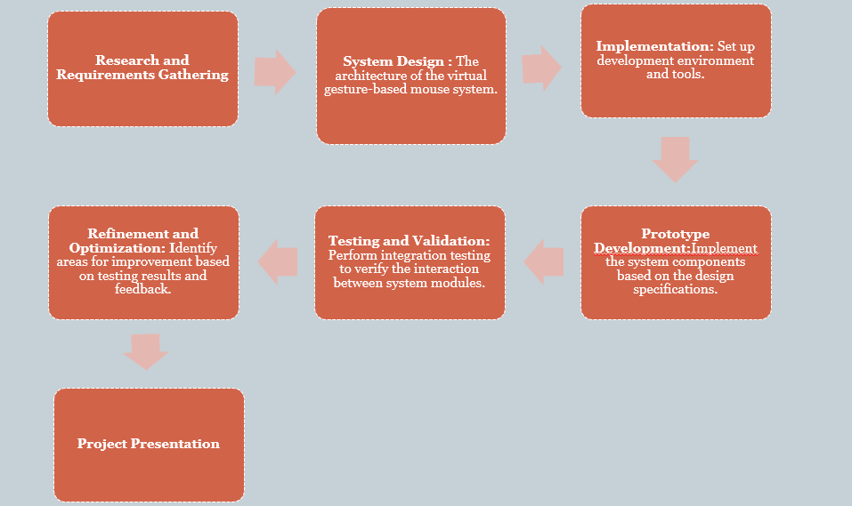
Project Execution Plan

Slide 10
Technical Description
MediaPipe and OpenCV Integration: Utilizes the MediaPipe framework for hand gesture detection and tracking, leveraging machine learning concepts, while OpenCV is employed for computer vision tasks, including object detection.
Graph-Based System Analysis: Developers utilize MediaPipe for building and analyzing systems through graph-based approaches, allowing for application development and customization.
Single-Shot Detector Model: Implements a single-shot detector model within MediaPipe for real-time hand detection and recognition, with a focus on palm detection due to its ease of training and efficient non-maximum suppression.
OpenCV for Image Processing: OpenCV, a Python library for computer vision, facilitates image and video processing, enabling tasks such as face and object detection in real-time applications.

Slide 11
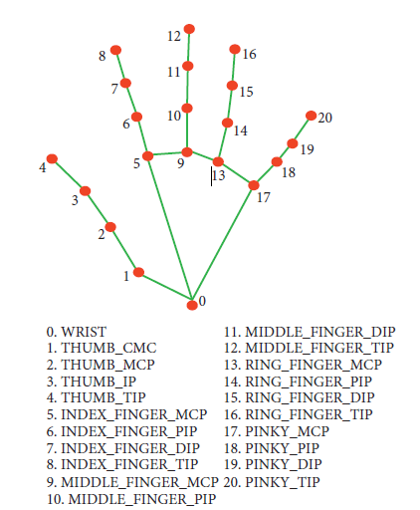
AI Virtual Mouse System Camera: Relies on webcam frames captured by a laptop or PC, utilizing OpenCV for video capture and processing.
The video frames are processed from BGR to RGB
colour space to find the hands in the video frame
by frame as shown in the following code:
def findHands(self, img , draw = True):
imgRGB = cv2.cvtColor(img , cv2.COLOR_BGR2RGB)
self.results = self.hands.process(imgRGB)
The AI virtual mouse system makes use of the transformational algorithm, and it converts the coordinates of fingertip from the webcam screen to the computer window full screen for controlling the mouse.

Slide 12
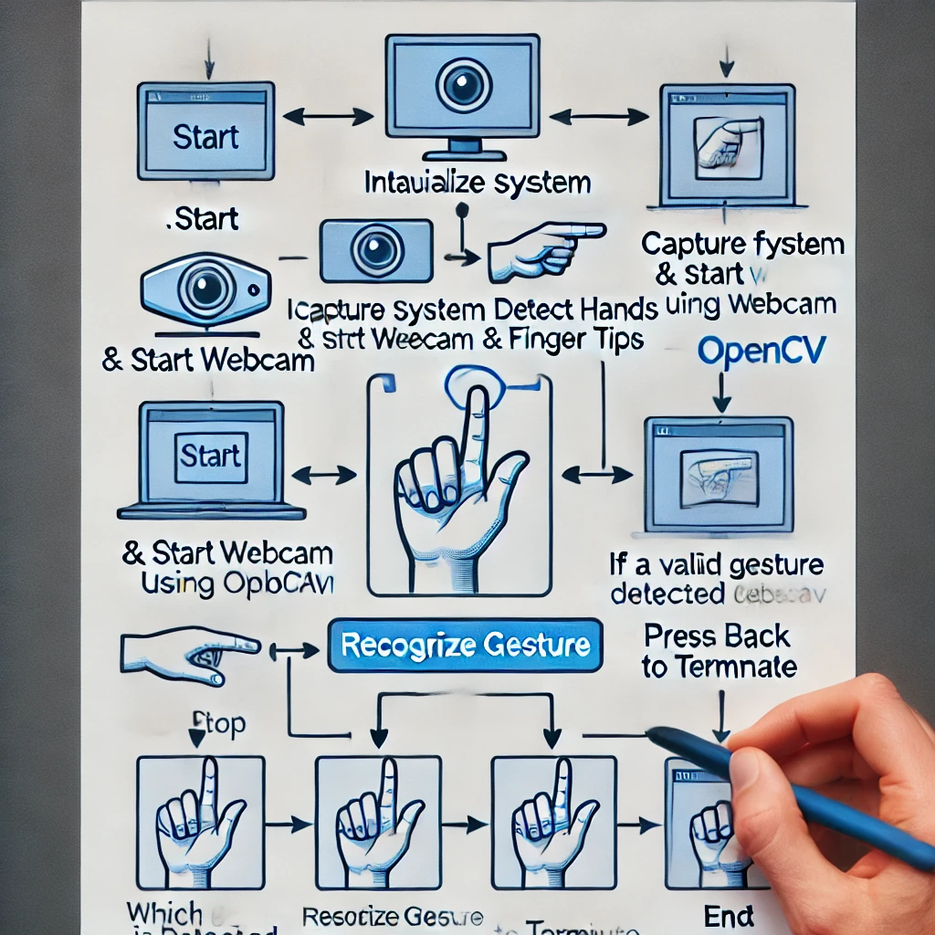
Block Diagram

Slide 13
Proposed Methodology
The Glide Gesture system follows these key steps:
1. Capture Gesture via Camera
2. Preprocess Image (Grayscale, Edge Detection)
3. Extract Features (Contours, Keypoints)
4. Classify Gesture using a Trained Model
5. Execute the Mapped Action

Slide 14
Requirement Analysis
1. Hardware Requirements:
- Standard Laptop/PC with Webcam
- GPU (Optional for faster model training)
2. Software Requirements:
- Python, TensorFlow, OpenCV, NumPy, Pandas
3. User Needs:
- General users for accessibility
- Developers for integration
- Businesses for automation applications

Slide 15
Conclusion
Glide Gesture revolutionizes human-computer interaction by providing a cost-effective, efficient, and accessible gesture-based input system. With its applications in smart homes, gaming, and accessibility solutions, it paves the way for a touch-free future.
The virtual mouse system's main objective is to eliminate the need for a hardware mouse by allowing users to manage mouse cursor functions with hand gestures instead.
The described method can be used with a webcam or an integrated camera that analyses frames to recognize hand movements and hand tips and execute specific mouse actions.
The Glide Gesture project represents a step toward a more immersive and intelligent technological future, making digital interactions more natural, efficient, and accessible.

Slide 16
Future Scope
Voice Assistant Integration: Integrating voice recognition and natural language processing technologies into the virtual mouse system can enable users to interact with their computers through voice commands.
Development of Virtual Keyboard: Adding a virtual keyboard to the system will enable users to type and input text without the need for a physical keyboard.
Unified Application for Multiple Modules: Creating a unified application that integrates all the different modules—gesture control, eye tracking, voice recognition, and virtual keyboard—into a single cohesive platform will significantly enhance user convenience.
Further Reduction of Latency: Reducing latency is crucial for improving the responsiveness and user experience of the virtual mouse system.

Slide 17
References
[1] D. Du, X. Hu, "Steiner Tree Problems In Computer Communication Networks", World Scientific Publishing Company, 2008.
[2] Boon Ping Lim, Poh Kit Chong, Ettikan Kandasamy Karuppiah, Yaszrina Mohamad Yassin, Amril Nazir, Mohamed Farid Noor Batcha, “FARCREST: Euclidean Steiner Tree-based Cloud Service Latency Prediction System” (2013) in 10th annual IEEE CCNC.
[3] Hand Gesture Recognition using Deep Learning - IEEE Xplore, 2022.
[4] Advances in Computer Vision for Gesture Recognition - ACM Digital Library, 2024.
[5] Kim, S., Lee, J., & Park, G. (2023). "Deep Learning-Based Hand Gesture Recognition for Smart Home Control." *Journal of AI Research*, 45(3), 112-129.
[6] Patel, R., & Sharma, V. (2021). "A Survey on Gesture-Based Interaction Systems: Techniques and Applications." *International Journal of Computer Science & Applications*, 39(2), 88-105.
[7] Zhang, H., & Li, X. (2024). "Real-Time Hand Gesture Recognition Using CNN and Transfer Learning." *Proceedings of the IEEE Computer Vision Conference*, 78-92.
[8] Nakamura, H., & Takahashi, K. (2022). "AI-Powered Gesture Recognition: Future Trends and Ethical Considerations." *Journal of Emerging Technologies*, 28(1), 190-205.
[9] S. Shriram, B. Nagaraj, J. Jaya, S. Shankar, and P. Ajay, "Deep Learning-Based Real-Time AI Virtual Mouse System Using Computer Vision to Avoid COVID-19 Spread," Journal of Healthcare Engineering, vol. 2021, Article ID 8133076, 2021, doi: 10.1155/2021/8133076.
[10] J. Katona, “A review of human–computer interaction and virtual reality research fields in cognitive InfoCommunications,” Applied Sciences, vol. 11, no. 6, p. 2646, 2021.

Slide 18
Thank You

