Slide 1

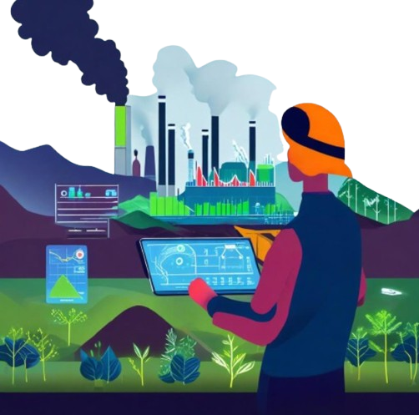
BASIC DETAILS OF THE TEAM AND PROBLEM STATEMENT
2024
Problem Statement ID :SIH1644
Problem Statement Title: A web application specifically
designed for Indian coal mines to quantify their carbon
footprint and explore pathways to carbon neutrality.
Theme: RENEWABLE/SUSTAINABLE ENERGY
Category: Software
Team ID:24424
Team Name:TECH4EARTH

Slide 2
IDEA TITLE: ECO MINE
DETAILED EXPLANATION:
It provides real-time carbon emission quantification for all mining activities—from excavation to transportation, enabling mines to
pinpoint where emissions are the highest.
EcoMine is a smart, web-based platform designed to empower Indian coal mines in their journey toward sustainability and carbon neutrality.
EcoMine does more than just estimate carbon footprints; it also suggests practical pathways toward achieving carbon neutrality—
whether through afforestation, renewable energy integration, or carbon credit trading.
By integrating data visualization tools, all stakeholders can track emissions, monitor carbon reduction, and make informed sustainability
decisions.
ADDRESSING THE PROBLEM
INNOVATION & UNIQUENESS
India is the second-largest coal producer, heavily relying on coal for energy.
Coal mining contributes significantly to carbon emissions, conflicting with India's climate commitments.
EcoMine addresses this by calculating emissions and suggesting carbon reduction strategies.
Aligns with India’s climate goals (Paris Agreement, net-zero emissions by 2070).
Integrates machine learning for precise carbon footprint calculations specific to Indian coal mines.
Provides customizable pathways to carbon neutrality (afforestation, renewable energy, carbon credit trading).
Multi-stakeholder system supporting mine operators, government authorities, and general users.
Ensures a comprehensive, data-driven solution for sustainability.

Slide 3
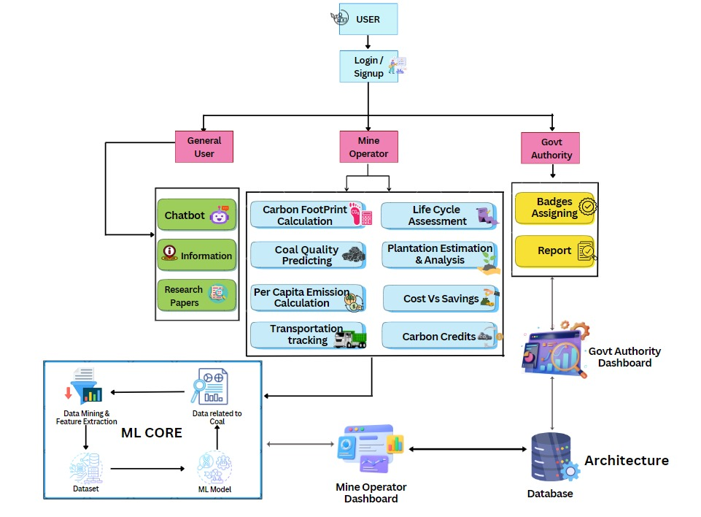
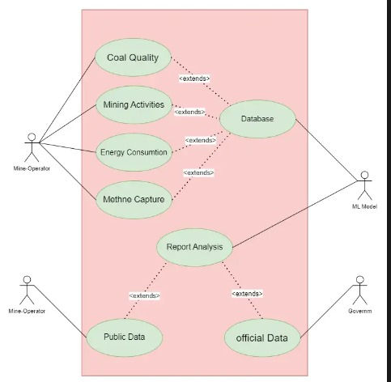









TECHNOLOGICAL APPROACH
Vendor Registration
Scraper(CVE Collection)
TECHNOLOGY STACK:

Slide 4
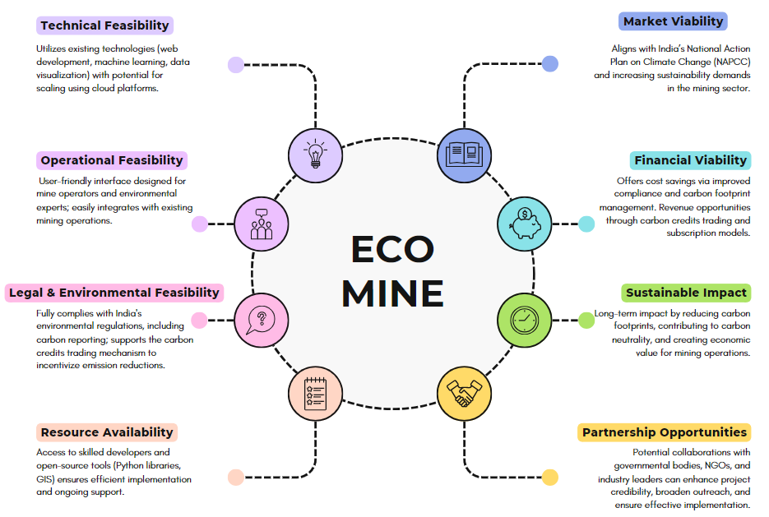
FEASIBILITY AND VIABILITY

Slide 5
IMPACT & BENEFITS
IMPACT ON TARGET AUDIENCE:
Mine Operators:
  Real-time data for better emission management.
  Cost savings through optimized operations and emission reduction strategies.
  Enhanced regulatory compliance.
Government Authorities:
  Transparent monitoring of mine emissions and environmental performance.
  Incentivized badge system for sustainability efforts.
  Supports India's climate commitments.
General Public:
  Increased transparency in mining operations.
  Promotes awareness of environmental sustainability.
BENEFITS OF THE SOLUTION:
Pathway to Carbon Neutrality:
Quantifies emissions and suggests reduction strategies like afforestation and renewable energy adoption.
Carbon Credits and Savings:
Calculates potential carbon credits and identifies cost-saving opportunities.
Data Visualization:
User-friendly dashboards for tracking emissions and carbon sinks.
Scalable:
Applicable to different mine types and sizes.
ADDITIONAL IMPACT:
Innovation in Mining:
Accelerates AI adoption with advanced ML models, modernizing traditional mining practices.
Long-Term Environmental Benefits:
Reduces greenhouse gas emissions, supports India's sustainability goals, and preserves ecosystems.
Social and Economic Impact:
Raises sustainability awareness and creates job opportunities in carbon credit trading and environmental management.
Policy Support:
Provides a model for future emission-reduction policies across various industries.

Slide 6
RESEARCH AND REFERENCES
The Greenhouse Gas Protocol - Mining Guidance:GHG Protocol Mining Guidance
Ministry of Environment, Forest and Climate Change, Government of India:National Action Plan on Climate Change
International Energy Agency (IEA):Reducing Emissions from Coal Mining
Food and Agriculture Organization (FAO):Carbon Sequestration through Afforestation
World Bank:Carbon Markets and Pricing
National Green Tribunal, Government of India:Environmental Regulations and Compliance
National Green Tribunal, Government of India:Environmental Regulations and Compliance
Indian Bureau of Mines: Mining Statistics and Environmental Management
TEAM MEMBER DETAILS
Team Leader Name: Patharlapalli Mounika
Branch (Btech/Mtech/PhD etc.): Btech Stream (ECE, CSE etc.): CSE(AI&ML)
Team Member 1 Name: Marthurthi Eswari
Year (I,II,III,IV): III
Branch (Btech/Mtech/PhD etc.): Btech Team Member 2 Name: Bhavaraju Sathwika | Stream (ECE, CSE etc.): | CSE(AI&ML) | Year (I,II,III,IV): | III
Branch (Btech/Mtech/PhD etc.): Btech | Stream (ECE, CSE etc.): | CSE(AI&ML) | Year (I,II,III,IV): | III
Amrutha Valli
Team Member 3 Name: Peetha Anusha
Branch (Btech/Mtech/PhD etc.): Btech Stream (ECE, CSE etc.): CSE(AI&ML)
Team Member 4 Name: Peesapati Venkata Rasagna
Branch (Btech/Mtech/PhD etc.): Btech Stream (ECE, CSE etc.):
Team Member 5 Name: Matsa Likitha
Branch (Btech/Mtech/PhD etc.): Btech Stream (ECE, CSE etc.):
Year (I,II,III,IV): III
CSE(AI&ML)
Year (I,II,III,IV): III
CSE(AI&ML)
Year (I,II,III,IV): III

