Slide 1
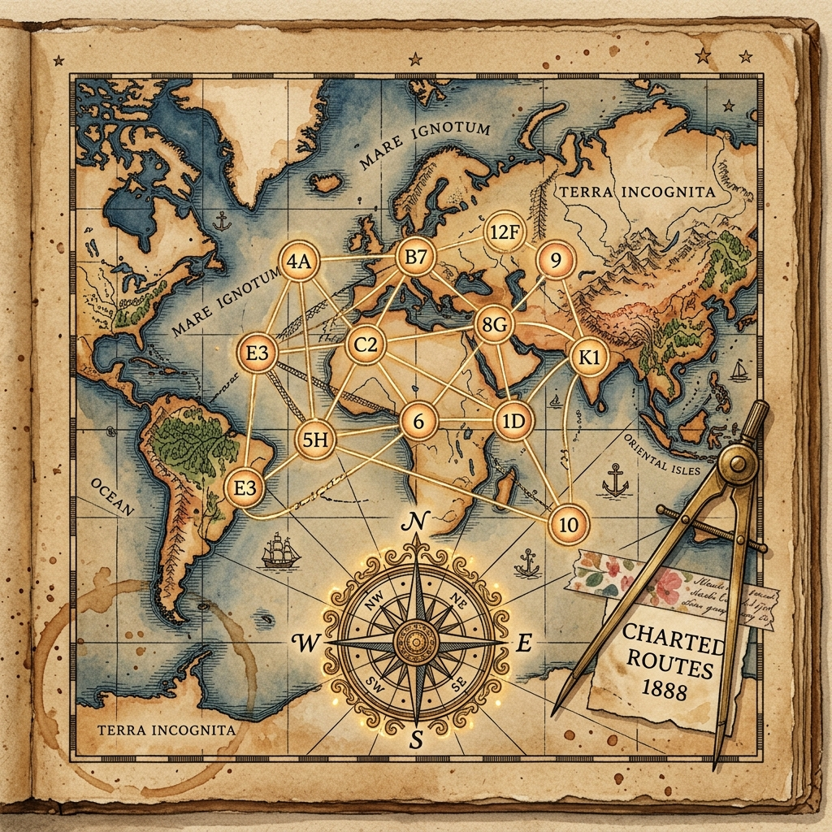
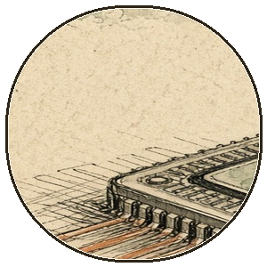
Algorithms & Data Structures · Graph Theory · Group 2
Dijkstra's Algorithm
A scrapbook for anyone who has ever stared at a weighted graph and wondered: “what is the quickest way out of here?”
GREEDY & PROUD
NON-NEGATIVE ONLY
Open the scrapbook ›
Use arrow keys or space to navigate.
Exhibit A: our pathfinding notes after week 4.
01 / 18
"Edsger Dijkstra designed it in 20 minutes without pencil or paper. We took three weeks and cried."

Slide 2
the table of contents, taped down
What's mapped in this notebook
ONE-LINE DEFINITION
Seven topics, one greedy genius, and a solemn vow to never relax an edge into negative territory.
01
Shortest Path Problem
One origin, everywhere to reach: why graphs need compasses.
02
Algorithm Spectrum
Dijkstra vs. BFS vs. Bellman-Ford vs. A* Search.
03
Greedy Philosophy
Always trust the closest unvisited node — lock it in forever.
04
Data Structures & Kit
Distances, visited set, and the almighty priority queue.
05
Edge Relaxation
Discovering a shortcut and celebrating with math.
06
Step-by-Step Trace
Walking through a 5-node graph with zero panic.
07
Complexity & Impact
Arrays, min-heaps, GPS routing, and the negative edge trap.
02 / 18
"I drew the graph. Then I colored the nodes. Then the graph colored me."

Slide 3
a 60-second recap, because context is cute
First: why do graphs need navigation?
ONE-LINE DEFINITION
A graph has vertices (places) and weighted edges (costs). We want the lowest total cost from one start to all other nodes.
Weighted edges as real friction
Edges carry weights: road mileage, fiber latency, flight ticket prices, or energy expended. Cheaper is always better.
Single-source vs. all-pairs
Dijkstra solves Single-Source Shortest Paths (SSSP): you pick one hometown vertex, and it computes optimal paths to every reachable vertex in the universe.
Why brute force dies a painful death
Checking every permutation of paths across a graph leads to exponential factorial explosion. You need a disciplined pruning strategy.
Searching without an algorithm is just walking around in circles.
03 / 18
"The shortest path between two points is rarely a straight line when mountains exist."

Slide 4
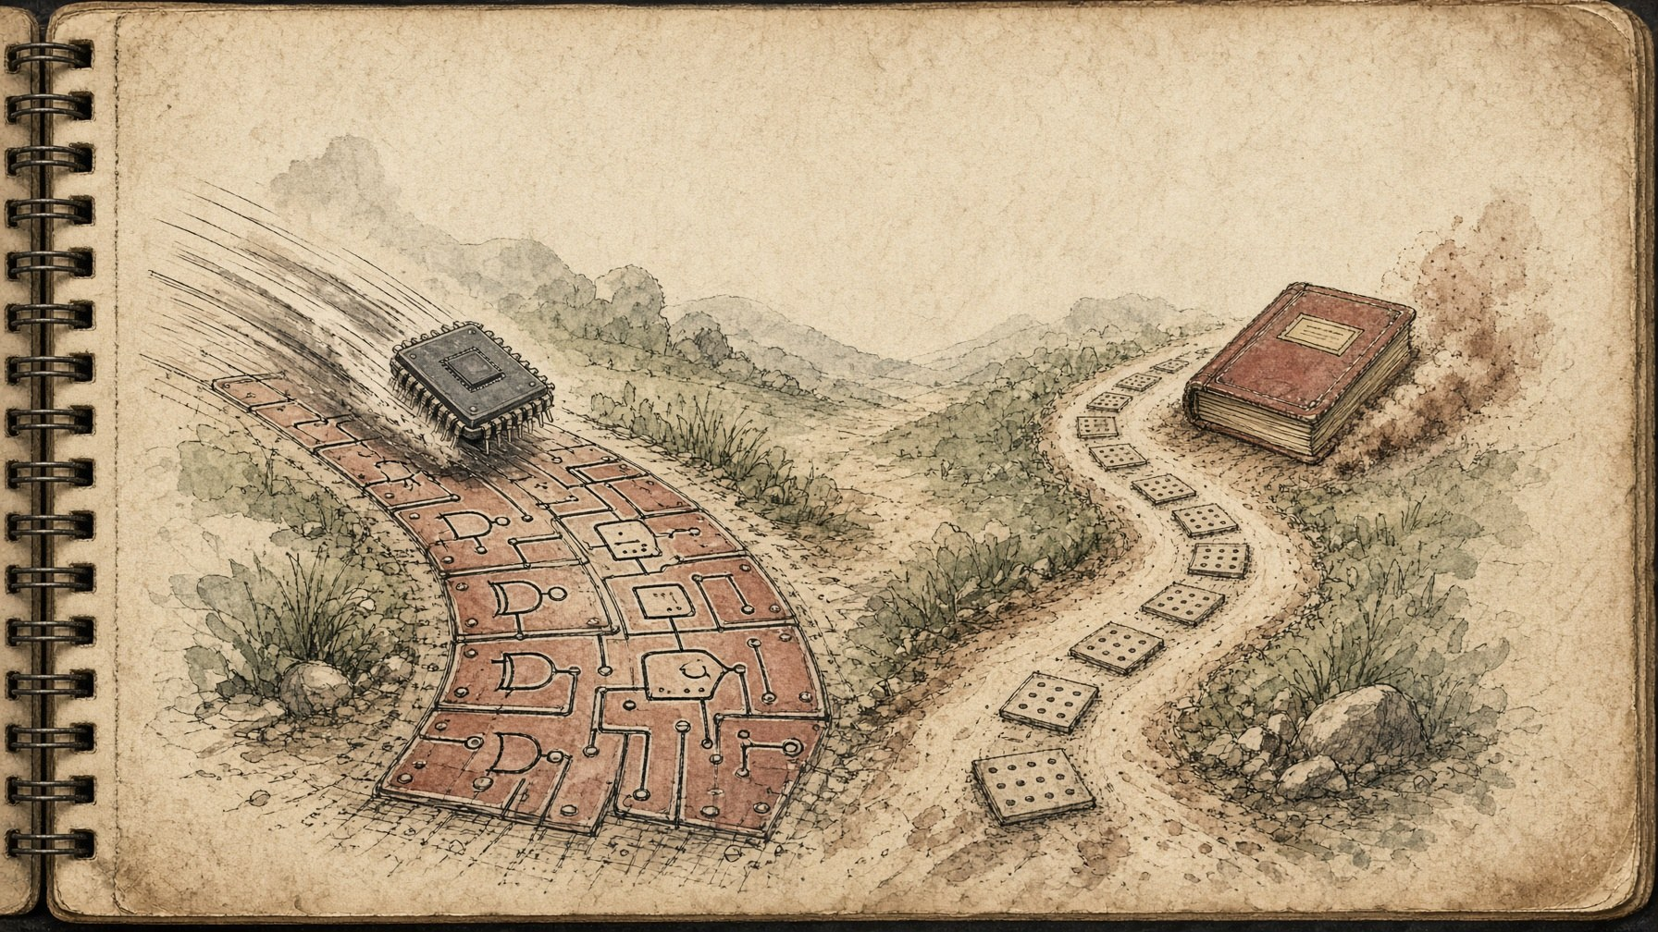
topic 1 · Pathfinding algorithms
Pick your pathfinding flavor
ONE-LINE DEFINITION
BFS, Dijkstra, Bellman-Ford, and A*: choosing your pathfinder depends on edge weights, negative cycles, and whether you have a map compass.
Dijkstra's Algorithm
· Non-negative weighted edges (weights w ≥ 0).
· Greedy selection: locks in closest unvisited node permanently.
· Fast & optimal: O((V + E) log V) with a binary min-heap.
· Radial search: explores equally in all directions without a compass.
Bellman-Ford & A*
· Bellman-Ford handles negative edge weights & detects negative cycles.
· Bellman-Ford is slower: O(V · E), relaxing all edges V-1 times.
· A* Search adds a goal-directed heuristic (h-score) to steer forward.
· Unweighted BFS only works when all edge costs are identical (1).
Left path: greedy speed. Right path: negative weight insurance.
NO NEGATIVES
04 / 18
"Bellman-Ford tolerates debt. Dijkstra demands non-negative cash upfront."

Slide 5
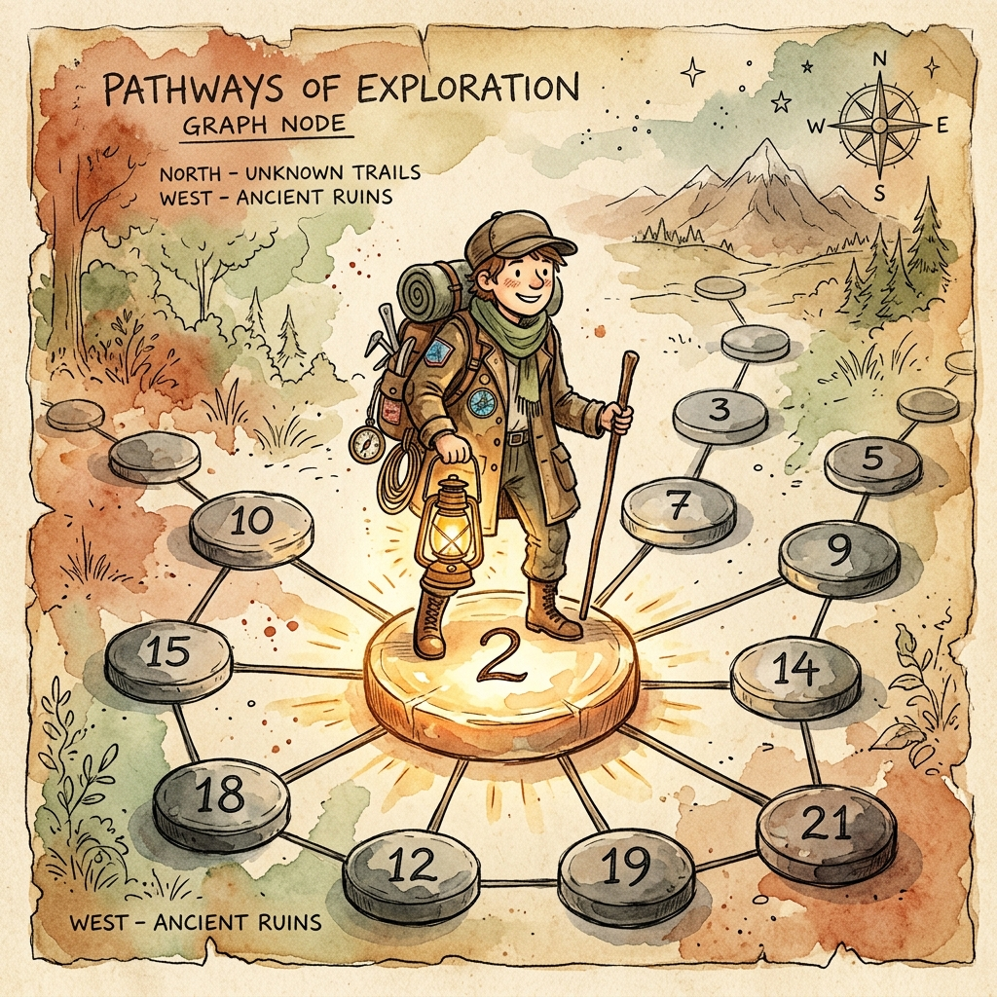
topic 2 · The Greedy Philosophy
The art of being unapologetically greedy
ONE-LINE DEFINITION
At every step, Dijkstra picks the unvisited vertex with the smallest tentative distance, marks it permanent, and never looks back.
The permanent guarantee
Because all edge weights are ≥ 0, any alternative route to the current closest node must take extra steps through other nodes with greater or equal distances. It can never be shorter!
No regrets, no backtracking
Once a vertex is marked visited (settled), its shortest path distance is carved in stone. We never re-evaluate it.
The contract with reality
Greedy choice only holds when edge costs cannot decrease downstream. Negative weights void the entire warranty.
Step onto the closest glowing stone. Trust the math completely.
GREEDY CHOICE
05 / 18
"Greed is good, provided every edge has a non-negative cost."

Slide 6
anatomy hour · the algorithm's data toolkit
Peek inside the pathfinder's toolkit
ONE-LINE DEFINITION
Distance table + visited set + priority queue. That's the entire engine. Everything else is just bookkeeping.
1. Distance Array dist[]
Tracks tentative shortest distances from source. Starts at 0 for source, ∞ for all others.
2. Visited Set visited[]
Boolean set of finalized vertices whose shortest paths are permanently locked in.
3. Priority Queue PQ
Min-heap extracting vertex with minimum tentative distance in O(log V) time.
4. Parent Array parent[]
Stores predecessor vertex on shortest path. Essential for reconstructing the actual path.
5. Adjacency List adj[]
Stores neighbors and edge weights: adj[u] = [(v, cost), ...]. Memory-efficient graph model.
6. Relaxation Logic
If dist[u] + weight(u, v) < dist[v], update dist[v] and push (dist[v], v) into PQ.
Dijkstra's algorithm orchestrates three simple structures. The distance array keeps score, the priority queue picks the next champion, and the relaxation formula updates tentative promises until every reachable node is settled.
06 / 18
"Initialize to infinity. A humble start for any hopeful path."

Slide 7
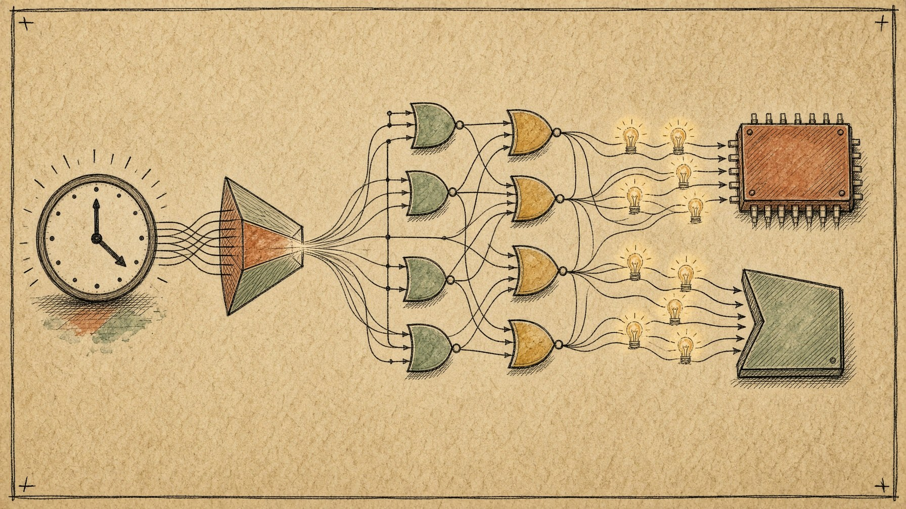
topic 3 · Data structures & setup
Setting up the board before the walk
ONE-LINE DEFINITION
Before the first step, every destination is an infinite mystery, and our starting spot is completely free.
1. Source Vertex
dist[source] = 0. Standing on your own doorstep costs zero gas money.
2. The Uncharted World
dist[v] = ∞ for all v ≠ source. We assume unreachable until proven otherwise.
3. The Min-Heap Queue
PQ.insert((0, source)). Priority queue orders nodes by tentative distance.
4. Empty Visited Set
visited = {}. No vertex is settled until extracted from the priority queue.
Left to right: origin, priority heap, relaxation, settled path.
5. Breadcrumb Pointers
parent[v] = NIL for all v. Path will be rebuilt backwards from destination.
6. Non-Negative Weights
Every edge must satisfy weight(u, v) ≥ 0. Zero is fine; negative is forbidden.
07 / 18
"To travel the world, first accept that everywhere else starts at infinity."

Slide 8
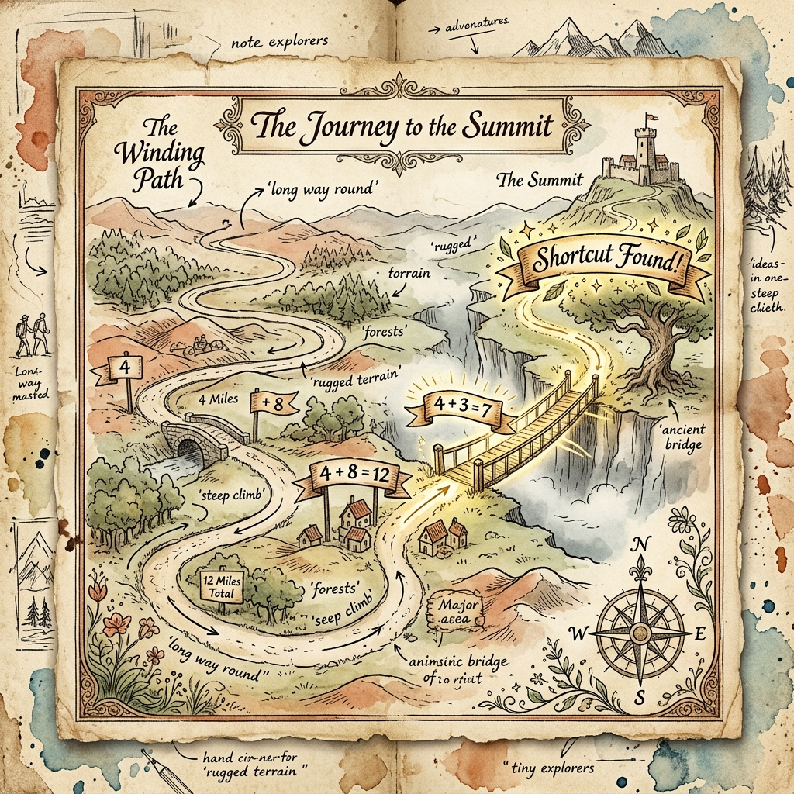
topic 4 · The relaxation step
How a shortcut gets officially adopted
ONE-LINE DEFINITION
Relaxation is the moment you discover: 'Wait, walking through node U to get to V is cheaper than the path I had before!'
The golden inequality
When inspecting edge (u, v) with weight w, we compare: is dist[u] + w < dist[v]? If yes, we found a superior route!
Updating the tentative record
Set dist[v] = dist[u] + w. Node V's distance drops, and we set parent[v] = u to remember who showed us the shortcut.
Alerting the priority queue
Push the new (dist[v], v) into the min-heap. Node V now moves closer to the front of the line for upcoming extraction.
NAPKIN FORMULA: if (dist[u] + w(u, v) < dist[v]) => dist[v] = dist[u] + w(u, v)
Whenever a bridge through current node U beats V's personal best, relax the edge immediately.
Old record: 12. Via node U: 4 + 3 = 7. Shortcut adopted!
08 / 18
"Relaxation in computer science does not involve spas. It involves arithmetic."

Slide 9

topic 5 · Walkthrough example
Meet our 5-node test graph
ONE-LINE DEFINITION
Let's trace Dijkstra step-by-step from Source A across a weighted graph with vertices {A, B, C, D, E}.
The Graph Topology
Vertices A..E. Edges: A-B(4), A-C(2), B-C(1), B-D(5), C-D(8), C-E(10), D-E(2). All edge weights strictly positive.
Step 0: Start at A
Extract A (dist=0). Relax neighbors: dist[B] becomes 4, dist[C] becomes 2. Min-Heap now holds: C(2), B(4).
Step 1: Extract C (dist=2)
Next smallest is C! Relax neighbors: path to B through C is 2+1 = 3 < 4! B is updated to 3. Relax D to 10, E to 12.
Graph blueprint: 5 vertices, 7 weighted bridges, zero negative traps.
TRACE VERIFIED
09 / 18
"C was closer than B, and then C gave B a better discount."

Slide 10
trace deep dive · the execution table
The table that tracks every step
ONE-LINE DEFINITION
Step-by-step evolution of tentative distances. Bold values represent permanently settled vertices.
Step | Pick | dist[A] | dist[B] | dist[C] | dist[D] | dist[E]
Init | — | 0 | ∞ | ∞ | ∞ | ∞
1 | A (0) | [0] | 4 | 2 | ∞ | ∞
2 | C (2) | [0] | 3* | [2] | 10 | 12
3 | B (3) | [0] | [3] | [2] | 8* | 12
4 | D (8) | [0] | [3] | [2] | [8] | 10*
Early Shortcut for B
Direct edge A-B cost 4. But visiting C first (cost 2) + edge C-B (cost 1) drops B's cost to 3!
Cascading Shortcut for D
Path A→C→D cost 10. But going through B gives 3 + 5 = 8, saving 2 units.
Final Destination E
Path A→C→B→D→E gives 8 + 2 = 10, beating direct route A→C→E (12).
ALL SETTLED
10 / 18
"Watch the infinities melt away, row by row."

Slide 11

path reconstruction · backtracking
How to actually retrace your steps
ONE-LINE DEFINITION
Knowing the minimum numerical cost is only half the prize. The parent pointer array lets us reconstruct the exact highway route.
The Parent Array
Whenever an edge (u, v) is relaxed, we record parent[v] = u. This creates a reverse shortest-path tree pointing back toward the source.
Backtracking from Destination
Want the route to node E? Look up parent[E] = D, parent[D] = B, parent[B] = C, parent[C] = A, parent[A] = NIL.
Reverse for Victory
Reversing [E, D, B, C, A] gives the optimal forward path: A → C → B → D → E, with optimal total cost = 10.
Follow the breadcrumb trail backwards. Reverse it. Arrive safely.
BREADCRUMBS
11 / 18
"Store one pointer per vertex. Walk backwards to go forward."

Slide 12
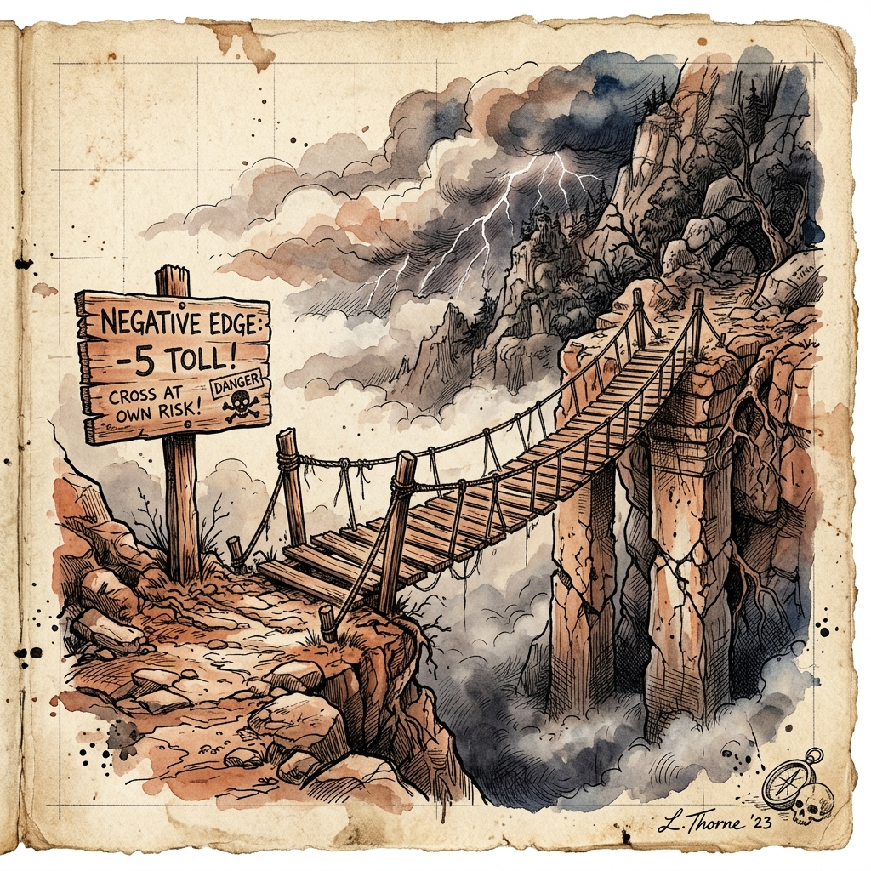
the danger zone · negative weights
The kryptonite: negative edge weights
ONE-LINE DEFINITION
Dijkstra assumes a settled node's distance can never decrease. A negative edge shatters this promise and leads to incorrect answers.
The Broken Greedy Assumption
If edge weights can be negative, taking a longer detour through an unvisited node could end up cheaper than an already 'finalized' node.
The Negative Cycle Black Hole
If a cycle's total edge sum is negative, traversing it infinitely reduces path cost toward -∞. The concept of 'shortest' becomes meaningless!
The Remedy: Bellman-Ford
When negative weights exist, swap Dijkstra for Bellman-Ford. It relaxes all edges V-1 times and detects negative cycles.
A negative edge is a toll booth that pays you to drive through.
DANGER: -W
12 / 18
"Dijkstra doesn't do refunds. If an edge pays you to cross it, call Bellman."

Slide 13
topic 6 · Performance & implementation
Three implementations, three speed tiers
ONE-LINE DEFINITION
How fast Dijkstra runs depends entirely on how you find the minimum unvisited node. Data structure choice makes all the difference.
1. Unordered Array
Time: O(V²)
• Extract-Min: O(V) scan
• Decrease-Key: O(1)
Pros: Very simple; optimal for dense graphs where E ≈ V².
Cons: Terribly slow on massive sparse road networks.
2. Binary Min-Heap
Time: O((V + E) log V)
• Extract-Min: O(log V)
• Decrease-Key: O(log V)
Pros: Standard workhorse; lightning fast on sparse graphs (E << V²).
Cons: Log factor on every relaxation.
3. Fibonacci Heap
Time: O(E + V log V)
• Extract-Min: O(log V) amortized
• Decrease-Key: O(1) amortized
Pros: Theoretically optimal bound.
Cons: High constant factors, complex pointer bookkeeping.
O((V+E) LOG V)
13 / 18
"In theory, Fibonacci heaps are king. In practice, binary heaps take the trophy."

Slide 14
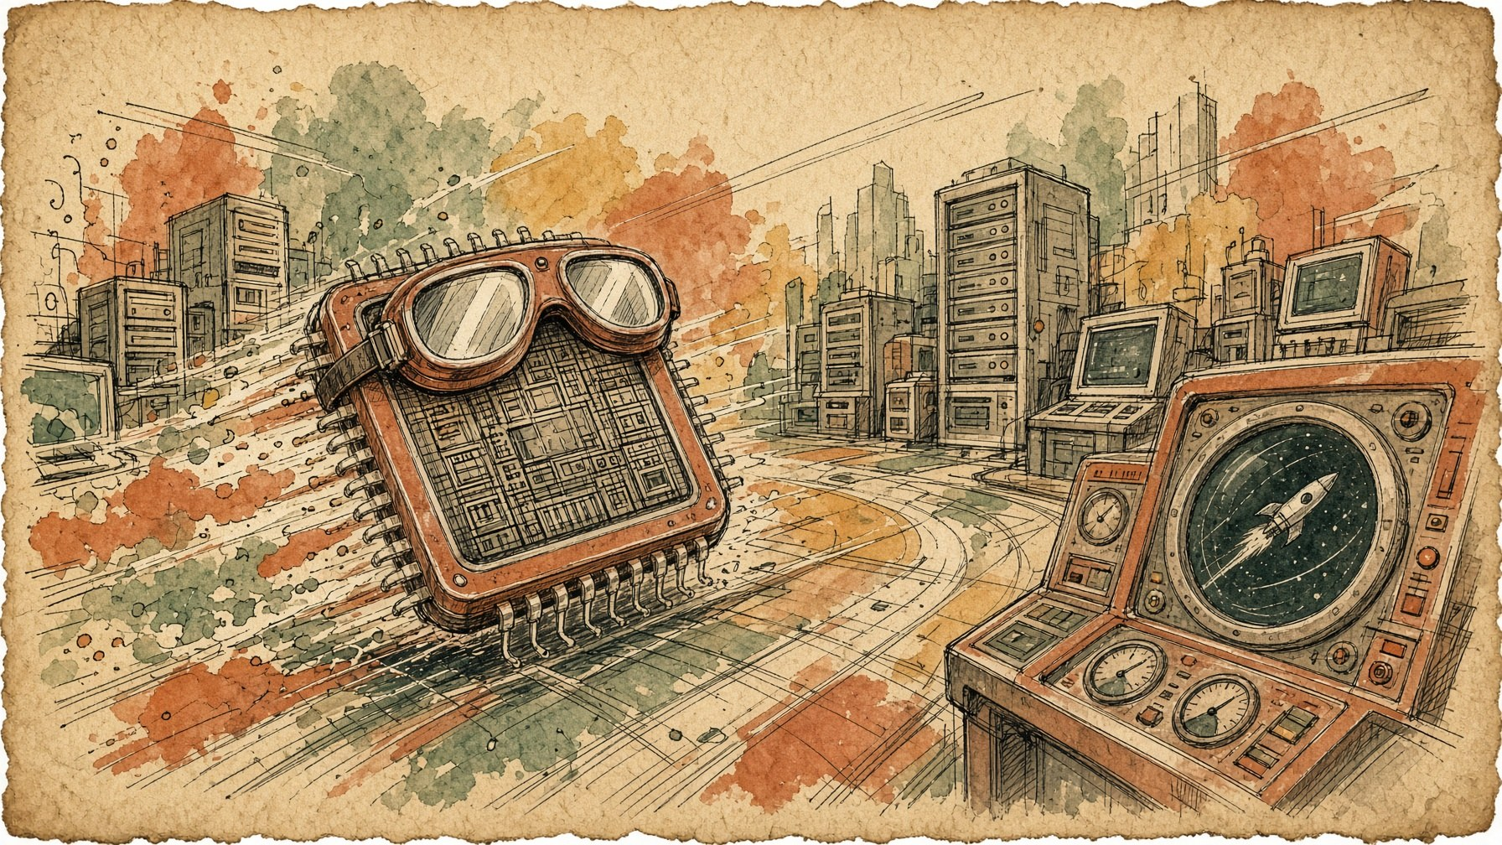
topic 6a · Advantages
Why Dijkstra remains the industry king
ONE-LINE DEFINITION
Decades after its 1956 discovery, Dijkstra's algorithm remains the foundational engine of networking, GPS, and logistics.
Mathematically Proven Optimal
For non-negative edge weights, Dijkstra is strictly optimal. It never settles for approximate paths or risky heuristic shortcuts.
Single-Source, All-Destinations
In a single pass, it computes shortest paths from the source to every reachable node in the entire network.
Near-Linear Efficiency
Paired with a binary min-heap or priority queue, it executes in O((V + E) log V), easily chewing through millions of graph nodes.
Decades old, yet still running the internet routing table under the hood.
PROVEN OPTIMAL
14 / 18
"Simplicity plus mathematical proof equals 70 years of dominance."

Slide 15

topic 6b · Limitations
The fine print in the pathfinder's contract
ONE-LINE DEFINITION
Fast and optimal, but completely blind to spatial direction and strictly allergic to negative numbers.
Blind Radial Expansion
Dijkstra searches in all directions equally like ripples in a pond. Even if your destination is North, it patiently checks South and West first.
Negative Edge Allergy
A single negative edge breaks the greedy correctness guarantee. It will happily return sub-optimal paths without throwing an error.
Memory Footprint at Scale
Storing millions of road segments, distance arrays, and priority queues in RAM requires massive memory caching and graph partitioning.
Dijkstra expands in concentric circles. A* shines a directional flashlight.
BLIND SEARCH
15 / 18
"It will find the shortest path to Paris by also carefully checking Munich."

Slide 16
topic 6b · Limitations
The fine print in the pathfinder's contract
ONE-LINE DEFINITION
Fast and optimal, but completely blind to spatial direction and strictly allergic to negative numbers.
Blind Radial Expansion
Dijkstra searches in all directions equally like ripples in a pond. Even if your destination is North, it patiently checks South and West first.
Negative Edge Allergy
A single negative edge breaks the greedy correctness guarantee. It will happily return sub-optimal paths without throwing an error.
Memory Footprint at Scale
Storing millions of road segments, distance arrays, and priority queues in RAM requires massive memory caching and graph partitioning.
Dijkstra expands in concentric circles. A* shines a directional flashlight.
BLIND SEARCH
15 / 18
"It will find the shortest path to Paris by also carefully checking Munich."

Slide 17
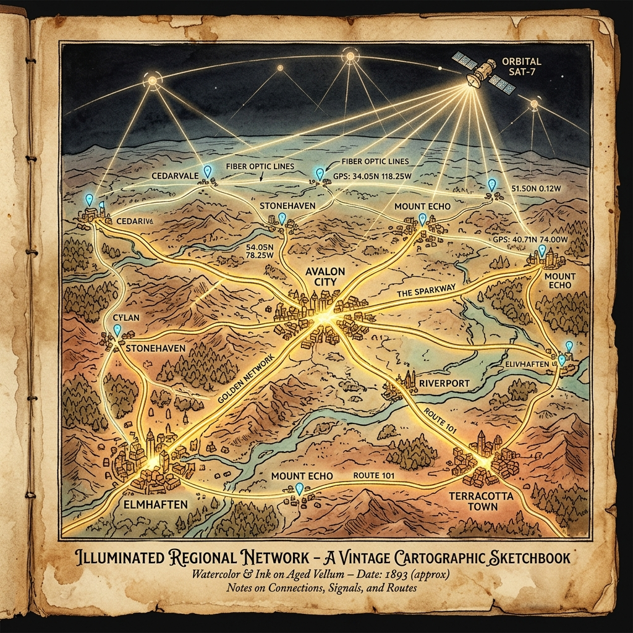
topic 7 · Applications
Where Dijkstra actually directs traffic
ONE-LINE DEFINITION
From your fiber-optic router packets to your Friday night pizza delivery navigation route.
1. Internet Routing Protocols
OSPF (Open Shortest Path First) and IS-IS use Dijkstra's SPF algorithm to calculate shortest router hops across global backbones.
2. GPS & Road Navigation
Google Maps and OpenStreetMap use Dijkstra and its bidirectional A* variants for turn-by-turn routing across road networks.
3. Telecom & Fiber Latency
Telecommunication carriers route voice and high-frequency trading data through minimum-latency fiber optic cable paths.
4. Robotics & Game AI
Grid path planning for autonomous factory rovers, drone delivery routes, and game NPC navigation on 3D navmeshes.
Natural habitat: any system where arriving late costs millions.
IN PRODUCTION
16 / 18
"Every time your packet hops across three continents, thank Edsger."

Slide 18
the fridge door
Stick this on the fridge
ONE-LINE DEFINITION
If you remember four things from this deck, remember these four things.
1
Greedy core: Settle the closest unvisited node permanently, relax its neighbors, and repeat.
What
Single-Source Shortest Path algorithm for non-negative weighted graphs.
2
Strict non-negative rule: Weights must be ≥ 0. A single negative edge shatters the optimality proof.
Who
Edsger W. Dijkstra in 1956 (demonstrating the ARMAC computer).
3
The relaxation formula: If dist[u] + w(u, v) < dist[v], update dist[v] and set parent[v] = u.
How
Min-heap priority queue + edge relaxation + parent pointer backtracking.
4
Complexity sweet spot: O((V + E) log V) with a binary min-heap — lightning fast for sparse real-world graphs.
Why / Why not
Guaranteed optimal and fast; but blind radial search and zero negative tolerance.
17 / 18
"If it's positive, it's optimal. If it's negative, it's chaos."

Slide 19

Group 2 · Algorithms & Data Structures
That's a wrap — the optimal kind
Questions? We relax them. The shortest path to clarity begins with the nearest unvisited microphone.
COST = MIN
OPTIMAL PATH
Path settled. Total cost minimized. Next graph, please.
18 / 18
"Applause is a non-negative edge weight. Please add it to our score."

