Slide 1
Department of Information Science & Engineering
Project Based Learning
Text Summarizer
Presented By
Abhishek Shankar 1BY20IS009
Ajay V Kamath 1BY20IS016
Akanksh P N 1BY20IS017
C B Suraj Krishnan 1BY20IS044
Under the guidance of
Dr. Mohan B A
2022-23
ODD Semester

Slide 2
Contents
Introduction
Objectives
Literature Survey
Proposed Methodology
System Architecture / Design
Context Model
Implementation
Screenshots
Future Scope / Enhancement

Slide 3
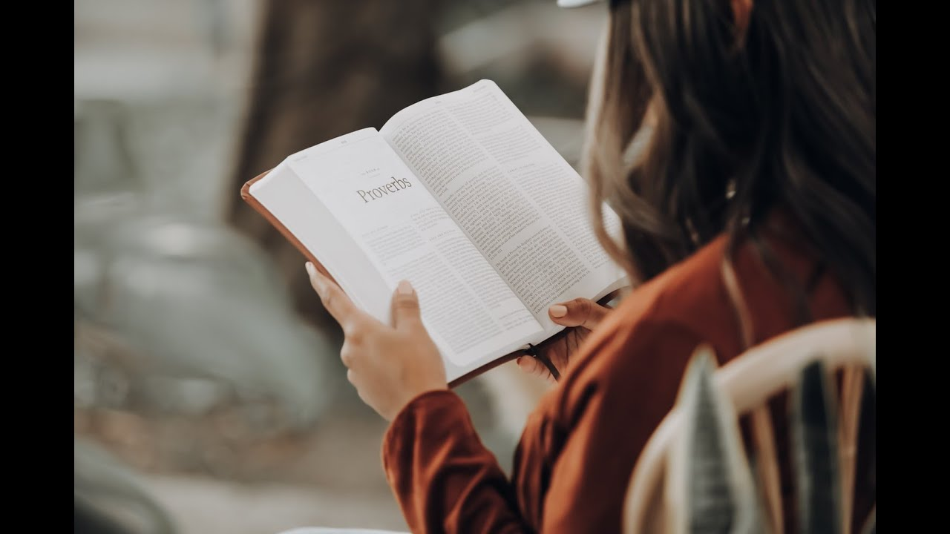
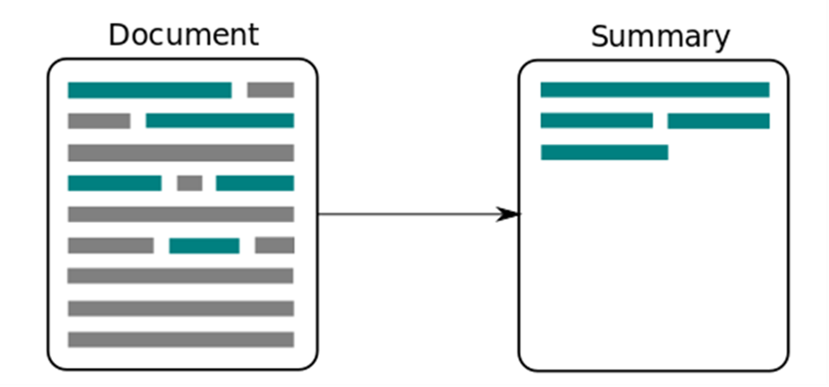
Introduction
Reading entire texts is time consuming
Reading only the key points saves time
Long text can be summarized to short paragraphs to reduce the size of article, yet retaining its meaning and purpose

Slide 4



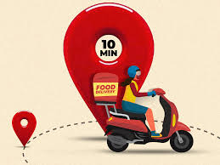








Slide 5
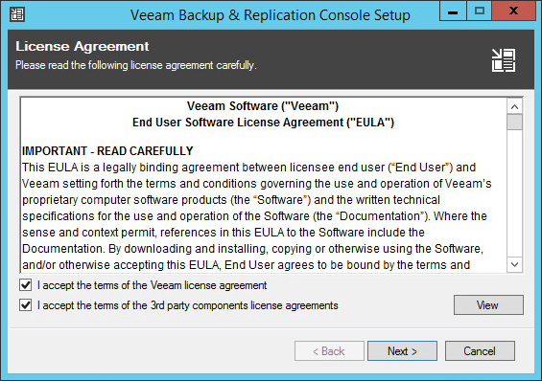
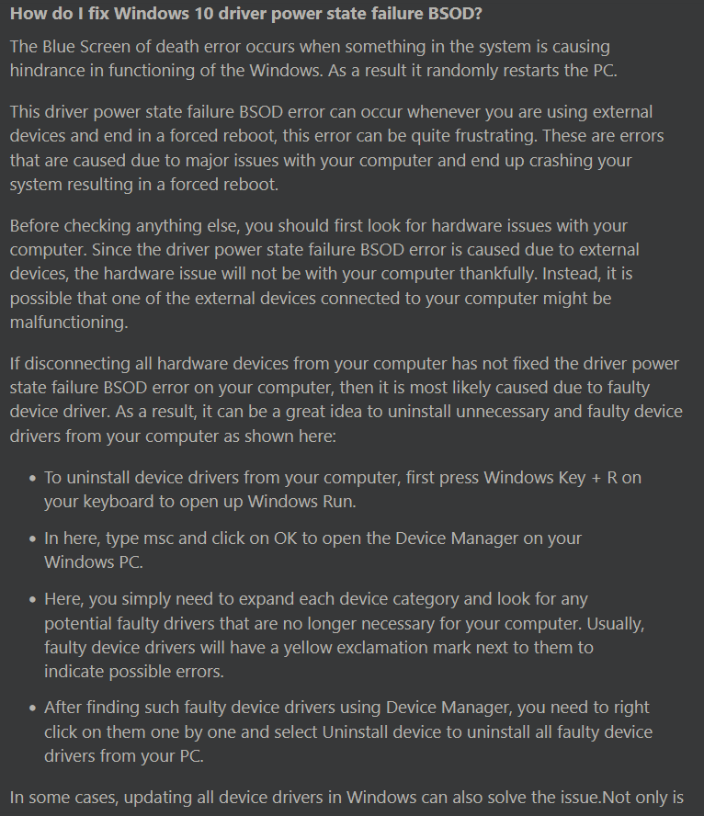

Slide 6
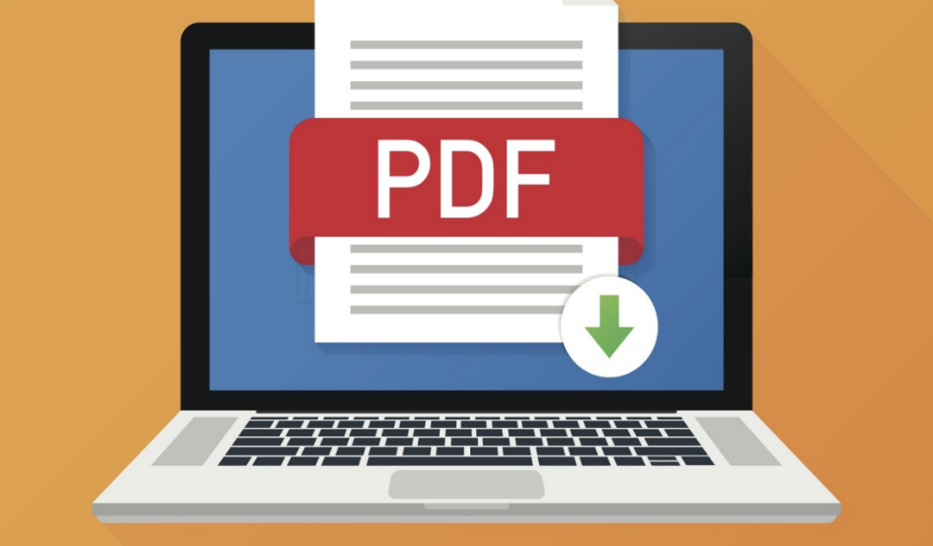
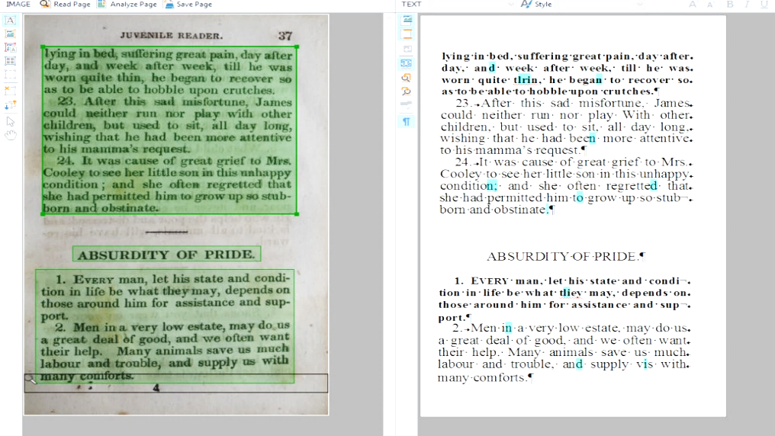
Objectives
Provide easy to use interface
Text sources: pdf, images, plain text and URL.
Clean the text
It Identify the important information and remove redundant and unimportant words
Summarize the given text source
Produce systematic output

Slide 7
Proposed Methodology
The project is set to offer 4 features, a regular text summarizer with text for input, a PDF
summarizer, an Image summarizer, and a website summarizer.
Text Summarization – transformers model is used to summarize
PDF summarizer – handle pdf using pdf2image and perform OCR using Tesseract
Image summarizer –perform OCR using Tesseract and summarize text
Website summarizer –Scrape text from website using BeautifulSoup and summarize that text

Slide 8
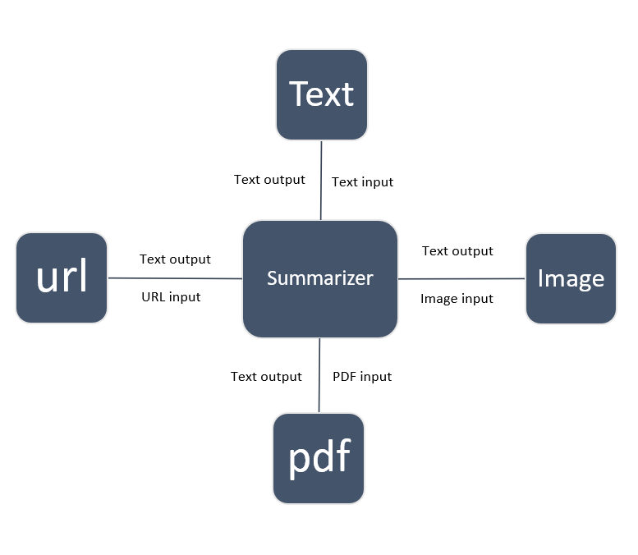
Context Diagram

Slide 9

Implementation
Functional requirements
Provide precise summary
Ability to take image, pdf, plaintext and URL as input
Web based interaction
Provide output in copyable format
Non functional requirements
Must return summary quickly
Data security
Must be efficient
Easy to use interface
Portability

Slide 10


Implementation
Hardware requirements
Memory: Minimum 8gb ram.
Processor: Intel i5 8th gen/AMD Ryzen 5 or above.
Storage: 500MB free disk space
Optional: Graphics card(for faster processing)
Software requirements Python 3.8 and above.
Web browser Tesseract-OCR v5.03 Python libraries:
pytesseract
Transformers
PIL
Pdf2image
BeautifulSoup
flask

Slide 11
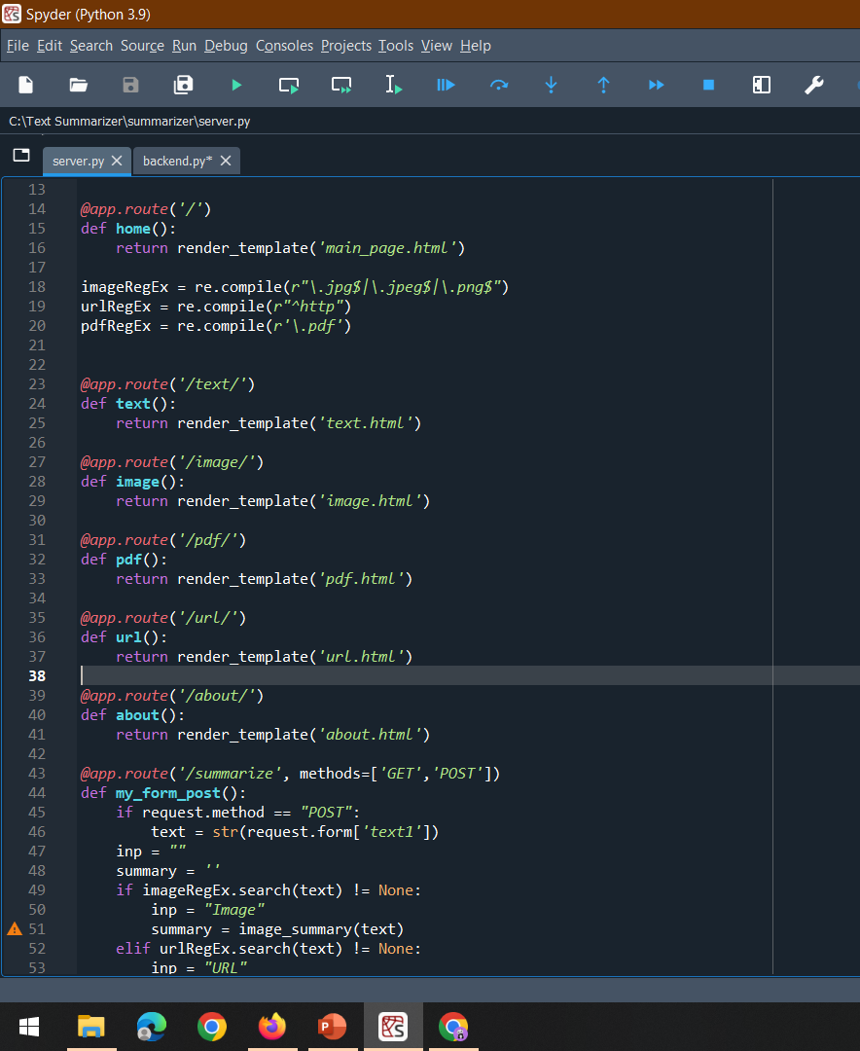
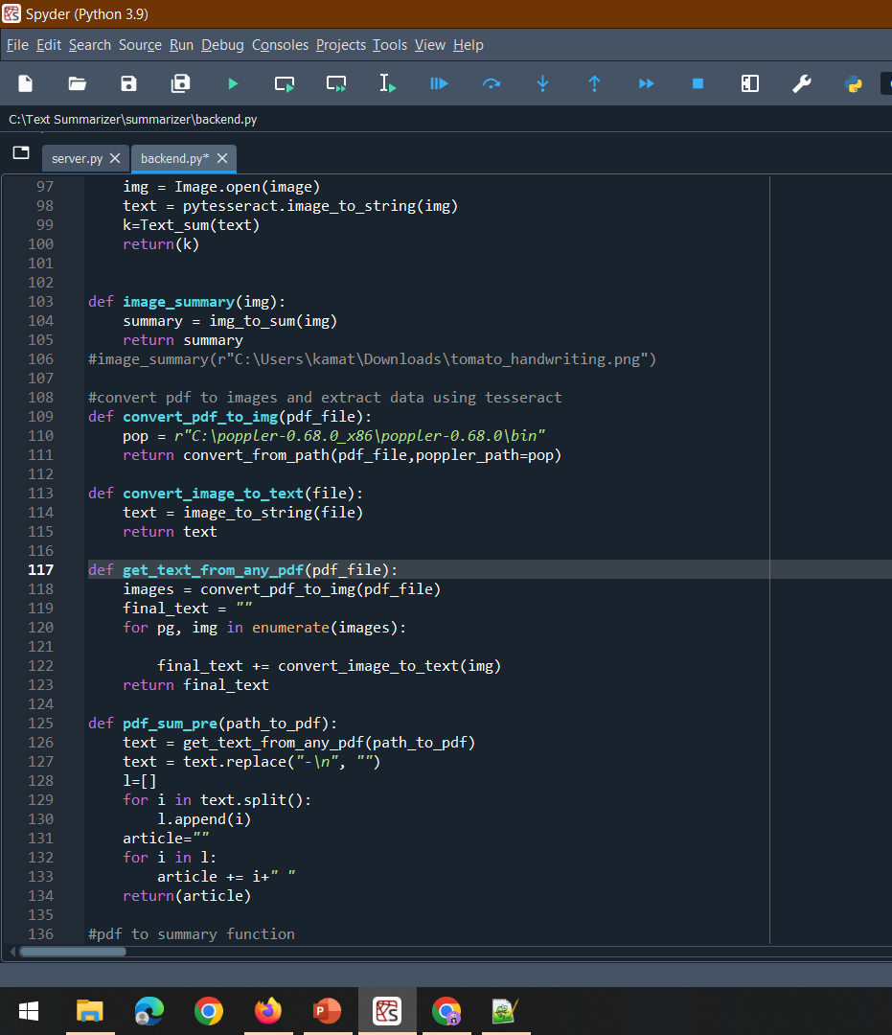
Screenshots

Slide 12
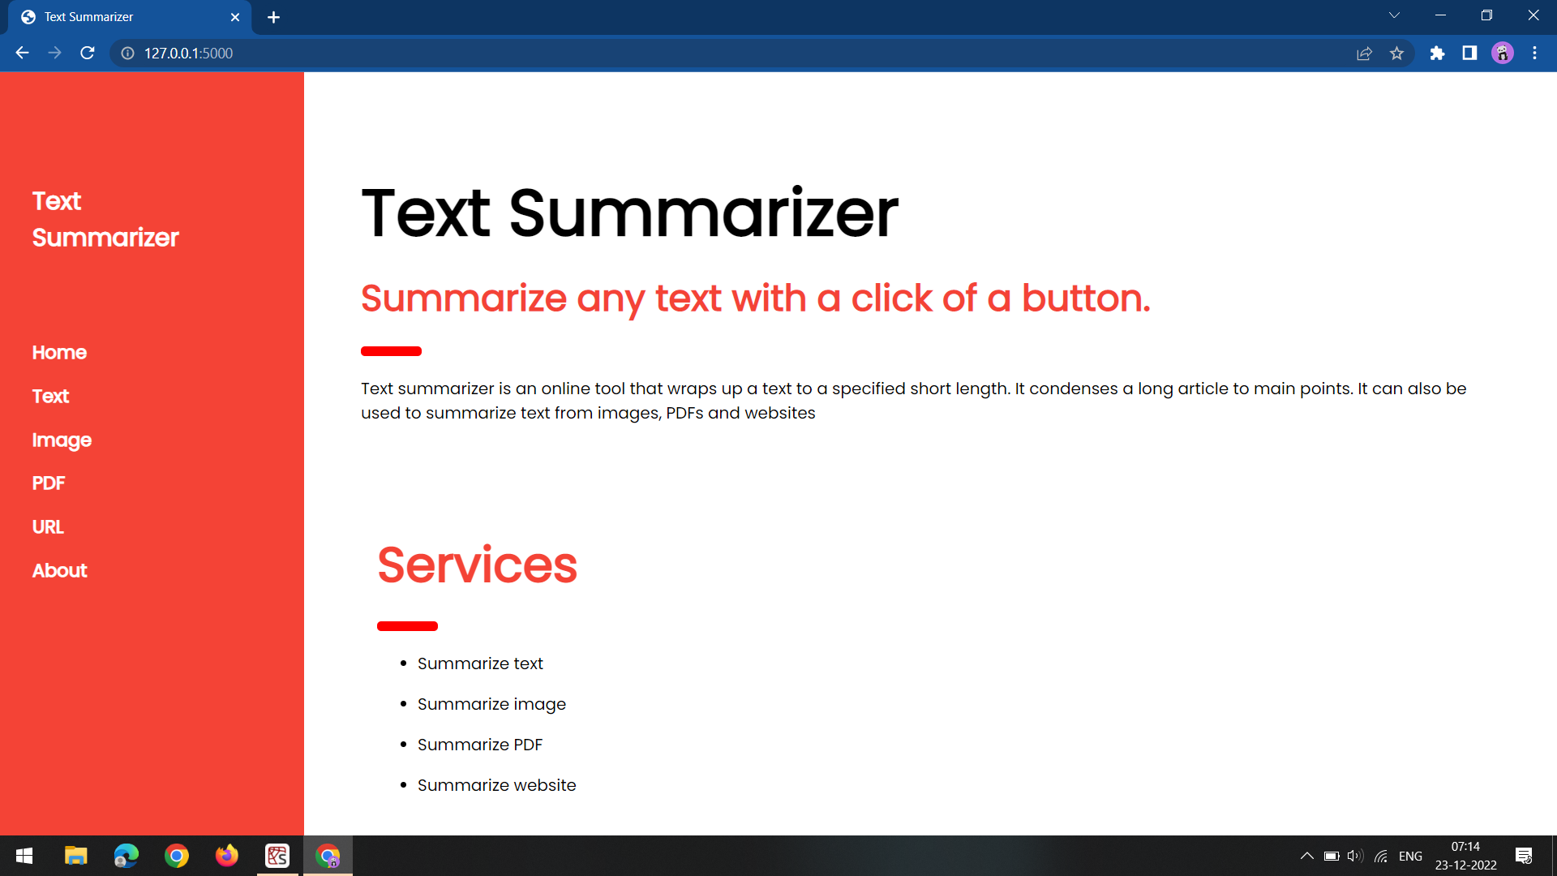
Screenshots

Slide 13
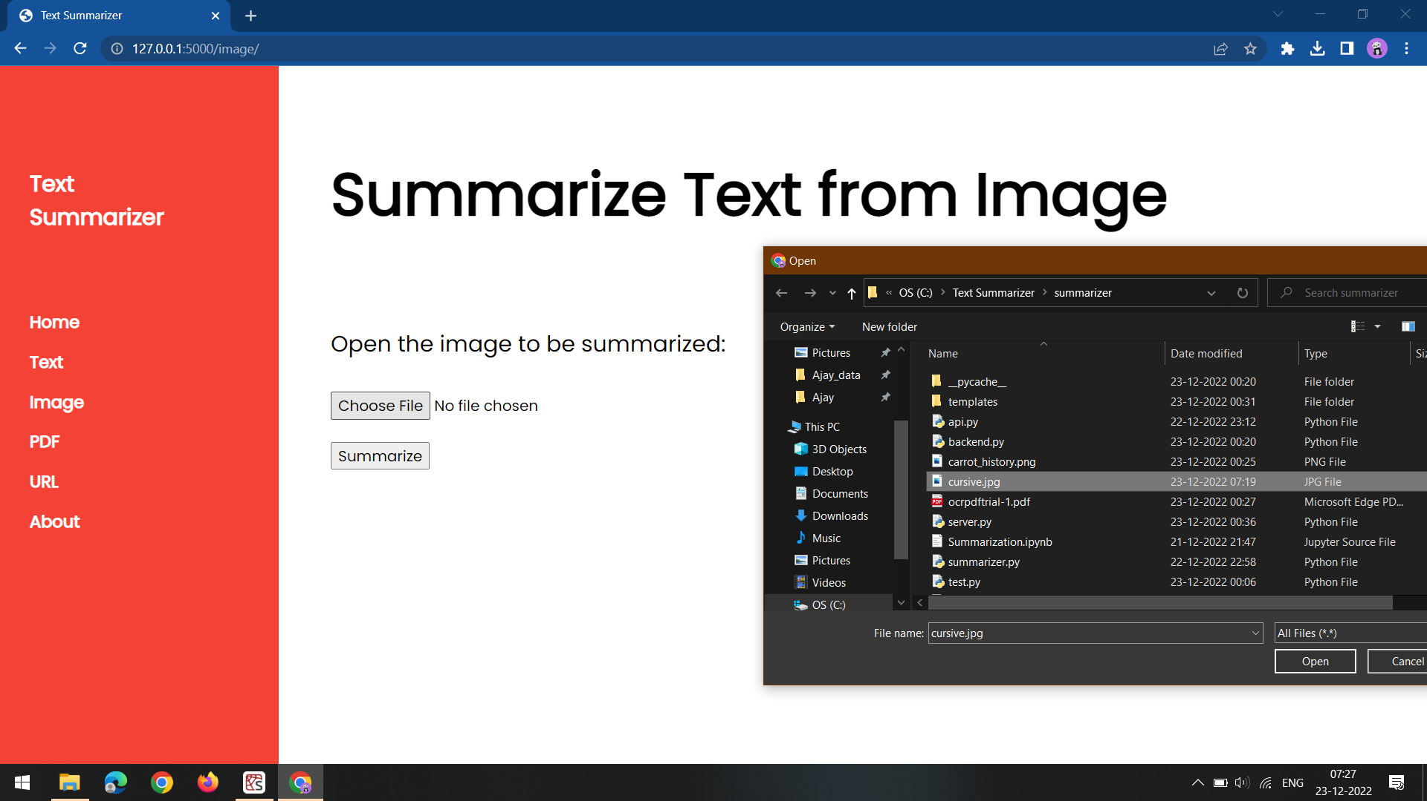
Screenshots

Slide 14
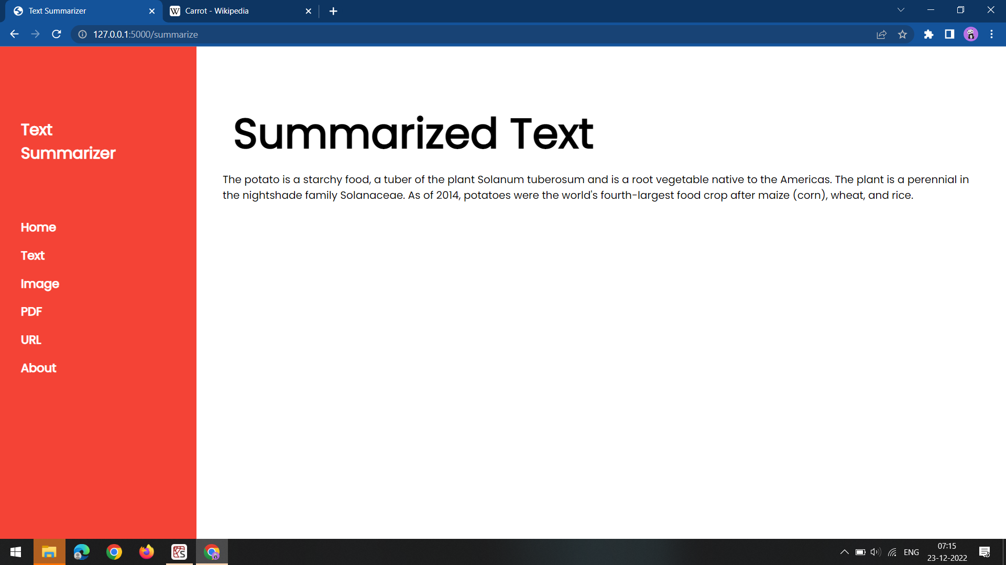
Screenshots

Slide 15
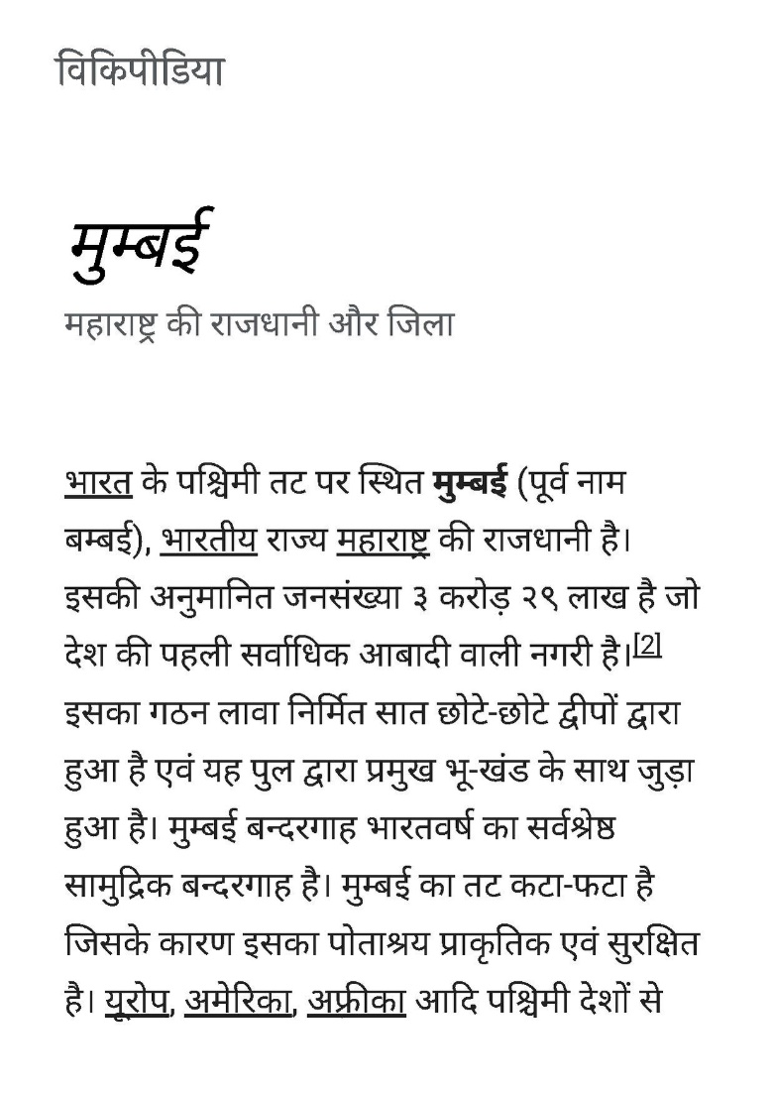
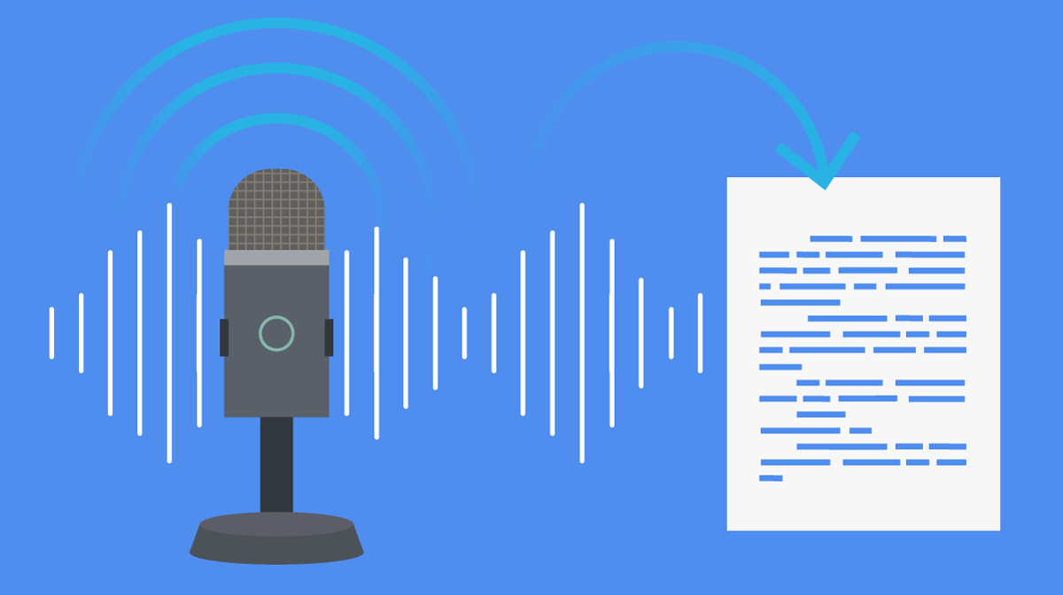
Future Scope/ Enhancement
Multiple page summarization.
Customized summary
Add voice or speech as an input
Summarize text from other languages
Make a mobile app
Web extension for on-the-go website summarization

Slide 16
Conclusion
We have developed a solution that satisfies the following requirements:
Summarize text
Create web based interface
Accept input from various sources
Show systematic output
Produce output in 5-10 seconds

Slide 17
Thank you

