Slide 1

MSR INSIGHT – ACADEMIC PLATFORM
DEPT. OF ISE
Guided By:
PRATHIMA M. N.
KARTHIK S POOJARY (1MS23IS051)
AJAY KUMAR S (1MS24IS400)
AKASH SHIVANAND NAVANI (1MS24IS402)
AKSHAY KUMAR (1MS24IS403)

Slide 2
Introduction
MSR Insight is an industry-grade, AI-powered academic reporting platform developed to automate the generation of professional and insight-driven student performance reports.
• Seamlessly ingests academic scores, attendance records, and behavioural data
• Processes information through a sophisticated Intelligence Service
• Outputs professional, high-fidelity A4-formatted reports with AI-generated feedback
• Features a Retrieval-Augmented Generation (RAG) assistant for proctors
• Fosters academic excellence through intelligent analytics

Slide 3
Motivation and Scope
Motivation
Reduce workload for faculty and proctors.
Improve accuracy and consistency in reporting.
Enhance transparency between institution and parents.
Enable early academic intervention for students.
Scope
Automated processing of marks and attendance data.
Intelligent comment generation based on performance patterns.
Report creation in digital format (HTML/PDF/Email).
Email delivery to parents through integrated mail system.
Conversational Access about students
Scalable to institutional databases in future phases.

Slide 4
Challenges and Issues
Existing systems store marks but do not analyze performance trends.
No automated identification of low attendance or weak subjects.
Reports lack personalized smart comments.
Report generation remains manual and fragmented.
No unified integration of:
marks
attendance
proctor feedback
parental notification
No automated email dispatch mechanism.
Proposed project fills these gaps through intelligent end-to-end automation.

Slide 5
Problem Statement
Educational institutions manage large volumes of student academic data, including attendance records, assessment scores, examination results, and historical performance information. However, accessing and consolidating this data often requires navigating multiple portal pages and manually compiling information into reports. This process is time-consuming, inefficient, and places a significant administrative burden on proctors and faculty members, particularly when managing large groups of students.
Beyond report preparation, existing systems provide limited support for performance analysis and student monitoring. The absence of automated data collection, intelligent analytics, personalized feedback generation, and centralized access to academic information makes it difficult to identify performance trends, support data-driven mentoring, and deliver timely reports to students and parents. Therefore, there is a need for an integrated, AI-powered academic reporting platform that automates data acquisition, generates professional performance reports, provides actionable insights, and enables efficient academic management through intelligent analytics and conversational data access.

Slide 6
Objective
Real-Time Student Data Scraping and Analytics
Automate Academic Performance Analysis
Provide Personalized Student Monitoring
Generate Professional Academic Reports
Automate Parent Communication
Enable Conversational Access to Academic Data
Enhance Proctoring and Mentorship
Minimize manual intervention and human error.

Slide 7
Literature Review
Sl No | Title of Paper | Methodology / Tools Used | Observation | Limitation
1 | Retrieval-Augmented Generation | RAG Framework, Dense Vector Retrieval, Neural Retriever | Improves factual accuracy and reduces hallucinations | Retrieval overhead
2 | Classifier Chains for Multi-Label Classification | Classifier Chains, Multi-label Learning | Captures relationships between academic metrics | Increased model complexity
3 | Llama Foundation Models | Transformer Architecture, RLHF, Prompt Engineering | Generates context-aware responses | Requires careful prompt design
4 | Educational Data Mining Review | Data Mining, Predictive Analytics | Identifies learning patterns | Data quality dependency
5 | Automated Data Extraction in Education | Web Scraping, DOM Parsing | Automates academic data collection | Portal structure changes

Slide 8
Sl No | Title of Paper | Methodology / Tools Used | Observation | Limitation
6 | Generative Language Models in Pedagogy | LLMs, AI Feedback Systems | Enhances personalized feedback | Possibility of hallucination
7 | Analytics in Learning and Education | Learning Analytics, Dashboards | Supports proactive interventions | Requires continuous updates
8 | Predictive Modeling using RNN | Recurrent Neural Networks | Predicts student trends | Training complexity
9 | Attention Is All You Need | Transformer, Self-Attention | Improved contextual understanding | High computational cost
10 | Long Short-Term Memory Networks | LSTM, Time-Series Prediction | Captures long-term dependencies | Slower than Transformers

Slide 9
Sl No | Title of Paper | Methodology / Tools Used | Observation | Limitation
11 | Multi-Label Classification of Student Metrics | Behavioral Analytics | Provides richer student profiles | Complex data representation
12 | Microservices for Scalability | Service-Oriented Architecture | Improves scalability | Deployment complexity
13 | Microservices Architecture Definition | Distributed Systems, REST APIs | Enhances fault tolerance | Service coordination challenges
14 | Design Patterns for Reusable Software | Factory, Singleton, Observer | Improves maintainability | Learning curve
15 | REST Architectural Styles | REST APIs, Stateless Communication | Enables scalable web systems | Network dependency

Slide 10
Sl No | Title of Paper | Methodology / Tools Used | Observation | Limitation
16 | Security and Privacy in Web Scraping | Secure Scraping, Access Control | Protects sensitive data | Ethical concerns
17 | JSON Media Type Standard | JSON Data Exchange Format | Simplifies interoperability | Limited validation support
18 | RESTful Service Performance Evaluation | Caching, Connection Pooling | Improves response time | Infrastructure overhead
19 | LLMs in Academic Feedback Generation | Prompt Engineering, Context Injection | Produces meaningful feedback | Risk of inaccurate responses
20 | Database Systems: The Complete Book | Normalization, Indexing, SQL | Supports data integrity | Database management complexity

Slide 11
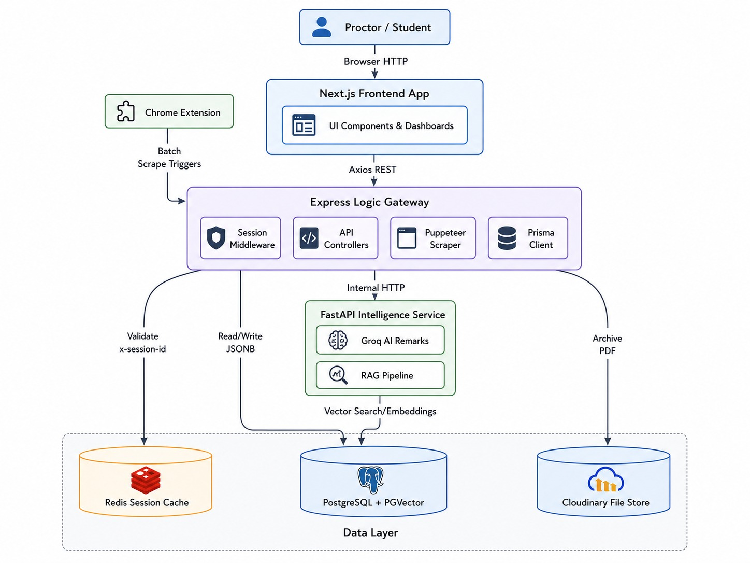
Methodology

Slide 12
Results and Discussion
Automated Student Data Collection
Performance Analysis Dashboard
Professional Report Generation
RAG-Based Proctor Assistant
Enhanced Student Monitoring
Automated Parent Communication
Secure and Scalable System Architecture

Slide 13
Conclusion
Successfully automated the academic evaluation and reporting process.
Reduced manual effort and administrative workload for educators.
Implemented an AI-powered platform for intelligent academic analytics.
Integrated RAG, Gemini, and Llama 3.1 for contextual insight generation.
Enabled natural language querying through the Proctor Assistant.
Generated personalized and actionable student performance reports.
Improved scalability and performance using a modern microservice architecture.
Enhanced academic monitoring and decision-making through data-driven insights.
Provided a secure and user-friendly system for students and proctors.
Established a foundation for future AI-driven educational analytics solutions.

Slide 14
REFERENCES
[1] Lewis et al., Retrieval-Augmented Generation for Knowledge-Intensive NLP Tasks (2020)
[2] Read et al., Classifier Chains for Multi-Label Classification (2011)
[3] Touvron et al., Llama 2: Open Foundation and Fine-Tuned Chat Models (2023)
[4] Romero & Ventura, Educational Data Mining: A Review of the State of the Art (2010)
[5] Smith et al., Automated Data Extraction in Educational Environments (2021)
[6] Gupta et al., Generative Language Models in Pedagogy (2023)
[7] Siemens & Long, Penetrating the Fog: Analytics in Learning and Education (2011)
[8] Johnson & Lee, Predictive Modeling of Student Trajectories using RNN (2022)
[9] Vaswani et al., Attention Is All You Need (2017)
[10] Hochreiter & Schmidhuber, Long Short-Term Memory (1997)

Slide 15
[11] Chen & Davis, Multi-Label Classification of Student Behavioral Metrics (2020)
[12] Dragoni et al., Microservices: How To Make Your Application Scale (2017)
[13] Fowler & Lewis, Microservices: A Definition of This New Architectural Term (2014)
[14] Gamma et al., Design Patterns (1994)
[15] Fielding & Taylor, Architectural Styles and the Design of Network-Based Software Architectures (2002)
[16] Dubey & Sharma, Security and Privacy in Web Scraping (2017)
[17] Crockford, The Application/JSON Media Type for JavaScript Object Notation (2006)
[18] Kim & Smith, Performance Evaluation of RESTful Web Services in Microservice Architecture (2021)
[19] Zheng et al., Application of Large Language Models in Academic Feedback Generation (2023)
[20] Garcia-Molina et al., Database Systems: The Complete Book (2008)

Slide 16
Thank You

