Slide 1
PUBSUB
Ajay Kumar
Ramya Chander

Slide 2
SOFTWATE TOOLS
Language : Python
Framework : Django Protocol : MQTT
Library : paho-mqtt

Slide 3
What is MQTT?
Message Queuing Telemetry Transport
MQTT is a machine-to-machine messaging protocol, designed to provide lightweight Publish/Subscribe communication to "Internet of Things" devices. It is commonly used for geo-tracking fleets of vehicles, home automation, environmental sensor networks, and utility-scale data collection. MQTT invented by IBM.
Mosquito is a message broker that implements the MQTT protocol.

Slide 4
Methods in MQTT
Connect -Waits for connection to be established with the server.
Disconnect – Waits for the MQTT client to finish any work, which needs to be done and for the TCP/IP session to disconnect.
Subscribe – Requests the server to let the client subscribe to one or more topics.
Unsubscribe – Requests the server to let the client unsubscribe from one or more topics.
Publish – Returns immediately to application thread after passing request to the MQTT client.

Slide 5
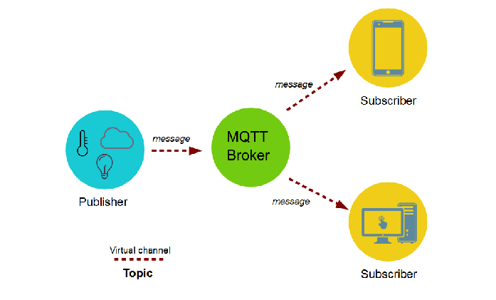
Message Queuing Telemetry Transport

Slide 6
Advantage/Disadvantage of MQTT
Advantage
High latency
Low bandwidth or unreliable network
Disadvantage
It operates over TCP/IP
Broker can limit the scale

Slide 7
How PUBSUB Works?
Django
User
Topic
Subscribe
Publish
Message
DataBase
MQTT
Broker/
Mosquito

Slide 8
Real Time MQTT
Facebook has used aspects of MQTT in its Messenger.

Slide 9
THANK YOU

