Slide 1


2007 Nobel Peace Prize
Climate Change as a Global Peace Issue
Recognizing the groundbreaking contributions of the IPCC and Al Gore in raising awareness about humanity's greatest environmental challenge.
Notes:
1

Slide 2

A Historic Recognition
The Nobel Committee's Decision
In October 2007, the Norwegian Nobel Committee made history by awarding the Peace Prize to climate science. For the first time, environmental threats were recognised as fundamental threats to global peace and security.
This marked a pivotal moment when climate change moved from scientific journals to the world's most prestigious peace platform.
Notes:
2

Slide 3
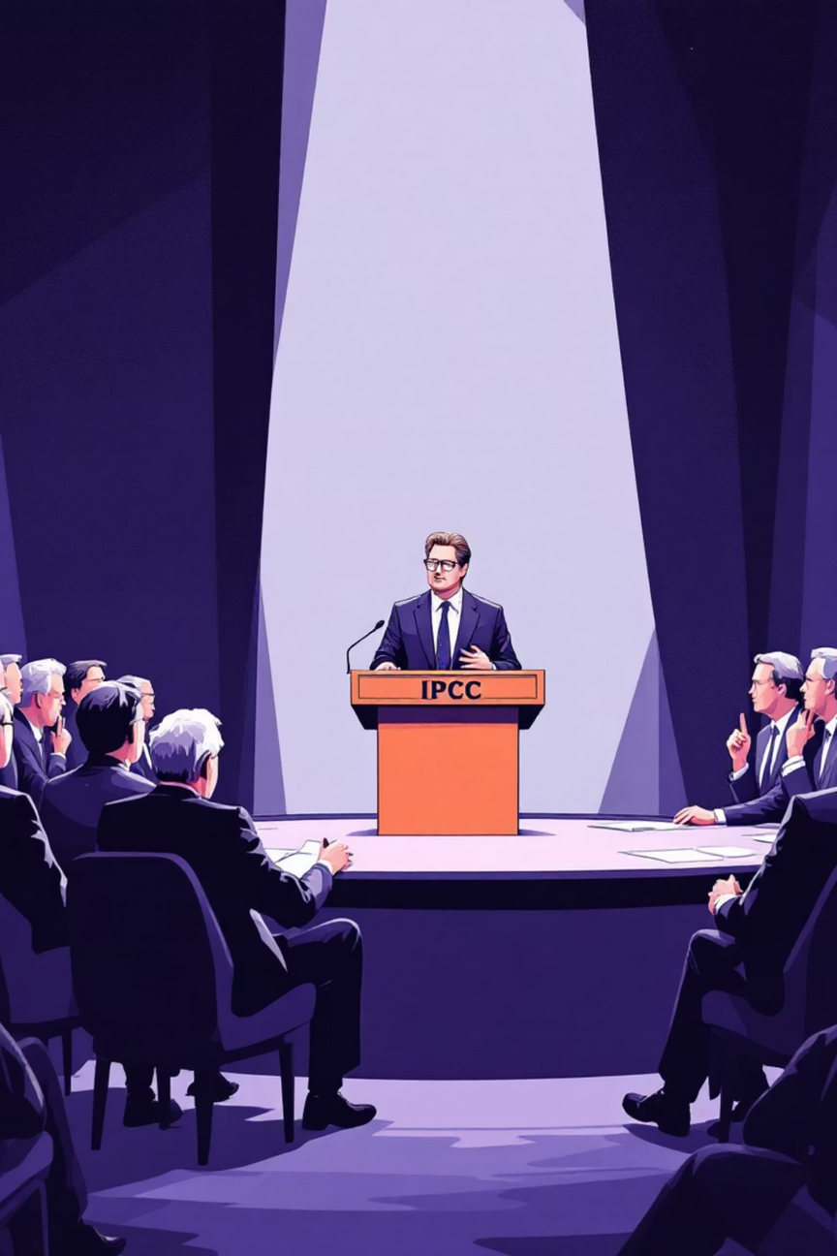
The Dual Recipients
Intergovernmental Panel on Climate Change
Thousands of scientists from 195 countries collaborating to assess climate science with unprecedented rigour and consensus.
Albert Arnold Gore Jr.
Former US Vice President turned environmental activist, filmmaker, and passionate advocate for climate action worldwide.
Notes:
3

Slide 4

Why Climate Change Threatens Peace
Resource Scarcity
Mass Migration
Economic Instability
Rising temperatures and changing precipitation patterns threaten water supplies and agricultural yields, potentially triggering conflicts over essential resources.
Sea-level rise and extreme weather events displace populations, creating refugee crises and border tensions between nations.
Climate impacts devastate economies, particularly in vulnerable regions, leading to social unrest and political instability.
Notes:
4

Slide 5

IPCC: The Scientific Foundation
Rigorous Assessment
Global Consensus
Policy Guidance
Evaluating thousands of peer-reviewed studies to provide comprehensive climate science reports every 5-7 years.
Building unprecedented scientific agreement that human activities are the primary driver of recent climate change.
Translating complex climate science into accessible information for policymakers and the public worldwide.
Notes:
5

Slide 6
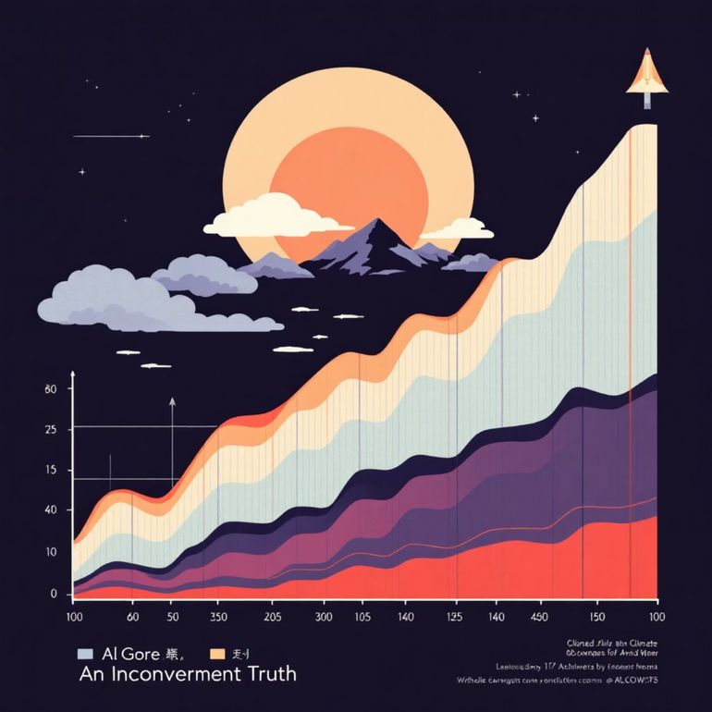
Al Gore: From Politics to Planet
An Inconvenient Truth
Gore's 2006 documentary became a cultural phenomenon, viewed by millions worldwide. The film transformed complex climate data into compelling storytelling, making global warming personally relevant to ordinary citizens.
Global Climate Campaigns
Through Live Earth concerts, Climate Reality Project presentations, and countless speeches, Gore brought climate science from academic circles into mainstream consciousness.
Notes:
6

Slide 7

The Award's Immediate Impact
190
50M
2008
Countries
Film Viewers
Policy Momentum
Represented in subsequent climate negotiations with renewed urgency
Watched "An Inconvenient Truth" following the Nobel recognition
Year when major climate legislation gained traction globally
Notes:
7

Slide 8
Transforming Global Discourse
Pre-2007: Scientific Issue
1
Climate change viewed primarily as an environmental or scientific concern, debated mainly in academic circles.
2
2007: Peace Issue
Nobel Prize reframes climate change as a security threat requiring urgent international cooperation and diplomatic solutions.
Post-2007: Global Priority
3
Climate action becomes central to international relations, with peace and security implications recognised at the highest levels.
Notes:
8

Slide 9
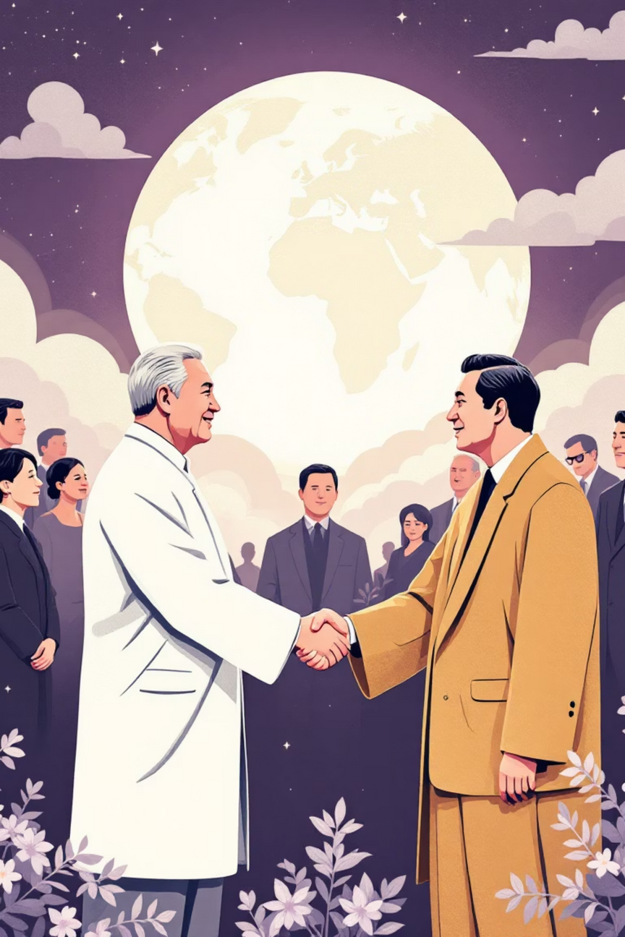


Legacy: Science Meets Diplomacy
"The IPCC and Al Gore have made the world conscious of the danger posed by climate change. They have laid the foundation for the measures that are needed to counteract such change."
— Norwegian Nobel Committee, 2007
Scientific Credibility
Established climate science as unequivocal basis for policy action
Public Awareness
Transformed climate change from niche concern to mainstream priority
Notes:
9

Slide 10

A Blueprint for Planetary Peace
Saving Our Planet = Securing Our Peace
The 2007 Nobel Peace Prize established that environmental protection and global peace are inseparable. By demonstrating how climate science and passionate advocacy can unite the world, the IPCC and Al Gore proved that humanity's greatest challenges require our greatest cooperation.
Their legacy reminds us that the path to lasting peace runs through the stewardship of our shared home.
Notes:
10

Slide 11
Thank You
Dinesh N - 2024503057
Bharathi Shankar R - 2024503063
Medhar Navas S - 2024503303
Nishanth S - 2024503508
Sameer Ahamed T- 2024503511
Sivasankaran M - 2024503558
Sivasankar C - 2024503572
Ajay Kumar S - 2024503701
Notes:
11

