Slide 1
The battle of neighborhoods
Setting up of a restaurant: Analysis of the neighborhood

Slide 2
INTRODUCTION
The proposed idea of study is to help someone who is planning to open a big restaurant or a hotel in Toronto.
Before starting, one has to look into the neighborhoods, the current trends, income of the people, the population in that area and income of different communities.
The owner has to set the audience and describe the audience's problem and how to solve it optimally.
Most importantly, the planner has to find out their competitors in that area and find how they have been functioning in the past.
Therefore, the person has to find the right location to set up his/her restaurant that would maximize his profit as well as benefit the surrounding.

Slide 3
Data
Data about Toronto's venues, neighborhood, latitudes, longitudes and category of the venues are to be taken and have to be prepared for the next process.
The data can be found in this link: https://raw.githubusercontent.com/ibm-developer-skills-network/yczvh-DataFilesForIBMProjects/master/segmenting_neighborhoods.json
A person has to find the venue categories from this data and find which has more number of hotels or cafeterias and decide upon the results.

Slide 4
Primary Audience
The person who is planning to open up a restaurant mostly targets the daily workers in that particular area.
Target audience is employers who go out to work most days and they must find the restaurant pristine and satisfy their needs.
The public, if finds the restaurant more awesome and likes what they offer, will spend a lot of time in this place and try various dishes offered by the restaurant.

Slide 5
Methodology and inference
The neighborhoods are found.
The categories of each venue in the neighborhood is displayed as a table.
Common venues are listed and various categories are printed.
One can see different shops and other centers.
So, the person who would like to start up a restaurant has to check the number of existing restaurants and how popular those are.
If the place has more number of hotels and shops and are popular, the owner has to look for other neighborhood where his/her shop would find maximum profit.

Slide 6
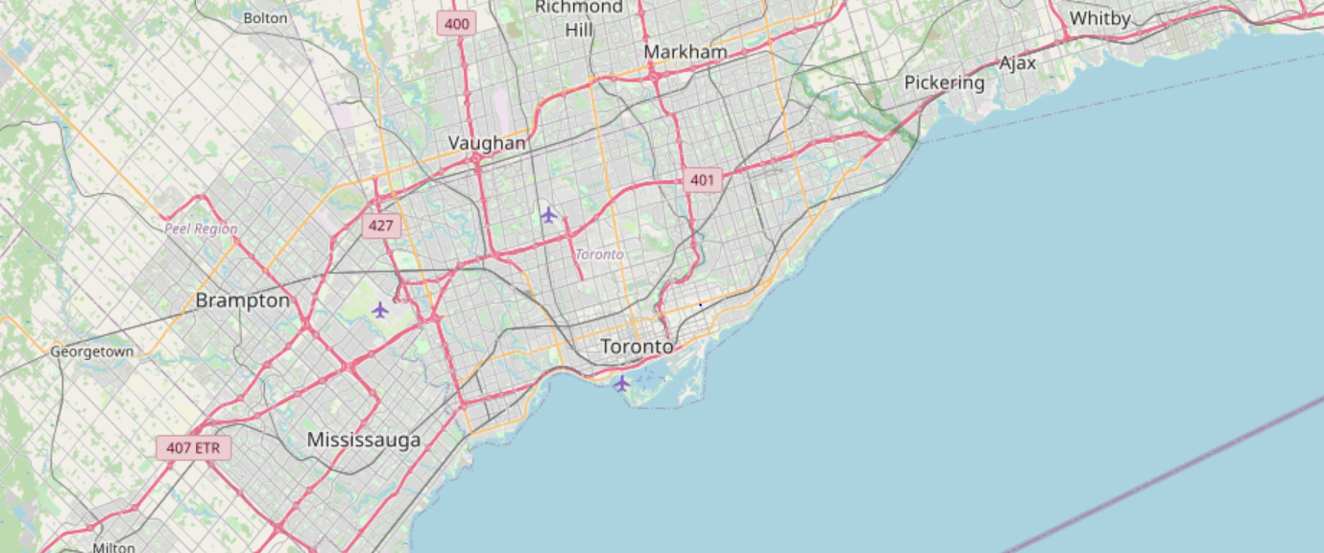
Surrounding Areas

Slide 7
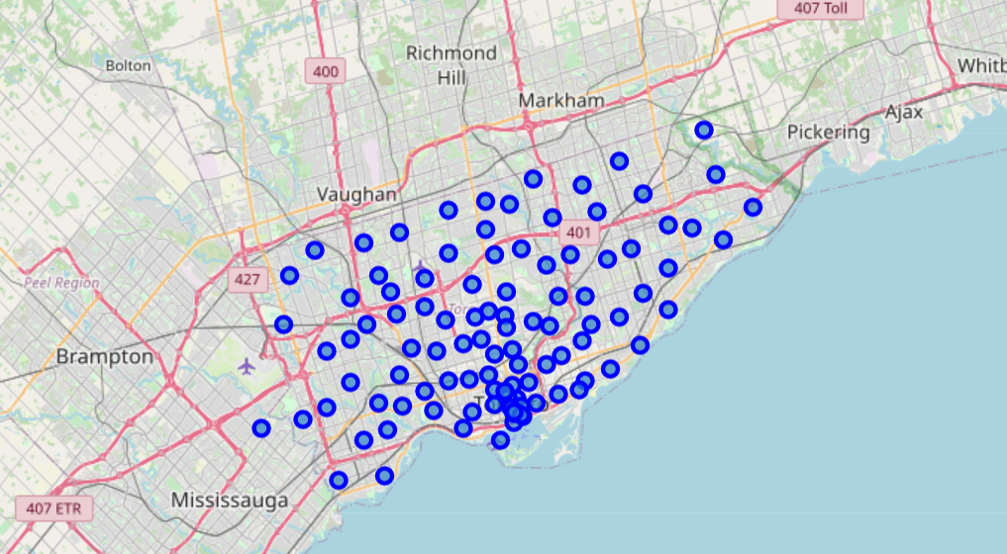
Neighboring places with most number of shops

Slide 8
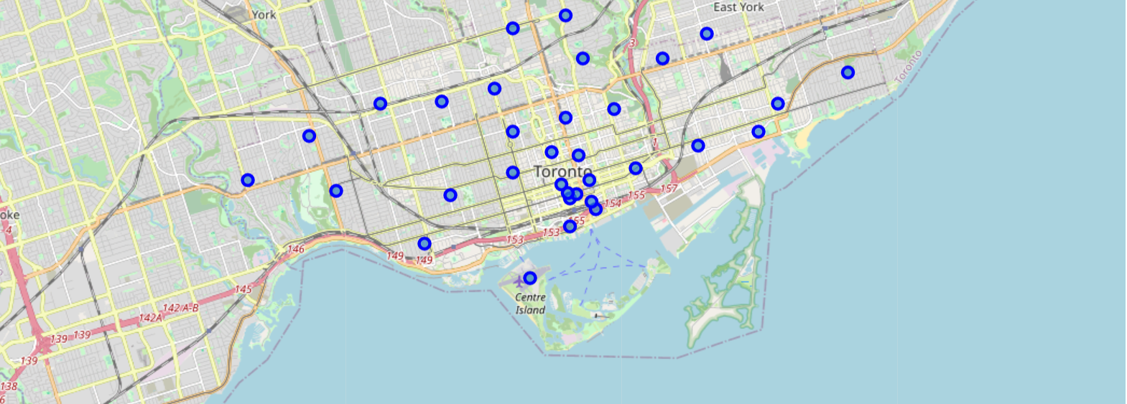
Mapping specific part of Toronto

Slide 9
Inference
After finding the common categories in venues and most common shops, the person has to make sure where to start his restaurant and what type of variety they want to provide.
In few venues, pizzas and donut shops are more majority and popular.
Thus, coming up with a pizza restaurant or a cafeteria or a donut shop would not be feasible to the new comer as there has been famous places where people go already and would not gain much profit.
Either the person must keep a different restaurant in such a popular place so that crowd may visit the place regularly or have to open up a few miles further than the seen place, targeting new population.

Slide 10
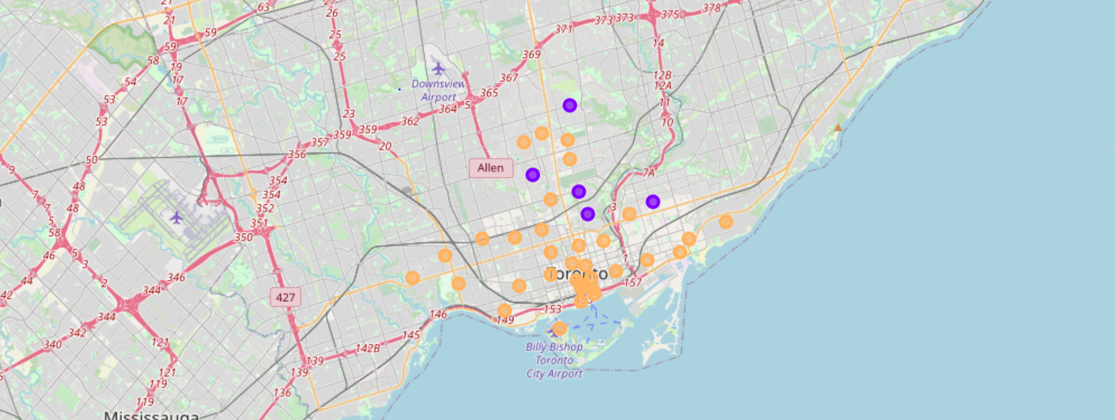
Clustering based on the venues

Slide 11
Conclusion
Thus, analysis of neighborhood is done and based on the most available shops, the person might decide what shop to come and where to open.
He/she would not open in such a place where there is already huge number of famous shops and the possibility becomes less.
Whereas, the person would open the shop as some place where there is more population and more employers are there so that income would be higher thus more profit could happen.

