Slide 1
Presentation On Clinic Management System
Submitted by:
Ajay Maharjan,
Amar Maharjan,
Kapil Chhatkuli,
Khusbu Shakya,
Krishna Khanal,
Shubhanjali Shakya

Slide 2
Problem definition
Clinics need to create written document
Manual record of clients information
Time consuming process to retrieve data
No proper management of schedule and appointments

Slide 3
Problem solution
It tracks and manages all the information of doctors, patients, schedule, appointments etc.
It generates the report of the patients.
To increase efficiency of managing the clinic operations.

Slide 4
Objectives Of Clinic Management System:
To manage all the information about clinic
To reduce the manual work for managing the Clinic operations
To tracks all the details about the Doctors, Patient, and Report
To make data retrieval easy and efficient

Slide 5
Benefits:
Alternative for manual file keeping system
Faster access, modification of files
Minimize overall paperwork
Provides the schedule of doctors
Views the appointments made by patients
Gives report of the patient

Slide 6
Limitations:
It is less secure
Not able to show the record of medicines storage
Does not shows the appointment status
System only accessible by the client side to create request appointment, view schedule and view appointments made by clients
Not able to cancel the appointment made by clients
Does not stores the report of clients

Slide 7
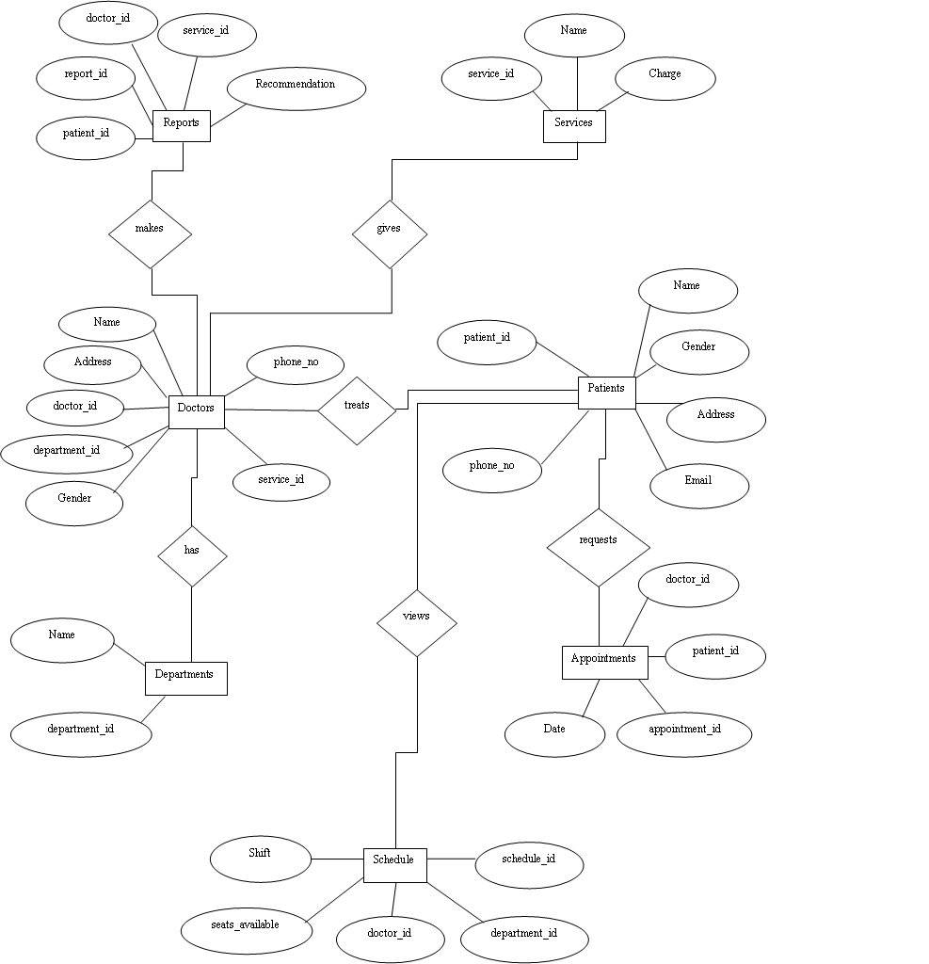
Entity Relationship Diagram:

Slide 8
Conclusion:
This coursework helped us to evaluate a minor scenario of the data storing and uses of database to store data and manage it
We had a few problem in using some system like GitHub, however from the guidance of our mentors we were able to complete the given task.

Slide 9
Thank You

