Slide 1
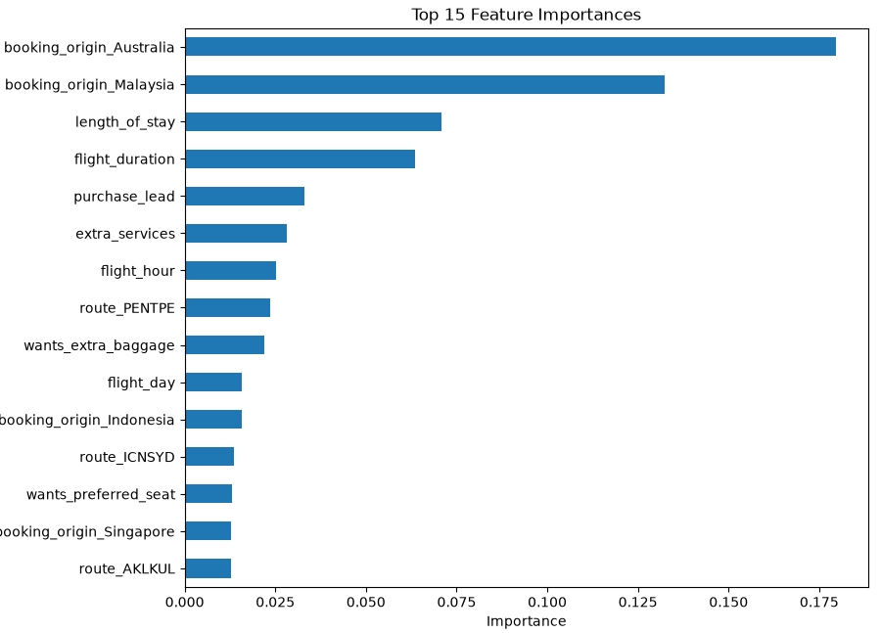
Airline Customer Booking Prediction — Model Performance
Random Forest classifier predicting booking completion from 50,000 customer search sessions (85% no-book / 15% book)
Metric | Value
Accuracy | 69.6%
Precision (booked) | 0.30
Recall (booked) | 0.76
F1-score (booked) | 0.43
ROC-AUC | 0.78
Model Configuration
• RandomForestClassifier: n_estimators=300, max_depth=15, min_samples_split=5
• class_weight='balanced' — corrects for 85/15 class imbalance
• 80/20 stratified train/test split, random_state=42
• Frequency encoding for route & origin; one-hot encoding for low-cardinality categoricals
Key Takeaway
Balancing classes lifted recall on bookers from 12% → 76%, meaning the model now catches most real bookers at the cost of more false positives (lower precision). Best suited for lead prioritization, not narrow high-confidence targeting.
Top predictors: customer origin (Australia, Malaysia), length of stay, flight duration, purchase lead time

Slide 2
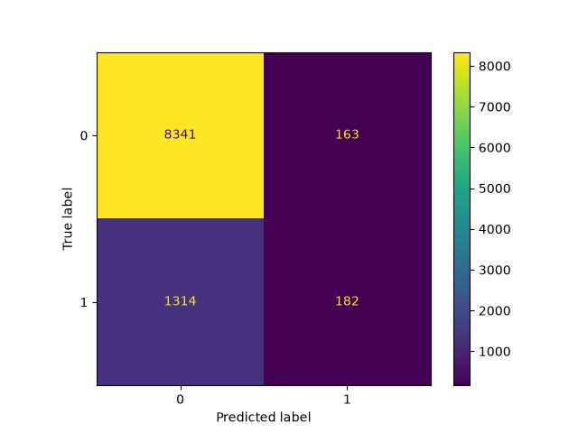
Error Analysis & Recommendations
Where the model succeeds, where it struggles, and how to improve it further
Interpretation
• Model reliably distinguishes bookers from non-bookers (ROC-AUC 0.78), well above random chance (0.5).
• 5-fold cross-validation revealed instability across folds likely due to unshuffled data splits, not a flaw in the model itself.
• Precision (0.30) means roughly 1 in 3 flagged customers actually book acceptable for outreach campaigns, less so for high-cost interventions.
Recommended Next Steps
• Re-run cross-validation with StratifiedKFold + shuffling to get a stable, trustworthy performance estimate.
• Tune the classification threshold (e.g. 0.3–0.4) to balance precision and recall based on campaign cost.
• Test gradient boosting (XGBoost/LightGBM) as a benchmark against Random Forest.
• Investigate whether origin-based features can be supplemented with real-time booking channel data for even stronger signal.
Confusion matrix: model correctly flags 76% of real bookers but generates a moderate false-positive rate

