Slide 1
Python and Netflix: What happens when you stream a film
Kalyan Prasad

Slide 2

WHO’s this?
Self Taught Data Scientist
(The one who realised something can do beyond excel)
Core member of Hyderabad Python User Group
AI & Fintech Enthusiast
Hobbyist Fitness, Movies, Sports and more
Social Handle: @Data Player

Slide 3
agenda
Introduction to Netflix
How does it use Python?
Open connect
Demand Engineering
Machine learning
Scientific Experimentation
Video Encoding
Netflix Animation and NVFX
Information Security
Monitoring and Auto Remediation
Resources

Slide 4
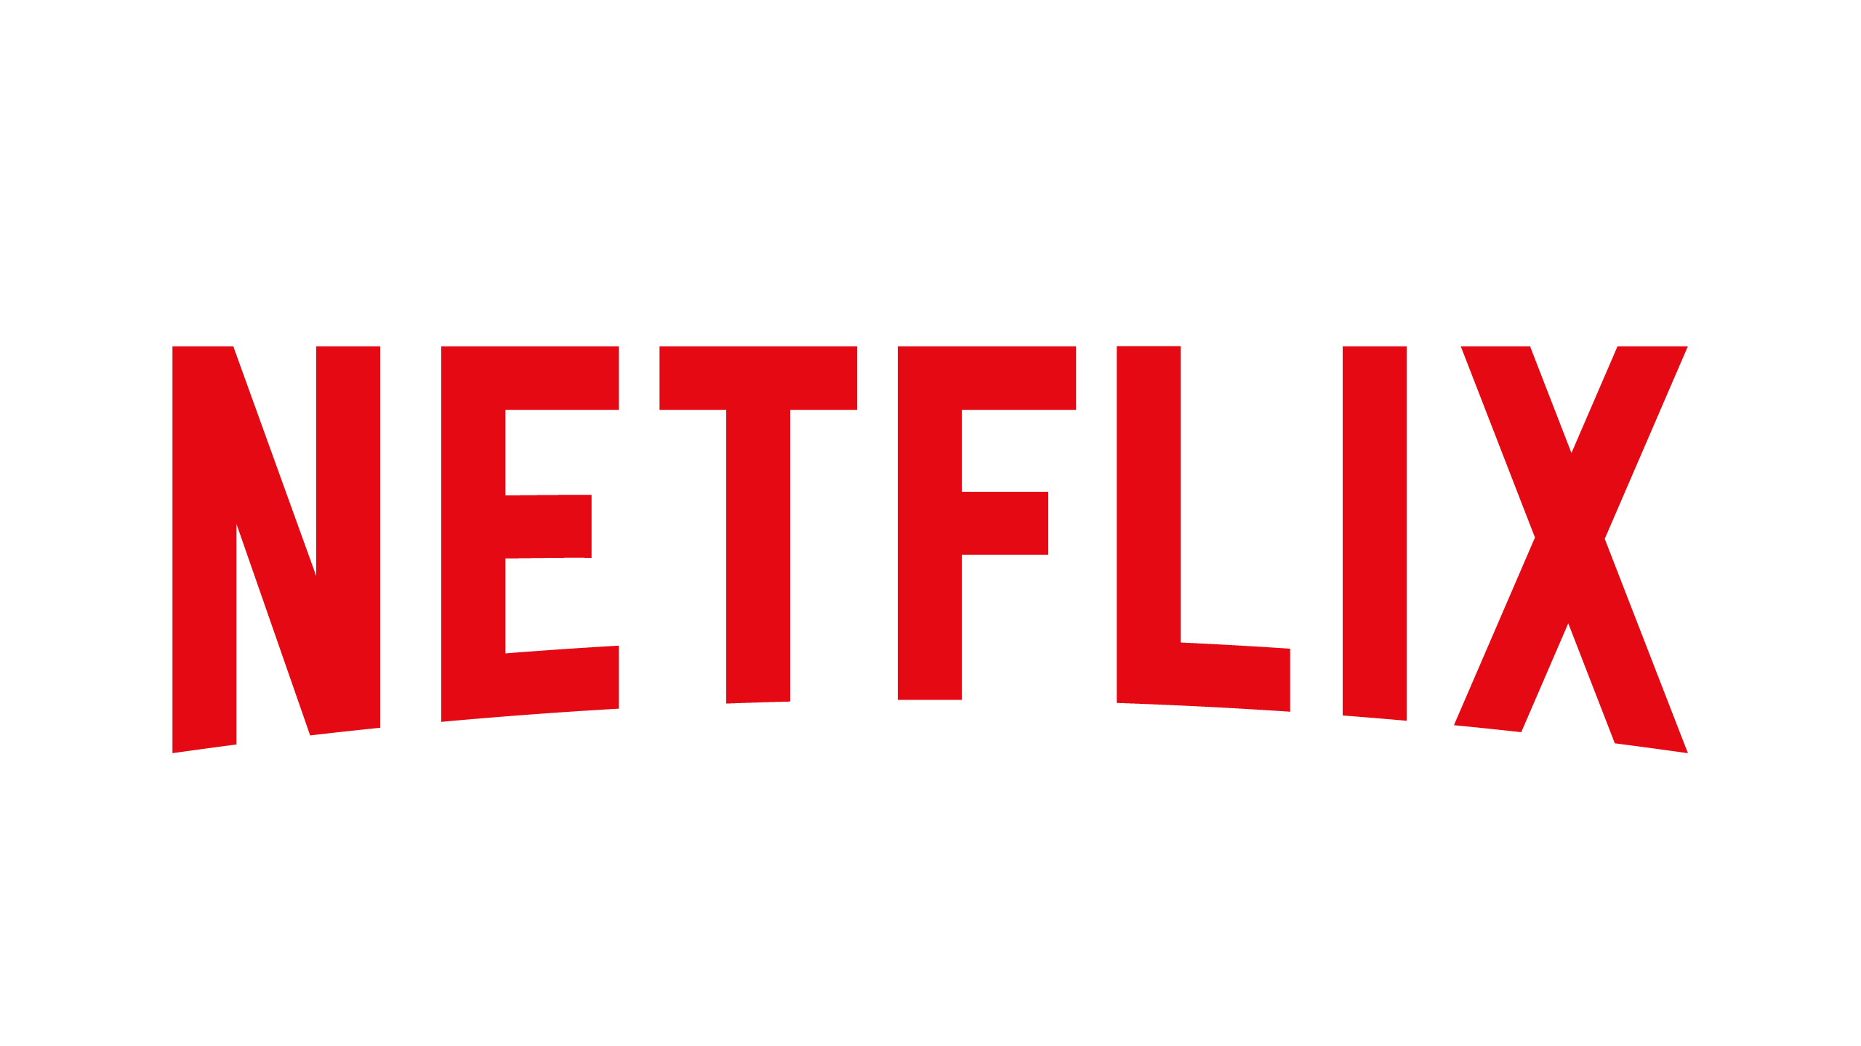
INTRODUCTION TO NETFLIX
Netflix is an American company which :
Renders Video on Demand (VOD) services
Has about 148 million subscribers
Revenue of $20.5B in 2019

Slide 5
How does it use python
“We use Python through the full content lifecycle, from deciding which content to fund all the way to operating the CDN that serves the final video to million users”
– Engineers at Netflix

Slide 6
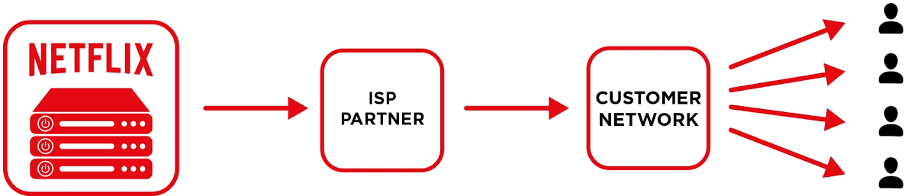
Open connect
Open Connect:
CDN (Content Delivery Network)
Comes in picture after you hit ‘play’ button
Looks after all the content users wants to watch

Slide 7


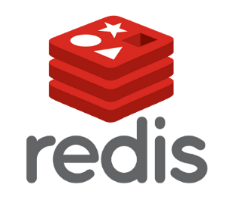


Demand engineering
Responsible for handling:
Regional Failovers
Traffic Administration
Capacity Operations Management
Fleet Efficiency

Slide 8
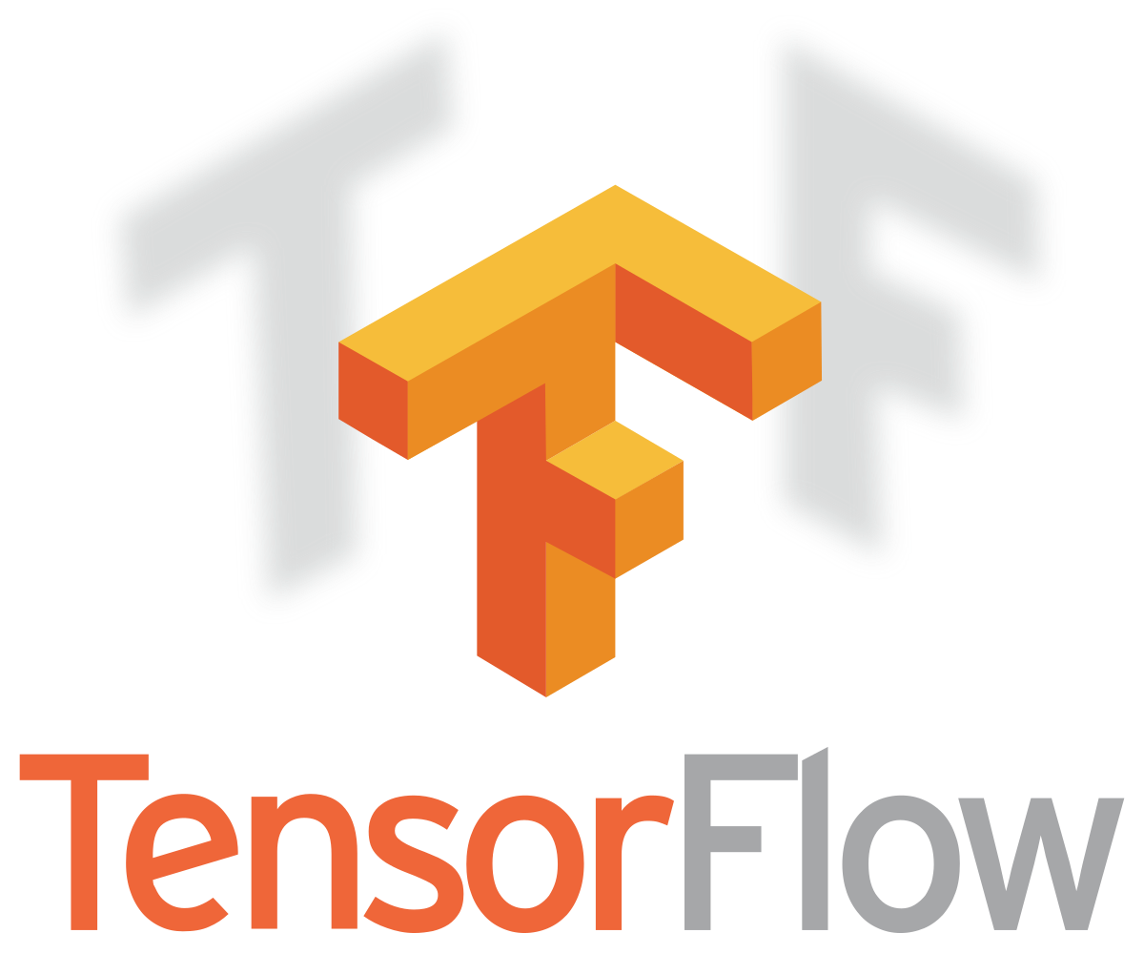


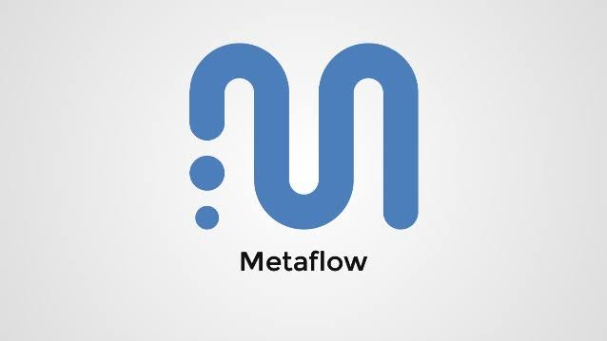

Machine learning
Ranges from :
Creating personalization algorithms to figuring out the use cases.
Provides personalized recommendations
Outlines on a day-to-day basis
Label generations , etc.

Slide 9
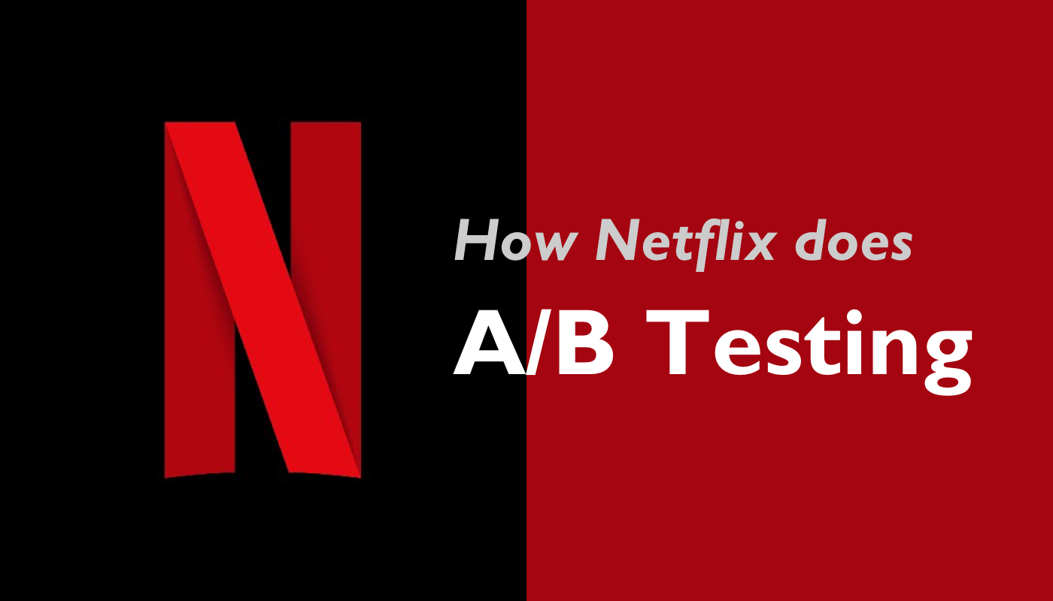
Scientific experimentation
Scientific experimentation team to allow A/B testing
Python framework used are:
Metrics Repo which is based on Pypika to write reusable code
Statistics sector PyArrow and RPy2
Visualizations is done using Plotty

Slide 10

Video encoding
Responsible for encoding and re-encoding tasks
Python is approximately used for 50 projects such as VMAF and MezzFS
Computer vision solutions(deals with imagery) using Archer, etc.

Slide 11

NETFLIX ANIMATION AND NVFX
Python forms the base for all Animations and Visual Effects(VFX) at Netflix.
All of the Maya and Nuke unions are done on Python.

Slide 12
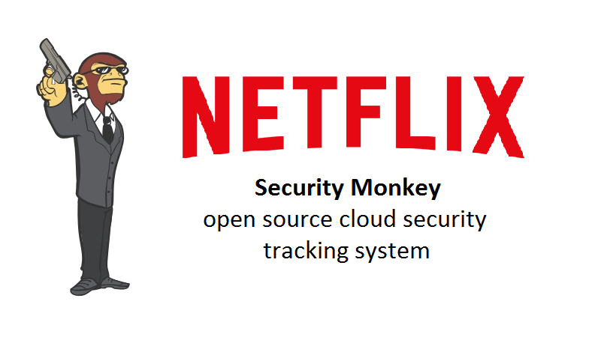
Information security
The most active open source Python project of this team is Security Monkey
Netflix also used BLESS to protect SSH resources
Repokid is used to grants IAM Permissions and TLS Certificates are allotted through Lemur. Both of these tasks mainly rely on Python.

Slide 13
Monitoring/auto remediation
Auto Remediation System
Event listener
Rules to respond to events
Workflow engine(Runs automation)
Insight Engineering team:
Build and execute tools for operational insight, diagnostics, auto-remediation, and altering
Makes use of Python for most of its services
Example, the Spectator Python client library
Products like Winston and Balt are also built on Python frameworks

Slide 14
Resources
https://netflixtechblog.com/python-at-netflix-bba45dae649e
https://www.techrepublic.com/article/how-netflix-uses-python-streaming-giant-reveals-its-programming-language-libraries-and-frameworks/

Slide 15
Thank you ☺

