Slide 1
Hadoop
Ajay J. Singala

Slide 2
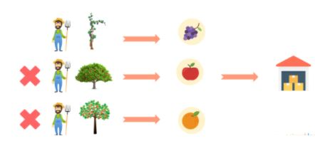
An Analogy
Jack, a grape farmer. He harvests the grapes in the fall, stores them in a storage room, and finally sells them in the nearby town. He kept this routing going for years until people began to demand other fruits. This rise in demand led to him growing apples and oranges, in addition to grapes.
Unfortunately, the whole process turned out to be time-consuming and difficult for Jack to do single-handedly.

Slide 3
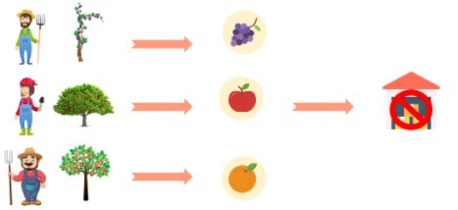
An Analogy (cont’d)
So, Jack hires two more people to work alongside him. The extra help speeds up the harvesting process as three of them can work simultaneously on different products.
However, this takes a nasty toll on the storage room, as the storage area becomes a bottleneck for storing and accessing all the fruits.

Slide 4
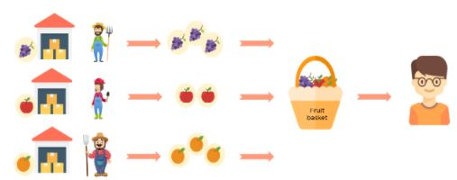
An Analogy (cont’d)
Jack thought through this problem and came up with a solution: give each one separate storage space. So, when Jack receives an order for a fruit basket, he can complete the order on time as all three can work with their storage area.
Notes:
Thanks to Jack’s solution, everyone can finish their order on time and with no trouble.
Even with sky-high demands, Jack can complete his orders.

Slide 5
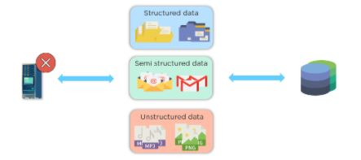
Analogy -> Big Data

Slide 6
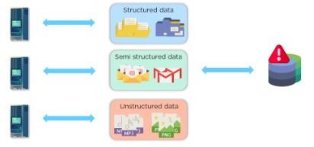
Analogy -> Big Data
Multiple machines help process data parallelly. However, the storage unit became a bottleneck resulting in a network overhead generation

Slide 7
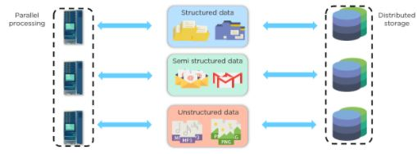
Analogy -> Big Data
To address this issue, the storage unit is distributed amongst each of the processors. The distribution resulted in storing and accessing data efficiently and with no network overheads.
This method is called parallel processing with distributed storage.
Notes:
This setup is how data engineers and analysts manage big data effectively.
Now, do you see the connection between Jack’s story and big data management?

Slide 8
Big Data Challenges
Big Data refers to the massive amount of data that cannot be stored, processed, and analyzed using traditional ways.
The main elements of Big Data are:
Volume - There is a massive amount of data generated every second.
Velocity - The speed at which data is generated, collected, and analyzed
Variety - The different types of data: structured, semi-structured, unstructured
Value - The ability to turn data into useful insights for your business
Veracity - Trustworthiness in terms of quality and accuracy

Slide 9
Big Data Challenges
Challenges | Solutions
Single central storage | Distributed storage
Serial processing One input One processor One output | Parallel processing Multiple inputs Multiple processors One output
Lack of ability to process unstructured data | Ability to process every type of data

Slide 10
What is Hadoop?
Hadoop, as a Big Data framework, provides businesses with the ability to:
distribute data storage,
parallel processing,
and process data at
higher volume,
higher velocity,
variety, ‘
value,
and veracity.
HDFS, MapReduce, and YARN are the three major components for this Hadoop tutorial.
HDFS: is the storage unit
MapReduce: is the processing unit
YARN: is a resource management unit

Slide 11
What is Hadoop?
Hadoop HDFS (Hadoop Distributed File System) uses name nodes and data nodes to store extensive data
MapReduce manages these nodes for processing,
and YARN (Yet Another Resource Negotiator) acts as an Operating system for Hadoop in managing cluster resources.

Slide 12
Who uses Hadoop?
British Airways
Uber
The Bank of Scotland
Netflix
The National Security Agency (NSA), of the United States
The UK’s Royal Mail system
Expedia
Twitter

Slide 13
Hadoop Components - HDFS
Data is stored in a distributed manner in HDFS. There are two components of HDFS - name node and data node. While there is only one name node, there can be multiple data nodes.
HDFS is specially designed for storing huge datasets in commodity hardware. An enterprise version of a server costs roughly $10,000 per terabyte for the full processor. In case you need to buy 100 of these enterprise version servers, it will go up to a million dollars.
Hadoop enables you to use commodity machines as your data nodes. This way, you don’t have to spend millions of dollars just on your data nodes. However, the name node is always an enterprise server.

Slide 14
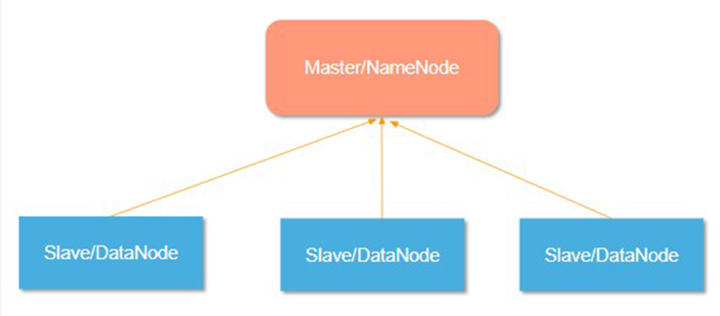
Hadoop Cluster
What is a Hadoop Cluster?
A collection of independent components connected through a dedicated network to work as a single centralized data processing resource.
Master and Slave Nodes
Master and slave nodes form the HDFS cluster. The name node is called the master, and the data nodes are called the slaves.
Notes:
The name node is responsible for the workings of the data nodes. It also stores the metadata.
The data nodes read, write, process, and replicate the data. They also send signals, known as heartbeats, to the name node. These heartbeats show the status of the data node.
Components of a Hadoop Cluster:
Hadoop cluster consists of three components -
Master Node:
Master node in a hadoop cluster is responsible for storing data in HDFS and executing parallel computation on the stored data using MapReduce.
Master Node has 3 nodes – NameNode, Secondary NameNode and JobTracker.
JobTracker monitors the parallel processing of data using MapReduce while the NameNode handles the data storage function with HDFS.
Replaced with YARN in Hadoop 2.
NameNode keeps a track of all the information on files (i.e. the metadata on files) such as the access time of the file, which user is accessing a file on current time and which file is saved in which hadoop cluster.
The secondary NameNode keeps a backup of the NameNode data.
Slave/Worker Node:
This component in a Hadoop cluster is responsible for storing the data and performing computations.
Every slave/worker node runs both a TaskTracker and a DataNode service to communicate with the Master node in the cluster.
The DataNode service is secondary to the NameNode and the TaskTracker service is secondary to the JobTracker.
Client Nodes:
Client node has Hadoop installed with all the required cluster configuration settings and is responsible for loading all the data into the Hadoop cluster.
Client node submits MapReduce jobs describing on how data needs to be processed and then the output is retrieved by the client node once the job processing is completed.
Client nodes are in charge of loading the data into the cluster.
Client nodes first submit MapReduce jobs describing how data needs to be processed and then fetch the results once the processing is finished.

Slide 15
Single Node vs Multi Node Hadoop Cluster
Single Node Cluster | Multi Node Cluster
Has only a single machine. | Will have more than one machine.
All the daemons i.e. DataNode, NameNode, TaskTracker and JobTracker run on the same machine/host. | All the essential daemons are up and run on different machines/hosts.
Everything runs on a single JVM instance. | Has a master slave architecture where in one machine acts as a master that runs the NameNode daemon while the other machines acts as slave or worker nodes to run other Hadoop daemons.
The default replication factor is 1. | Can be configured based on the number of data nodes available.
Notes:
Usually in a multi-node Hadoop cluster, there are cheaper machines (commodity computers) that run the TaskTracker and DataNode daemons while other services are run on powerful servers.
For a multi-node Hadoop cluster, machines or computers can be present in any location irrespective of the location of the physical server.

Slide 16
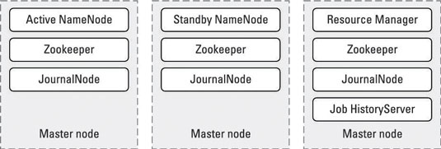
Master Nodes in Hadoop Clusters
The master nodes in distributed Hadoop clusters host the various storage and processing management services for the entire Hadoop cluster.
For e.g.;
3 Master Nodes:
Active Namenode
Standby Namenode
Resource Manager
Notes:
The master nodes in distributed Hadoop clusters host the various storage and processing management services, described in this list, for the entire Hadoop cluster. Redundancy is critical in avoiding single points of failure, so you see two switches and three master nodes.
NameNode: Manages HDFS storage. To ensure high availability, you have both an active NameNode and a standby NameNode. Each runs on its own, dedicated master node.
Checkpoint node (or backup node): Provides checkpointing services for the NameNode. This involves reading the NameNode’s edit log for changes to files in HDFS (new, deleted, and appended files) since the last checkpoint, and applying them to the NameNode’s master file that maps files to data blocks.
In addition, the Backup Node keeps a copy of the file system namespace in memory and keeps it in sync with the state of the NameNode. For high availability deployments, do not use a checkpoint node or backup node — use a Standby NameNode instead. In addition to being an active standby for the NameNode, the Standby NameNode maintains the checkpointing services and keeps an up-to-date copy of the file system namespace in memory.
JournalNode: Receives edit log modifications indicating changes to files in HDFS from the NameNode. At least three JournalNode services (and it’s always an odd number) must be running in a cluster, and they’re lightweight enough that they can be colocated with other services on the master nodes.
Resource Manager: Oversees the scheduling of application tasks and management of the Hadoop cluster’s resources. This service is the heart of YARN.
JobTracker: For Hadoop 1 servers, handles cluster resource management and scheduling. With YARN, the JobTracker is obsolete and isn’t used. A number of Hadoop deployments still haven’t migrated to Hadoop 2 and YARN.
Zookeeper: Coordinates distributed components and provides mechanisms to keep them in sync. Zookeeper is used to detect the failure of the NameNode and elect a new NameNode. It’s also used with HBase to manage the states of the HMaster and the RegionServers.
Here, you’ve got three master nodes (with the same hardware), where the key services Active NameNode, Standby NameNode, and Resource Manager each have their own server. There are JournalNode and Zookeeper services running on each server as well, but these are lightweight and won’t be a source of resource contention with the NameNode and Resource Manager services.

Slide 17
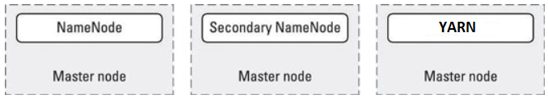
Master Nodes in Hadoop 2
Hadoop 2
You need a dedicated master node for the
NameNode,
Secondary NameNode, and
YARN.

Slide 18
Hadoop Components - HDFS
Features of HDFS
Provides distributed storage.
Can be implemented on commodity hardware.
Provides data security.
Highly fault-tolerant
If one machine goes down, the data from that machine goes to the next machine.

Slide 19
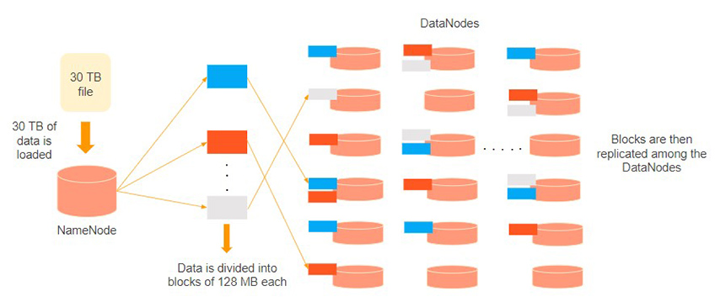
Hadoop Components - HDFS
Consider that 30TB of data is loaded into the name node. The name node distributes it across the data nodes, and this data is replicated among the data nodes. You can see in the image above that the blue, grey, and red data are replicated among the three data nodes.
Replication of the data is performed three times by default. It is done this way, so if a commodity machine fails, you can replace it with a new machine that has the same data.

Slide 20
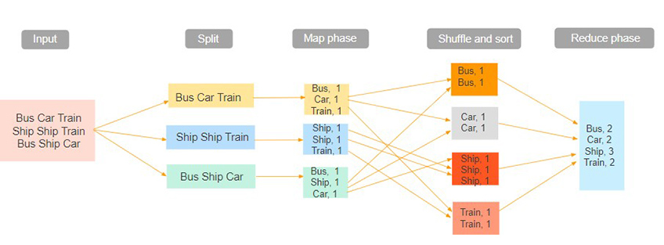
Hadoop Components - MapReduce
Hadoop MapReduce is the processing unit of Hadoop. In the MapReduce approach, the processing is done at the slave nodes, and the final result is sent to the master node.
A data containing code is used to process the entire data. This coded data is usually very small in comparison to the data itself. You only need to send a few kilobytes worth of code to perform a heavy-duty process on computers.
Notes:
The input dataset is first split into chunks of data.
In this example, the input has three lines of text with three separate entities - “bus car train,” “ship ship train,” “bus ship car.”
The dataset is then split into three chunks, based on these entities, and processed parallelly.
In the map phase, the data is assigned a key and a value of 1. In this case, we have one bus, one car, one ship, and one train.
These key-value pairs are then shuffled and sorted together based on their keys.
At the reduce phase, the aggregation takes place, and the final output is obtained.

Slide 21
Hadoop Components - YARN
Hadoop YARN stands for Yet Another Resource Negotiator.
It is the resource management unit of Hadoop and is available as a component of Hadoop version 2.
Hadoop YARN acts like an OS to Hadoop.
It is a file system that is built on top of HDFS.
It is responsible for managing cluster resources to make sure you don't overload one machine.
It performs job scheduling to make sure that the jobs are scheduled in the right place.
Notes:
The input dataset is first split into chunks of data.
In this example, the input has three lines of text with three separate entities - “bus car train,” “ship ship train,” “bus ship car.”
The dataset is then split into three chunks, based on these entities, and processed parallelly.
In the map phase, the data is assigned a key and a value of 1. In this case, we have one bus, one car, one ship, and one train.
These key-value pairs are then shuffled and sorted together based on their keys.
At the reduce phase, the aggregation takes place, and the final output is obtained.

Slide 22
Hadoop Components – YARN Features
Scalability:
The scheduler in Resource manager of YARN architecture allows Hadoop to extend and manage thousands of nodes and clusters.
Compatability:
YARN supports the existing map-reduce applications without disruptions thus making it compatible with Hadoop 1.0 as well.
Cluster Utilization:
Since YARN supports Dynamic utilization of cluster in Hadoop, which enables optimized Cluster Utilization.
Multi-tenancy:
It allows multiple engine access thus giving organizations a benefit of multi-tenancy.

Slide 23
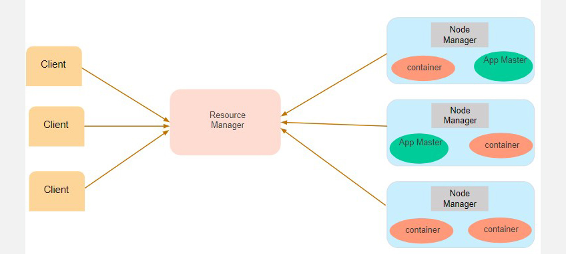
YARN
Scheduler
Application Manager
Notes:
Client: It submits map-reduce jobs.
Resource Manager: It is the master daemon of YARN and is responsible for resource assignment and management among all the applications. Whenever it receives a processing request, it forwards it to the corresponding node manager and allocates resources for the completion of the request accordingly. It has two major components:
Scheduler: It performs scheduling based on the allocated application and available resources. It is a pure scheduler, means it does not perform other tasks such as monitoring or tracking and does not guarantee a restart if a task fails. The YARN scheduler supports plugins such as Capacity Scheduler and Fair Scheduler to partition the cluster resources.
Application manager: It is responsible for accepting the application and negotiating the first container from the resource manager. It also restarts the Application Manager container if a task fails.
Node Manager: It take care of individual node on Hadoop cluster and manages application and workflow and that particular node. Its primary job is to keep-up with the Node Manager. It monitors resource usage, performs log management and also kills a container based on directions from the resource manager. It is also responsible for creating the container process and start it on the request of Application master.
Application Master: An application is a single job submitted to a framework. The application manager is responsible for negotiating resources with the resource manager, tracking the status and monitoring progress of a single application. The application master requests the container from the node manager by sending a Container Launch Context(CLC) which includes everything an application needs to run. Once the application is started, it sends the health report to the resource manager from time-to-time.
Container: It is a collection of physical resources such as RAM, CPU cores and disk on a single node. The containers are invoked by Container Launch Context(CLC) which is a record that contains information such as environment variables, security tokens, dependencies etc.

Slide 24
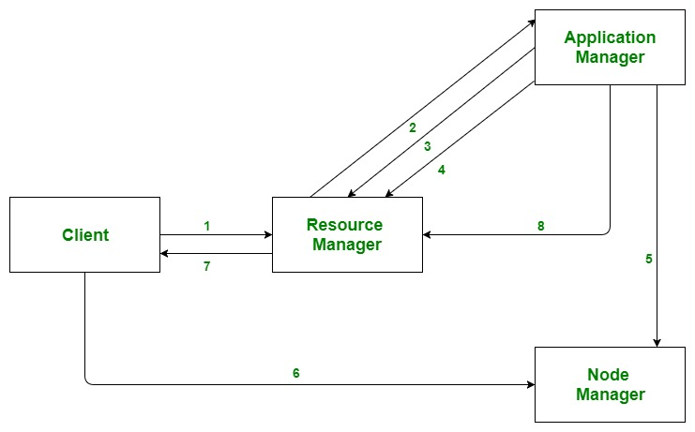
Application Workflow in Hadoop YARN
Notes:
Client submits an application
The Resource Manager allocates a container to start the Application Manager
The Application Manager registers itself with the Resource Manager
The Application Manager negotiates containers from the Resource Manager
The Application Manager notifies the Node Manager to launch containers
Application code is executed in the container
Client contacts Resource Manager/Application Manager to monitor application’s status
Once the processing is complete, the Application Manager un-registers with the Resource Manager

Slide 25
Hadoop Benefits
Speed. Hadoop’s concurrent processing, MapReduce model, and HDFS lets users run complex queries in just a few seconds.
Diversity. Hadoop’s HDFS can store different data formats, like structured, semi-structured, and unstructured.
Cost-Effective. Hadoop is an open-source data framework.
Resilient. Data stored in a node is replicated in other cluster nodes, ensuring fault tolerance.
Scalable. Since Hadoop functions in a distributed environment, you can easily add more servers.
Notes:
Understanding what is Hadoop requires further understanding on how it differs from traditional databases.
Hadoop uses the HDFS (Hadoop Data File System) to divide the massive data amounts into manageable smaller pieces, then saved on clusters of community servers.
This offers scalability and economy.
Furthermore, Hadoop employs MapReduce to run parallel processings, which both stores and retrieves data faster than information residing on a traditional database.
Traditional databases are great for handling predictable and constant workflows;
otherwise, you need Hadoop’s power of scalable infrastructure.

Slide 26
Hadoop Challenges
There’s a steep learning curve.
Not every dataset can be handled the same.
MapReduce is limited.
Security is an issue.
Notes:
There’s a steep learning curve.
If you want to run a query in Hadoop’s file system, you need to write MapReduce functions with Java, a process that is non-intuitive.
Also, the ecosystem is made up of lots of components.
Not every dataset can be handled the same.
Hadoop doesn’t give you a “one size fits all” advantage.
Different components run things differently, and you need to sort them out with experience.
MapReduce is limited.
Yes, it’s a great programming model, but MapReduce uses a file-intensive approach that isn’t ideal for real-time interactive iterative tasks or data analytics.
Security is an issue.
There is a lot of data out there, and much of it is sensitive.
Hadoop still needs to incorporate the proper authentication, data encryption, provisioning, and frequent auditing practices.

Slide 27

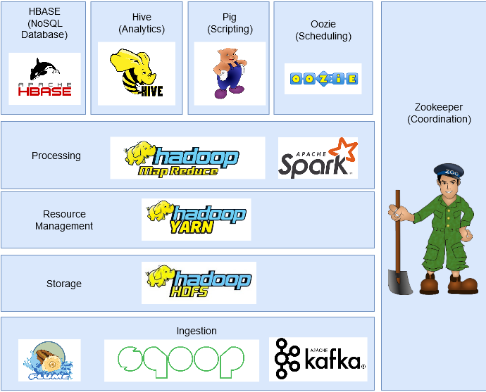
Hadoop Ecosystem

Slide 28

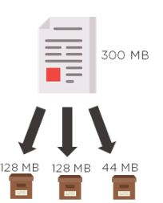
HDFS
Provides distributed storage.
Can be implemented on commodity hardware.
Provides data security.
Highly fault-tolerant
If one machine goes down, the data from that machine goes to the next machine.
Notes:
We spoke of HDFS storing data in a distributed fashion, but did you know that the storage system has certain specifications?
HDFS splits the data into multiple blocks, defaulting to a maximum of 128 MB.
The default block size can be changed depending on the processing speed and the data distribution.
As seen from the above image, we have 300 MB of data.
This is broken down into 128 MB, 128 MB, and 44 MB.
The final block handles the remaining needed storage space, so it doesn’t have to be sized at 128 MB.
This is how data gets stored in a distributed manner in HDFS.

Slide 29

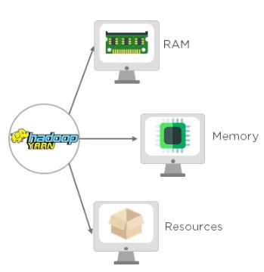
YARN
YARN handles the cluster of nodes and acts as Hadoop’s resource management unit.
YARN allocates RAM, memory, and other resources to different applications.
Two components:
Resource Manager (Master)
Node Manager (Slave)
Notes:
YARN is an acronym for Yet Another Resource Negotiator.
It handles the cluster of nodes and acts as Hadoop’s resource management unit.
YARN allocates RAM, memory, and other resources to different applications.
YARN has two components :
ResourceManager (Master) - This is the master daemon. It manages the assignment of resources such as CPU, memory, and network bandwidth.
NodeManager (Slave) - This is the slave daemon, and it reports the resource usage to the Resource Manager.

Slide 30

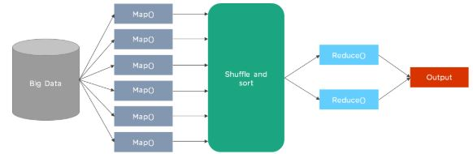
MapReduce
Notes:
Hadoop data processing is built on MapReduce , which processes large volumes of data in a parallelly distributed manner.
As we see, we have our big data that needs to be processed, with the intent of eventually arriving at an output.
So in the beginning, input data is divided up to form the input splits.
The first phase is the Map phase, where data in each split is passed to produce output values.
In the shuffle and sort phase, the mapping phase’s output is taken and grouped into blocks of similar data.
Finally, the output values from the shuffling phase are aggregated. It then returns a single output value.
In summary, HDFS, MapReduce, and YARN are the three components of Hadoop.
Let us now dive deep into the data collection and ingestion tools, starting with Sqoop.

Slide 31
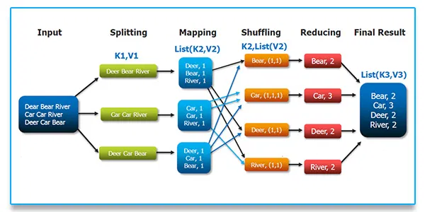
MapReduce – Example

Slide 32
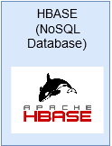
HBase
HBase is a Column-based NoSQL database.
It runs on top of HDFS and can handle any type of data.
Notes:
HBase is a Column-based NoSQL database.
It runs on top of HDFS and can handle any type of data.
It allows for real-time processing and random read/write operations to be performed in the data.

Slide 33
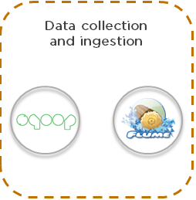
Sqoop
Sqoop is used to transfer data between Hadoop and external datastores such as relational databases and enterprise data warehouses.
It imports data from external datastores into HDFS, Hive, and HBase.
Notes:
A lot of applications still store data in relational databases, thus making them a very important source of data.
Therefore, Sqoop plays an important part in bringing data from Relational Databases into HDFS.
The commands written in Sqoop internally converts into MapReduce tasks that are executed over HDFS.
It works with almost all relational databases like MySQL, Postgres, SQLite, etc.
It can also be used to export data from HDFS to RDBMS.

Slide 34
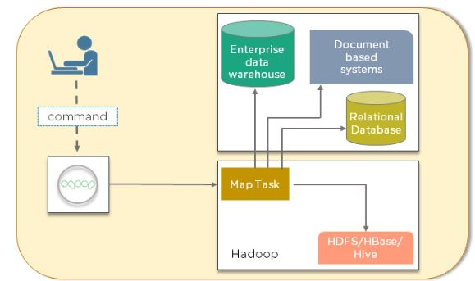
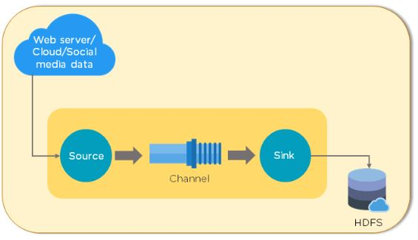
Flume
Notes:
Flume is another data collection and ingestion tool, a distributed service for collecting, aggregating, and moving large amounts of log data.
It ingests online streaming data from social media, logs files, web server into HDFS.
As you can see in the image on the right, data is taken from various sources, depending on your organization’s needs.
It then goes through the source, channel, and sink.
The sink feature ensures that everything is in sync with the requirements.
Finally, the data is dumped into HDFS.
Flume is an open-source, reliable, and available service used to efficiently collect, aggregate, and move large amounts of data from multiple data sources into HDFS.
It can collect data in real-time as well as in batch mode.
It has a flexible architecture and is fault-tolerant with multiple recovery mechanisms.
Let us now have a look at Hadoop’s scripting languages and query languages.

Slide 35
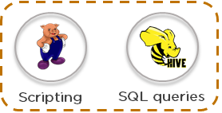
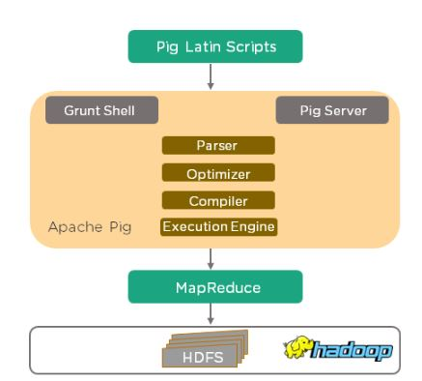
Pig
Apache Pig consists of:
Pig Latin
Pig Latin Compiler (Engine)
Notes:
Apache Pig was developed by Yahoo researchers, targeted mainly towards non-programmers.
It was designed with the ability to analyze and process large datasets without using complex Java codes.
It provides a high-level data processing language that can perform numerous operations without getting bogged down with too many technical concepts.
Pig was developed for analyzing large datasets and overcomes the difficulty to write map and reduce functions.
Apache Pig consists of:
Pig Latin - This is the language for scripting.
Pig Latin is the Scripting Language that is similar to SQL.
Pig Latin Compiler - This converts Pig Latin code into executable code.
Pig Engine is the execution engine on which Pig Latin runs.
Internally, the code written in Pig is converted to MapReduce functions and makes it very easy for programmers who aren’t proficient in Java.
Pig also provides Extract, Transfer, and Load (ETL), and a platform for building data flow.
Did you know that ten lines of Pig Latin script equals approximately 200 lines of MapReduce job?
Pig uses simple, time-efficient steps to analyze datasets.

Slide 36
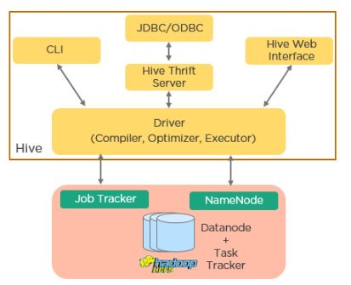
Hive
Hive uses SQL (Structured Query Language).
Two major components:
Hive Command Line
JDBC/ ODBC driver
Notes:
Hive uses SQL (Structured Query Language) to facilitate the reading, writing, and management of large datasets residing in distributed storage.
The hive was developed with a vision of incorporating the concepts of tables and columns with SQL since users were comfortable with writing queries in SQL.
Hive is a distributed data warehouse system developed by Facebook.
Hive allows for easy reading, writing, and managing files on HDFS.
It has its own querying language for the purpose known as Hive Querying Language (HQL) which is very similar to SQL.
This makes it very easy for programmers to write MapReduce functions using simple HQL queries.
Apache Hive has two major components:
Hive Command Line
JDBC/ ODBC driver
The Java Database Connectivity (JDBC) application is connected through JDBC Driver, and
The Open Database Connectivity (ODBC) application is connected through ODBC Driver.
Commands are executed directly in CLI.
Hive driver is responsible for all the queries submitted, performing the three steps of compilation, optimization, and execution internally.
It then uses the MapReduce framework to process queries.
You can see Hive’s architecture in the image.

Slide 37
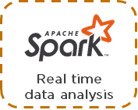
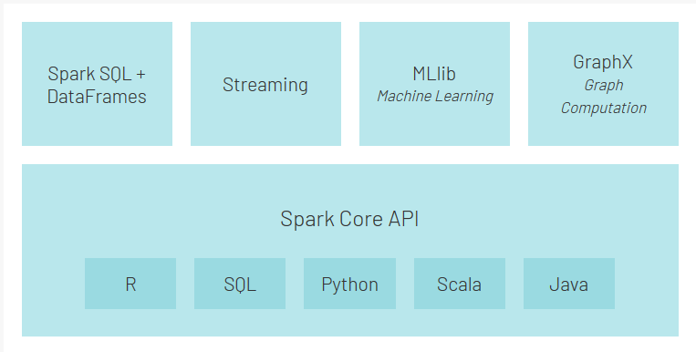
Spark
Spark is an alternative framework to Hadoop built on Scala.
Compared to MapReduce, it provides in-memory processing which accounts for faster processing.
In addition to batch processing offered by Hadoop, it can also handle real-time processing.
Notes:
Spark is an alternative framework to Hadoop built on Scala but supports varied applications written in Java, Python, etc.
Compared to MapReduce, it provides in-memory processing which accounts for faster processing.
In addition to batch processing offered by Hadoop, it can also handle real-time processing.
Spark is a huge framework in and of itself, an open-source distributed computing engine for processing and analyzing vast volumes of real-time data. It runs 100 times faster than MapReduce. Spark provides an in-memory computation of data, used to process and analyze real-time streaming data such as stock market and banking data, among other things.
Further, Spark has its own ecosystem as seen in the image:
Spark Core is the main execution engine for Spark and other APIs built on top of it
Spark SQL API allows for querying structured data stored in DataFrames or Hive tables
Streaming API enables Spark to handle real-time data.
It can easily integrate with a variety of data sources like Flume, Kafka, and Twitter
MLlib is a scalable machine learning library that will enable you to perform data science tasks while leveraging the properties of Spark at the same time
GraphX is a graph computation engine that enables users to interactively build, transform, and reason about graph-structured data at scale and comes with a library of common algorithms

Slide 38

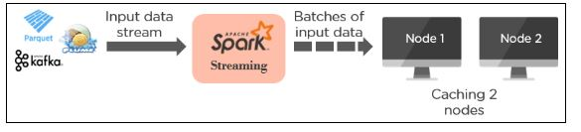
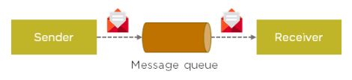
Kafka
Kafka is a distributed streaming platform designed to store and process streams of records. It is written in Scala. It builds real-time streaming data pipelines that reliably get data between applications, and also builds real-time applications that transform data into streams.
Kafka uses a messaging system for transferring data from one application to another. As seen below, we have the sender, the message queue, and the receiver involved in data transfer.
Notes:
There are a lot of applications generating data and a commensurate number of applications consuming that data.
But connecting them individually is a tough task.
That’s where Kafka comes in. It sits between the applications generating data (Producers) and the applications consuming data (Consumers).
Kafka is distributed and has in-built partitioning, replication, and fault-tolerance.
It can handle streaming data and also allows businesses to analyze data in real-time.
Kafka is a distributed streaming platform designed to store and process streams of records.
It is written in Scala.
It builds real-time streaming data pipelines that reliably get data between applications, and also builds real-time applications that transform data into streams.
Kafka uses a messaging system for transferring data from one application to another.
As seen in the image on the right, we have the sender, the message queue, and the receiver involved in data transfer.

Slide 39
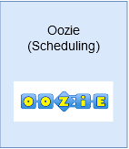
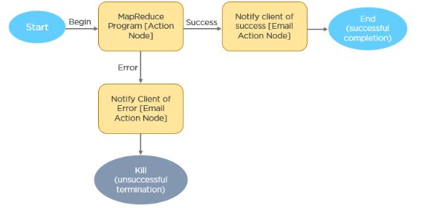
Oozie
Oozie is a workflow scheduler system used to manage Hadoop jobs.
It consists of two parts:
Workflow engine
Coordinator engine
Notes:
Oozie is a workflow scheduler system used to manage Hadoop jobs.
It consists of two parts:
Workflow engine - This consists of Directed Acyclic Graphs (DAGs), which specify a sequence of actions to be executed
Coordinator engine - The engine is made up of workflow jobs triggered by time and data availability
Oozie is a workflow scheduler system that allows users to link jobs written on various platforms like MapReduce, Hive, Pig, etc.
Using Oozie you can schedule a job in advance and can create a pipeline of individual jobs to be executed sequentially or in parallel to achieve a bigger task.
For example, you can use Oozie to perform ETL operations on data and then save the output in HDFS.
As seen from the flowchart, the process begins with the MapReduce jobs.
This action can either be successful, or it can end in an error.
If it is successful, the client is notified by an email.
If the action is unsuccessful, the client is similarly notified, and the action is terminated.

Slide 40
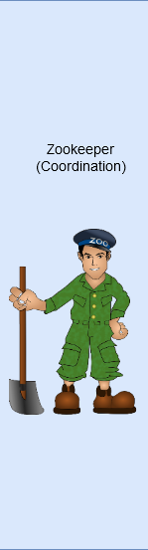
Zookeeper
In a Hadoop cluster, coordinating and synchronizing nodes can be a challenging task.
Therefore, Zookeeper is the perfect tool for the problem.
Notes:
In a Hadoop cluster, coordinating and synchronizing nodes can be a challenging task. Therefore, Zookeeper is the perfect tool for the problem.
It is an open-source, distributed, and centralized service for maintaining configuration information, naming, providing distributed synchronization, and providing group services across the cluster.

Slide 41

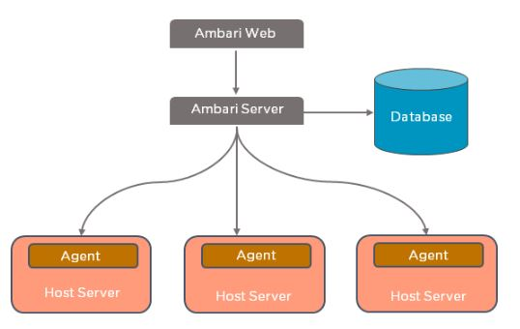
Ambari
Apache Ambari is an open-source tool responsible for keeping track of running applications and their statuses.
Ambari manages, monitors, and provisions Hadoop clusters.
Notes:
Apache Ambari is an open-source tool responsible for keeping track of running applications and their statuses.
Ambari manages, monitors, and provisions Hadoop clusters.
Also, it also provides a central management service to start, stop, and configure Hadoop services.
As seen in the following image, the Ambari web, which is your interface, is connected to the Ambari server.
Apache Ambari follows a master/slave architecture.
The master node is accountable for keeping track of the state of the infrastructure.
For doing this, the master node uses a database server that can be configured during the setup time.
Most of the time, the Ambari server is located on the MasterNode, and is connected to the database.
This is where agents look into the host server.
Agents run on all the nodes that you want to manage under Ambari.
This program occasionally sends heartbeats to the master node to show its aliveness.
By using Ambari Agent, the Ambari Server is able to execute many tasks.

Slide 42

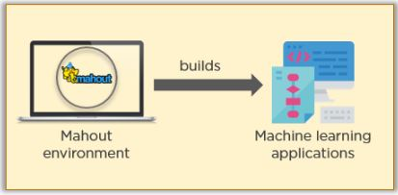
Mahout
Mahout is used to create scalable and distributed machine learning algorithms such as clustering, linear regression, classification, and so on.
It has a library that contains built-in algorithms for collaborative filtering, classification, and clustering.

Slide 43
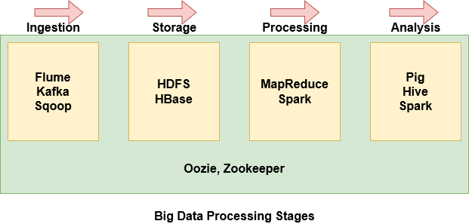
Stages of Big Data Processing
Notes:
With so many components within the Hadoop ecosystem, it can become pretty intimidating and difficult to understand what each component is doing.
Therefore, it is easier to group some of the components together based on where they lie in the stage of Big Data processing.
Flume, Kafka, and Sqoop are used to ingest data from external sources into HDFS
HDFS is the storage unit of Hadoop. Even data imported from Hbase is stored over HDFS
MapReduce and Spark are used to process the data on HDFS and perform various tasks
Pig, Hive, and Spark are used to analyze the data
Oozie helps to schedule tasks. Since it works with various platforms, it is used throughout the stages
Zookeeper synchronizes the cluster nodes and is used throughout the stages as well

Slide 44
Terms Related to HDFS
Replication:
Done by the datanode.
HeartBeat:
It is the signal that is sent by the datanode continuously to the namenode.
If the namenode does not receive the heartbeat from a node, then it will consider the datanode as “dead”.
Balancing:
If a datanode is dead / crashed, the blocks present on it are lost!
The blocks will be considered as “under-replicated” compared to the other blocks.
Master node (namenode) will give a signal to the other datanodes containing the replicas (of the blocks in question) to replicate so as to have an overall distribution of the blocks and it is all balanced.
NO TWO REPLICAS OF A BLOCK ARE PRESENT ON THE SAME DATANODE!

Slide 45
Limitations of HDFS
Small file is a problem:
For large number of small files, there will be lots of seeks (read/write) and lots of movement from one node to another to retrieve each small file.
This process is very inefficient due to file i/o.
Low latency data access:
Applications that require low-latency access to data, i.e.; within milliseconds will not work well with HDFS.

