Slide 1
YARN
Ajay J. Singala

Slide 2
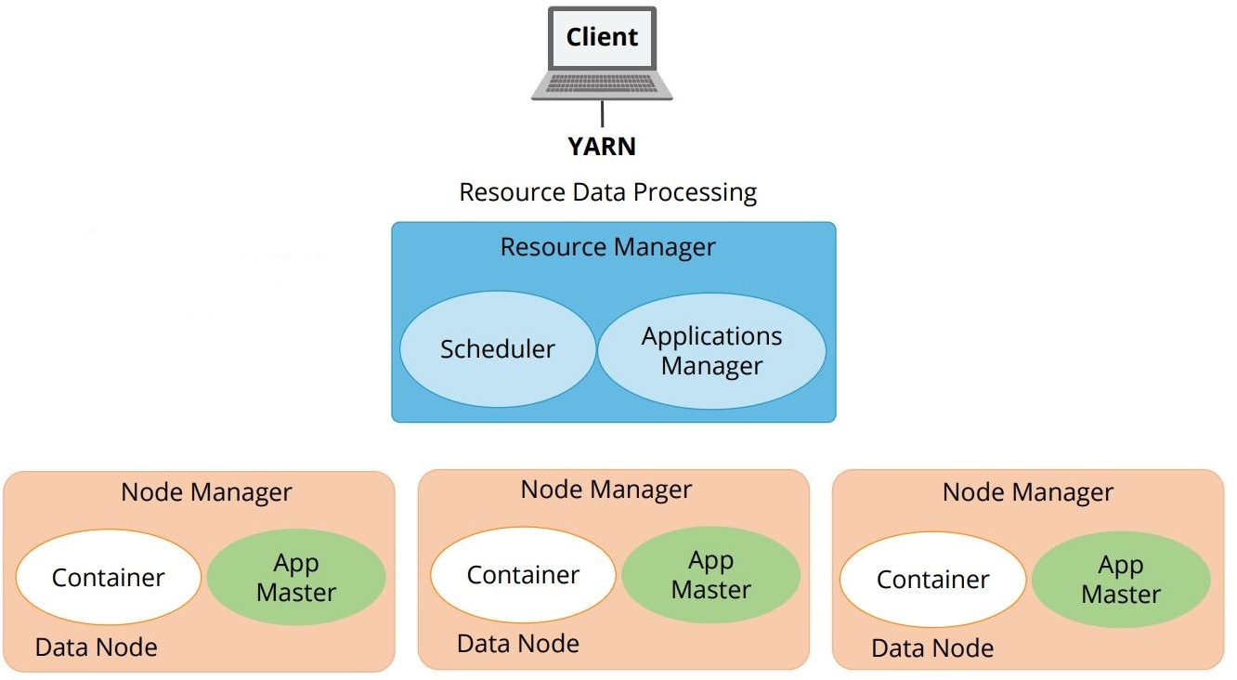
YARN Architecture
The three important elements of the YARN architecture are:
Resource Manager
Application Master
Node Managers
Notes:
Resource Manager:
The ResourceManager, or RM, which is usually one per cluster, is the master server.
Resource Manager knows the location of the DataNode and how many resources they have.
This information is referred to as Rack Awareness.
The RM runs several services, the most important of which is the Resource Scheduler that decides how to assign the resources.
Application Master:
The Application Master is a framework-specific process that negotiates resources for a single application, that is, a single job or a directed acyclic graph of jobs, which runs in the first container allocated for the purpose.
Each Application Master requests resources from the Resource Manager and then works with containers provided by Node Managers.
Node Managers:
The Node Managers can be many in one cluster.
They are the slaves of the infrastructure.
When it starts, it announces itself to the RM and periodically sends a heartbeat to the RM.
Each Node Manager offers resources to the cluster.
The resource capacity is the amount of memory and the number of v-cores, short for the virtual core.
At run-time, the Resource Scheduler decides how to use this capacity.
A container is a fraction of the NodeManager capacity, and it is used by the client to run a program.
Each Node Manager takes instructions from the ResourceManager and reports and handles containers on a single node.

Slide 3
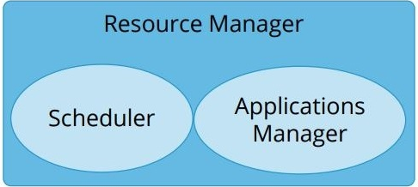
YARN – Resource Manager
Two main components
Scheduler and
Applications Manager
Notes:
The first element of YARN architecture is ResourceManager.
The RM mediates the available resources in the cluster among competing applications with the goal of maximum cluster utilization.
It includes a pluggable scheduler called the YarnScheduler, which allows different policies for managing constraints such as capacity, fairness, and Service Level Agreements.
The Resource Manager has two main components - Scheduler and Applications Manager.
The Scheduler :
Is responsible for allocating resources to various running applications depending on the common constraints of capacities, queues, and so on.
It does not monitor or track the status of the application.
Also, it does not restart the tasks in case of any application or hardware failures.
The Scheduler performs its function based on the resource requirements of the applications.
It does so based on the abstract notion of a resource container that incorporates elements such as memory, CPU, disk, and network.
The Scheduler has a policy plugin which is responsible for partitioning the cluster resources among various queues and applications.
The current MapReduce schedulers such as the Capacity Scheduler and the Fair Scheduler are some examples of the plug-in.
The Capacity Scheduler supports hierarchical queues to enable a more predictable sharing of cluster resources.
The Application Manager:
Is an interface which maintains a list of applications that have been submitted, currently running, or completed.
The Application Manager is responsible for accepting job-submissions, negotiating the first container for executing the application-specific Application Master and restarting the Application Master container on failure.

Slide 4
YARN – Application Master
A framework-specific library.
Negotiates resources from the RM and works with the NodeManager or Managers to execute and monitor containers and their resource consumption.
Manages the application lifecycle.
Notes:
The second element of YARN architecture is the Application Master (the one in green).
The Application Master in YARN is a framework-specific library, which negotiates resources from the RM and works with the NodeManager or Managers to execute and monitor containers and their resource consumption.
While an application is running, the Application Master manages the application lifecycle, dynamic adjustments to resource consumption, execution flow, faults, and it provides status and metrics.
The Application Master is architected to support a specific framework and can be written in any language. It uses extensible communication protocols with the Resource Manager and the Node Manager.
The Application Master can be customized to extend the framework or run any other code. Because of this, the Application Master is not considered trustworthy and is not run as a trusted service.
In reality, every application has its own instance of an Application Master. However, it is feasible to implement an Application Master to manage a set of applications, for example, an Application Master for Pig or Hive to manage a set of MapReduce jobs.

Slide 5
YARN – Node Manager
Sets up the container environment.
Monitors the health of the node
Reporting to the ResourceManager when a hardware or software issue occurs.
Runs on each node and manages activities:
container lifecycle management,
container dependencies,
container leases,
node and container resource usage,
node health, and
log management
Notes:
The third element of YARN architecture is the Node Manager (the one in orange).
When a container is leased to an application, the NodeManager sets up the container environment.
The environment includes the resource constraints specified in the lease and any kind of dependencies, such as data or executable files.
The Node Manager monitors the health of the node, reporting to the ResourceManager when a hardware or software issue occurs so that the Scheduler can divert resource allocations to healthy nodes until the issue is resolved.
The Node Manager also offers a number of services to containers running on the node such as a log aggregation service.
The Node Manager runs on each node and manages the activities such as container lifecycle management, container dependencies, container leases, node and container resource usage, node health, and log management and reports node and container status to the Resource Manager.

Slide 6
YARN – Node Manager - Container
A collection of a specific set of resources.
The Application Master must provide a Container Launch Context or CLC.
The CLC supports the Application Master to use containers.
Notes:
A YARN container (the one in white) is a collection of a specific set of resources to use in certain amounts on a specific node.
It is allocated by the ResourceManager on the basis of the application.
The Application Master presents the container to the Node Manager on the node where the container has been allocated, thereby gaining access to the resources.
The Application Master must provide a Container Launch Context or CLC.
This includes information such as Environment variables, dependencies on the requirement of data files or shared objects prior to the launch, security tokens, and the command to create the process to launch the application.
The CLC supports the Application Master to use containers.
This helps to run a variety of different kinds of work, from simple shell scripts to applications to a virtual operating system.

