Slide 1
Hive
Ajay J. Singala

Slide 2

Hive
Hive is a distributed data warehouse system developed by Facebook.
Hive is a data warehouse system that is used to query and analyze large datasets stored in the HDFS.
Hive uses a query language called HiveQL (aka HQL), which is similar to SQL.
Notes:
Hive is a distributed data warehouse system developed by Facebook.
Facebook adopted the Hadoop framework to manage their big data.
Hadoop uses MapReduce to process data.
With MapReduce, users were required to write long and extensive Java code.
Not all users were well-versed with Java and other coding languages.
Users were comfortable with writing queries in SQL (Structured Query Language), and they wanted a language similar to SQL.
Enter the HiveQL language.
The idea was to incorporate the concepts of tables and columns, just like SQL.
Hive is a data warehouse system that is used to query and analyze large datasets stored in the HDFS.
Hive uses a query language called HiveQL, which is similar to SQL.
As seen from the image,
The user first sends out the Hive queries.
These queries are converted into MapReduce tasks that accesses the Hadoop MapReduce system.

Slide 3
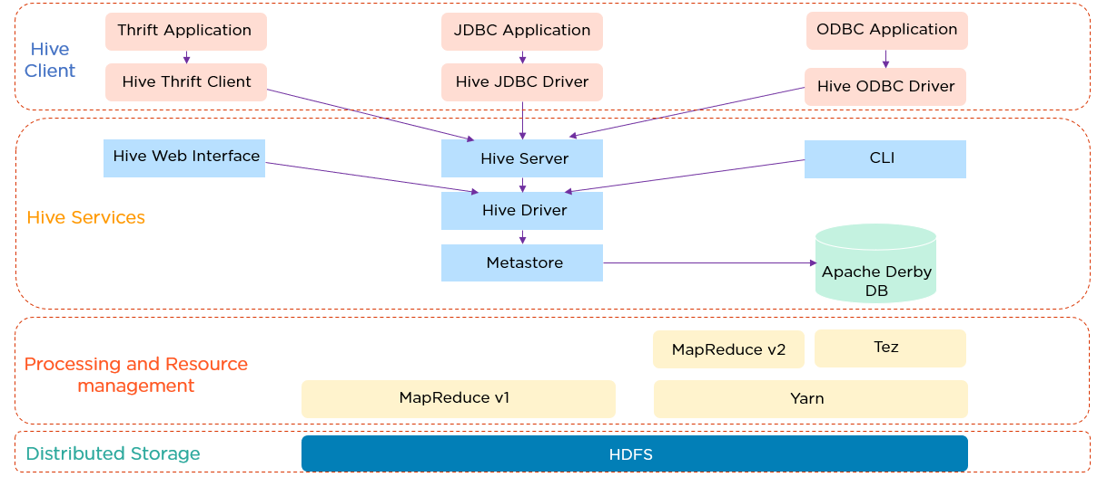
Hive Architecture
Notes:
The Hive client supports different types of client applications in different languages to perform queries.
Thrift is a software framework.
The Hive Server is based on Thrift, so it can serve requests from all of the programming languages that support Thrift.
Next, we have the JDBC (Java Database Connectivity) application and Hive JDBC Driver.
The JDBC application is connected through the JDBC Driver.
Then we have an ODBC (Open Database Connectivity) application connected through the ODBC Driver.
All these client requests are submitted to the Hive server.
Then there are the Hive Services that has the Hive web interface, or GUI, where programmers execute Hive queries.
Commands can also be executed directly in CLI.
Up next is the Hive driver, which is responsible for all the queries submitted.
It performs three steps internally:
Compiler - The Hive driver passes the query to the compiler, where it is checked and analyzed
Optimizer - Optimized logical plan in the form of a graph of MapReduce and HDFS tasks is obtained
Executor - In the final step, the tasks are executed
Metastore is a repository for Hive metadata.
It stores metadata for Hive tables, and you can think of this as your schema.
This is located on the Apache Derby DB.
Hive uses the MapReduce framework to process queries.
Finally, we have distributed storage, which is HDFS.
Let’s see how does the data flow in the Hive.

Slide 4
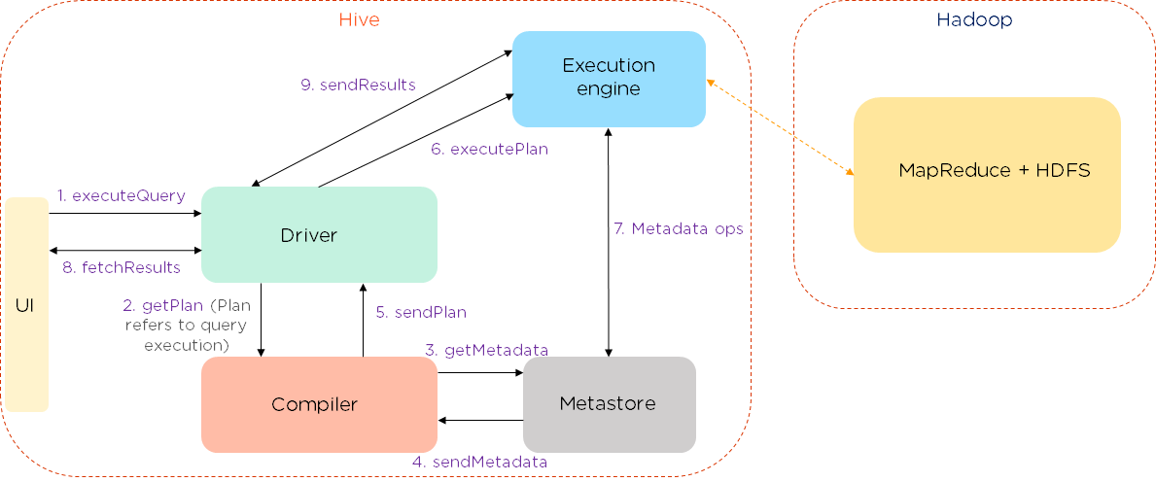
Hive Data Flow
Notes:
The data flows in the following sequence:
We execute a query, which goes into the driver.
Then the driver asks for the plan, which refers to the query execution.
After this, the compiler gets the metadata from the metastore.
The metastore responds with the metadata.
The compiler gathers this information and sends the plan back to the driver.
Now, the driver sends the execution plan to the execution engine.
The execution engine acts as a bridge between the Hive and Hadoop to process the query. In addition to this, the execution engine also communicates bidirectionally with the metastore to perform various operations, such as create and drop tables.
Finally, we have a bidirectional communication to fetch and send results back to the client.
Now take a look at Hive data modeling, which consists of tables, partitions, and buckets.

Slide 5
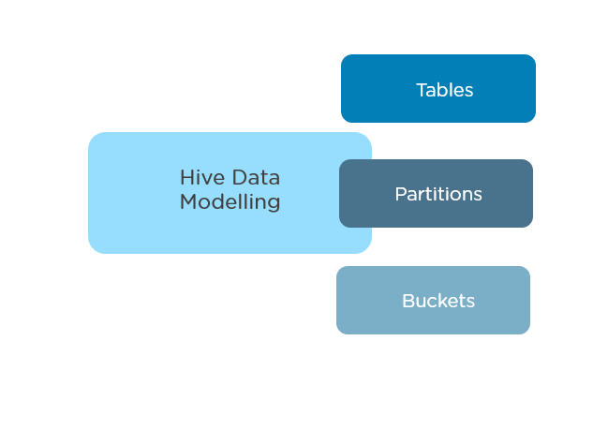
Hive Data Modeling
Tables
Partitions
Buckets
Notes:
Hive data modelling consists of tables, partitions, and buckets:
Tables - Tables in Hive are created the same way it is done in RDBMS.
Partitions - Here, tables are organized into partitions for grouping similar types of data based on the partition key.
Buckets - Data present in partitions can be further divided into buckets for efficient querying.
Let us dive into the Hive data types.

Slide 6
Hive Data Types
Primitive Data Types:
Numeric - Data types like integral, float, decimal
String - Data types like char, string
Date/Time - Data types like timestamp, date, interval
Miscellaneous - Data types like Boolean and binary
Complex Data Types:
Arrays - A collection of the same entities.
Syntax: array<data_type>
Maps - A collection of key-value pairs.
Syntax: map<primitive_type, data_type>
Structs - A collection of complex data with comments.
Syntax: struct<col_name : data_type [COMMENT col_comment],…..>
Units - A collection of heterogeneous data types.
Syntax: uniontype<data_type, data_type,..>

Slide 7
Hive Modes
Hive operates in two modes depending on the number and size of data nodes:
Local Mode
MapReduce Mode
Notes:
Hive operates in two modes depending on the number and size of data nodes. They are:
Local Mode
Used when Hadoop has one data node, and the amount of data is small.
Here, the processing will be very fast on smaller datasets, which are present in local machines.
MapReduce Mode
Used when the data in Hadoop is spread across multiple data nodes.
Processing large datasets can be more efficient using this mode.

Slide 8
Hive vs RDBMS
Hive | RDBMS
Hive enforces schema on reading | RDBMS enforces schema on write
Hive data size is in petabytes | Data size is in terabytes
Hive is based on the notion of write once and read many times | RDBMS is based on the notion of reading and write many times
Hive resembles a traditional database by supporting SQL, but it is not a database; it is a data warehouse | RDBMS is a type of database management system, which is based on the relational model of data
Easily scalable at low cost | Not scalable at low cost

Slide 9
Hive Features
The use of a SQL-like language called HiveQL in Hive is easier than long codes.
In Hive, tables are used that are similar to RDBMS, hence easier to understand.
By using HiveQL, multiple users can simultaneously query data.
Hive supports a variety of data formats.

Slide 10
Hive Demo

