Slide 1
MapReduce
Ajay J. Singala

Slide 2
Scenario
Consider a library that has an extensive collection of books that live on several floors; you want to count the total number of books on each floor.
Notes:
What would be your approach?
Completing this task by yourself would be tedious.
A different approach would be to assign each floor to a colleague so that the books from each floor are counted simultaneously by different people.
This approach is called parallel processing, making tasks easier to complete.
Technically, parallel processing refers to using multiple machines that contribute their RAM and CPU cores for data processing.
This is the concept of the Hadoop framework, where you not only store data across different machines, but you can also process the data locally.
The Apache Hadoop and Spark parallel computing systems let programmers use MapReduce to run models over large distributed sets of data, as well as use advanced statistical and machine learning techniques to make predictions, find patterns, uncover correlations, etc.

Slide 3
Overview of MapReduce
Processing engine of Hadoop.
Two phases in the MapReduce programming model:
Mapping
Reducing
Notes:
MapReduce is the processing engine of Hadoop that processes and computes large volumes of data.
It allows businesses and other organizations to run calculations to:
Determine the price for their products that yields the highest profits
Know precisely how effective their advertising is and where they should spend their ad dollars
Make weather predictions
Mine web clicks, sales records purchased from retailers, and Twitter trending topics to determine what new products the company should produce in the upcoming season
Before MapReduce, these calculations were complicated. Now, programmers can tackle problems like these with relative ease. Data scientists have coded complex algorithms into frameworks so that programmers can use them.
Companies no longer need an entire department of Ph.D. scientists to model data, nor do they need a supercomputer to process large sets of data, as MapReduce runs across a network of low-cost commodity machines.

Slide 4
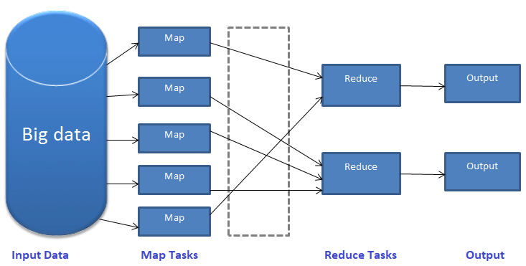
Mapping and Reducing
Notes:
Input Data:
Hadoop accepts data in various formats and stores it in HDFS. This input data is worked upon by multiple map tasks.
Map Tasks:
Map reads the data, processes it, and generates key-value pairs. The number of map tasks depends upon the input file and its format.
Typically, a file in a Hadoop cluster is broken down into blocks, each with a default size of 128 MB. Depending upon the size, the input file is split into multiple chunks. A map task then runs for each chunk. The mapper class has mapper functions that decide what operation is to be performed on each chunk.
Reduce Tasks:
In the reducing phase, a reducer class performs operations on the data generated from the map tasks through a reducer function.
It shuffles, sorts, and aggregates the intermediate key-value pairs (tuples) into a set of smaller tuples.
Output:
The smaller set of tuples is the final output and gets stored in HDFS.

Slide 5
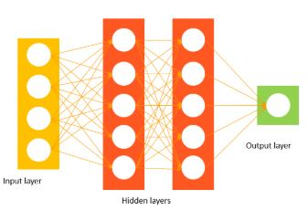
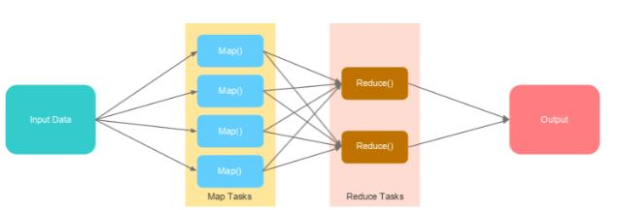
Mapping and Reducing
A mapper class handles the mapping phase.
It maps the data present in different datanodes.
A reducer class handles the reducing phase
It aggregates and reduces the output of different datanodes to generate the final output.
Notes:
A mapper class handles the mapping phase.
It maps the data present in different datanodes.
A reducer class handles the reducing phase
It aggregates and reduces the output of different datanodes to generate the final output.
Data that is stored on multiple machines pass through mapping.
The final output is obtained after the data is shuffled, sorted, and reduced.

Slide 6
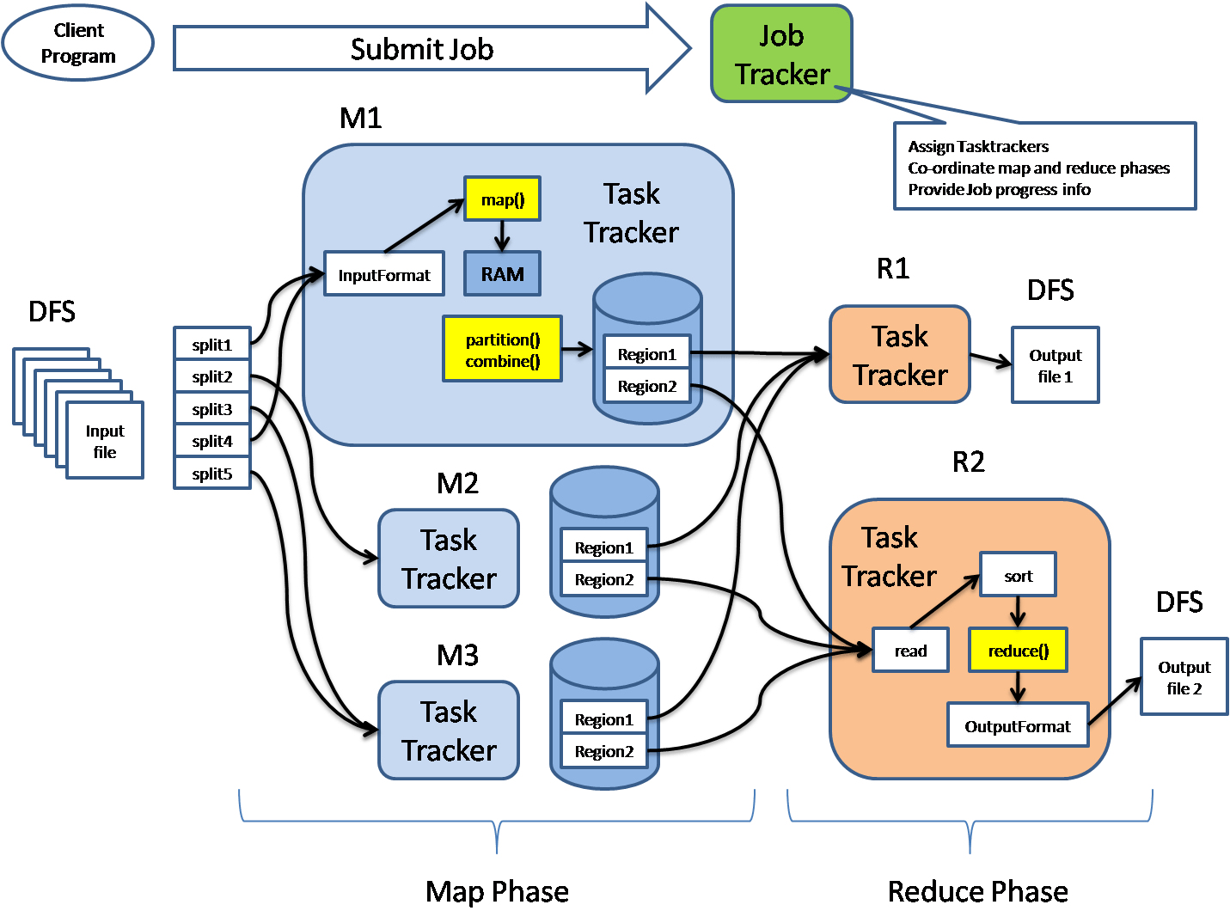
MapReduce Architecture
Notes:
MapReduce architecture consists of various components. A brief description of these components can improve our understanding on how MapReduce works.
Job: This is the actual work that needs to be executed or processed
Task: This is a piece of the actual work that needs to be executed or processed. A MapReduce job comprises many small tasks that need to be executed.
Job Tracker: This tracker plays the role of scheduling jobs and tracking all jobs assigned to the task tracker.
Task Tracker: This tracker plays the role of tracking tasks and reporting the status of tasks to the job tracker.
Input data: This is the data used to process in the mapping phase.
Output data: This is the result of mapping and reducing.
Client: This is a program or Application Programming Interface (API) that submits jobs to the MapReduce. MapReduce can accept jobs from many clients.
Hadoop MapReduce Master: This plays the role of dividing jobs into job-parts.
Job-parts: These are sub-jobs that result from the division of the main job.
In the MapReduce architecture, clients submit jobs to the MapReduce Master.
This master will then sub-divide the job into equal sub-parts.
The job-parts will be used for the two main tasks in MapReduce: mapping and reducing.
The developer will write logic that satisfies the requirements of the organization or company.
The input data will be split and mapped.
The intermediate data will then be sorted and merged.
The reducer that will generate a final output stored in the HDFS will process the resulting output.

Slide 7
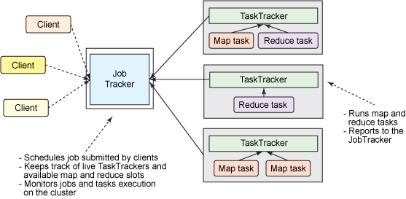
Job Trackers and Task Trackers
Notes:
Every job consists of two key components: mapping task and reducing task.
The map task plays the role of splitting jobs into job-parts and mapping intermediate data.
The reduce task plays the role of shuffling and reducing intermediate data into smaller units.
The job tracker acts as a master.
It ensures that we execute all jobs.
The job tracker schedules jobs that have been submitted by clients.
It will assign jobs to task trackers.
Each task tracker consists of a map task and reduces the task.
Task trackers report the status of each assigned job to the job tracker.

Slide 8
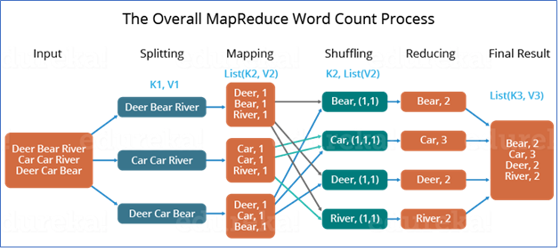
Phases of MapReduce
Notes:
Phases of MapReduce:
The MapReduce program is executed in three main phases: mapping, shuffling, and reducing. There is also an optional phase known as the combiner phase.
Mapping Phase
This is the first phase of the program. There are two steps in this phase: splitting and mapping. A dataset is split into equal units called chunks (input splits) in the splitting step. Hadoop consists of a RecordReader that uses TextInputFormat to transform input splits into key-value pairs.
The key-value pairs are then used as inputs in the mapping step. This is the only data format that a mapper can read or understand. The mapping step contains a coding logic that is applied to these data blocks. In this step, the mapper processes the key-value pairs and produces an output of the same form (key-value pairs).
Shuffling phase
This is the second phase that takes place after the completion of the Mapping phase. It consists of two main steps: sorting and merging. In the sorting step, the key-value pairs are sorted using the keys. Merging ensures that key-value pairs are combined.
The shuffling phase facilitates the removal of duplicate values and the grouping of values. Different values with similar keys are grouped. The output of this phase will be keys and values, just like in the Mapping phase.
Reducer phase
In the reducer phase, the output of the shuffling phase is used as the input. The reducer processes this input further to reduce the intermediate values into smaller values. It provides a summary of the entire dataset. The output from this phase is stored in the HDFS.
The diagram shows an example of a MapReduce with the three main phases. Splitting is often included in the mapping stage.
Combiner phase
This is an optional phase that’s used for optimizing the MapReduce process.
It’s used for reducing the pap outputs at the node level. In this phase, duplicate outputs from the map outputs can be combined into a single output.
The combiner phase increases speed in the Shuffling phase by improving the performance of Jobs.
The diagram on the next slide shows how all the four phases of MapReduce have been applied.

Slide 9
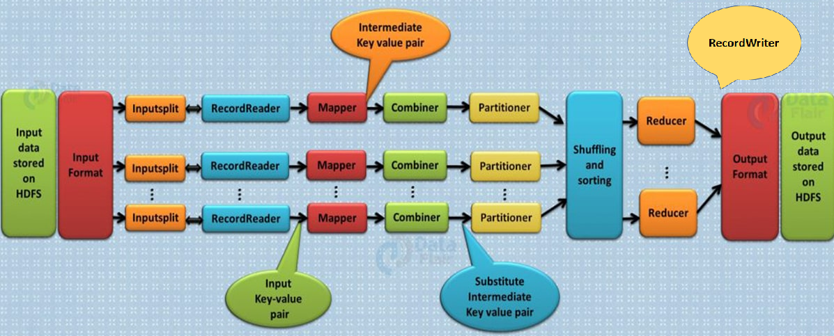
MapReduce Workflow
Notes:
The input data that needs to be processed using MapReduce is stored in HDFS. The processing can be done on a single file or a directory that has multiple files.
The input format defines the input specification and how the input files would be split and read.
The input split logically represents the data to be processed by an individual mapper.
RecordReader communicates with the input split and converts the data into key-value pairs suitable to be read by the mapper.
The mapper works on the key-value pairs and gives an intermittent output, which goes for further processing.
Combiner is a mini reducer that performs mini aggregation on the key-value pairs generated by the mapper.
Partitioner decides how outputs from combiners are sent to the reducers.
The output of the partitioner is shuffled and sorted. This output is fed as input to the reducer.
The reducer combines all the intermediate values for the intermediate keys into a list called tuples.
The RecordWriter writes these output key-value pairs from reducer to the output files.
The output data gets stored in HDFS.

Slide 10
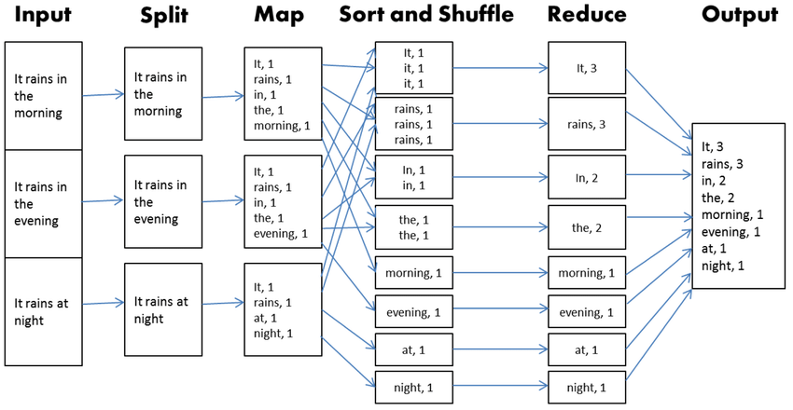
MapReduce Workflow Example

