Slide 1
MapReduce
Ajay J. Singala

Slide 2
Scenario
Consider a library that has an extensive collection of books that live on several floors; you want to count the total number of books on each floor.
Notes:
What would be your approach?
Completing this task by yourself would be tedious.
A different approach would be to assign each floor to a colleague so that the books from each floor are counted simultaneously by different people.
This approach is called parallel processing, making tasks easier to complete.
Technically, parallel processing refers to using multiple machines that contribute their RAM and CPU cores for data processing.
This is the concept of the Hadoop framework, where you not only store data across different machines, but you can also process the data locally.
The Apache Hadoop and Spark parallel computing systems let programmers use MapReduce to run models over large distributed sets of data, as well as use advanced statistical and machine learning techniques to make predictions, find patterns, uncover correlations, etc.

Slide 3
Overview of MapReduce
Processing engine of Hadoop.
Two phases in the MapReduce programming model:
Mapping
Reducing
Notes:
MapReduce is the processing engine of Hadoop that processes and computes large volumes of data.
It allows businesses and other organizations to run calculations to:
Determine the price for their products that yields the highest profits
Know precisely how effective their advertising is and where they should spend their ad dollars
Make weather predictions
Mine web clicks, sales records purchased from retailers, and Twitter trending topics to determine what new products the company should produce in the upcoming season
Before MapReduce, these calculations were complicated. Now, programmers can tackle problems like these with relative ease. Data scientists have coded complex algorithms into frameworks so that programmers can use them.
Companies no longer need an entire department of Ph.D. scientists to model data, nor do they need a supercomputer to process large sets of data, as MapReduce runs across a network of low-cost commodity machines.

Slide 4
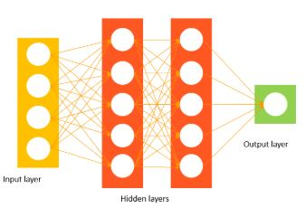
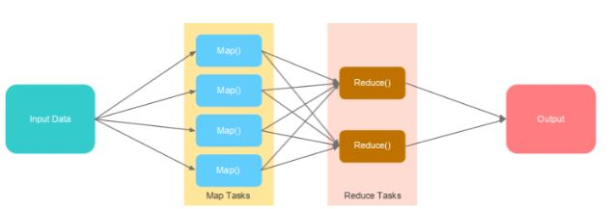
Mapping and Reducing
A mapper class handles the mapping phase.
It maps the data present in different datanodes.
A reducer class handles the reducing phase
It aggregates and reduces the output of different datanodes to generate the final output.
Notes:
A mapper class handles the mapping phase.
It maps the data present in different datanodes.
A reducer class handles the reducing phase
It aggregates and reduces the output of different datanodes to generate the final output.
Data that is stored on multiple machines pass through mapping.
The final output is obtained after the data is shuffled, sorted, and reduced.

Slide 5
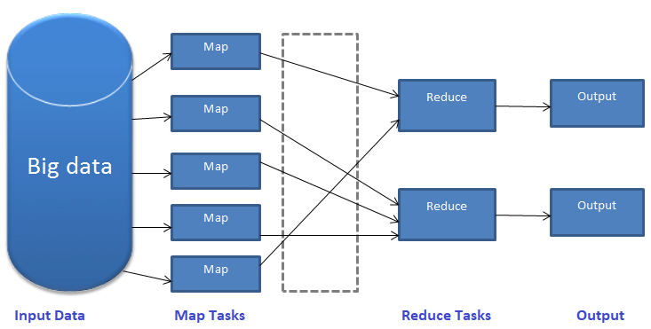
Mapping and Reducing
Notes:
Input Data:
Hadoop accepts data in various formats and stores it in HDFS. This input data is worked upon by multiple map tasks.
Map Tasks:
Map reads the data, processes it, and generates key-value pairs. The number of map tasks depends upon the input file and its format.
Typically, a file in a Hadoop cluster is broken down into blocks, each with a default size of 128 MB. Depending upon the size, the input file is split into multiple chunks. A map task then runs for each chunk. The mapper class has mapper functions that decide what operation is to be performed on each chunk.
Reduce Tasks:
In the reducing phase, a reducer class performs operations on the data generated from the map tasks through a reducer function.
It shuffles, sorts, and aggregates the intermediate key-value pairs (tuples) into a set of smaller tuples.
Output:
The smaller set of tuples is the final output and gets stored in HDFS.

Slide 6
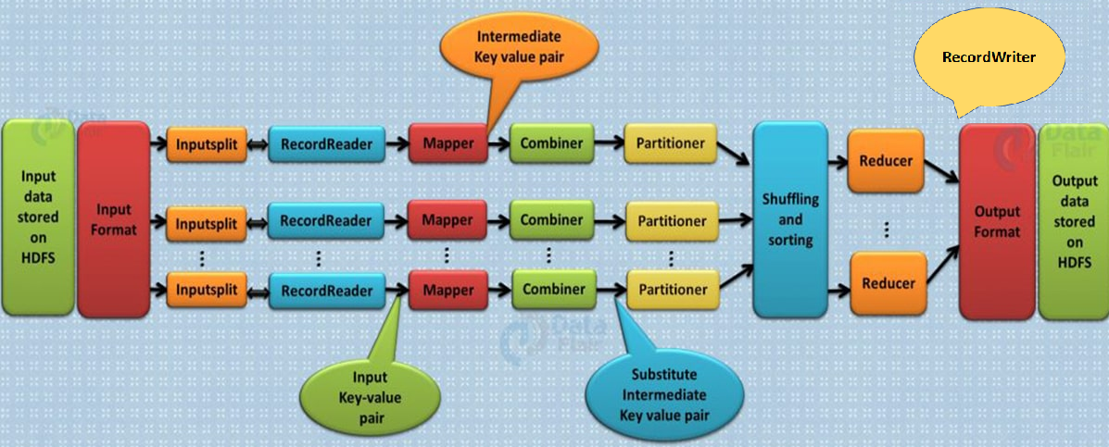
MapReduce Workflow
Notes:
The input data that needs to be processed using MapReduce is stored in HDFS. The processing can be done on a single file or a directory that has multiple files.
The input format defines the input specification and how the input files would be split and read.
The input split logically represents the data to be processed by an individual mapper.
RecordReader communicates with the input split and converts the data into key-value pairs suitable to be read by the mapper.
The mapper works on the key-value pairs and gives an intermittent output, which goes for further processing.
Combiner is a mini reducer that performs mini aggregation on the key-value pairs generated by the mapper.
Partitioner decides how outputs from combiners are sent to the reducers.
The output of the partitioner is shuffled and sorted. This output is fed as input to the reducer.
The reducer combines all the intermediate values for the intermediate keys into a list called tuples.
The RecordWriter writes these output key-value pairs from reducer to the output files.
The output data gets stored in HDFS.

Slide 7
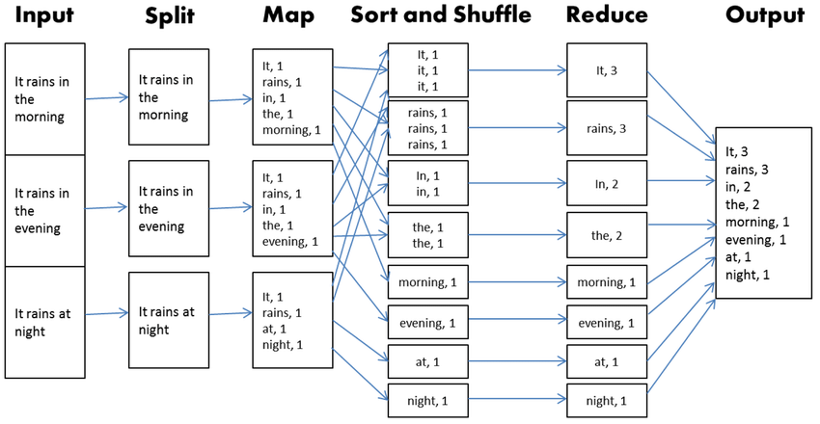
MapReduce Workflow Example

