Slide 1
PROMPTING
FUNDAMENTALS
From “Ask AI” to “Engineer the Request”
Design prompts that are clear, useful, repeatable and reviewable.
Microsoft Copilot Chat
GitHub Copilot
WinTrust AI Capability Program

Slide 2

Ajay J. Singala​
>30 years of experience​.
Enterprise / Solution Architect, Trainer, Mentor, ex-CTO.
Tech Stack: Microsoft, Azure, AWS, Big Data, AI/ML/DL/Gen AI/Agentic AI.​
Formula 1 Racing, Gamer, Travel, Photography, Souvenirs, Coins, Fridge Magnets, Shot Glasses, Keychains (not necessarily in this order)​.

Slide 3

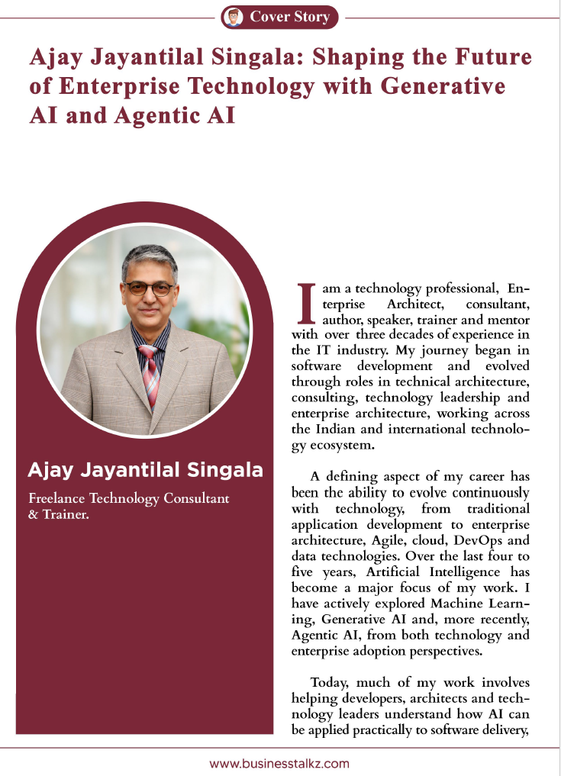

Slide 4
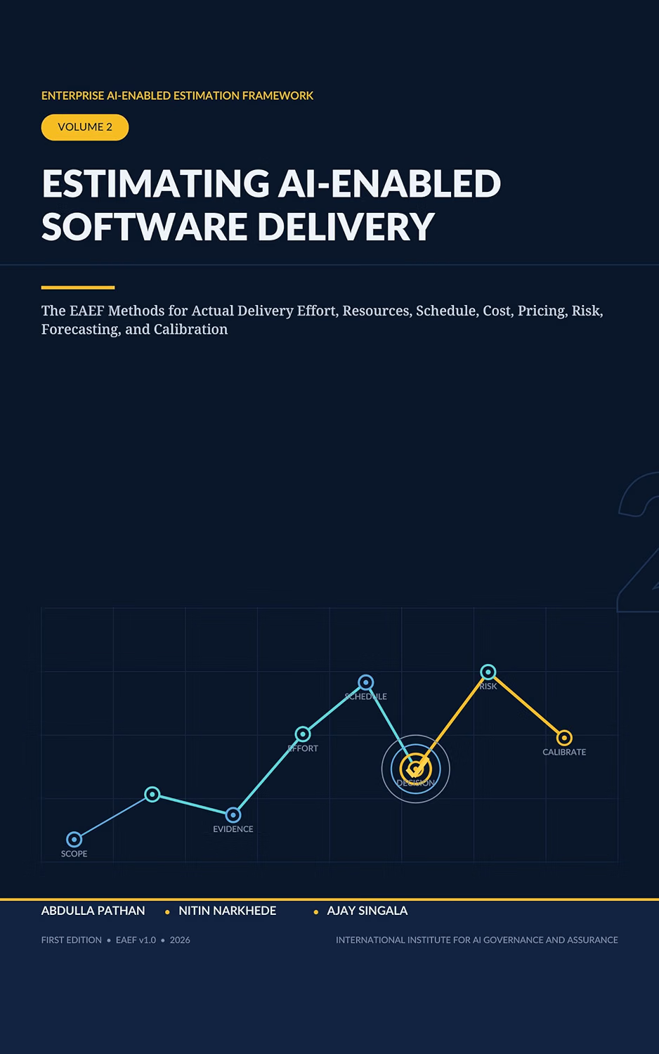
https://amzn.in/d/0f8eRvrU

Slide 5
Learning Objectives
Give AI enough context to do useful work
Specify the outcome you actually need
Control assumptions and ambiguity
Define the expected output
Validate AI responses
Adapt prompts to Data and Enterprise Operations work
WinTrust AI Capability Program

Slide 6
Today's Learning Journey
A practical path from vague requests to reliable AI work.
UNDERSTAND
SEE
BUILD
What prompting controls
Weak vs strong requests
Prompt anatomy
PRACTICE
DOCTOR
REFINE
Data + Ops examples
Rewrite five weak prompts
Test, compare, improve
WinTrust AI Capability Program

Slide 7
What Is a Prompt?
A prompt is more than a question.
“
WEAK
A useful prompt communicates intent, context, task, constraints and expected output.
“Analyze these tickets.”
STRONG
“You are a WinTrust operations analyst. Review the supplied tickets against the SLA policy. Identify SLA breaches and escalation candidates. Do not infer missing information. Return evidence and recommendation in a table.”
WinTrust AI Capability Program

Slide 8
Anatomy of a High-Quality Prompt
Use the components that reduce ambiguity.
Component | Question
Role | Who should AI act as?
Context | What does it need to know?
Task | What exactly should it do?
Criteria | What defines a good answer?
Constraints | What must it / must it not do?
Output | What should the answer look like?
Validation | How should the result be checked?
WinTrust AI Capability Program

Slide 9
Context Is Not the Same as Instructions
CONTEXT
TASK
CONSTRAINT
OUTPUT
WinTrust has defined SLAs for different incident severities.
Identify tickets that have breached their SLA.
Use only the supplied SLA policy.
Return a table with evidence.
Separate the situation, the work, the boundaries and the result.
WinTrust AI Capability Program

Slide 10
The Most Important Prompting Principle
DON’T ASK AI TO “FIGURE EVERYTHING OUT.”
Tell AI what “good” looks like.
DEFINED
VAGUE
“Identify issues that…
Prioritize them using…
Support each finding with…
Do not assume…
Return…”
“What are the important issues?”
WinTrust AI Capability Program

Slide 11
Prompt Specificity
More detail does not automatically mean a better prompt.
TOO VAGUE
TOO RESTRICTIVE
RIGHT LEVEL
“Analyze the data.”
“Analyze these 300 rows using exactly these 27 steps…”
“Analyze for revenue leakage and operational anomalies. Prioritize by business impact. Show evidence and flag assumptions.”
Goal: minimum ambiguity, not maximum prompt length.
WinTrust AI Capability Program

Slide 12
Zero-Shot, Few-Shot and Examples
Examples can communicate the pattern you want.
ZERO-SHOT
FEW-SHOT
“Classify this ticket as P1, P2, P3 or P4.”
Example 1: Critical customer + major service disruption → P1
Example 2: Minor documentation issue → P4
Now classify the following ticket.
Important: an example is not automatically a business rule.
WinTrust AI Capability Program

Slide 13
Structured Output
Ask for a usable result, not just an answer.
INSTEAD OF
ASK FOR
“
Ticket | Severity | SLA | Evidence | Recommendation
INC-1042 | P2 | Breached | ... | Escalate
INC-1057 | P4 | Within | ... | Monitor
Analyze the tickets.
Structured output makes AI easier to review, compare, validate and reuse.
WinTrust AI Capability Program

Slide 14
Data Track vs Enterprise Operations
Same prompting principles. Different work.
DATA
ENTERPRISE OPERATIONS
SQL generation
Data-quality investigation
ETL transformation
Analytics
Data validation
Documentation
Ticket triage
Incident analysis
Runbooks
Scripting
Operational reporting
Root-cause investigation
The framework stays the same. The context and constraints change.
WinTrust AI Capability Program

Slide 15
Copilot Chat vs GitHub Copilot
Two Copilots. Different jobs.
Copilot Chat | GitHub Copilot
Analyze | Generate code
Summarize | Explain code
Research | Review code
Transform | Generate tests
Compare | Refactor
Reason through a problem | Debug
Generate → Explain → Review → Test → Challenge → Approve
WinTrust AI Capability Program

Slide 16
Live Demo: Bad Prompt
Start with the weak request. Do not fix it yet.
Analyze these tickets and tell me what is important.
RUN IT
What is missing?
Role • Definition of “important” • Business context • Criteria • Output • Evidence • Validation
Better
Strong
Production-oriented
WinTrust AI Capability Program

Slide 17
Live Demo: Improved Prompt
Same task. Better specification.
PROMPT
You are a WinTrust operations analyst.
Review the supplied operational tickets against the WinTrust SLA policy.
Identify tickets that have breached their SLA, require escalation, or show evidence of increasing operational risk.
For every finding, cite the evidence from the ticket.
Do not infer missing information.
Return: Ticket ID | Severity | SLA Status | Evidence | Recommendation
ROLE
CONTEXT
TASK
CONSTRAINTS
OUTPUT
VALIDATION
WinTrust AI Capability Program

Slide 18
Track Specific Prompt Demos
Data & Enterprise Ops
DATA TRACK PROMPT
Review the operations ticket data from a data-analysis perspective. Identify patterns that could indicate data-quality, reporting, integration or upstream-data issues. Separate genuine data signals from symptoms that may simply reflect application or infrastructure problems.
ENTERPRISE OPS TRACK PROMPT
Review the operations tickets from an operations-management perspective. Identify tickets that require escalation based on severity, customer criticality, SLA exposure and affected transactions. Return Ticket ID, reason, urgency and recommended next action. Use only evidence from the dataset and SLA policy.
ROLE
CONTEXT
TASK
CONSTRAINTS
OUTPUT
VALIDATION
WinTrust AI Capability Program

Slide 19
Prompt Quality Test
Before you press Enter
1
Is the task unambiguous?
2
Does AI have enough context?
3
Have I defined “good”?
4
Have I constrained assumptions?
5
Is the output usable?
6
Can I validate the answer?
If your prompt fails several checks, fix the prompt before blaming the model.
WinTrust AI Capability Program

Slide 20
Prompt Doctor Framework
Use this checklist for every weak prompt.
ROLE
CONTEXT
TASK
CRITERIA
Who should AI be?
What does it need to know?
What exactly should it do?
What makes the answer good?
CONSTRAINTS
OUTPUT
VALIDATION
What must it not assume/do?
What should I receive?
How will I check it?
Use the components that reduce ambiguity. Not every prompt needs the same amount of detail.
WinTrust AI Capability Program

Slide 21
Prompt Doctor: Data Example
From “find problems” to rule-based investigation.
WEAK
BETTER
“Find the data quality problems in this file.”
You are a data-quality analyst.
Review the supplied transaction dataset against the approved WinTrust data-quality rules.
For each issue provide: Record ID | Field | Rule Violated | Evidence | Severity | Recommended Action.
Do not classify unusual values as errors unless a defined rule is violated. Do not invent missing values.
Key distinction: an anomaly is not automatically a data-quality error.
WinTrust AI Capability Program

Slide 22
Prompt Doctor: Enterprise Operations Example
Evidence first. Assumptions visible.
WEAK
BETTER
“Analyze these tickets and tell me what is important.”
You are a WinTrust operations analyst.
Review the supplied tickets against the WinTrust Operations SLA Policy.
Identify SLA breaches and tickets requiring escalation.
For each finding provide: Ticket ID | Severity | SLA Status | Evidence | Escalation Recommendation.
Use only information in the ticket and policy. Clearly identify missing information. Do not infer a root cause unless evidence supports it.
Do not let the model silently convert a symptom into a root cause.
WinTrust AI Capability Program

Slide 23
Compare the Outputs
Evaluate quality, not writing style.
Dimension | Original | Revised
Completeness
Evidence
Assumptions
Consistency
Usability
Validation
Which output would you trust more in a real business workflow, and what would you still verify?
WinTrust AI Capability Program

Slide 24
Prompting Is Iterative
The first prompt is rarely the final prompt.
PROMPT
OUTPUT
REVIEW
IDENTIFY GAP
REFINE
NEW OUTPUT
VALIDATE
Prompt → output → inspect → refine → test → validate
WinTrust AI Capability Program

Slide 25
Don't Fix the Prompt Until You Understand the Failure
A poor answer does not always mean a poor prompt.
Missing context
Ambiguous task
Wrong assumptions
AI does not have the information it needs.
Multiple reasonable interpretations exist.
The prompt silently embeds an assumption.
Bad source data
Capability limit
Wrong tool
The input itself is incomplete or wrong.
The task is beyond what the model can reliably do.
A deterministic or specialist tool is more appropriate.
WinTrust AI Capability Program

Slide 26
Prompting Anti-Patterns
Five common mistakes to watch for.
TOO VAGUE
TOO LITTLE CONTEXT
HIDDEN ASSUMPTIONS
NO OUTPUT SPEC
NO VALIDATION
“Analyze this.”
“What's the best option?”
“Explain why the customer is unhappy.”
“Give me some insights.”
“Tell me the answer.”
Safer wording: distinguish facts, evidence, interpretation and recommendation.
WinTrust AI Capability Program

Slide 27
Enterprise Prompting = Quality + Control
A production-grade prompt supports a repeatable business task.
USEFUL
SPECIFIC
EVIDENCE-BASED
REPEATABLE
REVIEWABLE
SAFE
“Production-grade” does not mean “very long”. It means clear boundaries, useful outputs and appropriate validation.
WinTrust AI Capability Program

Slide 28
Start Building Your Prompt Library Today
Capture what works, what fails and how you validated it.
Capture | Why it matters
Prompt | Reusable instruction
Use Case | When to use it
Input / Context | What it needs
Expected Output | What good looks like
What Worked / Failed | Learning
Validation Method | How you checked it
Improved Version | Current best prompt
The goal is not a collection of clever prompts. It is a reusable work asset.
WinTrust AI Capability Program

Slide 29
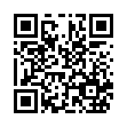
Feedback
https://www.surveymonkey.com/r/TC5BGXZ

Slide 30
Hands-on Lab: Prompt Doctor
Diagnose → Rewrite → Test → Compare
You will work with FIVE deliberately weak prompts.
1. DIAGNOSE
2. REWRITE
3. TEST
4. COMPARE
What is missing?
What is ambiguous?
What could AI assume?
Use the 7-part framework.
Run original and revised prompts.
Which output is more useful?
Start
Open: Participant_Handouts/Session_01_Prompt_Doctor.md
WinTrust AI Capability Program

Slide 31
Track Challenge
Turn one real task into a better prompt.
DATA
ENTERPRISE OPERATIONS
Choose one:
SQL
Data Quality
ETL
Analysis
Rewrite it using the prompt framework.
Choose one:
Ticket Triage
Incident Analysis
Runbook
Reporting
Rewrite it using the prompt framework.
Choose a task you actually perform in 10–30 minutes, not a six-month transformation project.
WinTrust AI Capability Program

Slide 32
Key Takeaways
Six habits to carry into every AI interaction.
1
Be clear about the task.
2
Give AI the context it needs.
3
Define what good looks like.
4
Constrain assumptions.
5
Specify a usable output.
6
Always validate important results.
“
The best prompt isn't the cleverest prompt. It is the prompt that consistently produces an output you can evaluate and use.
WinTrust AI Capability Program

Slide 33
FROM PROMPTING
TO WORKING WITH AI
ASK
SPECIFY
EVALUATE
REFINE
VALIDATE
NEXT SESSION
AI for Research & Executive Communication
WinTrust AI Capability Program

Slide 34
Thank you

