Slide 1
WINTRUST | AI CAPABILITY PROGRAM
Problem Solving
& Prototyping
Turn an ambiguous problem into a testable, reviewable prototype
Copilot Chat + GitHub Copilot
Generate → Explain → Review → Test → Challenge → Approve
WINTRUST | PROBLEM SOLVING & PROTOTYPING
01

Slide 2
Why this session matters
• Many AI-assisted solutions fail because the problem was never made precise.
• Generated code can look convincing while implementing the wrong rule.
• A prototype is useful only when requirements, assumptions and limits are visible.
• Today is about a small, testable, reviewable prototype, not a production system.
WINTRUST | PROBLEM SOLVING & PROTOTYPING
02

Slide 3
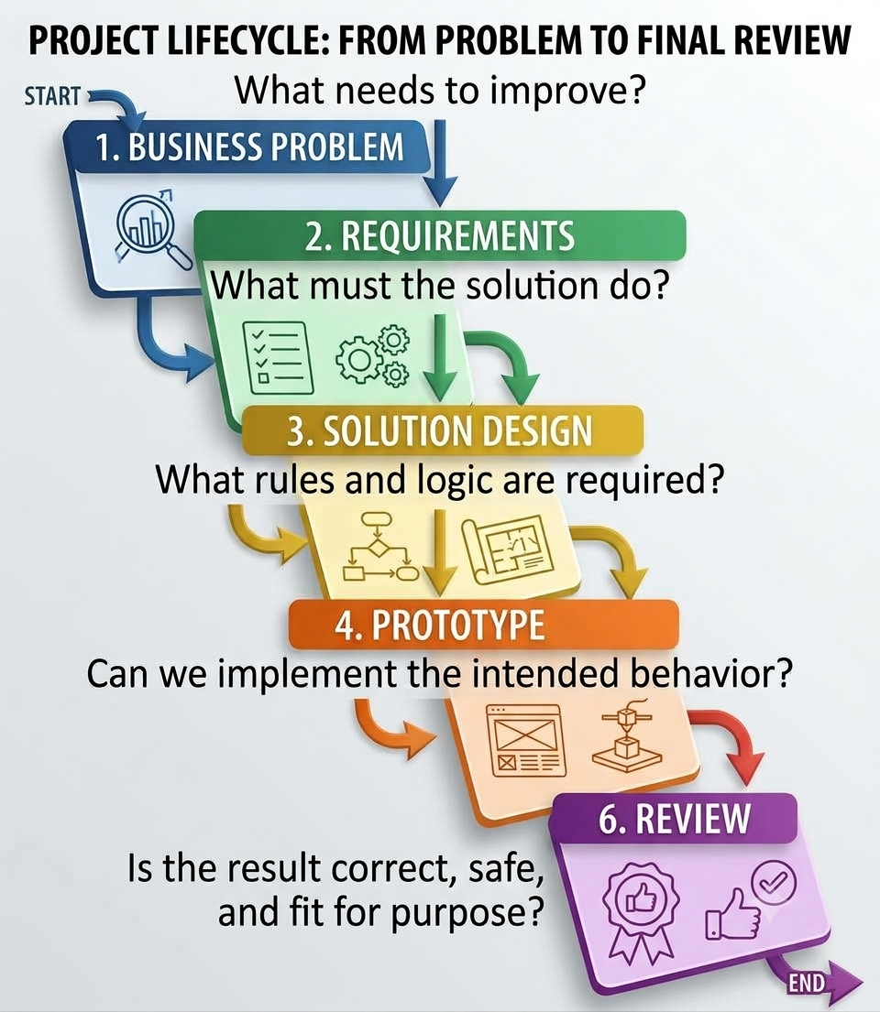
The problem-solving lifecycle
CORE MODEL
• Do not let speed skip the steps that make the result safe and useful.
WINTRUST | PROBLEM SOLVING & PROTOTYPING
03

Slide 4
Vague request vs. testable problem
REQUIREMENTS
• Vague:
“Build something that prioritizes operational tickets.”
• Missing: inputs, rules, boundaries, outputs, exceptions and acceptance criteria.
• Testable:
“Create a deterministic Python function that evaluates a ticket using documented severity and SLA rules, returns an explainable classification, identifies whether escalation is required, and handles invalid or missing inputs explicitly.”
• If two developers could implement different behaviours, clarify the request.
WINTRUST | PROBLEM SOLVING & PROTOTYPING
04

Slide 5
A compact problem-definition framework
REQUIREMENTS
• Problem and user: what task needs support, and who uses the result?
• Inputs and outputs: what information is supplied and what must be returned?
• Rules and assumptions: what is known and what needs confirmation?
• Exceptions and constraints: what can be invalid, unsafe or out of scope?
• Acceptance criteria: what observable tests prove the behaviour is correct?
WINTRUST | PROBLEM SOLVING & PROTOTYPING
05

Slide 6
Demo 1 | Clarify before coding
COPILOT CHAT PROMPT
Act as a senior business analyst and solution designer.
WinTrust wants a small Python prototype for deterministic operational ticket triage. It should evaluate ticket information and produce an explainable result.
Do not write code yet.
Produce: business problem and users; inputs and outputs; rules to confirm; errors and exceptions; security constraints; acceptance criteria; decisions requiring human approval.
Separate established requirements, assumptions and unanswered questions. Do not invent WinTrust policies or SLA thresholds. Finish with the five most important questions before implementation.
WINTRUST | PROBLEM SOLVING & PROTOTYPING
06

Slide 7
Acceptance criteria make behaviour testable
REQUIREMENTS
• Normal: valid ticket within SLA returns a clear result.
• Boundary: elapsed time exactly equals SLA is not a breach under the training rule.
• Exception: unsupported severity or invalid time is rejected.
• Priority: a P1 ticket is escalated under the training rule.
• Explainability: result states which rule caused escalation.
• Safety: no ticket updates, external calls or notifications.
• These are training rules for this exercise, not confirmed production policy.
WINTRUST | PROBLEM SOLVING & PROTOTYPING
07

Slide 8
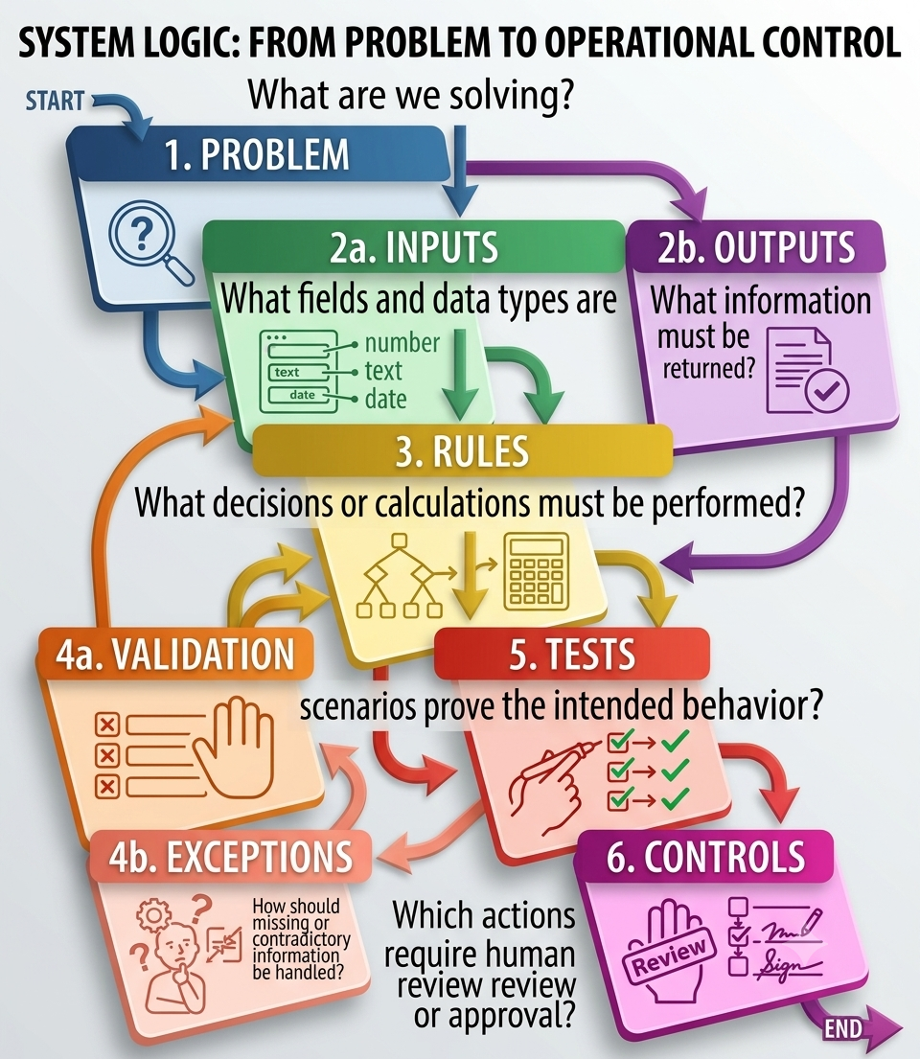
Turn requirements into solution design
SOLUTION DESIGN
• Inputs: ticket ID, severity, elapsed minutes, SLA minutes and supplied fields.
• Validation: reject missing identifiers, unsupported severity and invalid numeric values.
• Decision rules: implement only agreed rules, in a visible order.
• Outputs: structured result with decision, SLA status and reasons.
• Failure behaviour: raise a clear validation error rather than silently guessing.
• Out of scope: production integration, ticket updates, notifications and autonomous actions.
WINTRUST | PROBLEM SOLVING & PROTOTYPING
08

Slide 9
Demo 2A: Starter file | ticket_triage_starter.py
GITHUB COPILOT
from dataclasses import dataclass
@dataclass
class Ticket:
ticket_id: str
customer_criticality: str
severity: str
elapsed_minutes: int
sla_minutes: int
affected_transactions: int
symptom: str
def classify_ticket(ticket: Ticket) -> dict:
"""Implement deterministic training rules using GitHub Copilot."""
raise NotImplementedError
WINTRUST | PROBLEM SOLVING & PROTOTYPING
09

Slide 10
Demo 2A: The agreed training rules
IMPLEMENTATION CONTRACT
• Escalate a P1 ticket.
• A breach occurs only when elapsed_minutes > sla_minutes.
• A ticket that has breached its SLA must be escalated.
• Exactly at the SLA limit is not a breach.
• Reject unsupported severity; reject negative elapsed time and non-positive SLA.
• Reject negative affected_transactions and blank ticket_id.
• Return ticket_id, severity, sla_breached, escalate and reasons.
• No external services, side effects or additional invented rules.
WINTRUST | PROBLEM SOLVING & PROTOTYPING
10

Slide 11
Demo 2A: Copilot Chat | Review the design
DEMO PROMPT
Review the proposed ticket-triage design before implementation.
Create a decision table covering P1, SLA breach, both conditions and neither; input validation and expected errors; SLA boundary cases; output schema with explainable reasons; at least eight tests; risks and unresolved policy questions.
Use only the training rules. Do not add customer criticality, affected transaction volume or symptom as escalation rules. Do not write implementation code yet.
WINTRUST | PROBLEM SOLVING & PROTOTYPING
11

Slide 12
Demo 2B: GitHub Copilot | Implement the prototype
DEMO PROMPT
Implement classify_ticket in Code/ticket_triage_starter.py.
Rules: P1 escalates; breach means elapsed_minutes > sla_minutes; breached tickets escalate; exactly at limit is not a breach.
Reject unsupported severity, negative elapsed time, non-positive SLA, negative affected_transactions and blank ticket_id.
Return ticket_id, severity, sla_breached, escalate and reasons. Use deterministic Python, type hints and ValueError for invalid input. Preserve the dataclass.
No LLM or external service. No ticket changes or notifications. Do not invent rules. Explain the logic and list tests to run.
WINTRUST | PROBLEM SOLVING & PROTOTYPING
12

Slide 13
Starter test | readable and reviewable | test_ticket_triage.py
GITHUB COPILOT
from ticket_triage_starter import Ticket, classify_ticket
def test_critical_customer_sla_breach():
t = Ticket("INC-TEST-1", "Critical", "P2", 300, 240, 12000, "elevated response time")
assert classify_ticket(t)["escalate"] is True
def test_low_impact_ticket():
t = Ticket("INC-TEST-2", "Medium", "P4", 30, 2880, 2, "documentation issue")
assert classify_ticket(t)["escalate"] is False
The first test passes because of the SLA breach, not because customer criticality is a rule.
WINTRUST | PROBLEM SOLVING & PROTOTYPING
14

Slide 14
Start with tests, not trust | Generate meaningful tests
TESTING
• Existing tests are a starting point, not proof of correctness.
• Add P1 within SLA, P2 with breach, P4 within SLA, and P1 plus breach.
• Test the exact boundary and one minute beyond it.
• Test unsupported severity, negative elapsed time, zero SLA, negative impact count and blank ID.
• Check both the decision and explanation returned.
• Never weaken a valid test just to make generated code pass.
Demo 2C: Ask GitHub Copilot to expand the tests
WINTRUST | PROBLEM SOLVING & PROTOTYPING
13

Slide 15
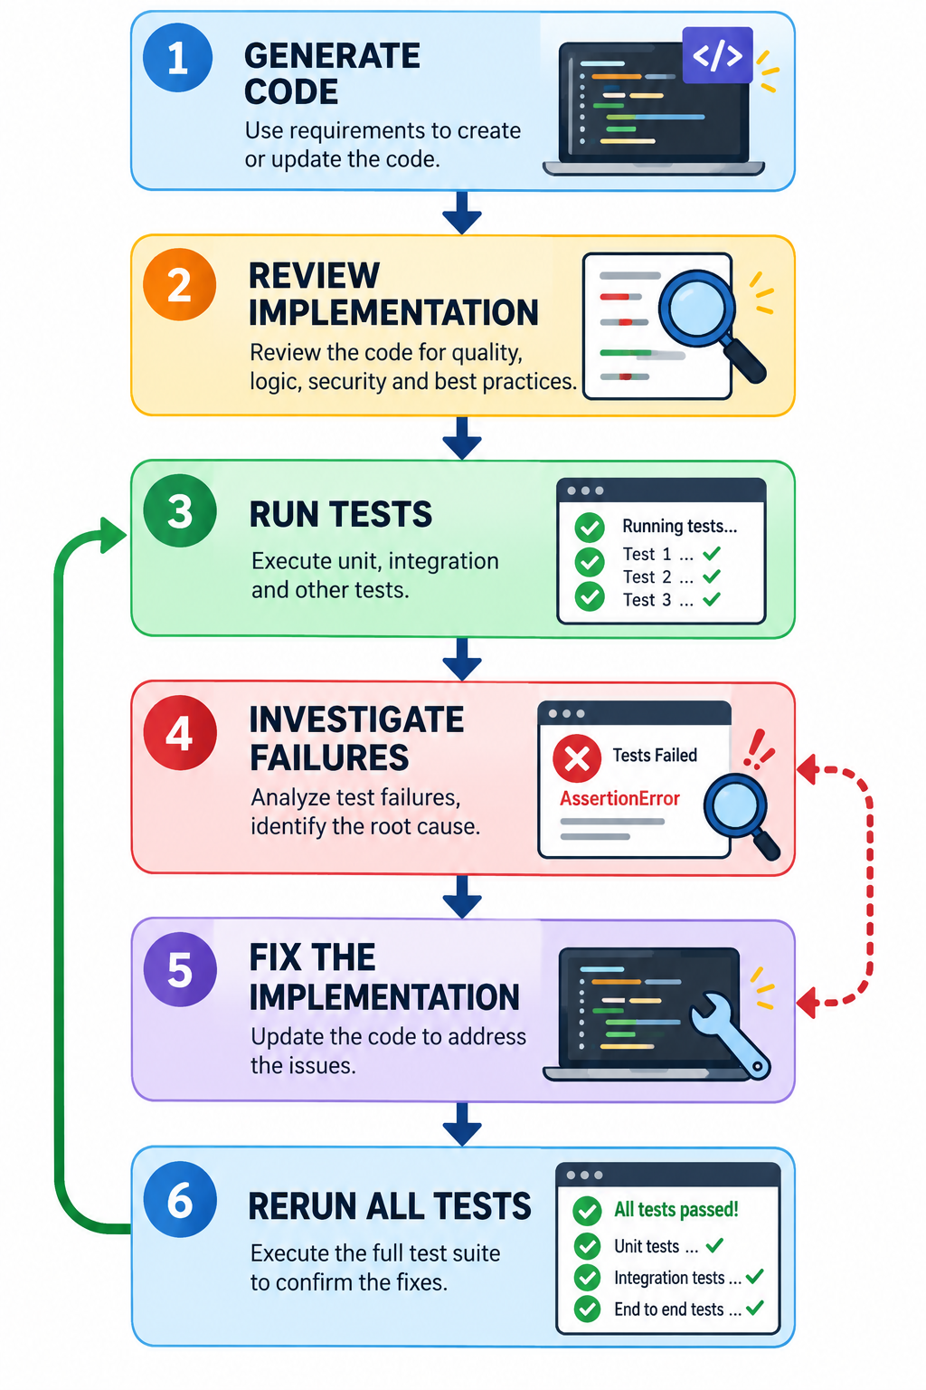
A disciplined test workflow
GITHUB COPILOT
• Generate implementation → Review against rules → Run tests → Investigate failures → Fix implementation → Run all tests again.
• A green test suite is evidence for the tested cases, not proof of universal correctness.
• If a test fails, understand the cause before changing code or tests.
WINTRUST | PROBLEM SOLVING & PROTOTYPING
15

Slide 16
Demo 3 | Challenge the prototype
CRITICAL REVIEW
• Ask Copilot to identify likely correctness defects.
• Check whether code implements exactly the documented rules.
• Inspect validation order, boundary comparisons and error messages.
• Look for hidden dependencies, side effects and unnecessary complexity.
• Check whether tests could pass even if the logic were wrong.
• Ask for evidence in the code and a test that would expose each issue.
WINTRUST | PROBLEM SOLVING & PROTOTYPING
16

Slide 17
Copilot Chat | Code review prompt
CRITICAL REVIEW PROMPT
Sample Prompt:
Review classify_ticket against the stated training rules.
For each finding provide severity, exact code evidence, why it matters, a minimal correction and a test that would detect it.
Check boundaries, invalid inputs, returned fields, explanation quality, unsupported rules, side effects, complexity and test coverage.
Do not claim tests were executed unless you actually ran them. Do not add new business rules.
WINTRUST | PROBLEM SOLVING & PROTOTYPING
17

Slide 18
Contradictory or incomplete inputs
RELIABILITY
• Severity says P1, but an operator note says “low priority.” Which field is authoritative?
• SLA minutes is zero or missing. Reject, request clarification, or default?
• A ticket mentions many affected transactions, but no impact-based rule exists.
• Do not let generated code silently resolve policy conflicts. Surface ambiguity and route the decision to an accountable human.
WINTRUST | PROBLEM SOLVING & PROTOTYPING
18

Slide 19
Deterministic rules vs. AI judgment
DESIGN PRINCIPLE
• Good fit for deterministic code: SLA comparison, required-field validation, allowed-value checks, reproducible reports and explicit decision reasons.
• Potential fit for AI assistance: summarize long incident descriptions, suggest likely categories for human review, draft explanations from approved facts, find themes across unstructured notes.
• Keep policy decisions deterministic where possible and human accountability visible.
WINTRUST | PROBLEM SOLVING & PROTOTYPING
19

Slide 20
Data Track | SQL-based data-quality investigation
TRACK APPLICATION
Objective: Use GitHub Copilot to translate data-quality requirements into SQL queries that identify invalid or suspicious records.
Scenario: The WinTrust data team receives transaction data from upstream systems. Before using it for reporting, the team needs to identify records that violate agreed data-quality rules.
Input file: transactions_500.csv from the existing demo pack.
Proposed checks, subject to confirming the source schema:
Missing transaction or customer identifiers.
Invalid transaction dates.
Unsupported currency codes.
Unsupported product codes.
Negative transaction amounts.
Duplicate transaction identifiers.
Missing or unexpected status values, where an approved status vocabulary exists.
WINTRUST | PROBLEM SOLVING & PROTOTYPING
20

Slide 21
Define the rules before generating SQL
DATA TRACK
Check | Rule | Expected result
Transaction ID | Must not be null or blank | Flag invalid rows
Customer ID | Must not be null or blank | Flag invalid rows
Transaction date | Must be a valid date in YYYY-MM-DD format | Flag invalid rows
Currency code | Must belong to the approved set | Flag unsupported values
Product code | Must belong to the approved set | Flag unsupported values
Amount | Must be numeric and non-negative | Flag invalid amounts
Duplicate ID | Check repeated transaction IDs | Report duplicates for investigation
Status | Compare against an approved list, if available | Do not invent allowed values
WINTRUST | PROBLEM SOLVING & PROTOTYPING
21

Slide 22
Data Track Demo: GitHub Copilot | Generate SQL data-quality checks
DATA TRACK PROMPT
Ask Copilot to inspect the schema or work from the confirmed column list.
Review its proposed rules before accepting the SQL.
Generate one query at a time, starting with missing identifiers.
Ask Copilot to explain each query.
Run the SQL in the selected SQL environment.
Compare the results against a few manually checked records.
Ask Copilot to challenge its own query for missed cases.
WINTRUST | PROBLEM SOLVING & PROTOTYPING
22

Slide 23
Data Track Demo | Challenge the generated SQL
DATA TRACK
Review the SQL data-quality checks you generated.
Check for:
Incorrect or invented column names
Incorrect handling of NULL and blank values
Invalid date handling, including impossible calendar dates
Duplicate detection that produces misleading counts
Incorrect treatment of negative, NULL or non-numeric amounts
Hard-coded allowed values that lack approval
Queries that flag records incorrectly or miss invalid records
SQL dialect incompatibilities
Unnecessary modification of source data
For every issue:
Show the relevant SQL
Explain the problem
Provide a corrected query or expression
Give a test record that would expose the problem
Distinguish issues you can establish from the SQL itself from issues that require execution against the dataset.
Do not claim that the queries passed tests unless they were run and their results were inspected.
WINTRUST | PROBLEM SOLVING & PROTOTYPING
23

Slide 24
Enterprise Ops | Keep the prototype safe
ENTERPRISE OPS
• Suitable exercises: ticket classification, SLA checks, log summarization and report generation.
• Use supplied sample data, local files and read-only checks.
• For operational automation, begin with dry-run output and explicit approval.
• Do not execute destructive commands, change production settings or send notifications.
• A prototype is not production-ready until controls, ownership and rollback are addressed.
WINTRUST | PROBLEM SOLVING & PROTOTYPING
24

Slide 25
Prototype quality checklist
REVIEW GATE
• Correctness: does the code implement the agreed rules?
• Validation: are missing, malformed and boundary inputs handled?
• Explainability: can a reviewer understand each result?
• Tests: are normal, edge and invalid cases covered?
• Safety: are side effects and privileged actions absent?
• Maintainability: is the code readable and reasonably simple?
• Human control: are unresolved decisions routed to an owner?
WINTRUST | PROBLEM SOLVING & PROTOTYPING
25

Slide 26
Hands-on lab | Build, test and challenge
LAST 30 MINUTES
• Enterprise Ops files: Code/ticket_triage_starter.py and Code/test_ticket_triage.py.
Implement deterministic triage, run tests and challenge the result.
• Data files: transactions_500.csv
The WinTrust data team must assess whether a transaction dataset is suitable for downstream reporting.
File: Participant_Handouts/Session_04_Problem_Solving.md
WINTRUST | PROBLEM SOLVING & PROTOTYPING
26

Slide 27
Hands-on workflow
LAB INSTRUCTIONS
Enterprise Operations participants
1. Read the starter files and clarify rules.
2. Prompt Copilot and inspect the generated code.
3. Review the code against requirements before running tests.
4. Run tests and investigate failures before making changes.
5. Challenge the result and document one limitation.
Do not change requirements without recording the decision. Finish by naming one control required before production.
Data participants
Use this sequence:
INSPECT SCHEMA → DEFINE RULES → GENERATE SQL → REVIEW → EXECUTE → VALIDATE RESULTS
Inspect schema: confirm the actual columns and types.
Define rules: agree what constitutes a defect.
Generate SQL: use Copilot to produce individual checks.
Review: challenge the generated queries before execution.
Execute: run them against the dataset.
Validate results: manually inspect sample records and reconcile counts.
Participants should not alter source data to make the checks pass. They should report the defects and their implications.
Start
WINTRUST | PROBLEM SOLVING & PROTOTYPING
27

Slide 28
Thank you

