Slide 1
WINTRUST | AI CAPABILITY PROGRAM
MC-II: UNDER THE HOOD
How LLMs work, why they fail, and how to troubleshoot them with confidence
Common Masterclass | Data + Enterprise Ops
• Microsoft Copilot Chat • GitHub Copilot (optional)

Slide 2
PURPOSE
Why this masterclass matters
AI can produce fluent answers that are incorrect.
Better prompts cannot compensate for missing evidence.
More context is not always better context.
Some tasks require retrieval, computation or testing, not more prompting.
High-impact actions still require appropriate controls and human judgment.
WINTRUST | AI CAPABILITY PROGRAM

Slide 3
OUTCOMES
Learning outcomes
Explain tokens, context windows, attention and next-token prediction.
Distinguish model knowledge from supplied evidence and retrieved information.
Diagnose common response failures and choose a suitable correction.
Apply grounding and verification to Data and Enterprise Ops tasks.
Recognize when deterministic tools or human approval are necessary.
WINTRUST | AI CAPABILITY PROGRAM

Slide 4
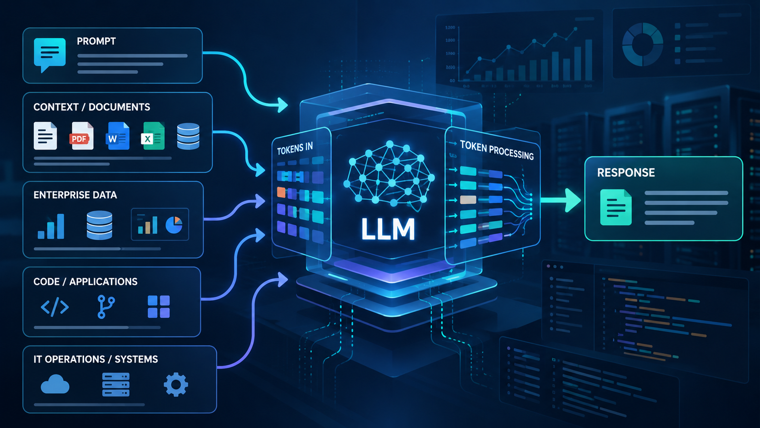
HOW MODELS WORK
How an LLM Works
WINTRUST | AI CAPABILITY PROGRAM

Slide 5
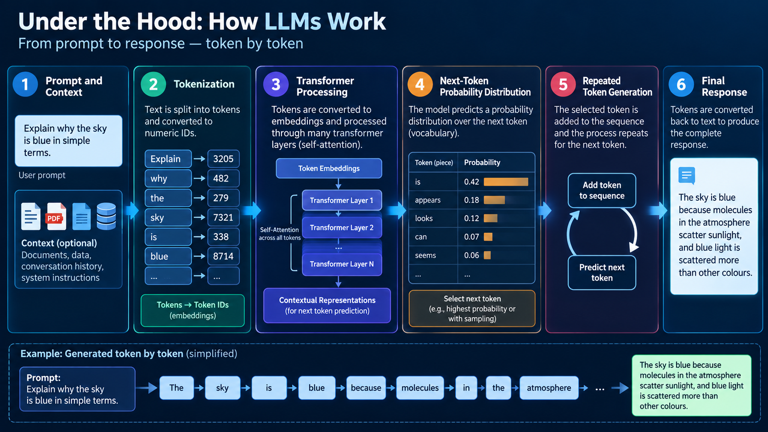
HOW MODELS WORK
An LLM predicts the next token
Prompt + context
Tokenization
Transformer
Next-token prediction
Repeated generation
›
›
›
›
Instructions and evidence
Text becomes tokens
Contextual processing
Probability distribution
Token by token
A generated response is not automatically a verified answer.
WINTRUST | AI CAPABILITY PROGRAM

Slide 6
HOW MODELS WORK
What is a token?
Tokens are model input units
Practical implication
• May be a whole word, part of a word, punctuation or another text unit.
• Do not estimate token counts by counting words.
• One word does not necessarily equal one token.
• Large inputs may compete for limited context.
• Longer prompts and documents generally consume more context.
• Keep the task and relevant evidence focused.
• Tokenization varies by model and tokenizer.
• Use product-specific limits rather than assuming one universal size.
WINTRUST | AI CAPABILITY PROGRAM

Slide 7
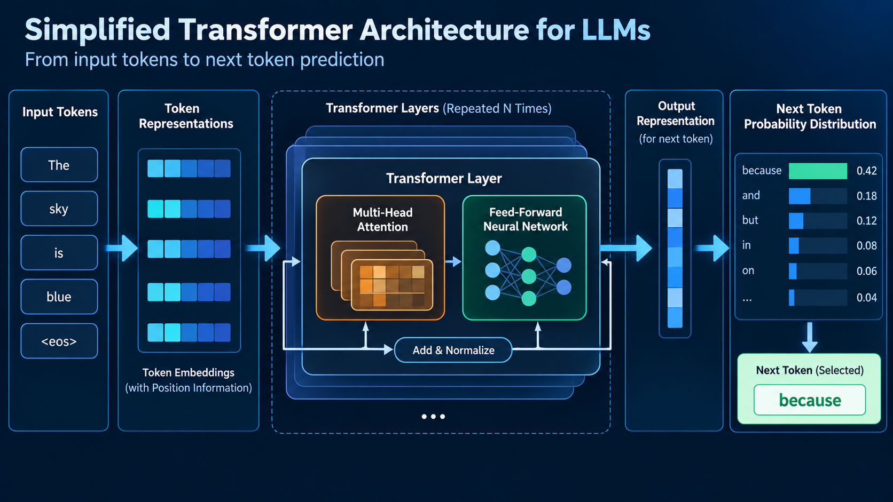
HOW MODELS WORK
What is a transformer?
Input tokens
Attention
Transformer layers
Output scores
›
›
›
Token representations
Relate context
Repeated processing
Next-token options
Attention helps model contextual relationships; it does not guarantee factual reasoning.
WINTRUST | AI CAPABILITY PROGRAM

Slide 8
HOW MODELS WORK
Training versus inference
Training
Inference
• Model parameters are learned from training data.
• The trained model processes a new request.
• Large-scale optimization shapes learned patterns.
• Prompt, context and configuration influence the response.
• Occurs during model development or subsequent training.
• A prompt normally changes the task, not the model's trained parameters.
WINTRUST | AI CAPABILITY PROGRAM

Slide 9
HOW MODELS FAIL
Why fluent answers can be wrong
Hallucinated details or references.
Incorrect calculations or faulty inference.
Misinterpreted or conflicting instructions.
Outdated knowledge or missing context.
A confident tone is not evidence of correctness.
WINTRUST | AI CAPABILITY PROGRAM

Slide 10
CONTEXT AND ATTENTION
Understanding the context window
May include instructions, prompt, conversation history, supplied or retrieved material, and generated tokens.
Long conversations and documents consume context.
Products may summarize, truncate or otherwise manage context.
A context limit does not guarantee perfect recall.
WINTRUST | AI CAPABILITY PROGRAM

Slide 11
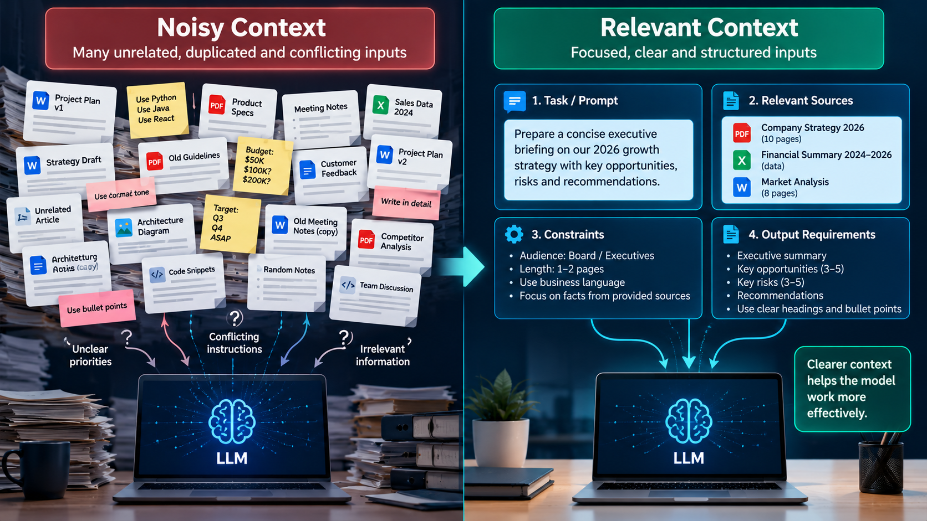
CONTEXT AND ATTENTION
More context is not always better
Noisy context
• Unrelated or duplicated documents.
• Conflicting instructions.
• Unclear source authority.
• Important facts buried in irrelevant material.
Relevant context
• Specific task and expected output.
• Relevant, trustworthy sources.
• Clear constraints and definitions.
• Explicit handling of missing evidence.
WINTRUST | AI CAPABILITY PROGRAM

Slide 12
CONTEXT AND ATTENTION
Attention and long-context limitations
Attention helps relate information across the available token sequence.
Relevant information may be harder to use when buried in long context.
Contradictions can create ambiguity.
Long context does not guarantee complete recall.
Put critical constraints up front and verify important claims.
WINTRUST | AI CAPABILITY PROGRAM

Slide 13
DISCUSSION
Checkpoint: diagnose the problem
Copilot summarizes an 80-page policy but omits an important exception.
Was the exception present in the supplied material?
Could Copilot access the document, and was the relevant section available?
Did the prompt explicitly request exceptions and limitations?
Compare the response against the source before assuming the prompt alone caused the failure.
WINTRUST | AI CAPABILITY PROGRAM

Slide 14
HOW MODELS FAIL
Five common failure patterns
Hallucination: plausible content unsupported by adequate evidence.
Ambiguity: the request permits multiple interpretations.
Missing context: necessary facts were not supplied or retrieved.
Instruction conflict: requirements contradict one another.
Reasoning or calculation error: faulty inference or computation.
WINTRUST | AI CAPABILITY PROGRAM

Slide 15
TROUBLESHOOTING
Match the failure to the fix
Failure → first corrective action
Other failure modes
• Ambiguous request → clarify task and constraints.
• Code defects → inspect implementation and test safely.
• Missing evidence → supply or retrieve relevant evidence.
• Unsafe recommendation → assess risk and apply controls.
• Unsupported claims → require evidence and explicit uncertainty.
• High-impact action → require appropriate authorization and approval.
• Incorrect calculation → use deterministic computation and verify.
• Do not use prompt rewriting as the universal solution.
WINTRUST | AI CAPABILITY PROGRAM

Slide 16
DEMO
Demo 1A: Same question, different context
Prompt 1
What caused the incident, and what should we do next?
Separate confirmed facts from assumptions. If the evidence is insufficient to determine the cause, say so.
WINTRUST | AI CAPABILITY PROGRAM

Slide 17
DEMO
Demo 1B: Supply incident evidence and Better Prompt
Incident record
Incident INC-2048
10:02 Monitoring detected a sharp increase in API response time.
10:04 API error rate increased from 0.5% to 8%.
10:06 Database CPU reached 94%.
10:08 A scheduled reporting job began.
10:12 API latency remained elevated.
No database execution plan, query log or dependency trace is available.
Using only this record, identify confirmed facts, plausible hypotheses, missing evidence, and safe non-destructive diagnostics. Do not claim the reporting job caused the incident.
WINTRUST | AI CAPABILITY PROGRAM

Slide 18
DEMO
Demo 2A: Improve the task definition
Initial prompt
Analyze these operational tickets and tell me what matters.
WINTRUST | AI CAPABILITY PROGRAM

Slide 19
DEMO
Demo 2B: Improved prompt
Use with ops_tickets_200.csv
Analyze the supplied operational tickets.
Return:
- Three recurring incident patterns, if supported by the data.
- Evidence for each pattern, including ticket references and counts where available.
- Severity or SLA concerns supported by the records.
- Missing information and limitations.
Do not invent ticket fields, infer causation from correlation, or claim that you executed queries or independently verified the data.
WINTRUST | AI CAPABILITY PROGRAM

Slide 20
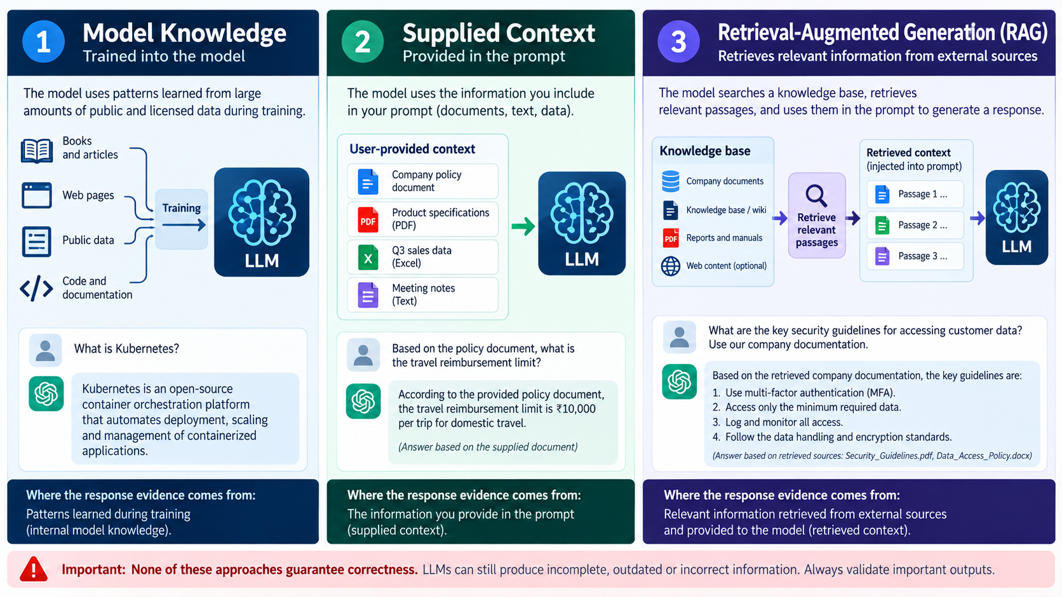
GROUNDING
Grounding, supplied context and RAG
Model knowledge
Supplied context
RAG retrieval
Context to model
›
›
›
Learned patterns
User-provided sources
Search relevant sources
Selected passages
Grounding improves evidence availability; it does not guarantee correctness.
WINTRUST | AI CAPABILITY PROGRAM

Slide 21
DEMO
Demo 3: Ground the answer in a runbook
Copilot Chat prompt
Using the supplied disk-utilization runbook, summarize the documented diagnostic and remediation steps.
For each step:
- State what the runbook explicitly says.
- Identify documented prerequisites or approval requirements.
- Flag risks to production availability or data integrity.
- Identify details the runbook does not specify.
Do not invent procedures or approval rules. Distinguish documented instructions from recommendations and reference the relevant section or wording where possible.
Required: WinTrust_Runbook_Disk_Utilization.docx | Optional: WinTrust_Operations_SLA_Policy.docx; WinTrust_GenAI_Security_Guidelines.docx
WINTRUST | AI CAPABILITY PROGRAM

Slide 22
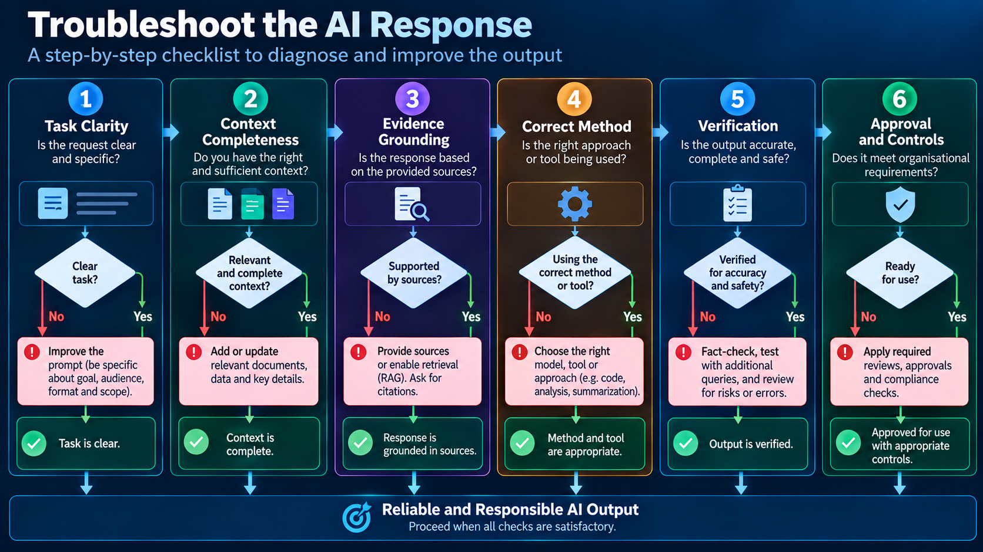
TROUBLESHOOTING
Troubleshoot the AI response
Task
Context
Grounding
Method
Verification
Control
›
›
›
›
›
Is it clear?
Is evidence present?
Can claims be traced?
Need computation?
Has it been checked?
Approval needed?
Fix the actual failure mechanism, not just the wording.
WINTRUST | AI CAPABILITY PROGRAM

Slide 23
TROUBLESHOOTING
A practical diagnostic decision guide
If you see this...
Try this first
• Wrong interpretation
• Clarify instructions and output format.
• Missing facts
• Supply or retrieve relevant evidence.
• Unsupported claims
• Require source references and uncertainty labels.
• Incorrect calculation
• Recalculate with a suitable tool.
• Incorrect code
• Inspect code and run tests in a safe environment.
• Unsafe recommendation
• Require risk assessment, authorization and approval.
WINTRUST | AI CAPABILITY PROGRAM

Slide 24
VERIFICATION
Why verification matters
Compare claims against source documents.
Recalculate totals independently.
Test SQL against known cases.
Use unit tests for generated code.
Challenge assumptions and boundary conditions.
Record unresolved uncertainties.
Data example: Verify totals by currency independently rathethan trusting a model's arithmetic.
Ops example: Confirm an incident recommendation against the runbook and applicable approval requirements.
WINTRUST | AI CAPABILITY PROGRAM

Slide 25
HANDS-ON LAB
Lab: Diagnose the model, improve the result
25 minutes | Copilot Chat | Work in pairs.
Choose the Data or Enterprise Ops scenario.
Submit the original prompt and its weakness.
Submit the improved prompt and response.
Identify two unsupported claims or assumptions and one limitation prompting could not resolve.
Do not modify source data or execute operational actions.
WINTRUST | AI CAPABILITY PROGRAM

Slide 26
HANDS-ON LAB
Data Track lab: Investigate transaction quality
Sample dataset
transaction_id,amount,currency
T101,1200,INR
T102,850,INR
T103,,INR
T104,-250,INR
T105,700,USD
Initial prompt: “Analyze this transaction data and tell me whether it is correct.”
Task: identify why the request is underspecified, then improve it.
WINTRUST | AI CAPABILITY PROGRAM

Slide 27
HANDS-ON LAB
Enterprise Ops lab: Investigate an incident
Incident record
Incident: INC-3091
Service: Customer API
Alert: Disk utilization at 92%
Trend: Increased from 78% over 30 minutes
Customer impact: Intermittent API timeouts reported
Recent change: Unknown
Available evidence: Disk utilization alert only
Initial prompt: “Tell me how to fix this incident.”
Start
WINTRUST | AI CAPABILITY PROGRAM

Slide 28
HANDS-ON LAB
Lab debrief: compare the tracks
Data track
Enterprise Ops track
• Known: values in the supplied CSV.
• Known: alert and incident observations.
• Uncertain: validity rules and business meaning.
• Uncertain: root cause and safe remediation.
• Improve with explicit checks and output requirements.
• Improve with evidence boundaries and diagnostic steps.
• Verify counts, totals and business rules.
• Verify runbook alignment and operational risk.
• Prompting cannot invent missing business definitions.
• Prompting cannot replace missing telemetry or authorization.
WINTRUST | AI CAPABILITY PROGRAM

Slide 29
DEMO
Optional Demo 4: Code explanation is not verification
GitHub Copilot Chat prompt
Explain how the ticket-triage implementation works.
Refer to these code files:
- Code/ticket_triage_starter.py
- Code/test_ticket_triage.py
Identify:
- Business rules implemented in code.
- Assumptions or missing edge cases.
- Behaviours that can be verified through unit tests.
- Business rules requiring clarification rather than inference.
Do not change files or claim tests have run.
Files: Code/ticket_triage_starter.py and Code/test_ticket_triage.py | Optional 5–7 minutes
WINTRUST | AI CAPABILITY PROGRAM

Slide 30
KNOWLEDGE CHECK
Knowledge check
Questions
Answers
• Does an LLM guarantee a correct answer every time?
• No.
• Does more context always improve the answer?
• No. Relevance and quality matter.
• Does RAG eliminate hallucinations?
• No.
• What should you do if evidence is missing?
• Supply or retrieve evidence and state uncertainty.
• Is prompting alone sufficient for exact calculations or high-impact changes?
• No. Verify with suitable tools and controls.
WINTRUST | AI CAPABILITY PROGRAM

Slide 31
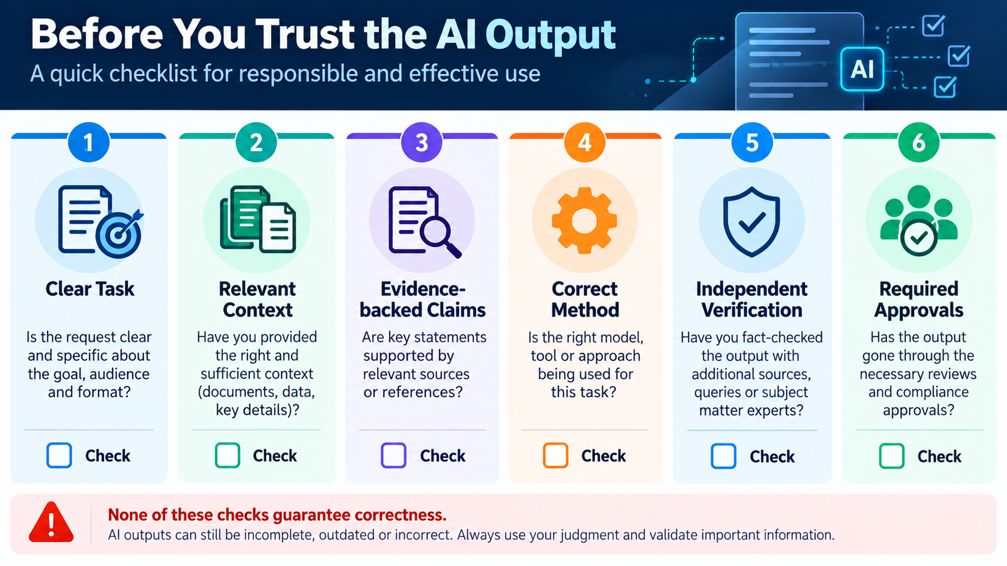
TAKEAWAYS
The troubleshooting checklist
Is the task clearly defined?
Does the model have relevant context?
Are claims supported by evidence?
Does the task need deterministic computation?
Have I verified the output?
Are required controls and approvals in place?
WINTRUST | AI CAPABILITY PROGRAM

Slide 32
TAKEAWAYS
Key takeaways
LLMs generate responses; they do not guarantee truth.
Context quality matters more than context volume.
Grounding improves evidence availability, not certainty.
Prompting is one troubleshooting tool, not the solution to every problem.
Verification and appropriate controls remain essential.
WINTRUST | AI CAPABILITY PROGRAM

Slide 33
NEXT SESSION
Bridge to Session 7: Risks, Security and Governance
What we learned
What comes next
• Models can generate plausible but unsupported answers.
• Sensitive data handling.
• Context may be incomplete, noisy or misleading.
• Prompt injection and malicious content.
• A response can be fluent and still be unsafe.
• Input, output and tool-access controls.
• Generated code and operational advice need verification.
• Human approval and governance.
WINTRUST | AI CAPABILITY PROGRAM

Slide 34
Thank you

