Slide 1


Slide 2

Apache Mahout
Apache Mahout is an open source project that is primarily used for creating scalable machine learning algorithms. It implements popular machine learning techniques such as:
Recommendation
Classification
Clustering

Slide 3
Features of Mahout
The algorithms of Mahout are written on top of Hadoop, so it works well in distributed environment. Mahout uses the Apache Hadoop library to scale effectively in the cloud.
Mahout offers the coder a ready-to-use framework for doing data mining tasks on large volumes of data.
Mahout lets applications to analyze large sets of data effectively and in quick time.
Includes several MapReduce enabled clustering implementations such as k-means, fuzzy k-means,Canopy.
Supports Distributed Naive Bayes and Complementary Naive Bayes classification implementations.

Slide 4
Goal 1: Machine Learning

Slide 5

Goal 2: Scalability
Be as fast and efficient as the possible given the intrinsic design of the algorithm
Most Mahout implementations are Map Reduce enabled

Slide 6
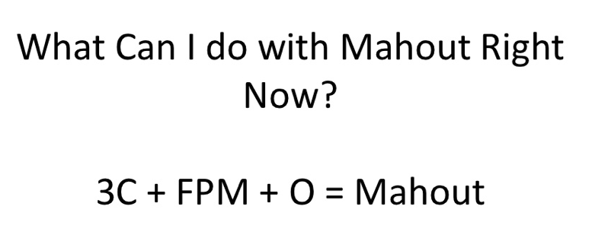
Mahout Package

Slide 7
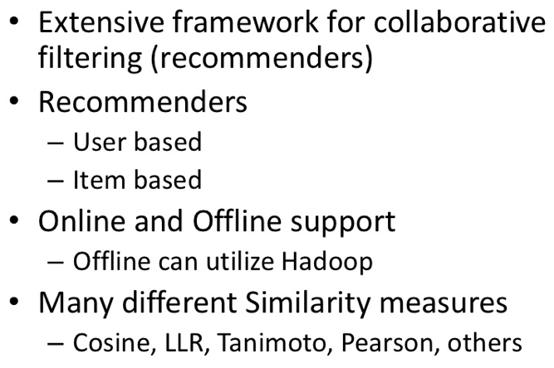
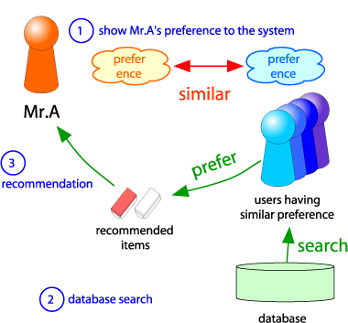
C1: Collaborative Filtering

Slide 8
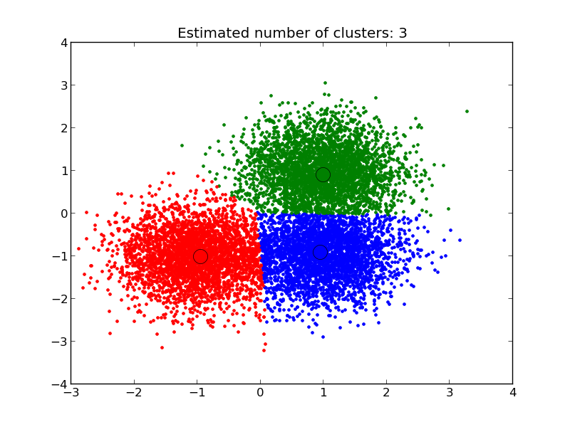
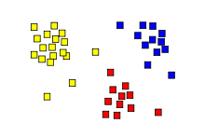
C2: Clustering
Group similar objects together
K-Means, Fuzzy K-Means, Density-Based,…
Different distance measures
Manhattan, Euclidean, …

Slide 9
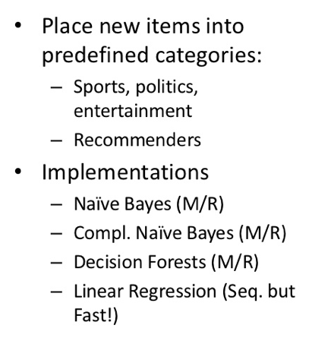
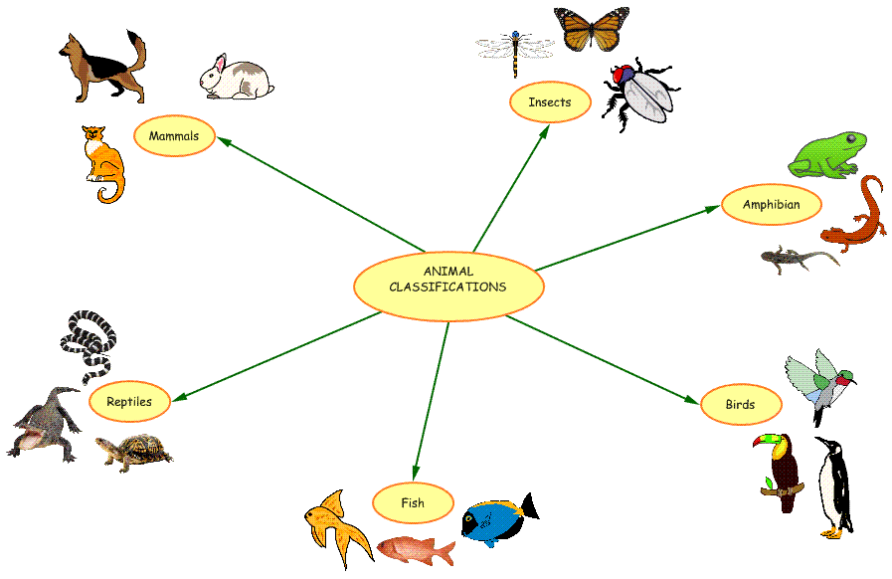
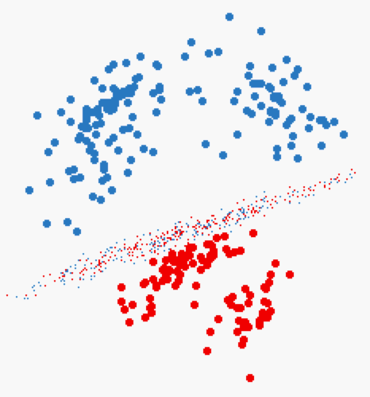
C3: Classification

Slide 10
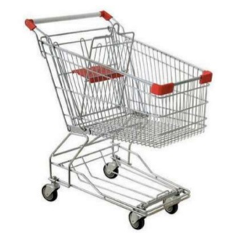
FPM: Frequent Pattern Mining
Find the frequent itemsets
<milk, bread, cheese> are sold frequently together
Very common in market analysis, access pattern analysis, etc…

Slide 11
O: Others
Outlier detection
Math libirary
Vectors, matrices, etc.
Noise reduction

Slide 12
We Focus On…
Clustering ➔ K-Means
Classification ➔ Naïve Bayes
Frequent Pattern Mining ➔ Apriori

Slide 13
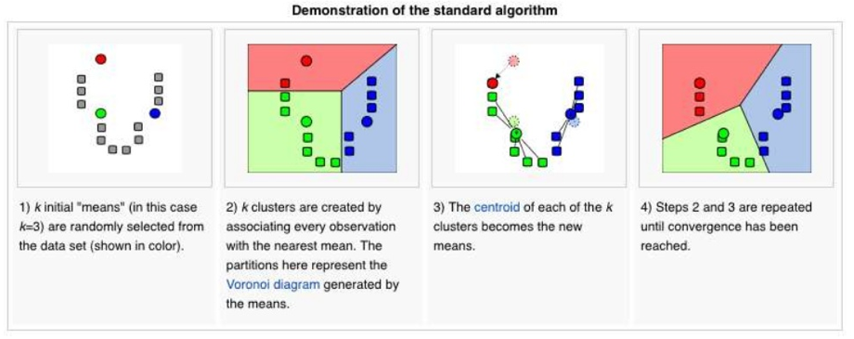
K-Means Algorithm
Iterative algorithm until converges

Slide 14
K-Means Algorithm
Step 1: Select K points at random (Centers)
Step 2: For each data point, assign it to the closest center
Now we formed K clusters
Step 3: For each cluster, re-compute the centers
E.g., in the case of 2D points ➔
X: average over all x-axis points in the cluster
Y: average over all y-axis points in the cluster
Step 4: If the new centers are different from the old centers (previous iteration) ➔ Go to Step 2

Slide 15
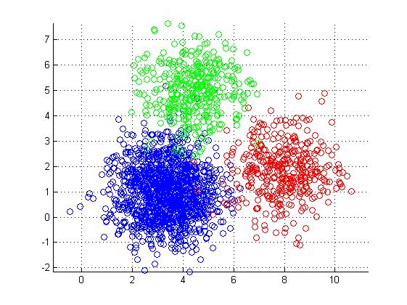
K-Means in MapReduce
Input
Dataset (set of points in 2D) --Large
Initial centroids (K points) --Small
Map Side
Each map reads the K-centroids + one block from dataset
Assign each point to the closest centroid
Output <centroid, point>

Slide 16
K-Means in MapReduce (Cont’d)
Reduce Side
Gets all points for a given centroid
Re-compute a new centroid for this cluster
Output: <new centroid>
Iteration Control
Compare the old and new set of K-centroids
If similar ➔ Stop
Else
If max iterations has reached ➔ Stop
Else ➔ Start another Map-Reduce Iteration

Slide 17
K-Means Optimizations
Use of Combiners
Similar to the reducer
Computes for each centroid the local sums (and counts) of the assigned points
Sends to the reducer <centroid, <partial sums>>
Use of Single Reducer
Amount of data to reducers is very small
Single reducer can tell whether any of the centers has changed or not
Creates a single output file

Slide 18
Naïve Bayes Classifier
Given a dataset (training data), we learn (build) a statistical model
This model is called “Classifier”
Each point in the training data is in the form of:
<label, feature 1, feature 2, ….feature N>
Label ➔ is the class label
Features 1..N ➔ the features (dimensions of the point)
Then, given a point without a label <??, feature 1, ….feature N>
Use the model to decide on its label

Slide 19
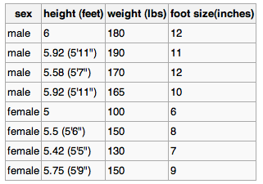
Naïve Bayes Classifier: Example
Best described through an example
Three features
Class label (male or female)
Training dataset

Slide 20

Naïve Bayes Classifier (Cont’d)
For each feature in each label
Compute the mean and variance
That is the model (classifier)

Slide 21

Naïve Bayes: Classify New Object
Male or female?
For each label ➔ Compute posterior value
The label with the largest posterior is the suggested label

Slide 22

Naïve Bayes: Classify New Object (Cont’d)
Male or female?
>> evidence: Can be ignored since it is the same constant for all labels
>> P(label): % of training points with this label
>> p(feature|label) = , f is feature value in sample
f

Slide 23


Naïve Bayes: Classify New Object (Cont’d)
Male or female?

Slide 24
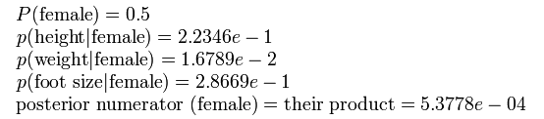
Naïve Bayes: Classify New Object (Cont’d)
Male or female?
The sample is predicted to be female

Slide 25
Frequent Pattern Mining
Very common problem in Market-Basket applications
Given a set of items I ={milk, bread, jelly, …}
Given a set of transactions where each transaction contains subset of items
t1 = {milk, bread, water}
t2 = {milk, nuts, butter, rice}

Slide 26
Frequent Pattern Mining
Given a set of items I ={milk, bread, jelly, …}
Given a set of transactions where each transaction contains subset of items
t1 = {milk, bread, water}
t2 = {milk, nuts, butter, rice}
What are the itemsets frequently sold together ??
% of transactions in which the itemset appears >= α

Slide 27
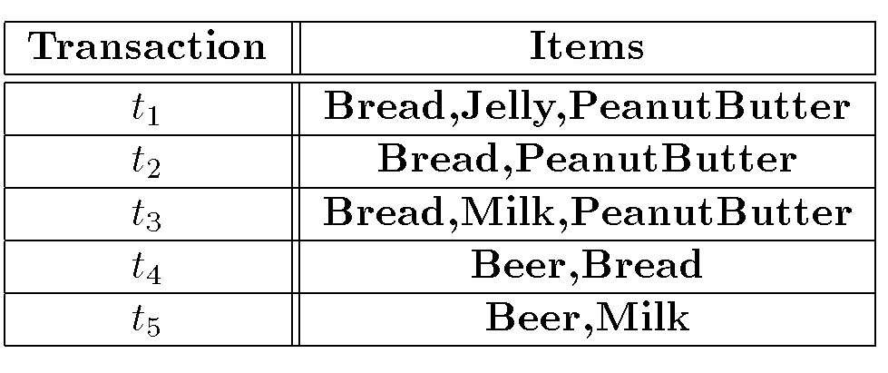
Example
Assume α = 60%, what are the frequent itemsets
{Bread} → 80%
{PeanutButter} → 60%
{Bread, PeanutButter} → 60%
called “Support”

Slide 28
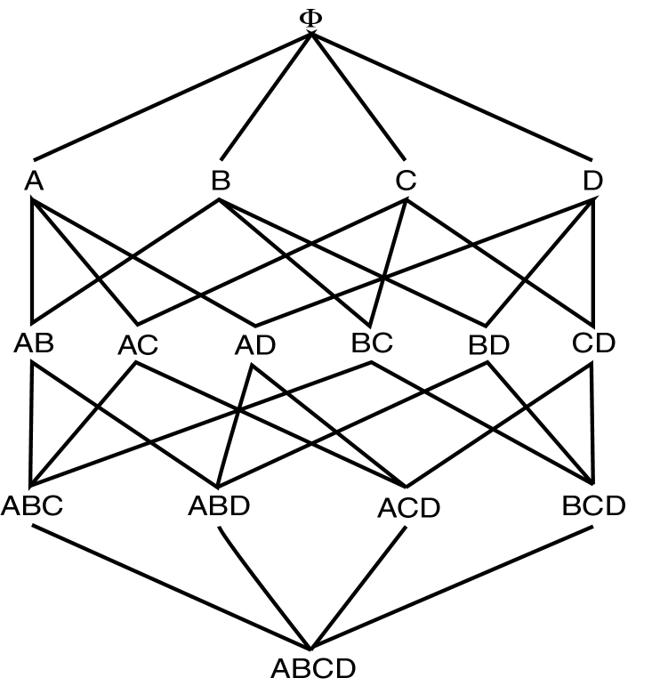
How to find frequent itemsets
Naïve Approach
Enumerate all possible itemsets and then count each one
All possible itemsets of size 1
All possible itemsets of size 2
All possible itemsets of size 3
All possible itemsets of size 4

Slide 29
Can we optimize??
Assume α = 60%, what are the frequent itemsets
{Bread} → 80%
{PeanutButter} → 60%
{Bread, PeanutButter} → 60%
called “Support”
Property
For itemset S={X, Y, Z, …} of size n to be frequent, all its subsets of size n-1 must be frequent as well

Slide 30
Apriori Algorithm
Executes in scans (iterations), each scan has two phases
Given a list of candidate itemsets of size n, count their appearance and find frequent ones
From the frequent ones generate candidates of size n+1 (previous property must hold)
All subsets of size n must be frequent to be a candidate
Start the algorithm where n =1, then repeat
Use the property reduce the number of itemsets to check

Slide 31
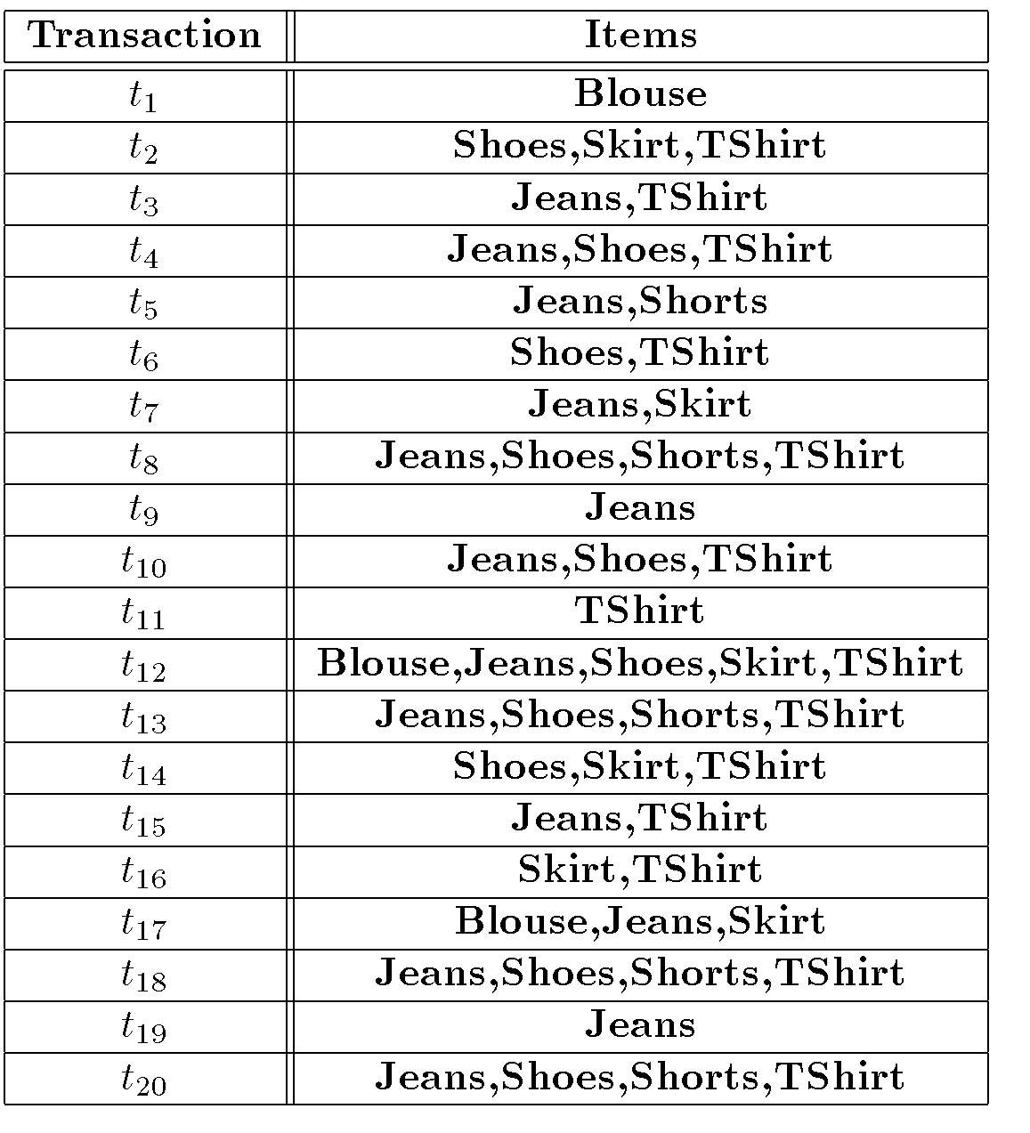
Apriori Example

Slide 32
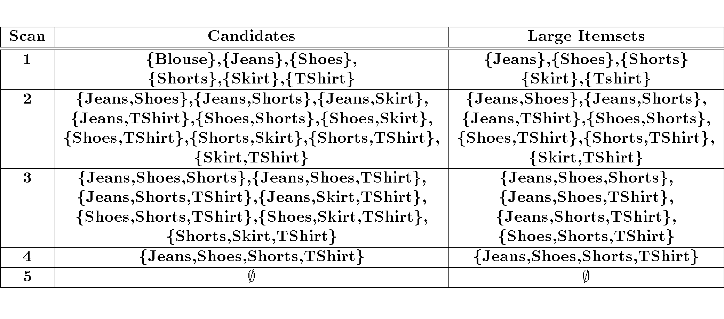
Apriori Example (Cont’d)

Slide 33
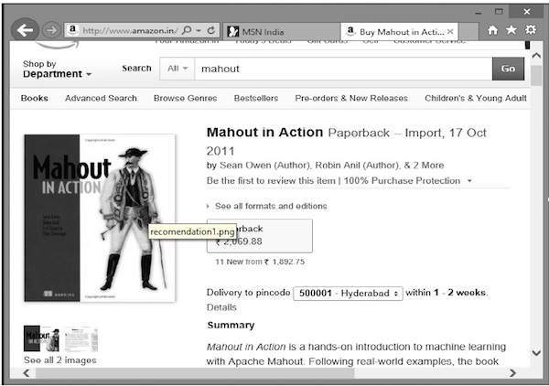
Recommendation
This is a popular machine learning technique.
We often get recommendations while accessing Amazon, Youtube, Google, Netflix etc. based upon our interests.
This happens due to recommendation technique.
Suppose you want to purchase the book “Mahout in Action” from Amazon:

Slide 34
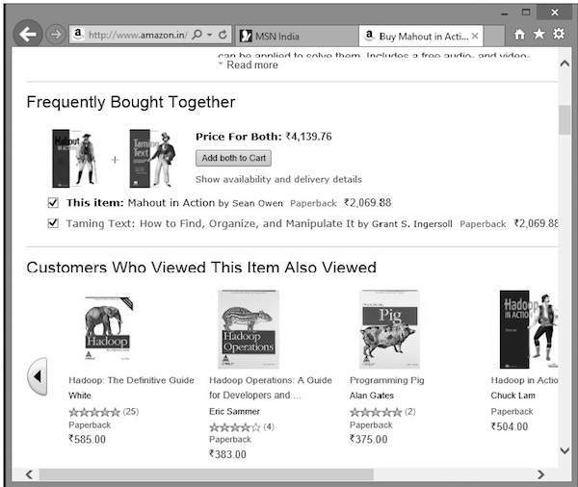
Along with the selected product, Amazon also displays a list of related recommended items, as shown below.
Such recommendation lists are produced with the help of recommender engines.

Slide 35
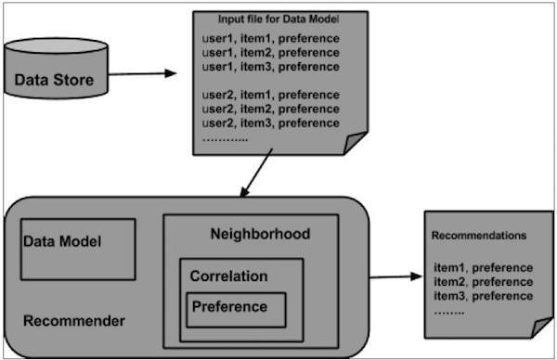
Architecture of Recommendation Engine

