Slide 1

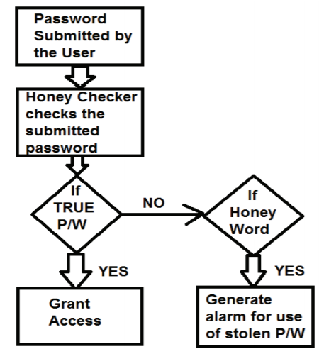
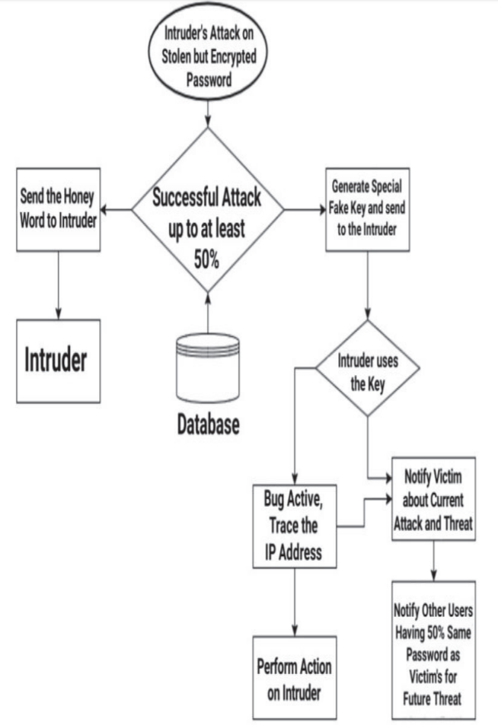
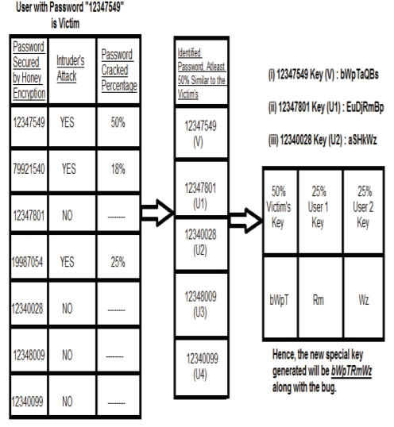

Sardar Patel Institute of Technology
Department of Computer Engineering
Academic Year 2019-20
Advanced Honey Encryption: An Escape-less Trap for Intruders
Name - Ajay Singh, MTech.(Comp.)
Project Guide : Dr. Anant Nimkar
Abstract
Most digital networks rely on cryptosystems that provides the confidentiality and integrity of traffic carried across the network even in presence of third party. This Poster concentrates on honey encryption, the proposed technique that converts its defensive action into both detection (tracing the hacker) and deflection action with the help of generation of special type of fake key or password. It will also show how the Victims will be notified about the attack along with other users who also have the probability of being attacked.
original key. If less than 50% of the attempted key is found to be similar to the original key then the account will be considered in the safe zone. After which the honey words will be supplied to the intruder. When 50% or more of the attempted key is found to be similar to the original key the original key is moved since it could lead to other victim with similar key and action is taken on the intruder.
Design
\
Result
Conclusion
The proposed method of honey encryption lets the user as well as software developers know about the mind level of intruders so that that can be prepared for future threats as well.
Reference
[1] A. Juels, T. Ristenpart, "Honey Encryption: Security beyond the BruteForce Bound" in Advances in Cryptology—Euro crypt 2014, IEEE Journal.
Introduction
Most security breaches involve accessing unauthorized data during network communication between two ends illegally. For the recent years, the intruders have demonstrated increased technical knowledge, developed new ways to exploit network vulnerabilities and created advanced software tools to automate attacks. To overcome these problems, one team of researchers, have finally found a way called honey encryption, which turns their defence into attack on the hackers themselves—by spewing fake keys at them and sending them drowning. This concept is used to deflect attackers when they try to decrypt the captured data that has been encrypted. It not only prevents the hacker from decrypting and retrieving the original data but also let that hacker sink in the pool of false keys.
Aim
To understand honey encryption technique that converts its defensive action into both detection (tracing the hacker) and deflection action with the help of generation of special type of fake key.
Objective
The proposed technique will keep the user passwords strong along with the ability to trace the IP address of intruders, notify the victim as well as other users whose chances of becoming next victim is high.
Methodology
As the intruder receives the encrypted data or the encrypted vault password, his first action will be to decrypt it and receive the original data by brute force attack. Honey encryption can be modified in such a manner that if attempts are made to crack the password the researched action comes into play. After the attack, the attempted key by the intruder will be matched by the

