Slide 1
Deterministic Algorithm
The output as well as the running time are functions only of the input.
Input
Output
Algorithm

Slide 2
What is a randomized algorithm ?

Slide 3
Randomized Algorithm
The output or the running time are functions of the input and random bits chosen .
Random bits
Input
Output
Algorithm

Slide 4


QuickSort($S$)
QuickSort($S$)
{ If (|$S$|>1)
Pick and remove an element $x$from $S$;
($S_{<x}$, $S_{>x}$)← Partition($S$,$x$);
return( Concatenate(QuickSort($S_{<x}$), $x$, QuickSort($S_{>x}$))
}

Slide 5
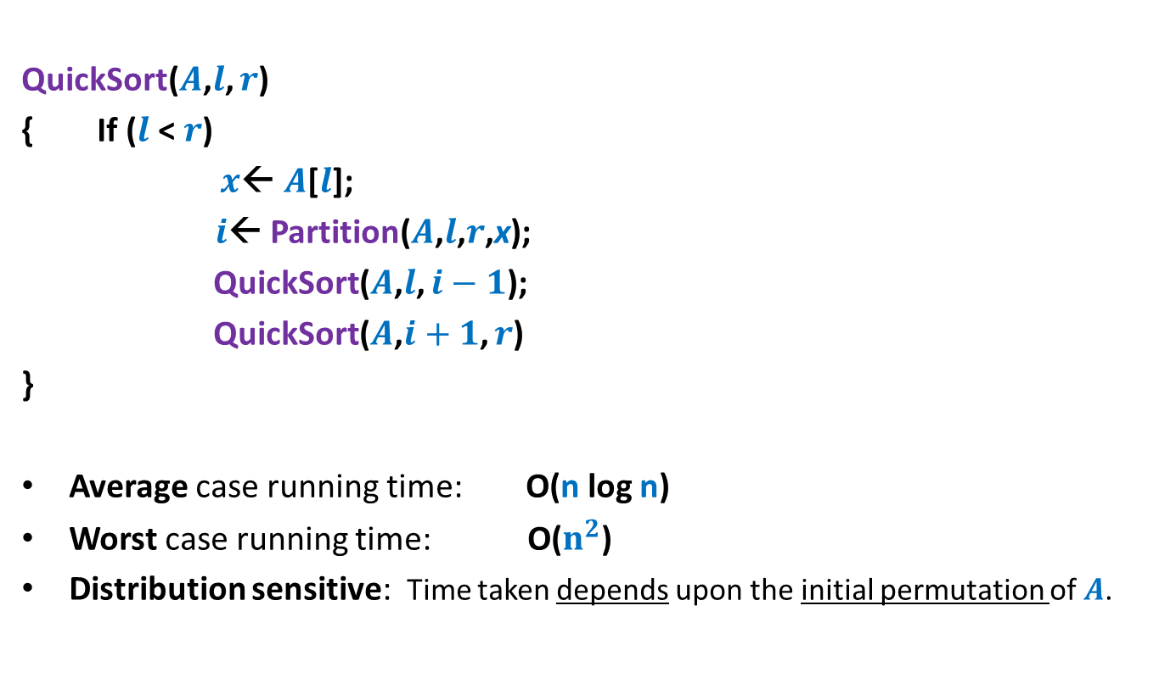

QuickSort($S$) When the input $S$is stored in an array $A$
QuickSort($A$,$l$, $r$)
{ If ($l$ < $r$)
$x$← $A$[$l$];
$i$← Partition($A$,$l$,$r$,x);
QuickSort($A$,$l$, $i−1$);
QuickSort($A$,$i+1$, $r$)
}
Average case running time: O(n log n)
Worst case running time: O($n^{2}$)
Distribution sensitive: Time taken depends upon the initial permutation of $A$.

Slide 6
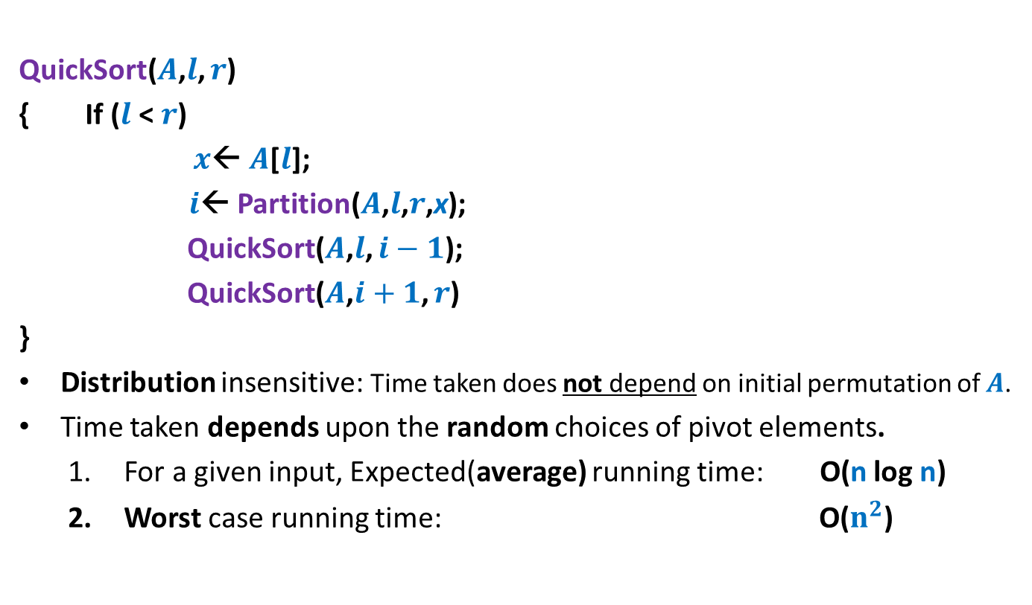

Randomized QuickSort($S$) When the input $S$is stored in an array $A$
QuickSort($A$,$l$, $r$)
{ If ($l$ < $r$)
$x$← $A$[$l$];
$i$← Partition($A$,$l$,$r$,x);
QuickSort($A$,$l$, $i−1$);
QuickSort($A$,$i+1$, $r$)
}
Distribution insensitive: Time taken does not depend on initial permutation of $A$.
Time taken depends upon the random choices of pivot elements.
For a given input, Expected(average) running time: O(n log n)
Worst case running time: O($n^{2}$)
an element selected randomly uniformly from $A$[$l$..$r$];

Slide 7
Motivation for Randomized Algorithms
“Randomized algorithm for a problem is usually simpler and more efficient than its deterministic counterpart.”

Slide 8
Types of Randomized Algorithms
Las Vegas Algorithms:
Gambling of Available Resources.
It always gives Correct Output.
It has a Bounded Running time (Finite time)
It also informs about failure.

Slide 9
Types of Randomized Algorithms
2. Monte Carlo Algorithms:
Gambling of Output.
It may not produce Correct Output (i.e failure probability is associated).
It has a Fix Running time
Failure probability can be minimized by repeated operation.

