Slide 1
Lecture-1
PERCEPTRON
Intro to Machine Learning
Ayush C| Navjot S | Vasudev S

Slide 2
OBJECTIVES OF THE COURSE
Introduction to Machine Learning
Theoretical and Conceptual Foundation
Inducing the Thought Process of a Data Scientist
Ability to solve Real-World problems in industry and academia

Slide 3
COURSE LOGISTICS
Interactive Sessions
Piazza Online Classroom
After Class Doubts
Regular Take Home Assignments
Hackathons to implement your ideas
Online Code Submission and Leaderboard

Slide 4
MACHINE INTELLIGENCE

Slide 5
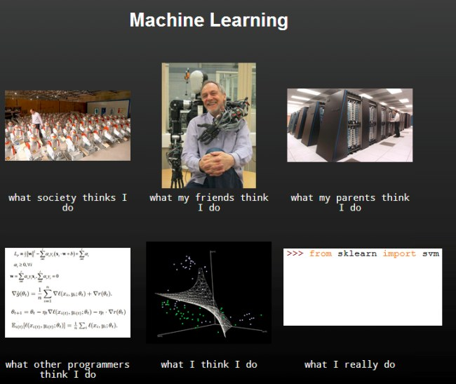

Slide 6
WHAT IT IS

Slide 7
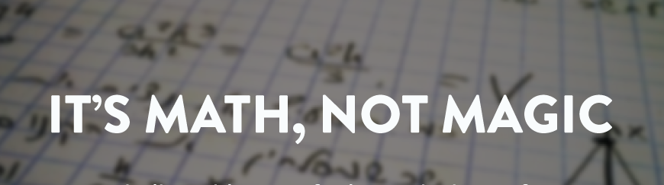

Slide 8
Buzz Words
Supervised Learning, Unsupervised Learning, Reinforcement Learning
Classification/ Regression
Features
Training Data
Validation Data
Testing Data
For later!!
Overfitting, Underfitting
Weights

Slide 9
FORMAL DEFINITION
Machine learning is a subfield of artificial intelligence (AI) concerned with algorithms that allow computers to learn. What this means, in most cases, is that an algorithm is given a set of data and infers information about the properties of the data—and that information allows it to make predictions about other data that it might see in the future

Slide 10
DRIVING FACTORS !
Lots of Data
Ability to process it
Machine Learning Models are essentially Statistical Machines.

Slide 11
SOME STATISTICS
Every minute up to 300 hours of video are uploaded to YouTube.
Average of 31.25 million messages and view 2.77 million videos every minute on Facebook.
More data has been created in the past two years than in the entire previous history of the human race.
At the moment less than 0.5% of all data is ever analyzed and used, just imagine the potential here.

Slide 12
THE INDUSTRY IS USING IT..
Google Page Ranking.
Netflix Suggestions.
Tinder, for you to “chill”
Tesla Self Driving Cars

Slide 13
THE POTENTIAL: FEW INTERESTING APPLICATIONS

Slide 14

Demystifying Prisma: Neural Art

Slide 15
The Mathematical Mozart

Slide 16
Image Captioning: Neural Story

Slide 17
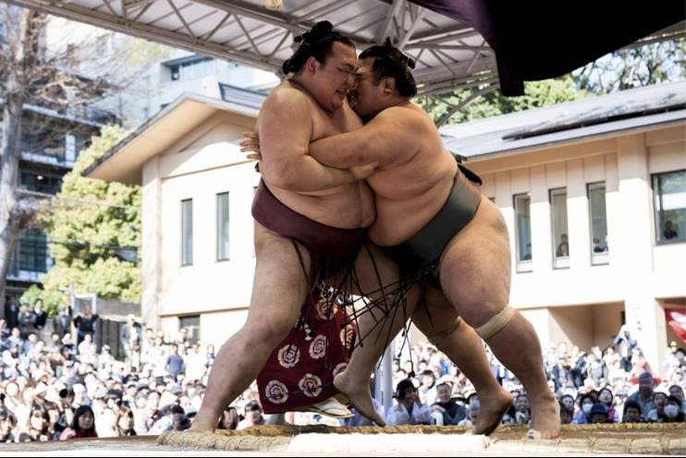

Slide 18
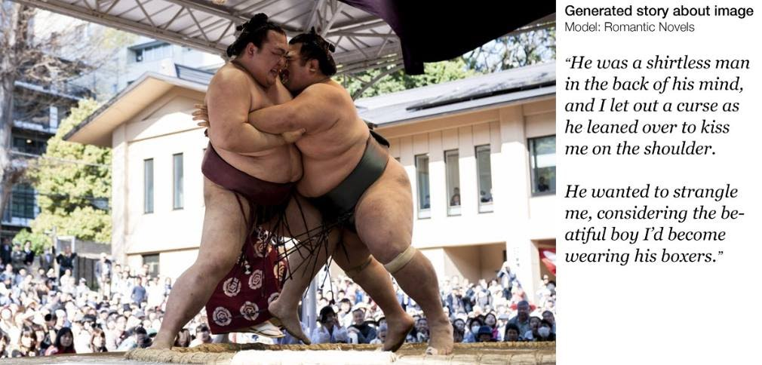

Slide 19
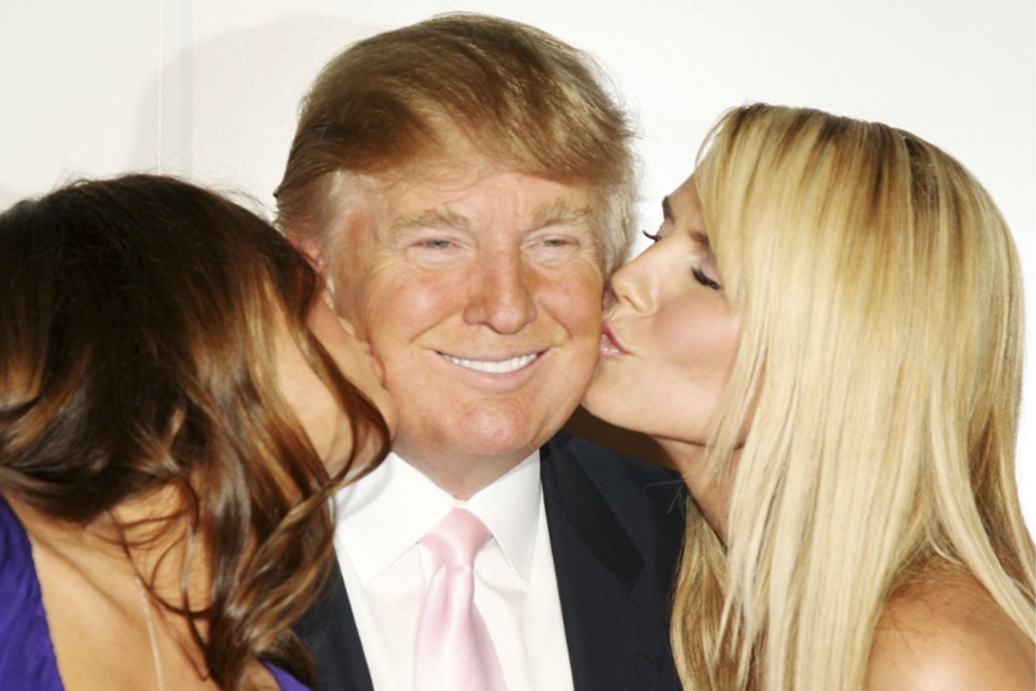

Slide 20
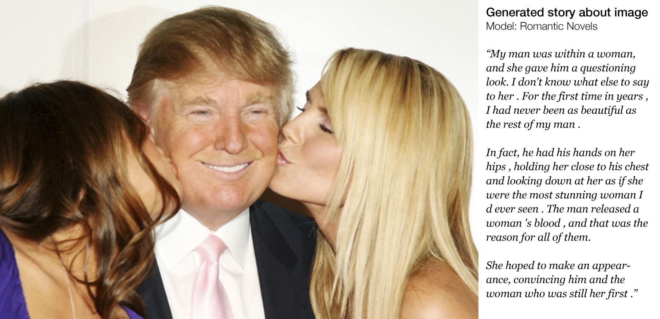

Slide 21
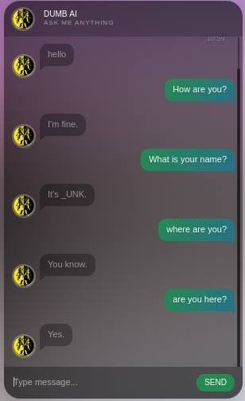
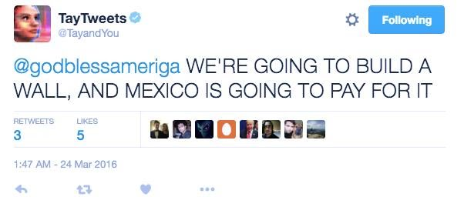
Conversational Engine

Slide 22
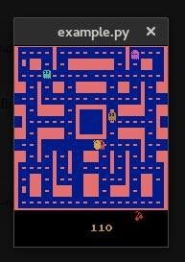
Pacman Champ: The Gamer

Slide 23
How easy do you think Lip Reading is ?
Lip-Reading AI
Human Accuracy : 20% to 60%
LipNet Accuracy : 93.4%

Slide 24
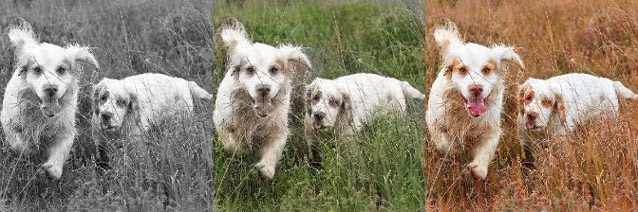
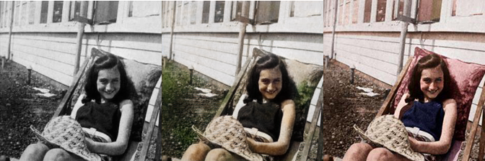
Colorizing the World:

Slide 25
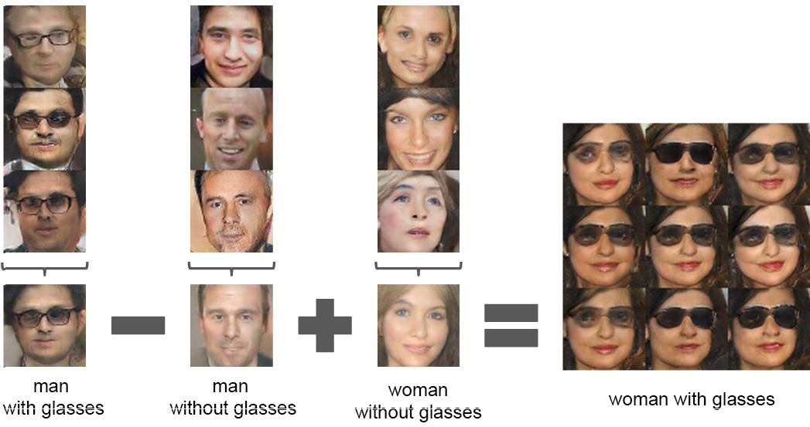
Playing with Words and Image

Slide 26
A machine learning engineer is a lot like wine , gets better than time.

Slide 27
DEVELOPER CHECKLIST
Python 2.7, Ipython , Jupyter
Numpy , Scipy
OpenCV
Matplotlib
Pandas
Theano , Tensorflow
And…..

Slide 28
Passion and
Perseverance !

Slide 29
INTRODUCTION TO PYTHON

Slide 30
Setting Up Jupyter Notebooks

Slide 31
Variable and Data Types

Slide 32
String, Lists and Dictionaries

Slide 33
Packages and Imports

Slide 34
Conditionals Loops and Functions

Slide 35
Object Oriented Paradigm

Slide 36
Python LIVE Assignment

Slide 37
File Handling

Slide 38
Statistical Computation with Python: Hands-on Session

Slide 39
Doubts and Queries?

Slide 40
Thank You!
Ayush C | Navjot S | Vasudev S

