Slide 1
Smart Aerial Response
An Autonomous UAV Framework for Resilient Flood Emergency Management in Smart Cities
Case studies: Varanasi and Kanpur, Uttar Pradesh
Team Ajay Thomas (23BCT0262) · Dharani I S (23BCT0222) · Sukant G (23BCT0184)
Guide Dr. Swarnalatha P, Professor Grade 1, SCOPE, VIT Vellore
Design of Smart Cities (Internet of Things) · Fall Semester 2026-27
Notes:
Good morning. We are Ajay Thomas, Dharani I S and Sukant G, working under Dr. Swarnalatha P. Our project is the IoT layer that lets a smart city's command centre trigger drone relief planning from river gauges, and decide where drone docks should be installed, shown on Varanasi and Kanpur.

Slide 2
Abstract
River gauges and drone docks report over LoRaWAN and MQTT to the city's command centre. When the river crosses its warning mark, a trigger engine re-plans relief missions from the docks that are still dry, using the existing open-source A.D.A.P.T. planner unchanged as the planning service. A scenario study chooses dock sites that stay usable as the flood rises.
94% · 90%
9.61
3 · 2
33/33
robust-dock coverage on unseen flood stages (Varanasi · Kanpur)
kbit/s message budget per city (computed, not measured)
automatic re-plans in the IoT loop; dry docks fell to 5 and 4 of 6
automated tests passed (pytest)
Software-in-the-loop prototype: sensors are simulated and missions are validated in software, not yet flown.
Notes:
Our work is the IoT layer around an existing open-source planner. Sensors trigger planning automatically, the planner is called with only the docks that are still dry, and our dock-siting study shows where the city should install docks: robust docks keep 94 and 90 percent coverage on flood stages they were not chosen from. The message budget is a calculation, and the re-plan counts come from our IoT loop runs.

Slide 3
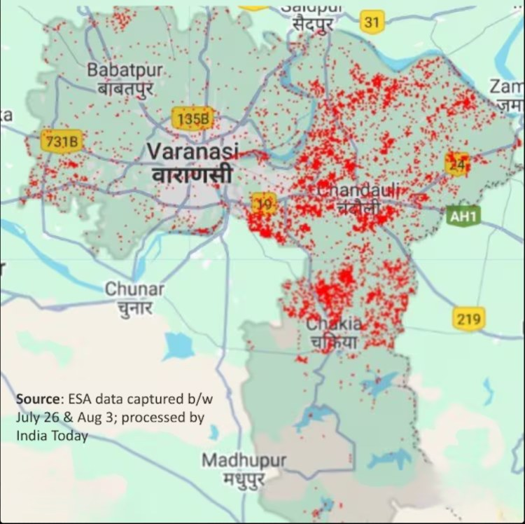



Problem: floods cut people off
2025 Ganga floods
In Varanasi the Ganga crossed its danger mark: 84 ghats submerged, over 6,500 people displaced (News18, Aug 2025).
Ground relief is slow
Boats struggle in fast water and helicopters are scarce; marooned pockets wait hours for food and medicine.
Cities already have the data
Varanasi built a 3-D digital twin to predict flooded homes; Kanpur and Varanasi run ICCCs. The missing link is acting on it.
Varanasi flood extent, August 2025 (ESA satellite data)
Notes:
Varanasi and Kanpur are Smart Cities Mission cities on the Ganga and both flooded in 2025. In Varanasi 84 ghats went under water and more than 6,500 people were displaced. The city already has sensors, a digital twin and a command centre; what it lacks is a system that turns those signals into relief missions automatically.

Slide 4
Objectives
1
Sense
2
Trigger
3
Plan
River gauges and docks report over LoRaWAN / MQTT to the ICCC
Re-plan automatically when the river crosses its CWC warning mark
Call the existing A.D.A.P.T. planner as a service, with dry docks only
4
Stay safe
5
Site docks
6
Show
Never launch from a flooded dock; keep the planner's battery checks
Find dock sites that stay dry as the flood rises
A live command-centre dashboard for city officials
Notes:
Six objectives that follow the IoT pipeline: sense, trigger, plan, keep it safe, choose where the infrastructure goes, and show it to the city. Objective five is our research contribution: dock sites that survive a rising flood.

Slide 5
Requirements
Functional
Non-functional
Ingest gauge levels, dock status and weather
Detect flood extent from a satellite map
Trigger a re-plan on warning or stage rise
Choose bases only from dry docks
Route around current and 2-h forecast water
Export one QGC WPL 110 mission per drone
Hand unreachable points to boat teams
Re-plan in about a minute on a laptop
City-wide IoT traffic ≤ 10 kbit/s
Battery ≤ 80% and payload ≤ 8 kg per sortie
Zero route crossings between drones
Open data and open standards (MQTT, LoRaWAN, MAVLink)
Clear failure messages; never a silent drop
Notes:
These are the key requirements from our SRS; the full list with IDs is in the report. Functional requirements follow the data from sensors to missions. The non-functional ones are what make it usable in a real command centre: fast, light on the network, and safe.

Slide 6
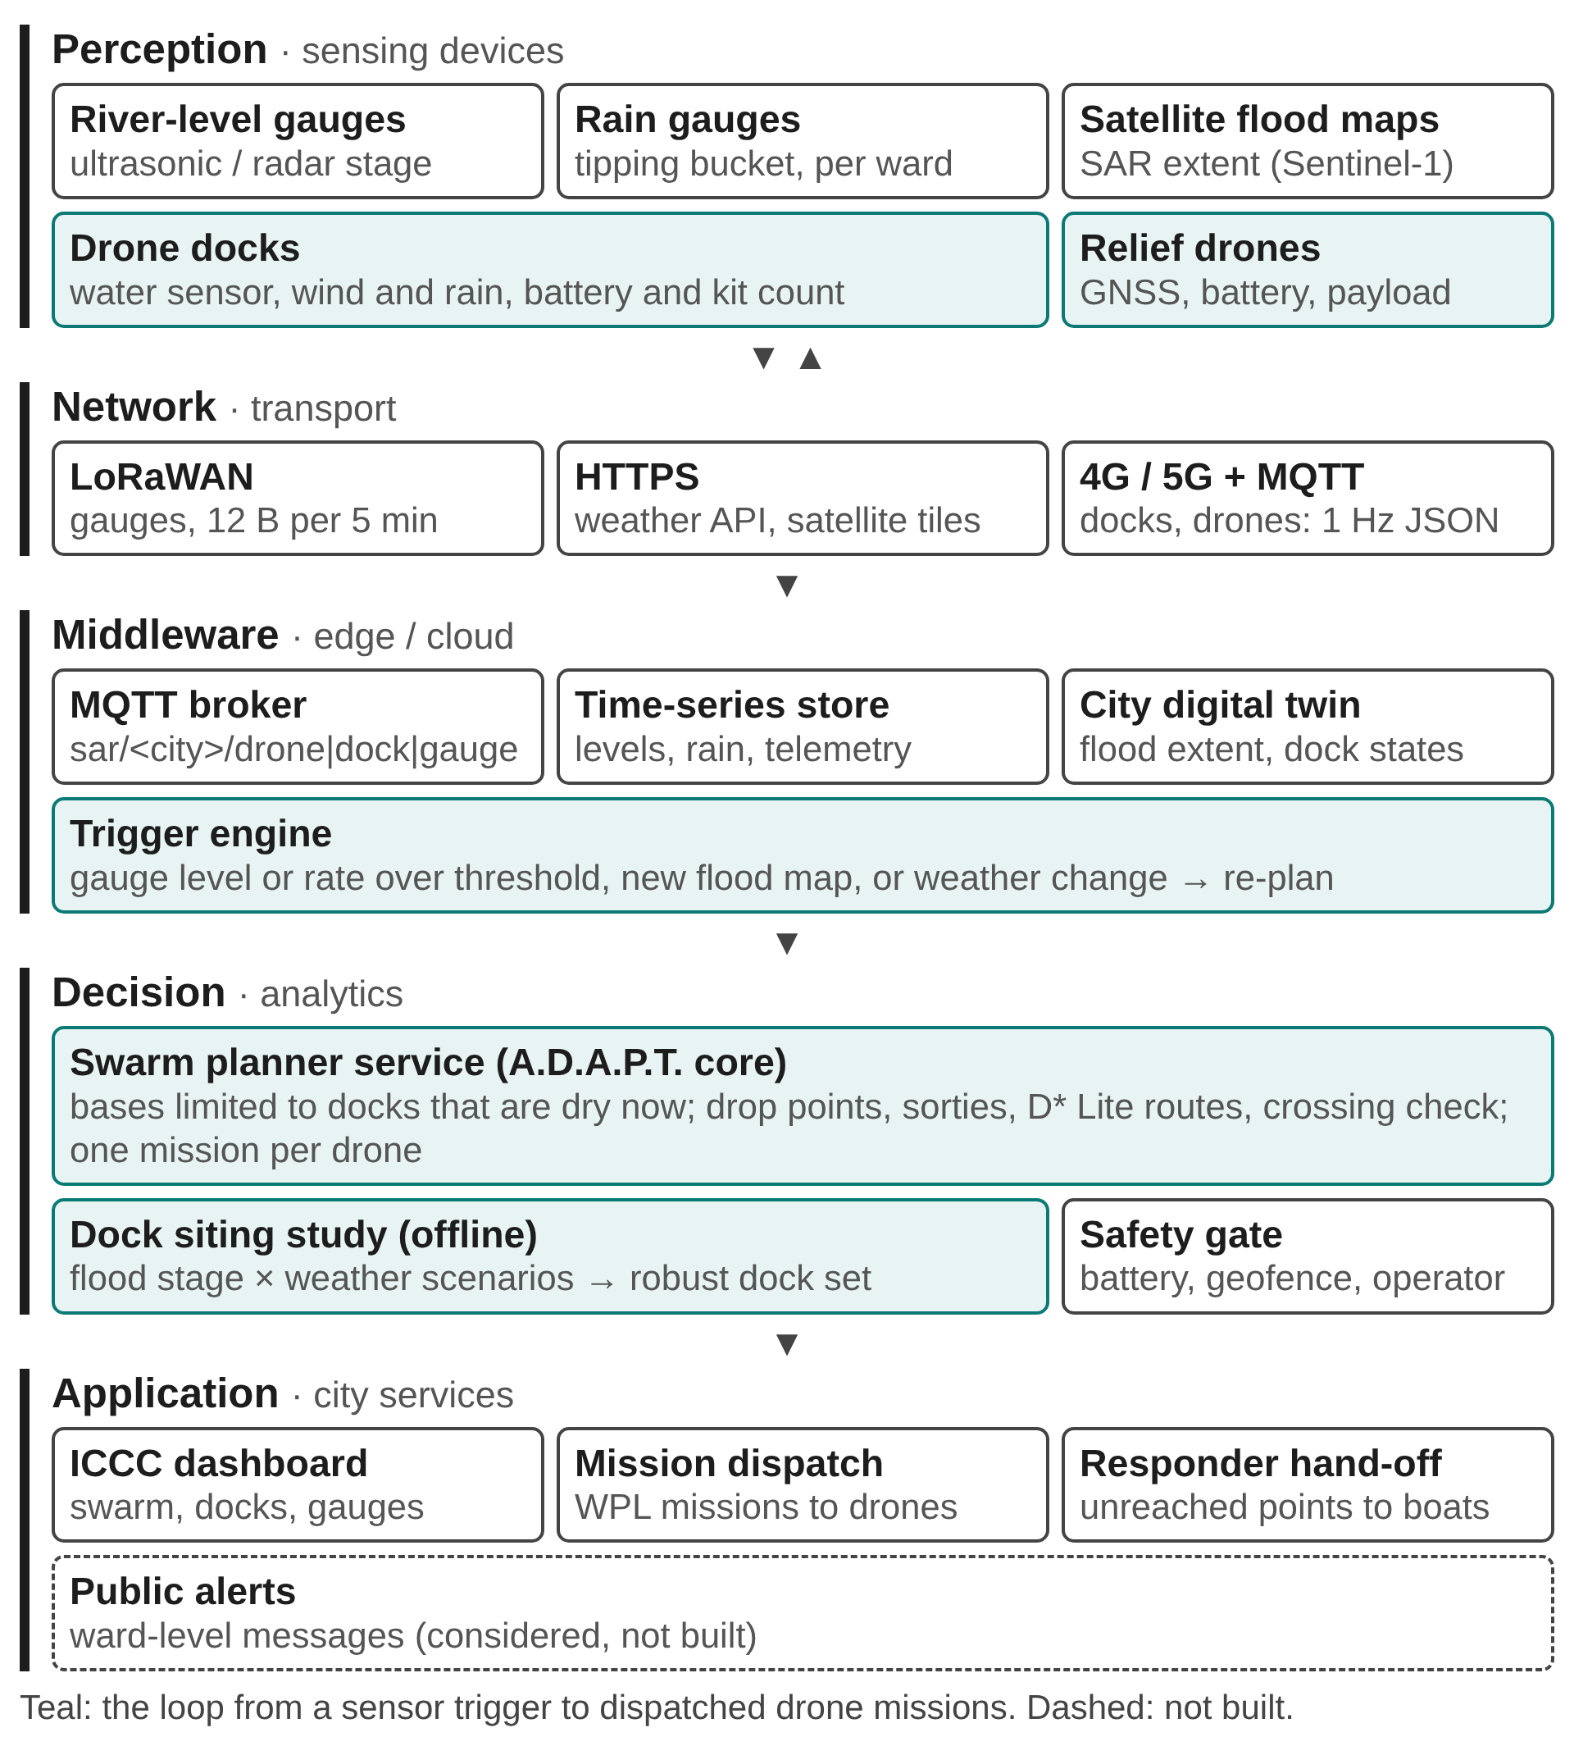
IoT architecture: five layers
Perception
River and rain gauges, satellite flood maps, dock sensors, drone telemetry
Network
LoRaWAN for gauges (12-byte uplinks), 4G/5G + MQTT for docks and drones
Middleware
MQTT broker, time-series store, digital twin, trigger engine
Decision
Swarm planner with bases limited to dry docks; offline dock-siting study
Application
ICCC dashboard, mission dispatch, hand-off to NDRF / boat teams
Notes:
This is the standard five-layer IoT stack applied to flood relief. Teal boxes are the closed loop: a sensor trigger in the middleware drives the planner in the decision layer, which dispatches missions. Public alerts are dashed because we considered but did not build them.

Slide 7
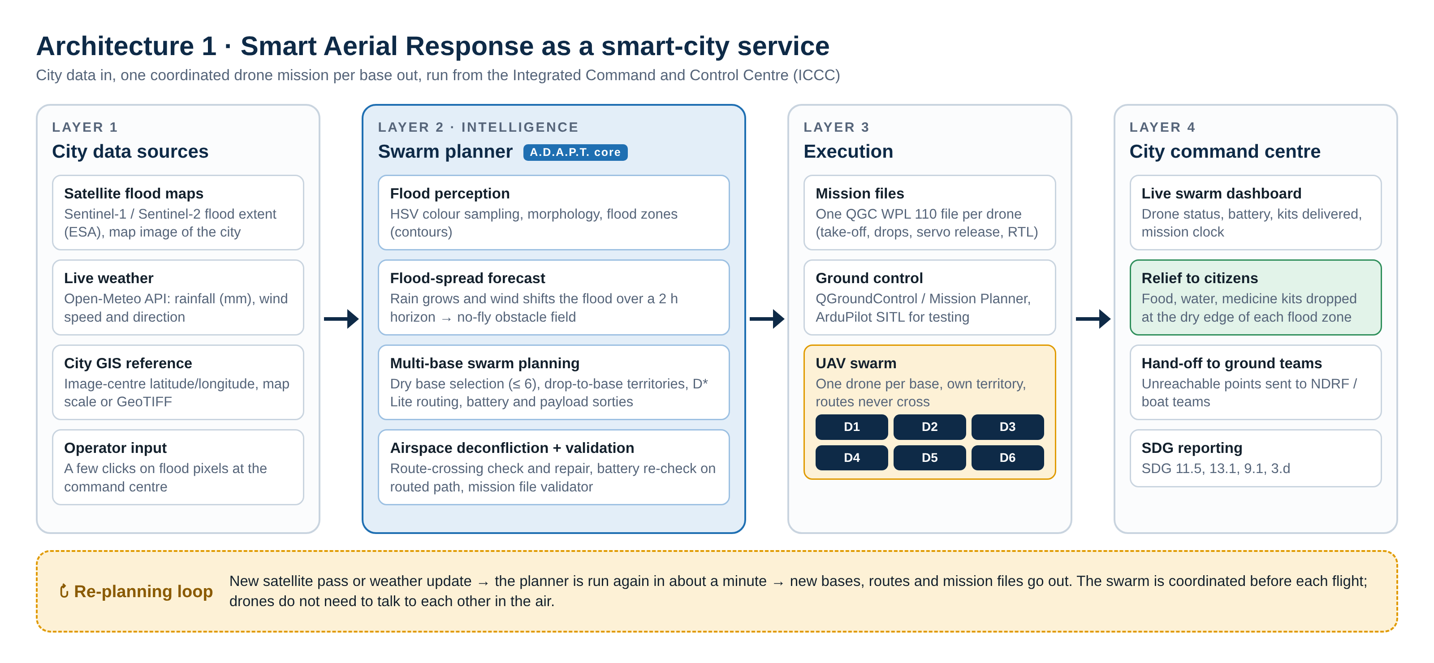
Smart-city system architecture
Planning service: the existing open-source A.D.A.P.T. planner [10], used unchanged. Our work is the IoT layer, dock siting and the ICCC dashboard around it.
Notes:
Four layers. City data in: satellite flood map, live weather, sensor triggers. Intelligence: the existing open-source A.D.A.P.T. planner, which we use unchanged as a service. Execution: one mission file per drone. Command centre: live dashboard, relief to citizens, unreachable points to NDRF and boat teams.

Slide 8






Implementation: the IoT trigger loop
Gauges
Network server
MQTT broker
Trigger engine
Planner [10]
ICCC
12-byte LoRaWAN uplink: id, time, level, rate, battery
decodes uplinks to JSON on sar/<city>/gauge/…
amqtt, in-process; docks publish status every second
level ≥ warning and stage rising → re-plan
existing A.D.A.P.T., unchanged; dry docks only
plan summary on sar/<city>/iccc/plan
Reference gauge (CWC) | Warning mark | Danger mark
Varanasi · Rajghat | 70.262 m | 71.262 m
Kanpur · Ganga Barrage | 114.000 m | 115.000 m
Each rise in flood stage drops flooded docks from the dry set and re-plans the swarm automatically.
Planner flood stage: 0 at the warning mark, 6 at the danger mark, 12 at danger + 1 m.
iot/smartcity_iot.py · iot/run_iot_demo.py · planner: existing open-source A.D.A.P.T. [10], used unchanged
Notes:
This loop runs on a laptop with a real MQTT broker. Simulated gauges send packed LoRaWAN uplinks, a network-server step decodes them, and the trigger engine watches the reference gauge against the Central Water Commission warning and danger marks. Every time the flood stage rises, it re-plans with only the docks that report dry.

Slide 9
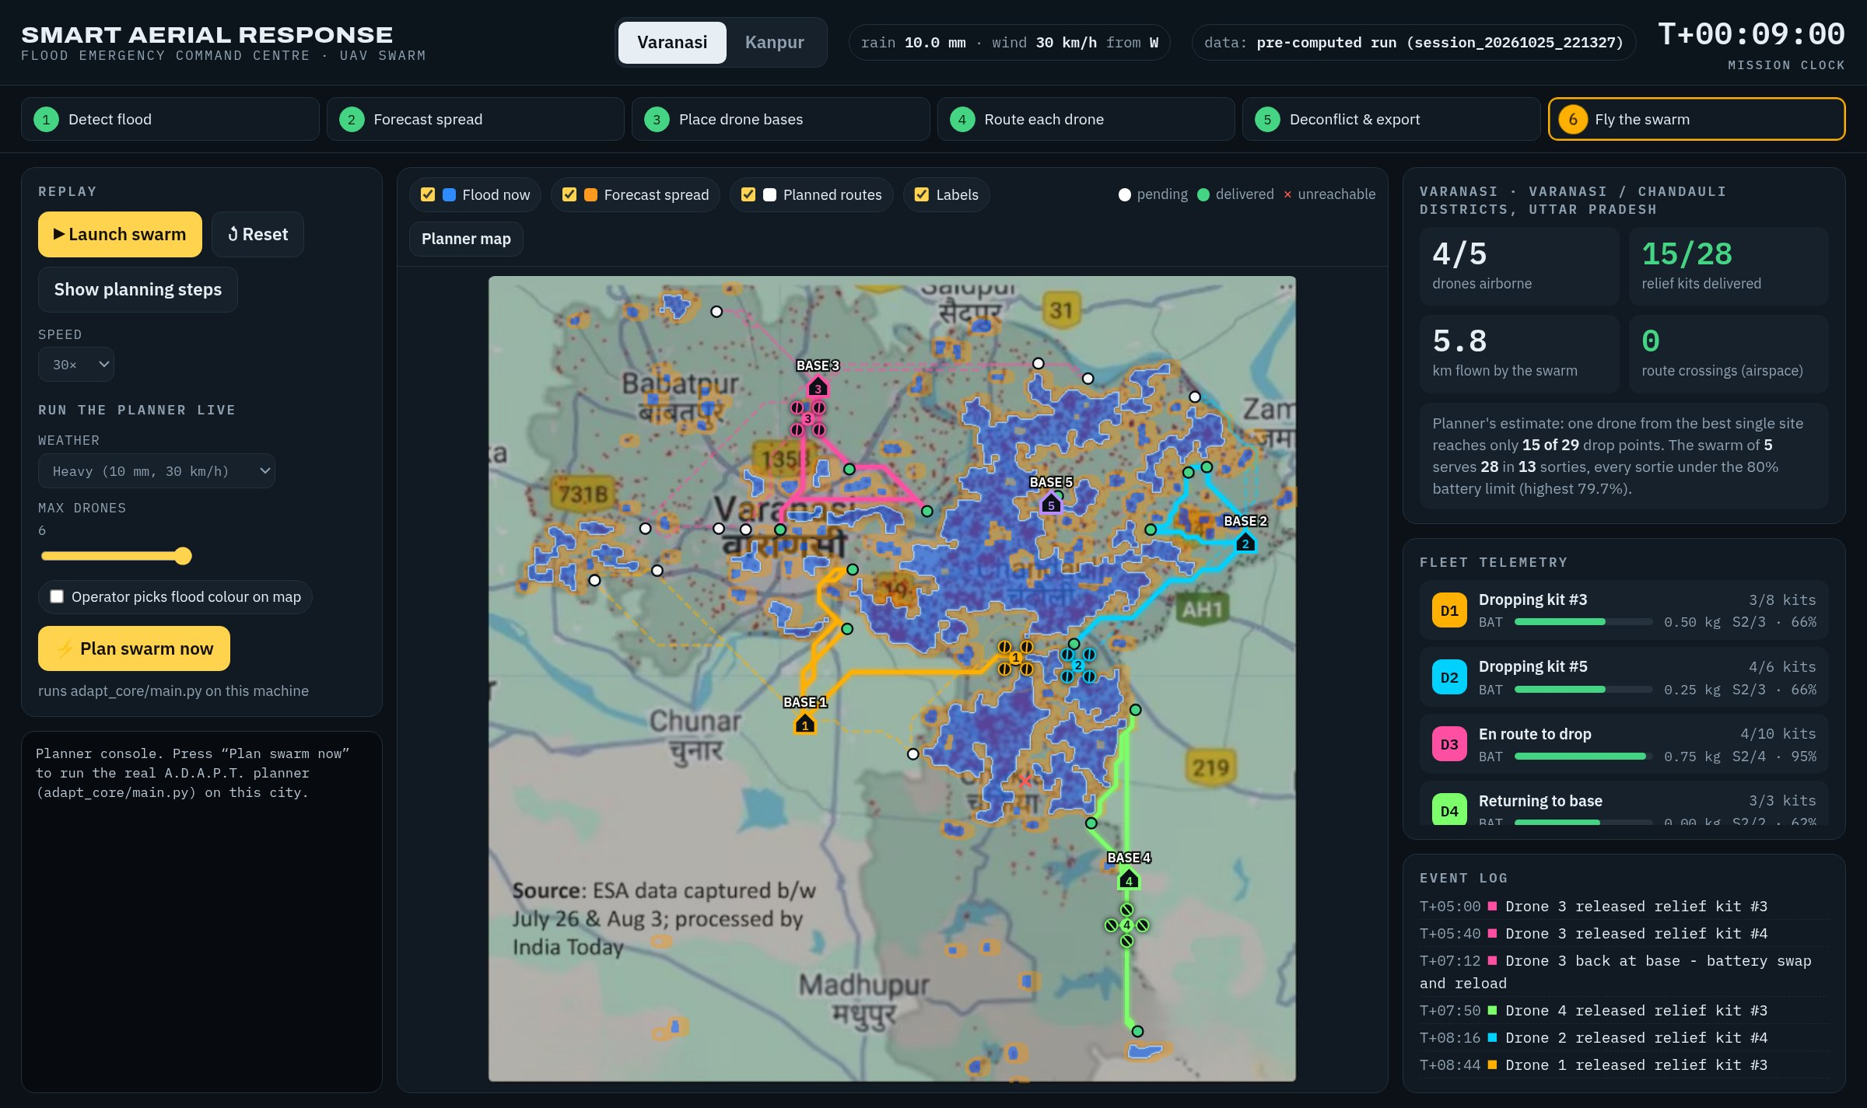
Implementation: ICCC dashboard
1 One button starts a planning run; its log streams live to the browser (SSE)
2 Each finished plan is replayed on the city map with live telemetry
3 Battery, payload, sortie and kits per drone, as an ICCC operator sees them
4 Python standard-library server; no cloud services needed
Command-centre view replaying a Varanasi plan: drones, docks, kits delivered and the planner log
Notes:
Switch to the browser here: run demo/start_demo.sh and open localhost:8765. Start a planning run for Varanasi and let the log stream, then replay the plan on the map. This dashboard is the application layer of our IoT architecture: it is what an ICCC operator would watch.

Slide 10


Novelty: what is new
IoT trigger loop
River gauges over LoRaWAN and docks over MQTT start a re-plan the moment the flood stage rises, with CWC thresholds.
Flood-resilient dock siting
Dock sites chosen across many flood stages and weathers stay usable when the water rises; tested on held-out stages.
ICCC dashboard integration
Plans arrive on an MQTT topic and are shown live to command-centre operators.
Dry-dock safety rule
The planner is only ever offered docks that report dry, so no mission starts from flooded ground.
Notes:
Everything on this slide is our own contribution; the route planner itself is an existing open-source tool we reuse unchanged. What is new is the IoT loop that triggers planning from river gauges, the study that tells the city where to put docks, and the integration with the command-centre dashboard.

Slide 11
Testing
Category | Tests | Passed | Result
Unit: acceptance tests of the reused planner | 12 | 12 | pass
IoT integration: codec, MQTT, bridge, trigger engine | 9 | 9 | pass
Study and data: dock sets, results, message budget | 9 | 9 | pass
System: server, dashboard, IoT loop with planner | 3 | 3 | pass
33/33
tests passed (100%), pytest
Unit tests are acceptance tests of the reused planner
180 scenario runs of the dock study all completed
IoT loop: 3 re-plans, dry docks 6→5 (VNS); 2 re-plans, dry docks 6→4 (KNP)
Notes:
We wrote 33 automated tests with pytest across unit, IoT, study and system levels; 33 pass. The unit tests check that the reused planner behaves as our system expects; the IoT and system tests cover our own code, including the broker, the trigger engine and the full loop.

Slide 12
Outcome: the IoT loop re-plans as the river rises
City | Plan | Flood stage | Docks dry | Drops served | Planner (s)
Varanasi | #1 | 0 | 6 of 6 | 27 of 29 | 23
Varanasi | #2 | 6 | 6 of 6 | 45 of 49 | 67
Varanasi | #3 | 12 | 5 of 6 | 24 of 29 | 42
Kanpur | #1 | 0 | 6 of 6 | 34 of 46 | 42
Kanpur | #2 | 12 | 4 of 6 | 11 of 13 | 28
94% · 90%
coverage with robust docks on unseen flood stages, against 49% · 45% for docks sited from one past flood
Heavy weather; river rising from 0.3 m below the warning mark to 1.25 m above danger (iot/runs/*/summary.json).
Drop points change with the flood stage, so compare plans within a row, not across rows.
Each plan is published to the ICCC dashboard
Notes:
These are results of our IoT loop. As the simulated river rose past the warning and danger marks, the trigger engine re-planned automatically: 3 re-plans, dry docks 6→5 in Varanasi and 2 re-plans, dry docks 6→4 in Kanpur, each time offering the planner only the docks that reported dry. The headline of the dock study is on the right.

Slide 13
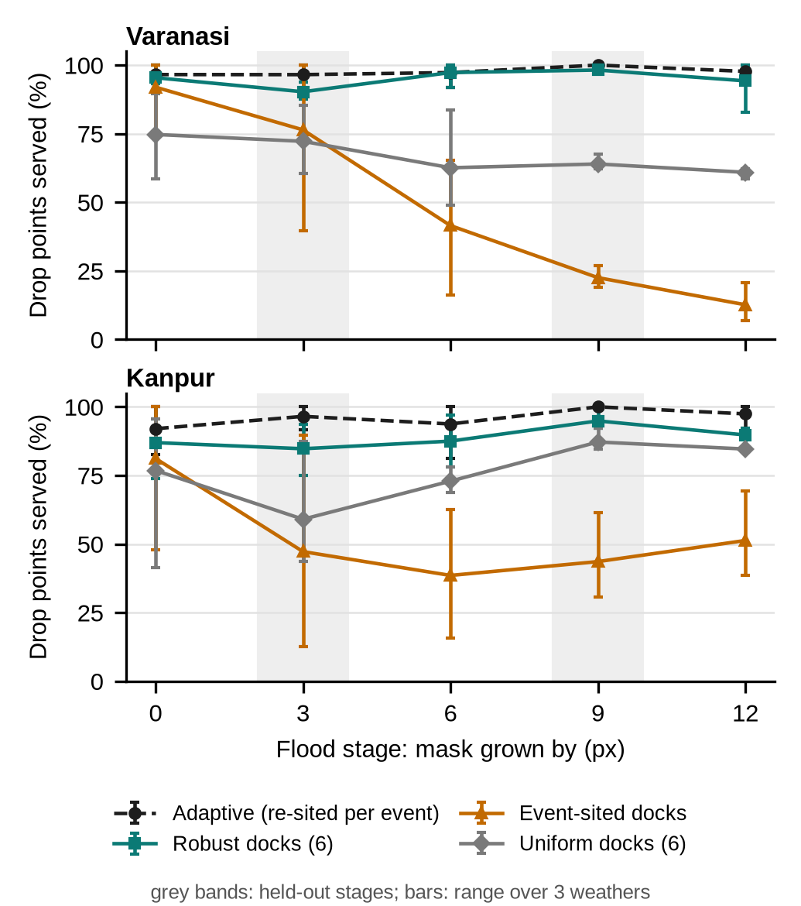
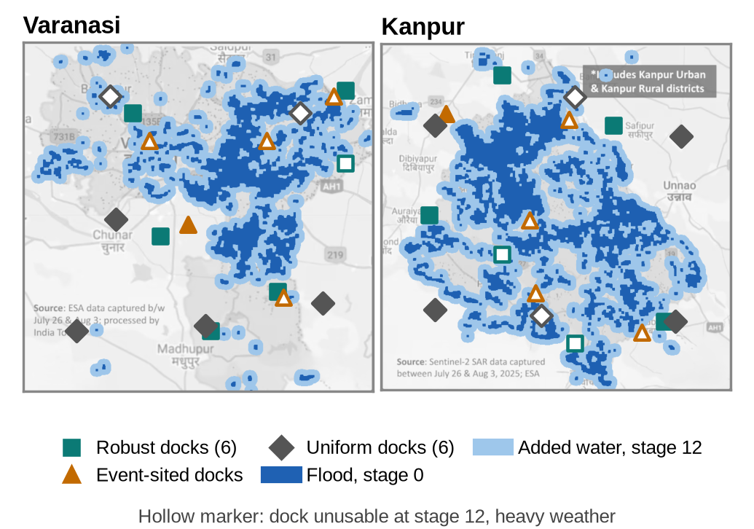
Outcome: where should the city install docks?
180 planner runs: 2 cities × 5 flood stages × 3 weathers
Docks sited from one past flood lose about 2.5 of 5 to the water
Freely re-sited bases reach 98% / 98%, but must move about 260–290 m at every rise
Dock sites over the stage-0 flood; hollow = unusable at stage 12
Docks (6) | VNS | KNP
Robust (ours) | 94% | 90%
Event-sited | 49% | 45%
Uniform | 68% | 73%
Coverage on unseen flood stages
Notes:
This is our research contribution. We tested where to install permanent docks across rising flood stages. Docks chosen with our robust method serve 94% of drop points in Varanasi and 90% in Kanpur on flood stages they were not chosen from, against 49% and 45% for docks sited from a single past flood, which the rising water covers.

Slide 14

Cost sketch and research outcome
Item (per city) | Qty | Indicative list price
Drone-in-a-box dock + drone (DJI Dock 2 bundle) | 6 | ₹12.3–20.2 lakh each
LoRaWAN ultrasonic level sensor (Dragino LDDS20) | 20 | ≈ US$79 each
MQTT broker, planner, dashboard | 1 | open source, existing ICCC servers
IEEE-format research paper
Flood-Resilient Siting of IoT Drone Docks for Smart-City Relief: A Scenario Study of Varanasi and Kanpur
Dr. Swarnalatha P, Ajay Thomas, Dharani I S, Sukant G
Indicative list prices from Indian resellers and the vendor web shop (Oct 2026), not quotations. The docks dominate the cost, which is why siting them where they survive the flood matters.
6 pages, two-column IEEE format; built on 180 new planner runs
Notes:
For a city, six dock-and-drone bundles are the main cost, at roughly 12 to 20 lakh rupees each at list price; the twenty gauges are a small fraction. These are indicative list prices, not quotes. Our unique outcome is an IEEE-format research paper on dock siting, with our guide as first author.

Slide 15
Conclusion and future work
From a river-gauge reading to relief missions from dry docks, automatically.
IoT loop re-plans on CWC thresholds: 3 re-plans, dry docks 6→5 (Varanasi), 2 re-plans, dry docks 6→4 (Kanpur)
Robust dock sites keep 94% / 90% coverage as the flood rises
Message budget 9.61 kbit/s per city; standard protocols fit a smart city's ICCC
Next
Field gauges and a LoRaWAN gateway
Georeferenced maps (GeoTIFF input is supported)
Flight trials in ArduPilot SITL, then outdoors
Hydraulic flood model in place of mask growth
Notes:
To close: our IoT layer turns river-gauge readings into relief missions from docks that are still dry, and our study tells the city where those docks should go. Everything is simulated so far; the next steps are real gauges and a LoRaWAN gateway, georeferenced maps and flight trials.

Slide 16
References
[1] S. Koenig, M. Likhachev, "D* Lite," AAAI, 2002.
[2] M. Erdelj et al., "Help from the sky: Leveraging UAVs for disaster management," IEEE Pervasive Computing, 16(1), 2017.
[3] N. Mohamed et al., "Unmanned aerial vehicles applications in future smart cities," Technol. Forecast. Soc. Change, 153, 2020.
[4] A. Zanella et al., "Internet of Things for smart cities," IEEE Internet of Things Journal, 1(1), 2014.
[5] LoRa Alliance, LoRaWAN Regional Parameters; OASIS, MQTT Version 5.0, 2019.
[6] MoHUA, Government of India, Smart Cities Mission, smartcities.gov.in
[7] Central Water Commission flood levels, as reported for Varanasi (Rajghat) and Kanpur (Ganga Barrage), Sept 2026.
[8] News18, "Ganga crosses danger mark in Varanasi; 84 ghats submerged, over 6,500 displaced," Aug 2025.
[9] Times of India, "3D digital twin helps Kashi plan flood response in advance," Sept 2026.
[10] T. Saha et al., A.D.A.P.T.: Autonomous Drone for Adaptive Path Tracking, GitHub, 2026.
Notes:
The full reference list is in the report and the research paper.

Slide 17
Thank you
Live demo: Varanasi and Kanpur · Questions
Notes:
Thank you. We are happy to run the live demo again or take questions.

