Slide 1

IMDB Data Analysis Report
Analysis & Prediction of Top Rated IMDB Movie Titles

Slide 2

Goals
What goals did this project achieve?
Create a model to predict user rating
Compare various Machine Learning algorithms to get the best fit algorithm for prediction of user rating with optimized metrics
Get insights from the data
32135 movie titles were analyzed to get intriguing insights on the basis of various features present in the dataset
Compare different languages for data science tasks
During this project various languages like R, Python, PySpark will be compared to analyze dataset and model it. Visualization will also be compared between R, Python and Power BI

Slide 3
Data Scraping
Retrieving data from IMDB’s top rated titles
Implemented using Python’s Beautiful Soup
Beautiful Soup
Beautiful Soup is a Python package used to parse HTML pages mainly and extract data. The usage of this package was very simple and I hit the ground running with this easy to use package despite having no experience in web scraping
Procedure
IMDB Web Links were collected for all the genres(Action, Animation, Biography, Comedy, Crime, Drama, Fantasy, Horror, Mystery, Romance, Sci-fi, Thriller, War) and stored into notepad files. Various empty lists were made such that genre and column based data was to be stored separately .Then using Beautiful Soup’s findAll() and urllib.Request, data was extracted and stored into the respective genres with different title counts and column list. Ultimately all the column lists of a genre were merged and then all the genres list merged to create a single Data frame which is to be cleaned later on. The data frame was saved as a csv file for further work in R & Python.
Extracted Raw Data
The 32135 Movie titles extracted were parsed into different columns which were namely: Genre Ranking, Movie Title, Release Year, Movie Duration, Primary Genre, Sub Genres (Non-Primary Genres), User Rating, Directors & Actors, User Votes.

Slide 4
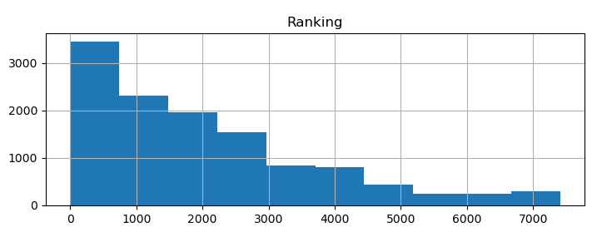
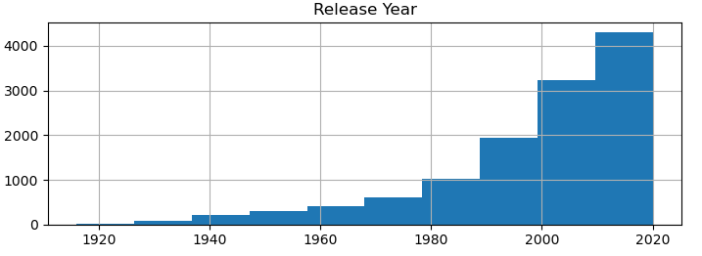
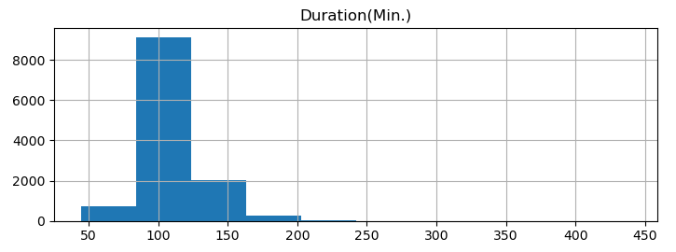
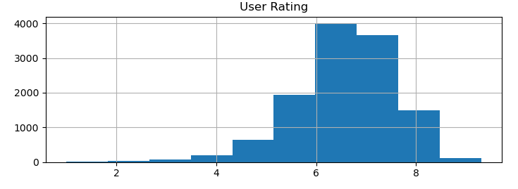
Raw Data Exploration
Checking distribution of dataset Columns of Numerical Columns
Implemented using Python’s matplotlib
Ranking Histogram is understandably right-skewed
Release Year Histogram is understandably left-skewed
Duration Histogram is concentrated to a specific range
User Rating is also concentrated to the range 6-8

Slide 5
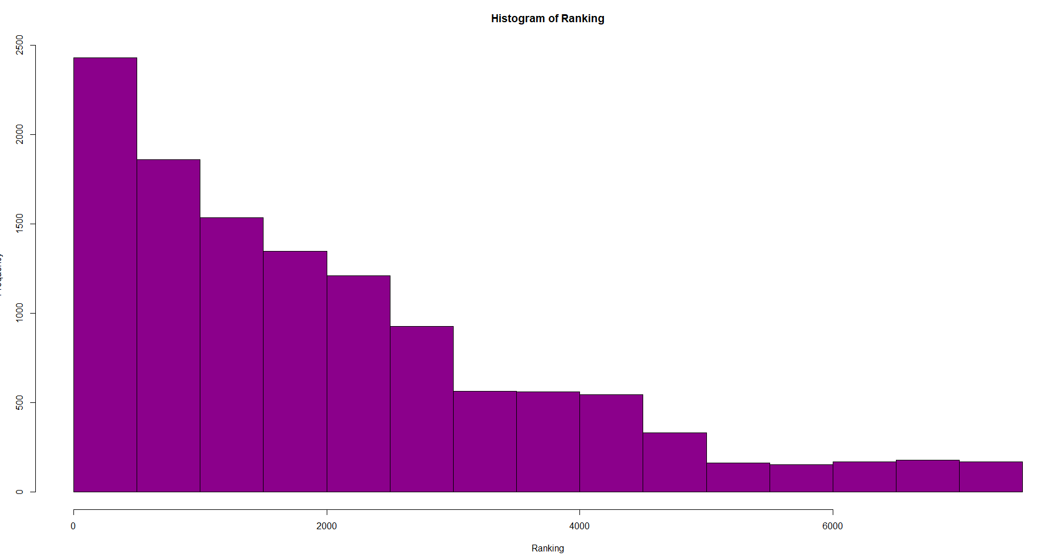
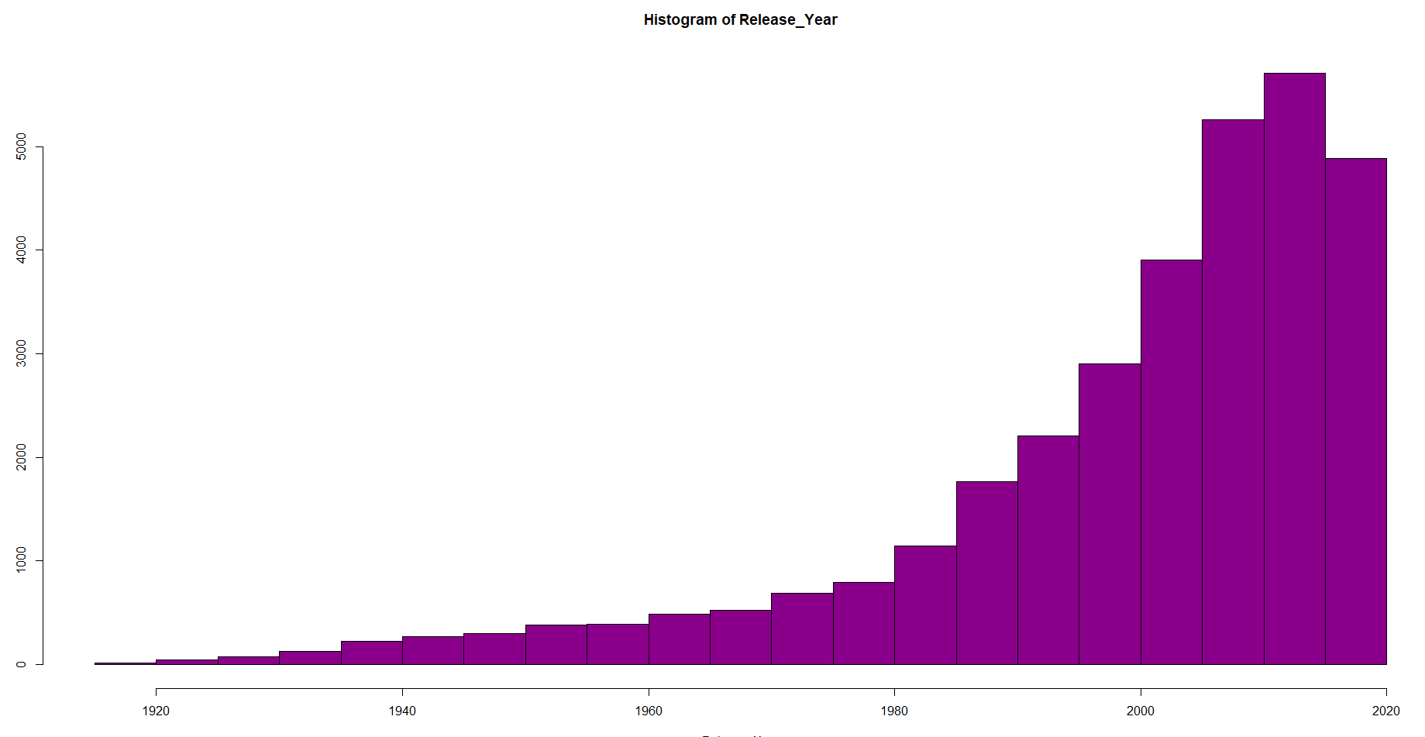
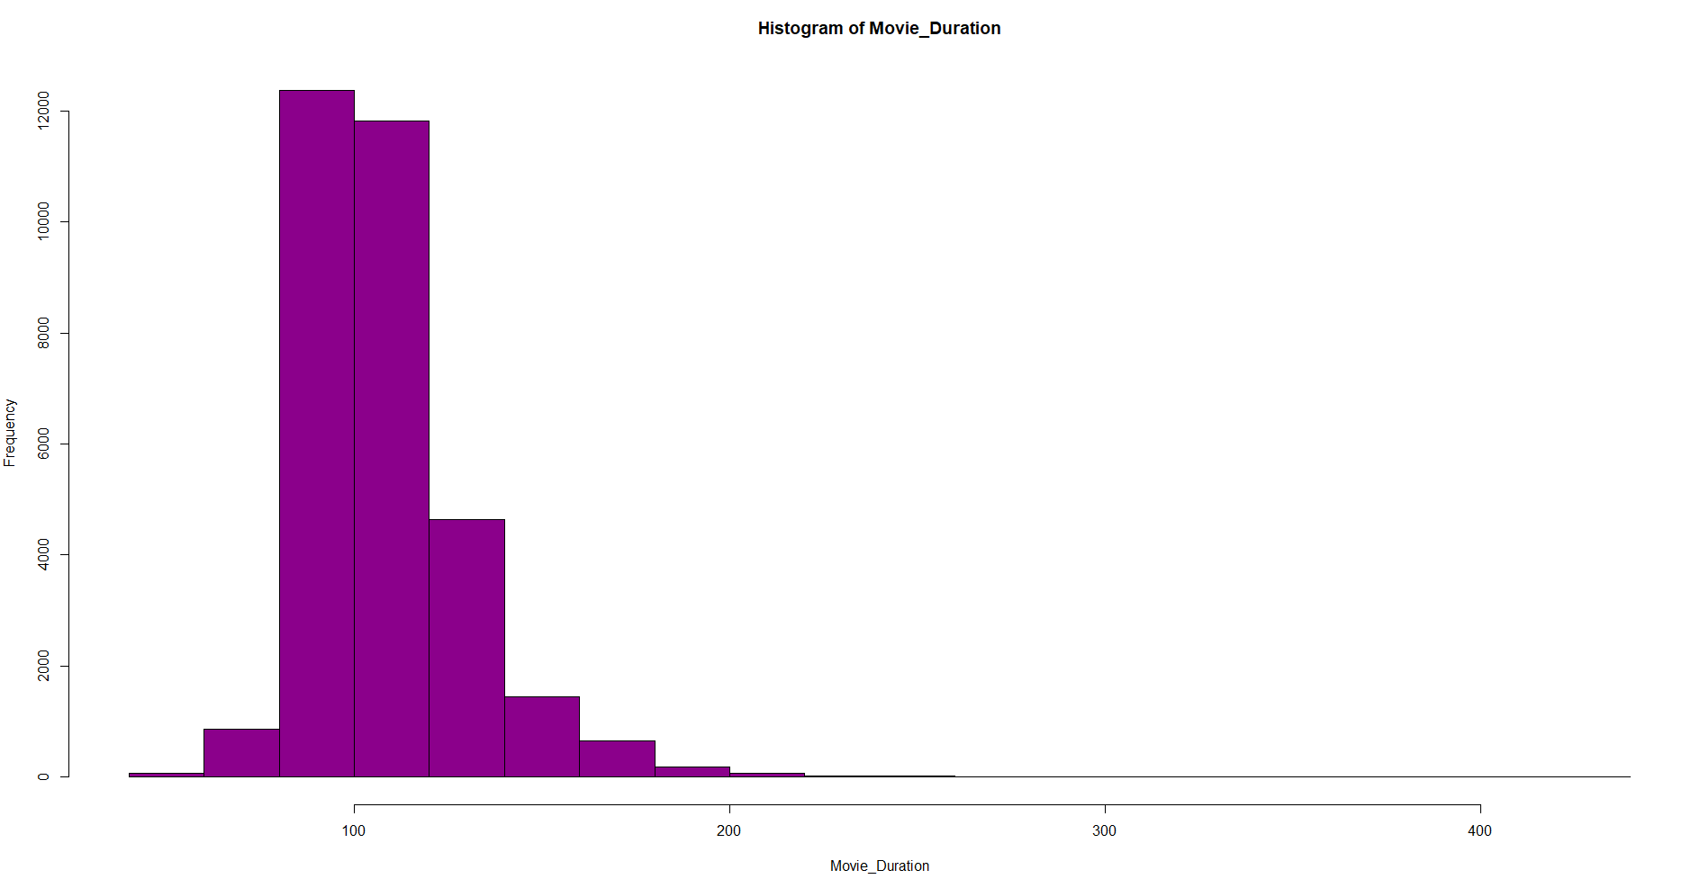
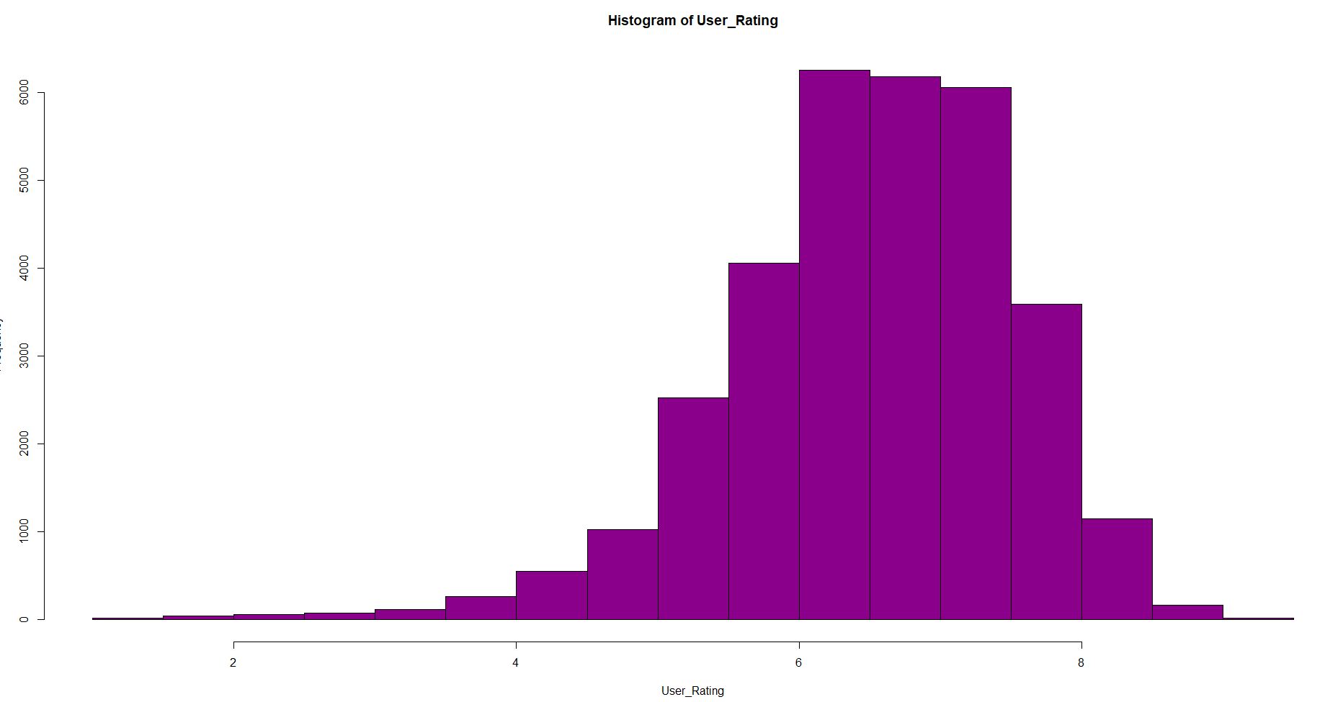
Raw Data Exploration
Checking distribution of dataset Columns of Numerical Columns
Implemented using R’s ggplot2
Ranking Histogram is understandably right-skewed
Release Year Histogram is understandably left-skewed
Duration Histogram is concentrated to a specific range
User Rating is also concentrated to the range 6-8

Slide 6
Kzdnotklykpohpvkob
Data Cleaning & Preprocessing
Pre-processing data into a further usable format
Implemented using Python’s Pandas & R’s dplyr and tidyr
Symbol removal
Integer columns such as Release Year contained unwanted symbols like ( , ), I, V, X while Duration Column contained phrases like min. These all were replaced by whitespaces and then the column values were trimmed
Column splitting
Columns such as Sub Genres and Directors & Actors contained multiple columns inside them. These were split into multiple columns using delimiter as the basis of splitting.
Using both the languages, almost similar tasks were completed in the Data Cleaning domain
Duplicate removal
Since all the movies scraped were top rated, so a lot of movies were duplicate in the main dataframe. Hence, after removing duplicates, around 20000 movies were removed and as a result the count was reduced to 12154
Almost all columns had minimal or no NA values except Sub Genre 3 . Sub Genre 3 had about 25% NA values and since the column isn’t very important, we removed it.
Column Removal
Type Conversion
The column types were found and then converted to suitable types. This was important as the future analysis and modelling have fixed type requirements which our data should be able to be converted to.

Slide 7

Kzdnotklykpohpvkob
Analysis Insights
Finding answers to some intriguing questions
Implemented using Python’s Matplotlib, R’s ggplot2 & PySpark
Which character is most used as the starting one for movie titles? Is it T or S or something else?
What is the genre proportion of top movies released per year? Does it follow a trend through all the years
What is the trend of count of top movies on IMDB since 1916 to 2020? Upward slope! You sure?
What is the increase/decrease in User Votes as per the Release Year of movies? Is it the obvious exponential increase?
What is the top most rated movie year wise since 1916? Are we going to see the Oscar winners or some surprising names
What is the average runtime of top movies as per the year? Is there a big difference or not?

Slide 8
Kzdnotklykpohpvkob
Analysis Insights
Finding answers to some intriguing questions
Implemented using Python’s Matplotlib, R’s ggplot2 & PySpark
Which genre has the most movies in IMDB’s top rated movies? Wild guess, Action! Right?
Most successful Secondary Supporting Actor? Don’t guess anymore, find out!
Most successful Primary Actor on basis of User Rating? De Niro, Daniel Day Lewis or Will Smith?
Most successful Supporting Actor on basis of User Rating? Morgan Freeman no doubt!
Most Successful Director of all Time? Is the answer surprising or is it easily guessable?
Decade Wise Movie Count? Didn’t we already answer that? No! That was year wise. Let’s get that data normalized, right?

Slide 9
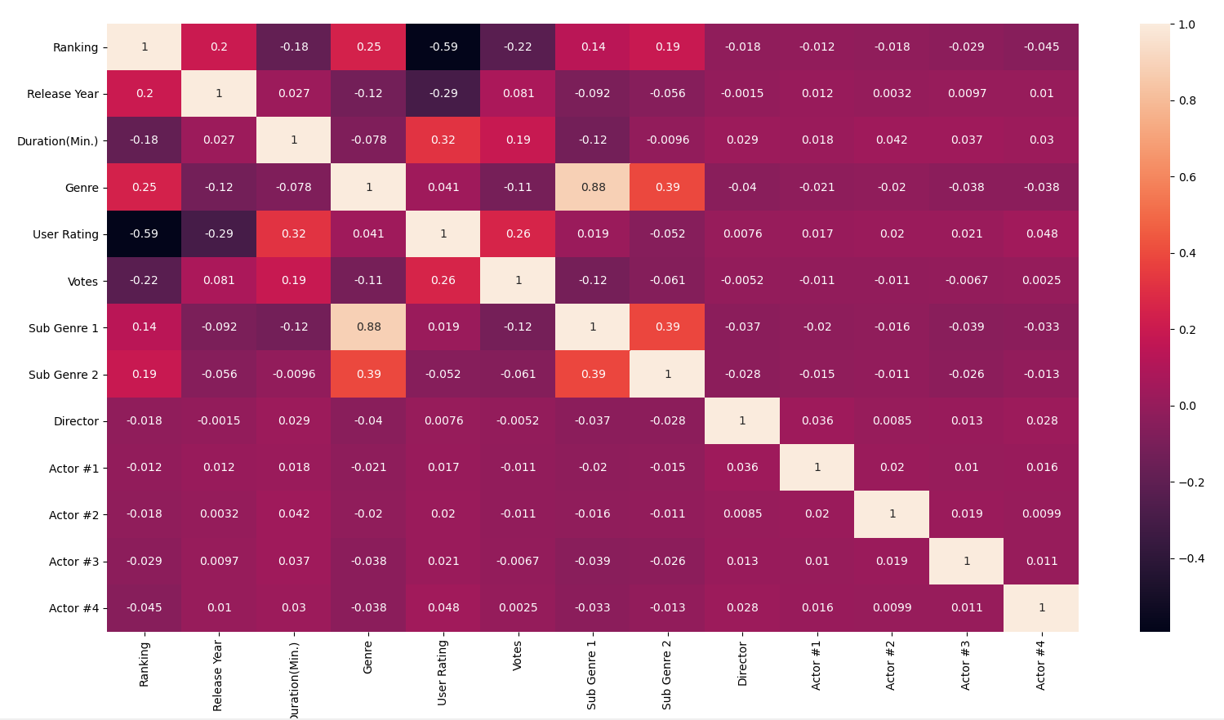
Kzdnotklykpohpvkob
Predicting Movie IMDB Rating
Creating a model to predict IMDB User Rating
Implemented using Python’s Scikit-learn and R’s dplyr
Step 1: Label Encoding
Correlation Heat Map
Resulting dataframe from Cleaning & Pre-processing steps is read into the Machine Learning python file. The non-numerical columns are converted to Category Types and then label encoded to get the correlation matrix and visualise it.
Step 2: Feature Selection
After viewing the adjacent correlation heatmap, various correlation index are analysed related to User Rating which is our target variable. The columns with minimal significant correlation index are removed from the dataframe.

Slide 10
Kzdnotklykpohpvkob
Predicting Movie IMDB Rating
Creating a model to predict IMDB User Rating
Implemented using Python’s Scikit-learn
Standard Regression Choice
Good for better accuracy
Multiple Linear Regression
Lasso Regression
Step 3. a: Final features and Dataframe splitting
Step 4.a: Regression Algorithms Selection
After analysing correlation matrix, final selected features were Movie Ranking, Release Year, Movie Duration & User Votes. Then using train-test-split from scikit-learn, data was divided into train and test set with 4:1 ratio.
Since I wanted to predict the User Rating to the point, I had to use Supervised Regression Algorithms. Plenty of Algorithms were implemented but the final selected ones are:
K-Nearest Neighbour
Random Forest Regression
Hyperparameter Tunning easy
Probably gives the highest accuracy

Slide 11


Kzdnotklykpohpvkob
Predicting Movie IMDB Rating
Model Evaluation on Basis of Various Metrics
Implemented using Python’s Scikit-learn
R2 Score
Mean Squared Error
Model Score
Coefficient of Determination. Means the % of variation of dependent variable which can be explained by independent variable. More the merrier.
MSE measures the average of error squares i.e the average squared difference between the estimated values and true value. Less the better.
Comparing the model predicted values to the actual values which we got by test data. More the number of matching values, the better
Metrics Score for Models
 | Multiple Linear Regression | Lasso Regression | K-Nearest Neighbor | Random Forest Regression
R2 Score | 44.7 | 45.3 | 43.4 | 69.6
Mean Squared Error | 60 | 59.3 | 61.4 | 32.9
Model Score | 44.2 | 44.7 | 52.7 | 95.7

Slide 12

Kzdnotklykpohpvkob
Predicting Movie IMDB Rating
Random Forest Regression
Gives the highest accuracy
Creating a model to predict IMDB User Rating
Implemented using R’s dplyr
Step 3.b: Final features and Dataframe splitting
Step 4.b: Model Selection
Since I wanted to predict the User Rating to the point, I had to use Supervised Regression Algorithms. After implementing four algorithms using Python, not many suitable options were available and I executed same algorithms which were tested using different metrics.
After analysing correlation matrix, final selected features were Movie Ranking, Release Year, Movie Duration & User Votes. Then using train-test-split from scikit-learn, data was divided into train and test set with 4:1 ratio.
Hyperparameter Tunning easy
Multiple Linear Regression
Standard Regression Choice
K-Nearest Neighbour

Slide 13



Kzdnotklykpohpvkob
Predicting Movie IMDB Rating
P-value of < 2e-16 means it is highly unlikely that any change in dependent variable due to independent variables is due to chance
Model Evaluation on Basis of Various Metrics
Implemented using R’s Caret, Random Forest
Means the % of variation of dependent variable which can be explained by independent variable
45.2
R2 Score
R2 Score
44.8
K-Nearest Neighbour
Multiple Linear Regression
<2e-16
P-value
75.8
56.8
Root Mean Square Error
Mean Absolute Error
Random Forest Regression
Square Root of Mean Squared Error. Punishes big errors.
Absolute error without considering the error direction
Variance Explained
71.2
Again, random forest regression gave the best performance in important metric

Slide 14
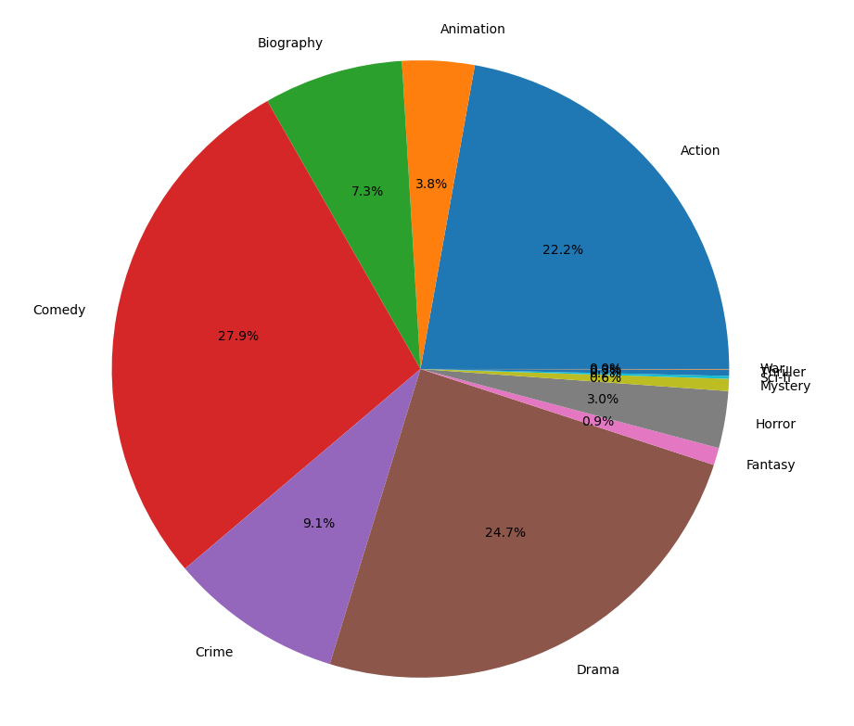
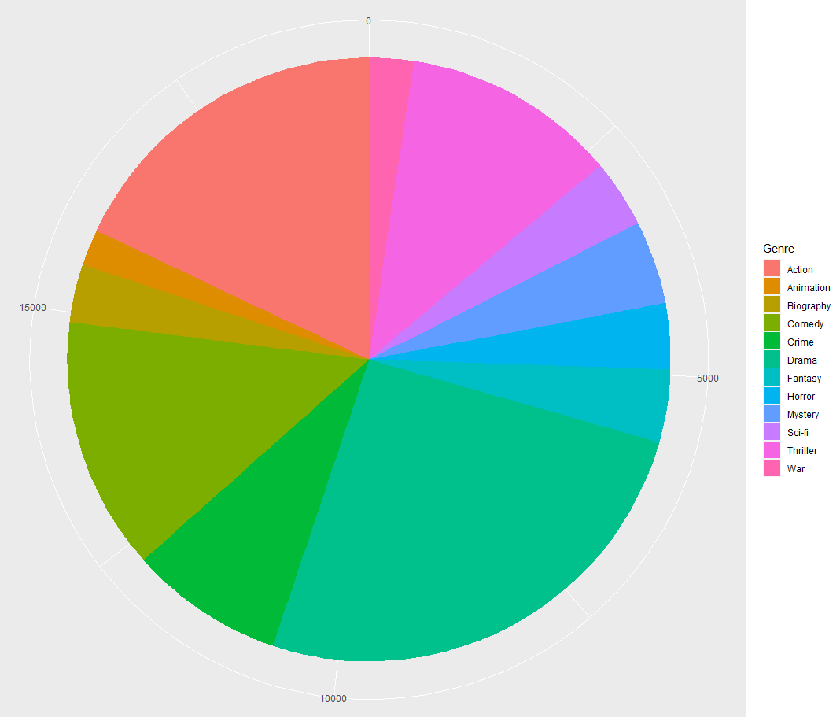
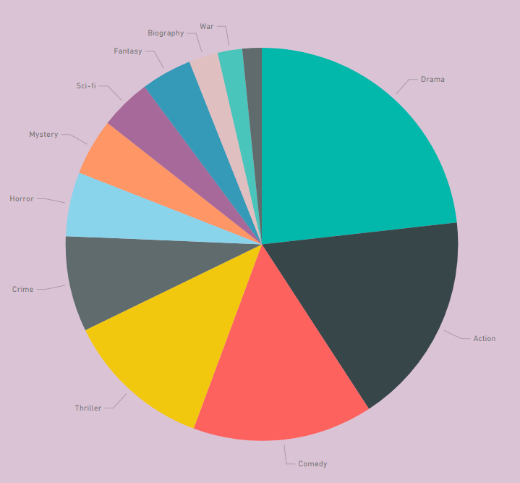
Kzdnotklykpohpvkob
Data Visualization
Visualizing the results of analytics questions
Implemented using Python’s matplotlib, R’s ggplot2 and Power BI
Data Visualization
Visualization was required to learn more about the data set and convey the results of the analytical questions I had regarding the IMDB dataset in a comprehensive method. All three options used very easy to use and gave quality results. A comparative example of Genre Wise Proportion of Top IMDB Movies is shown below:
Python's matplotlib
R's ggplot2
Power BI

Slide 15


Kzdnotklykpohpvkob
Language & Tools Comparison
Choice of language/tool is highly subjective in nature. My choice has been was based on the ease of use and value for effort.
Assessing which language was the most effective for which task
Most effective:
Power BI
Most effective:
Python
Most effective:
Python
Most effective:
R
Most effective:
R
Used Features & Line of Code
 | Web Scraping | Data Cleaning | Data Analysis | Machine Learning & Modelling | Data Visualization
Python
R
Py-spark
Power BI
348
93
372
216
93
-
63
336
92
84
-
-
339
-
-
-
-
-
-
-
Language/Tool Used
Language/Tool not used

Slide 16


Future Work
Plans to achieve more by enhancing the project
To-Do List:
Many enhancements are planned for this project to achieve more goals in future. Some of them are:
Use Py-Spark/Scrapy for Web Scraping. Beautiful Soup worked perfectly well for my project requirements and it's hard to think of scenarios when I might need to use Web sites for Web scraping which have security features of Captcha/ Limited Request Count. But for implementation purpose, Web Scraping will probably be done using Scrapy/Py-spark
Using Py-spark for Machine Learning Tasks would be an important to-do task as Python and R fulfill the requirements easily in non-big data scenarios, but for big data scenarios, using Big Data Technology such as Py-spark would be imminent. The transition is easier too due to Python's heavy influence over Py-Spark
Using Tableau and other Data Visualization tools. Power BI hands-down gave the best results in terms of Visualization due to obvious reasons. Comparing R & Python with a proper Data Visualization tool was somewhat unfair to them and thus the next comparison will be apple-to-apple I.e. A data visualization tool Vs. Another data visualization tools.
Creating full-fledged Machine Learning model which could give out maximum possible(>80%) accurate Movie Rating Prediction and the model should be able to use all the parameters which define a movie's critical success. However this might require multiple people and thus might require some time.

