Slide 1
Exploratory Data Analysis of Booking.com Multi-Destination Trips Dataset
Predicting the Next Destination in Multi-City Trips
Team: CodeRec

Slide 2
Dataset Overview
The dataset from Booking.com contains 1.5 million anonymized accommodation bookings, representing 359,000 unique trips across 39,000 destinations.
This dataset is particularly well-suited for modeling sequential recommendations and retrieval problems in a high cardinality target space.

Slide 3
Dataset Overview
The dataset consists of anonymized bookings representing multi-destination trips.
Key Columns:
user_id: User ID
checkin: Check-in date
checkout: Check-out date
city_id: Unique city ID
device_class: Device used for booking
affiliate_id: Affiliate channel ID
booker_country: Country of the booker
hotel_country: Country of the hotel
utrip_id: Unique multi-destination trip ID

Slide 4
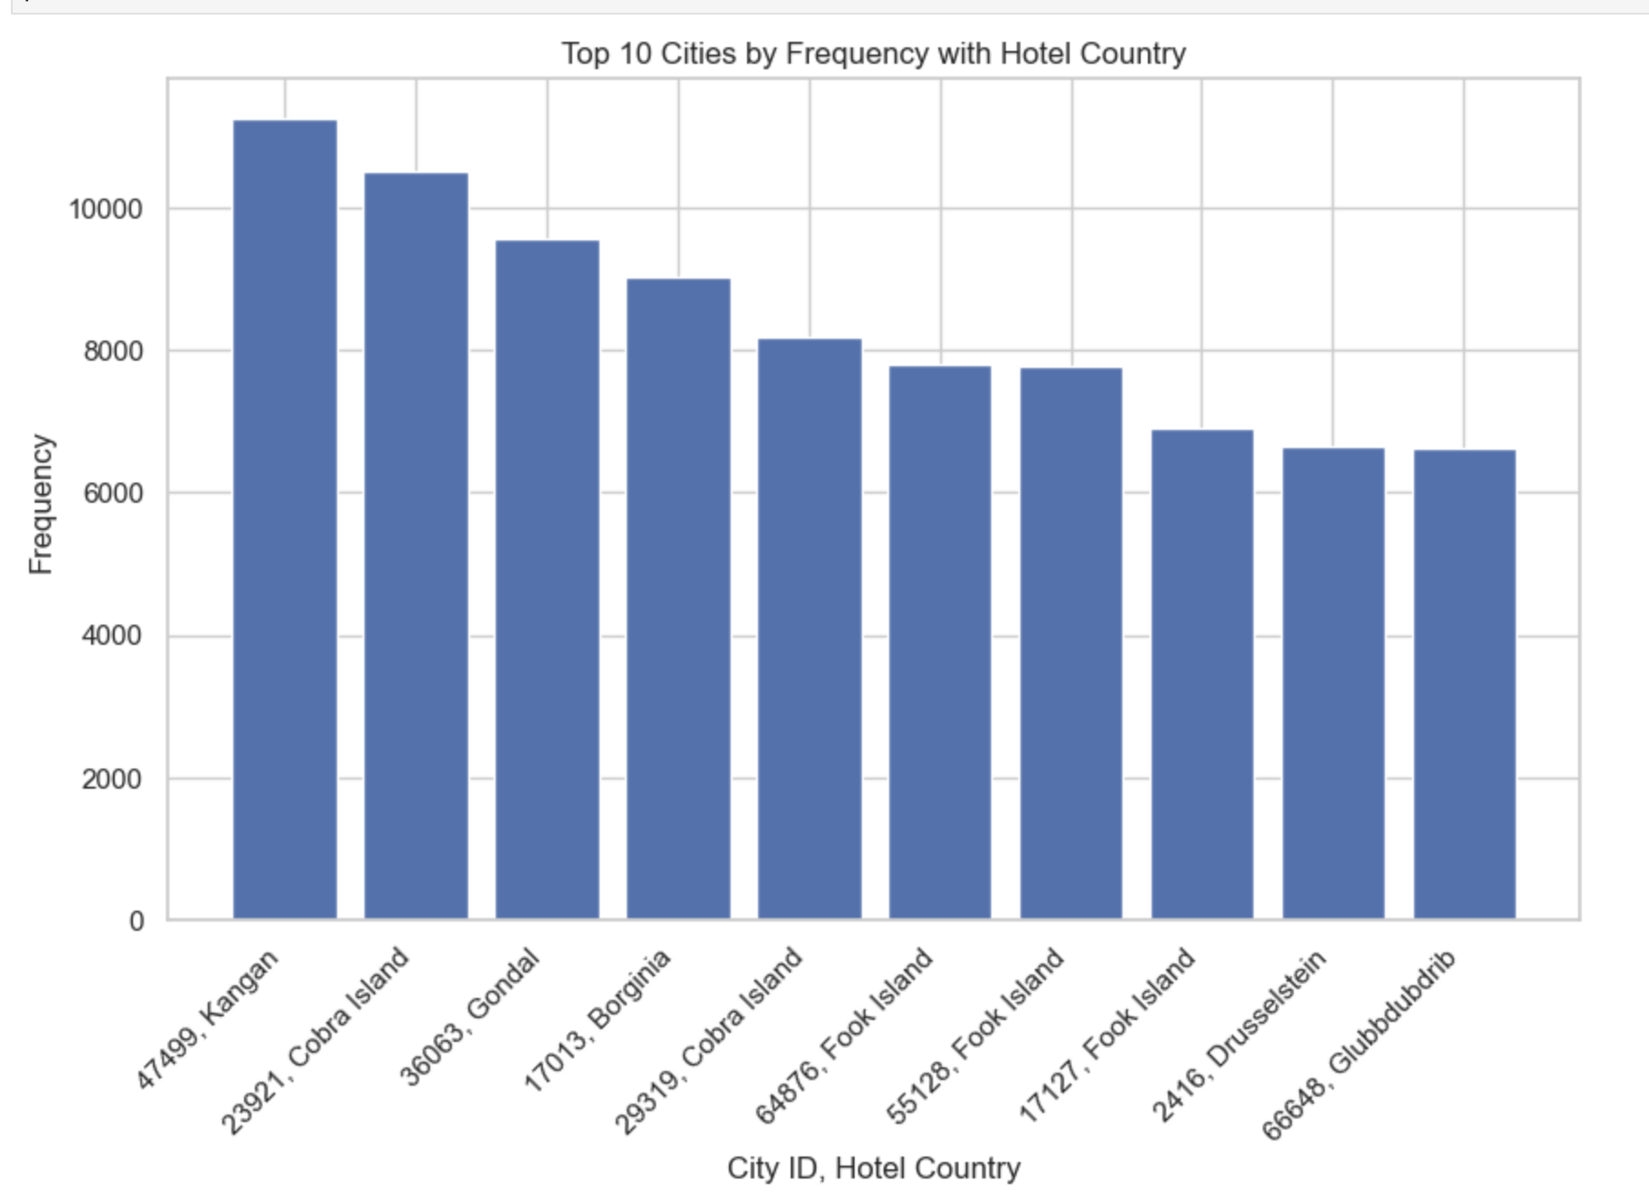
Most Popular Cities
The analysis identifies the most popular cities based on the number of bookings.
The top 10 cities with the highest number of bookings are presented.

Slide 5
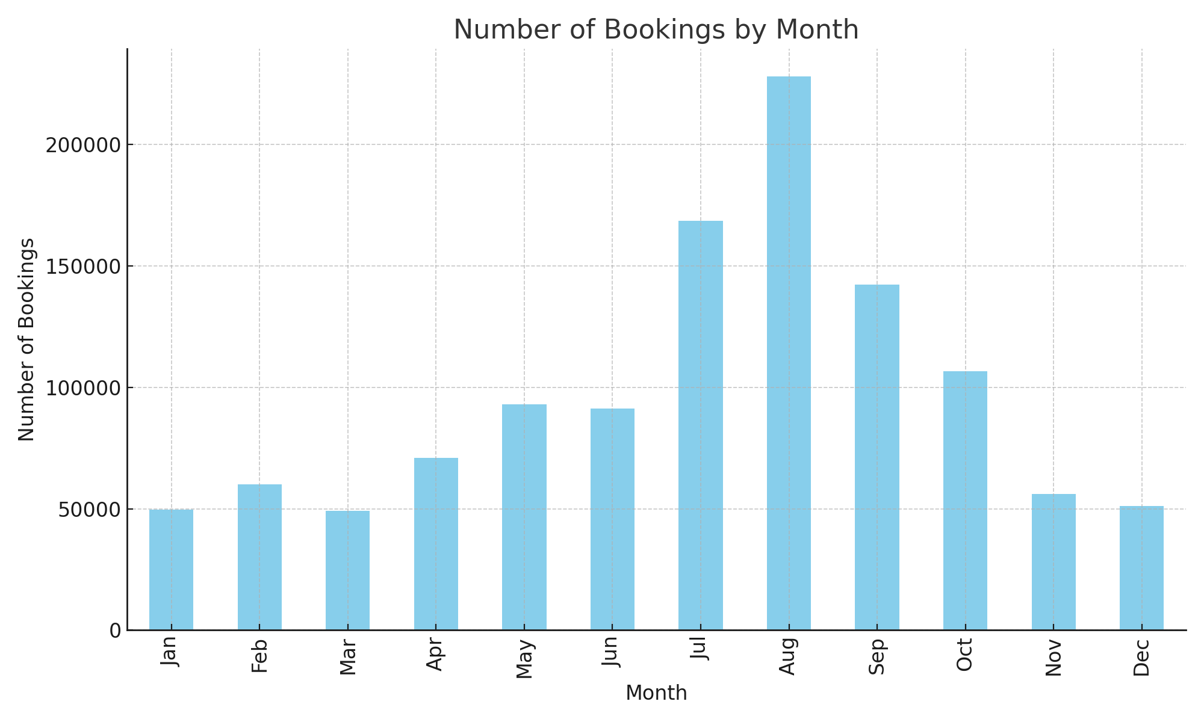
Bookings per Month
The analysis examines the number of bookings made per month
August had the highest bookings

Slide 6
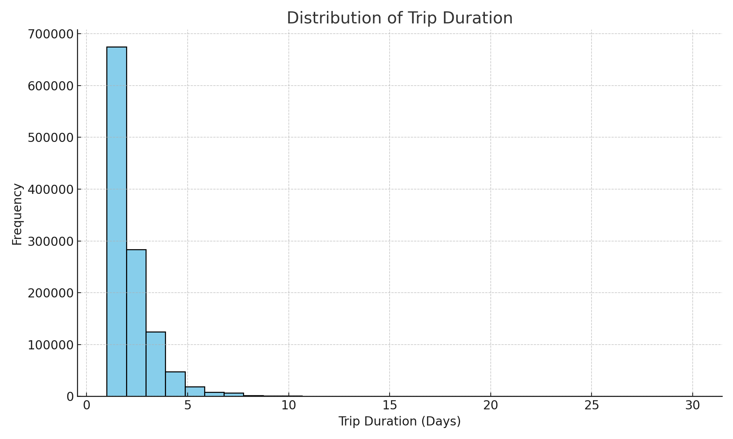
Trip Duration Distribution
The distribution of trip durations (in days) is analyzed.
The histogram shows the frequency of different trip lengths, most trips lasted 1-2 days

Slide 7
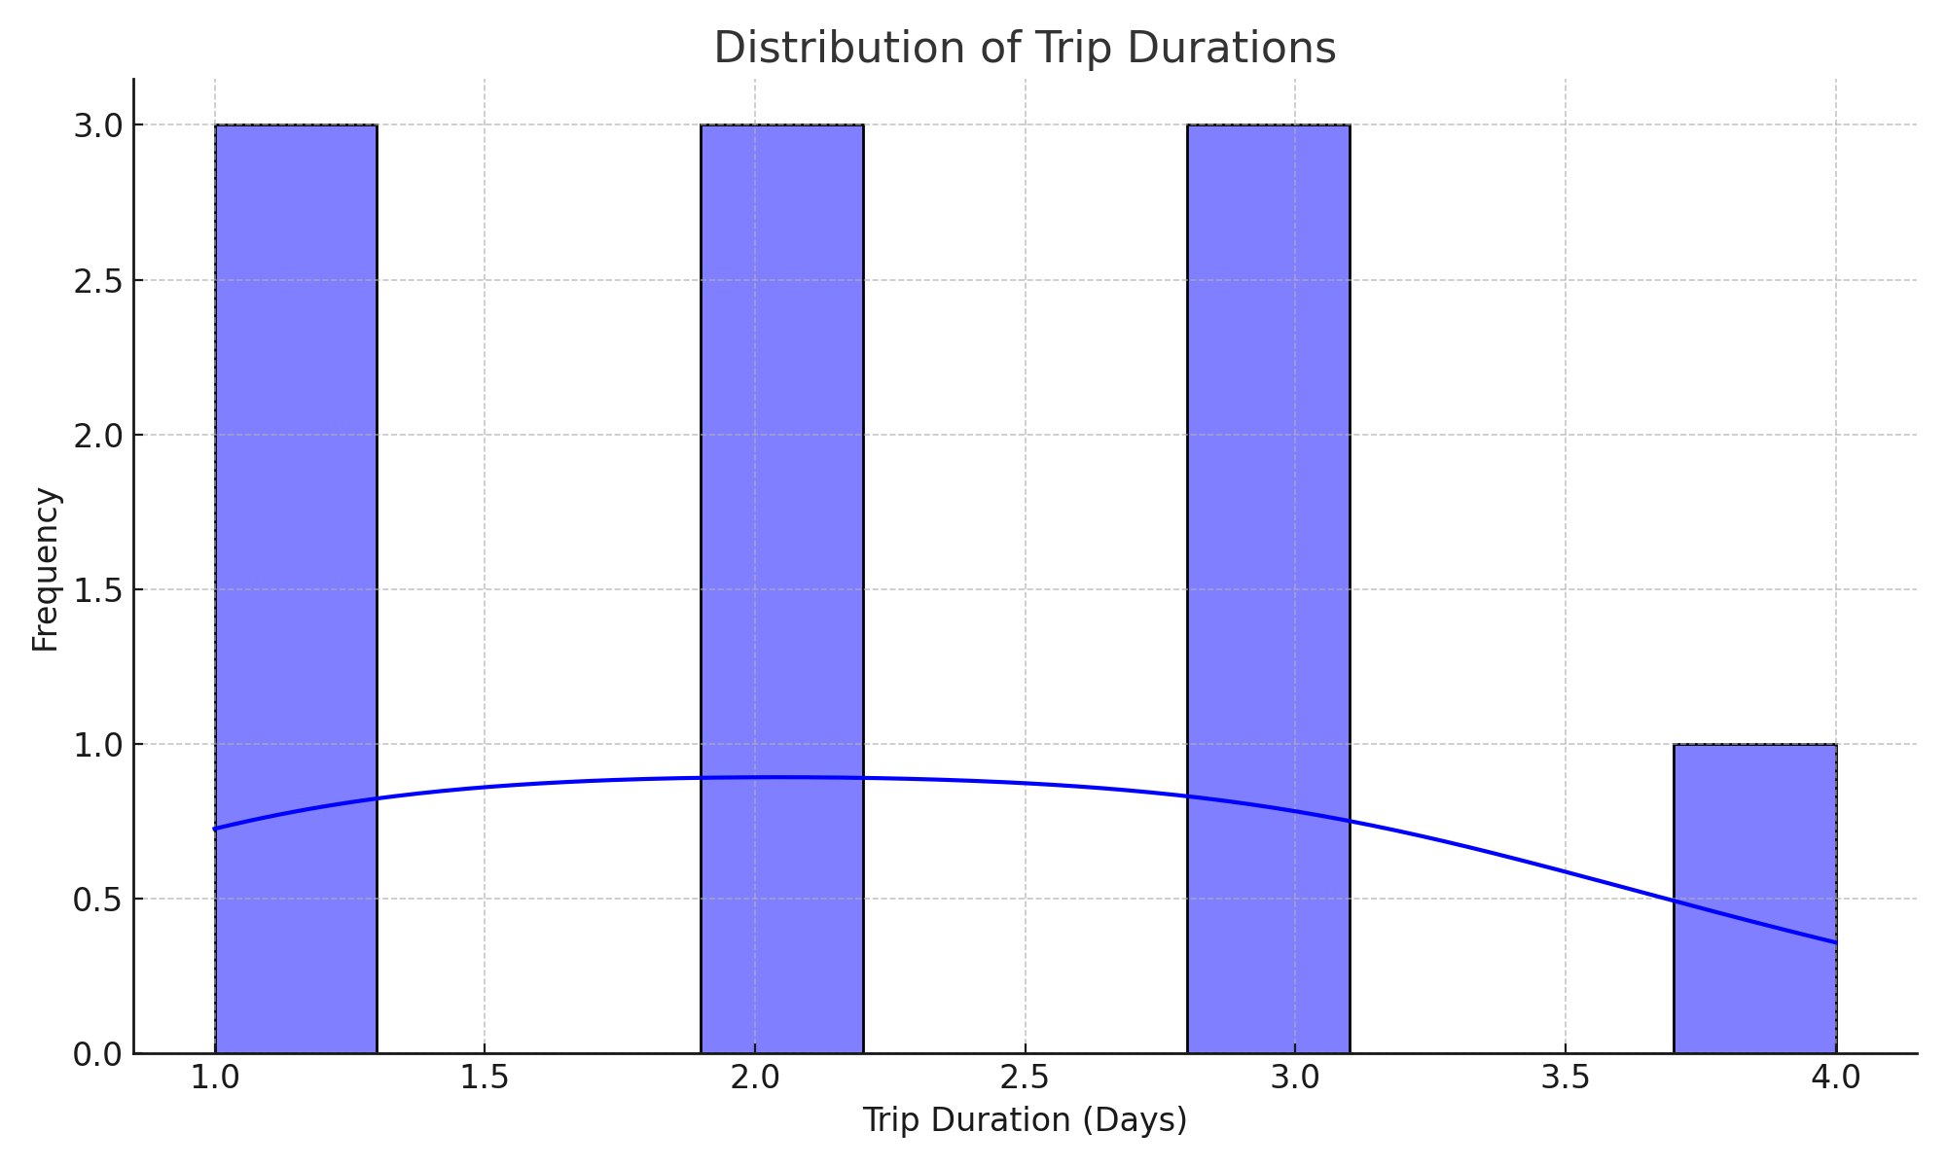
Distribution of Trip Durations

Slide 8
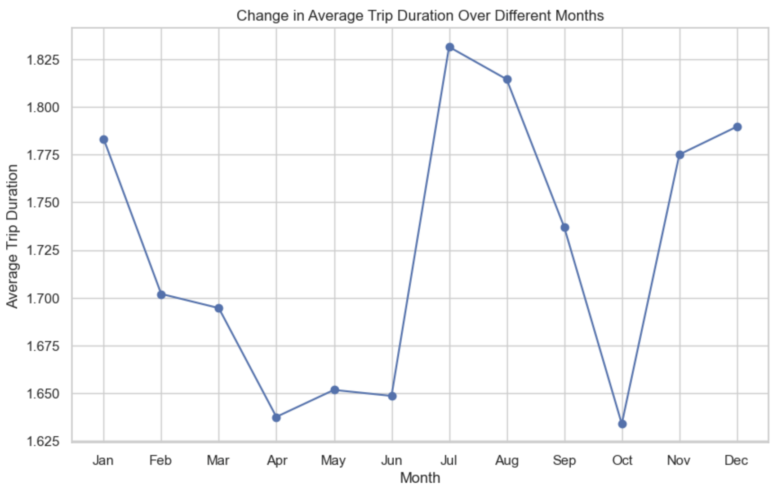
Change in Trip Duration Over Months
Seasonality peaks in Jan, Jul and December during winter/ summer holiday season

Slide 9
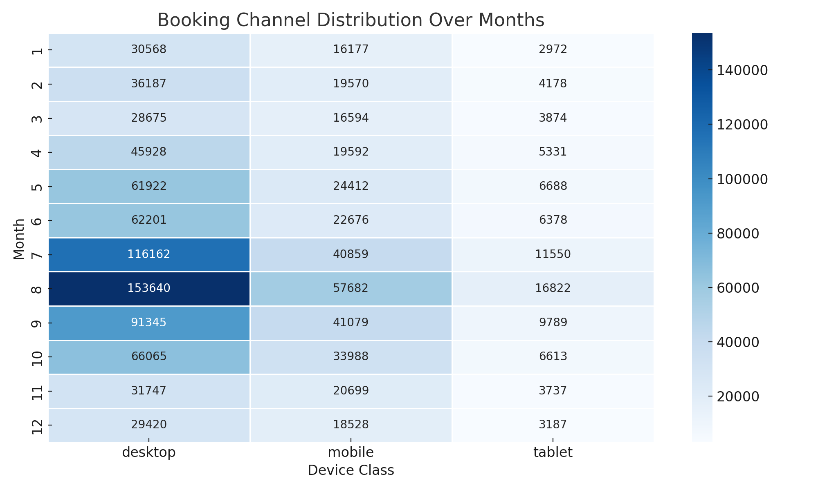
Booking Channel Distribution Over Months
The booking channel distribution over different months is visualized.
A heatmap shows the proportion of bookings made through various device classes each month.

Slide 10
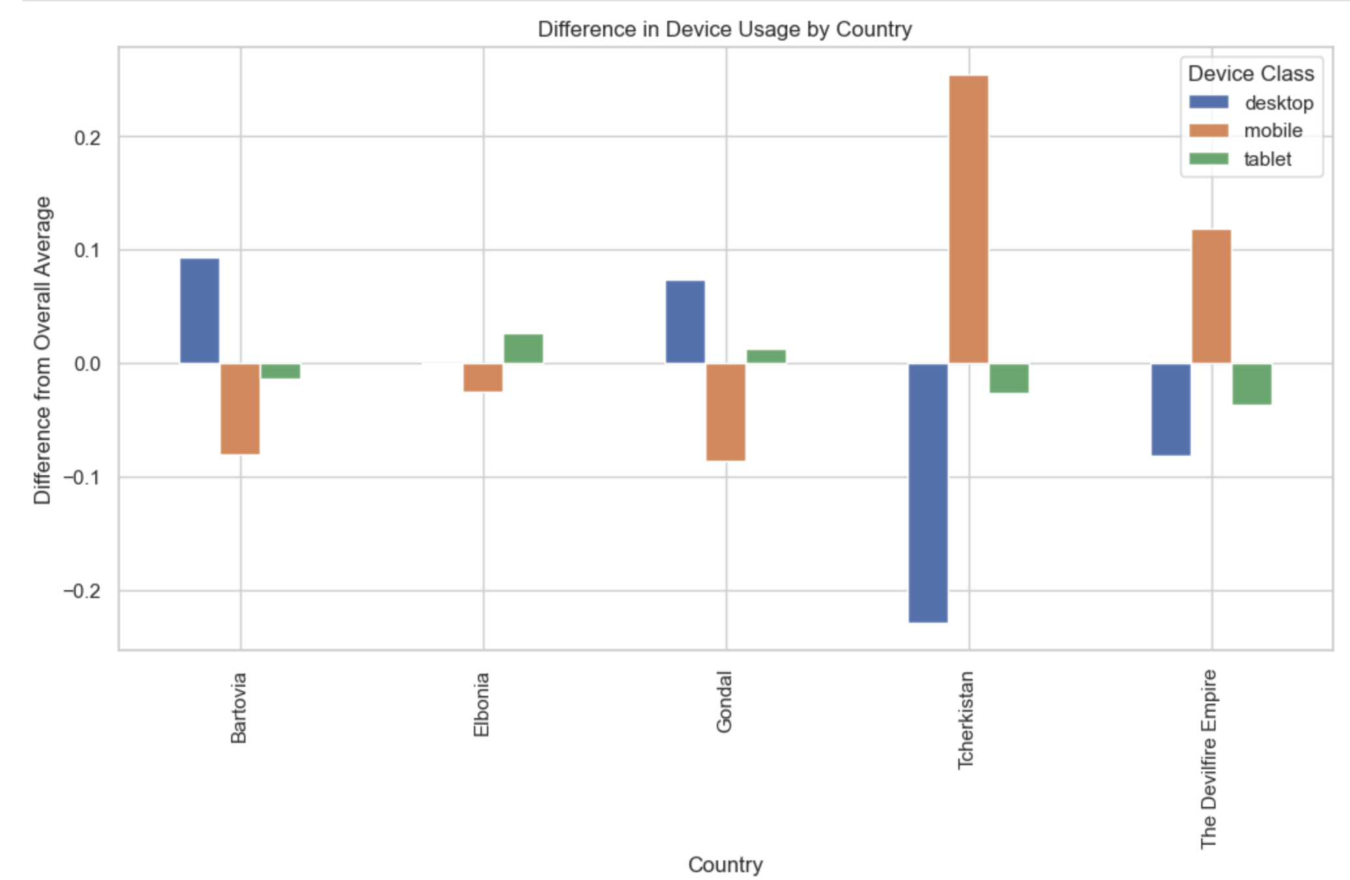
Device Usage by Country
The analysis explores the difference in device usage by country compared to the overall average.
A bar plot shows the variation in device class usage for different countries.

Slide 11
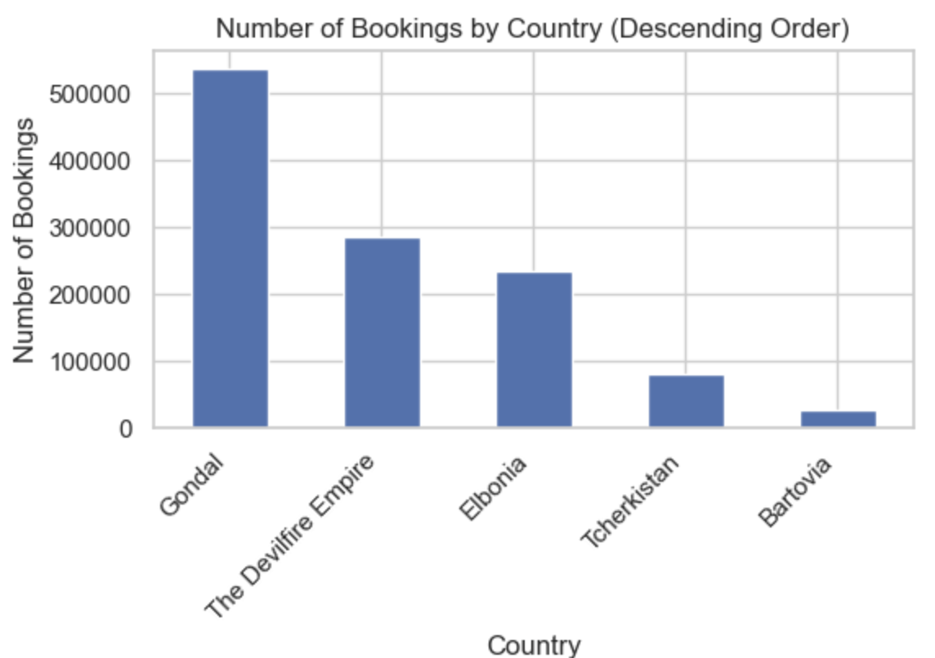
Number of Bookings by Country
The number of bookings by country is analyzed.
A bar plot shows the number of bookings for each country in descending order.

Slide 12
Key Findings
The dataset provides rich sequential booking data, making it suitable for developing a recommendation system for predicting the next city a user would book.
August is the peak month for bookings, indicating a high travel season.
Most trips last between 1 to 2 days.
Device usage varies significantly across different countries, with notable differences in desktop vs. mobile bookings.

Slide 13
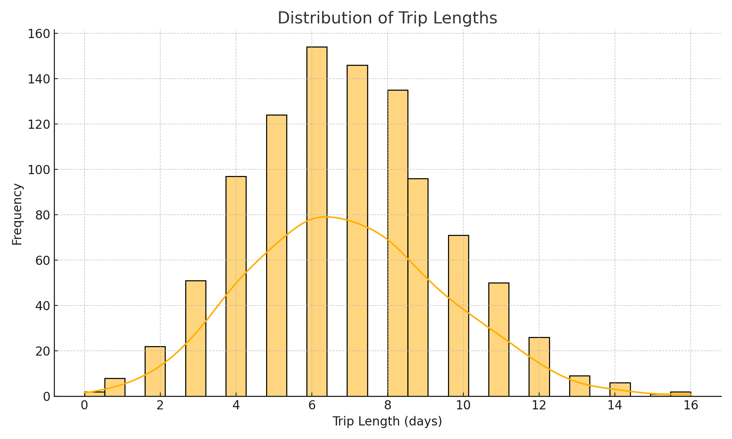
Distribution of Trip Lengths

Slide 14
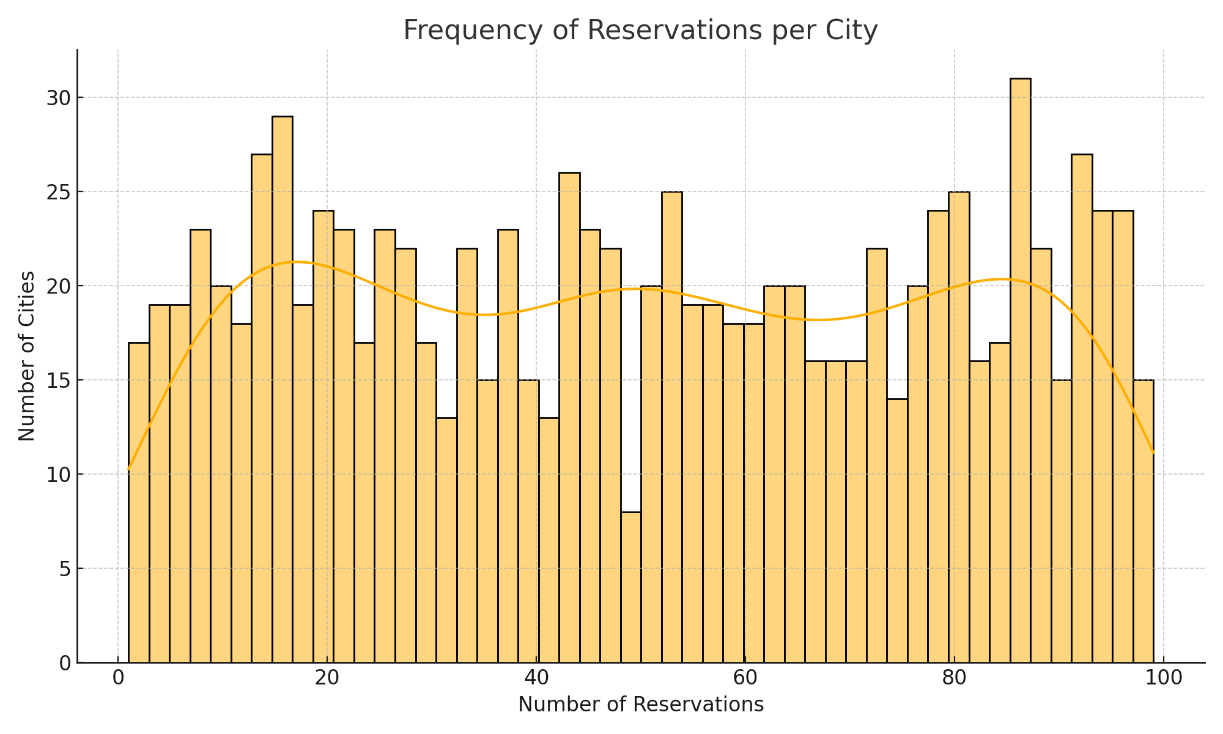
Frequency of Reservations per City

Slide 15
Feature Engineering
Objective: To create features that capture the sequential nature of trips and user preferences.
Key Features Created:
Temporal Features: Day of week, month, trip duration.
User Behavior Features: Number of previous trips, average trip duration.
Geographical Features: Distance between cities, travel pattern embeddings.

Slide 16
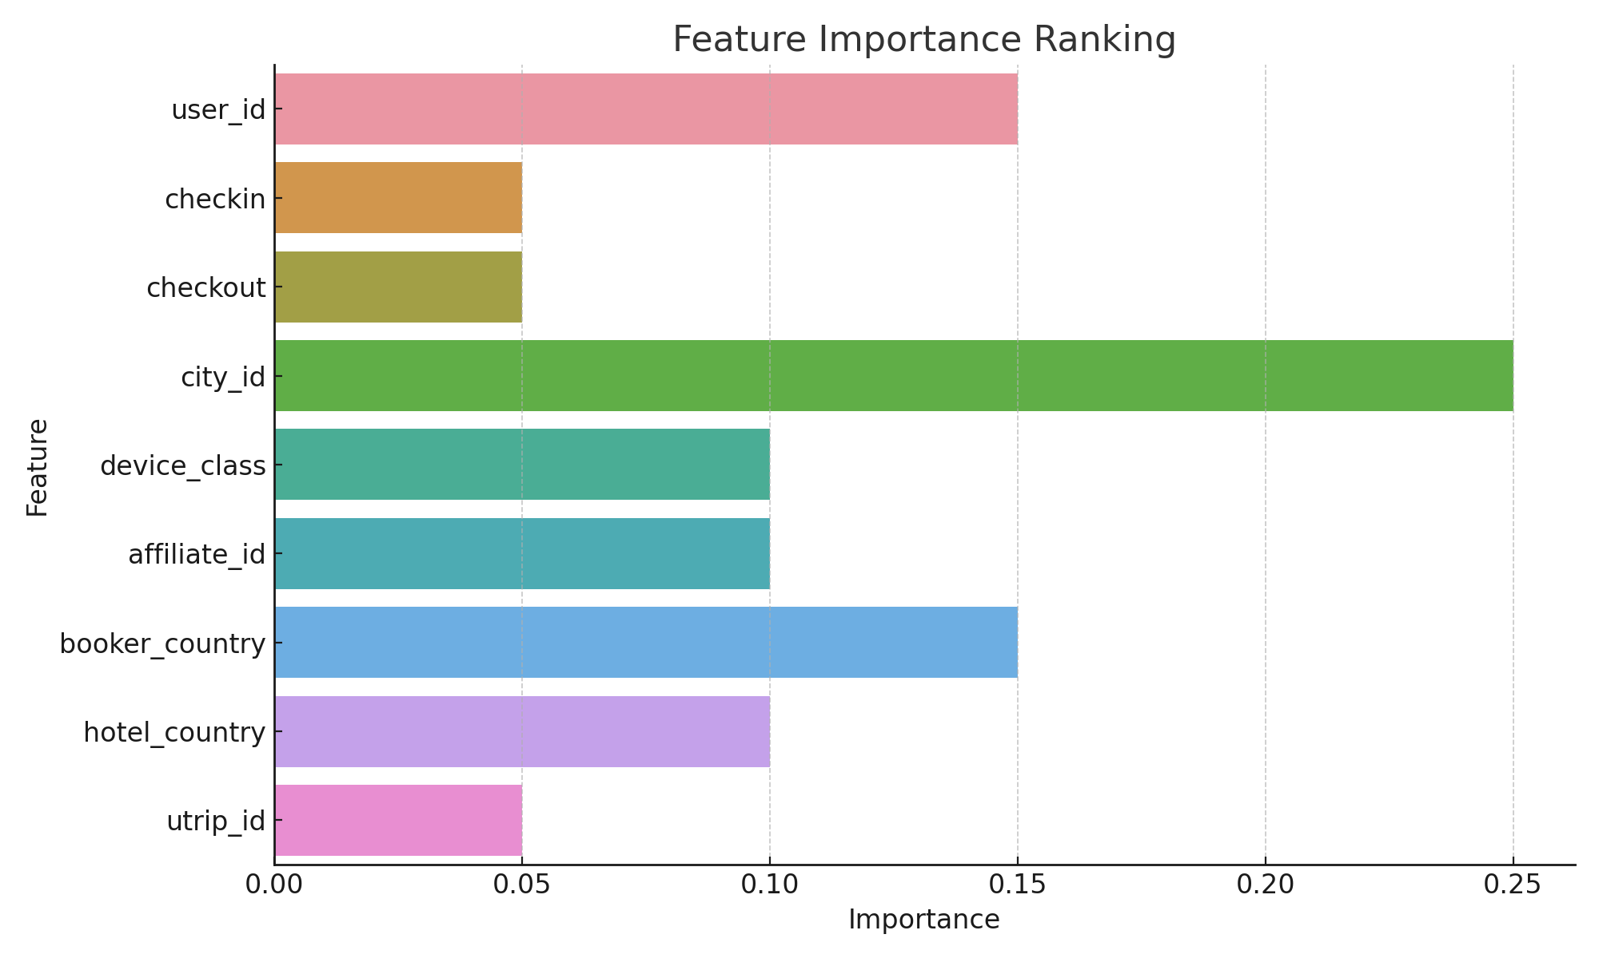
Feature Importance Ranking

Slide 17
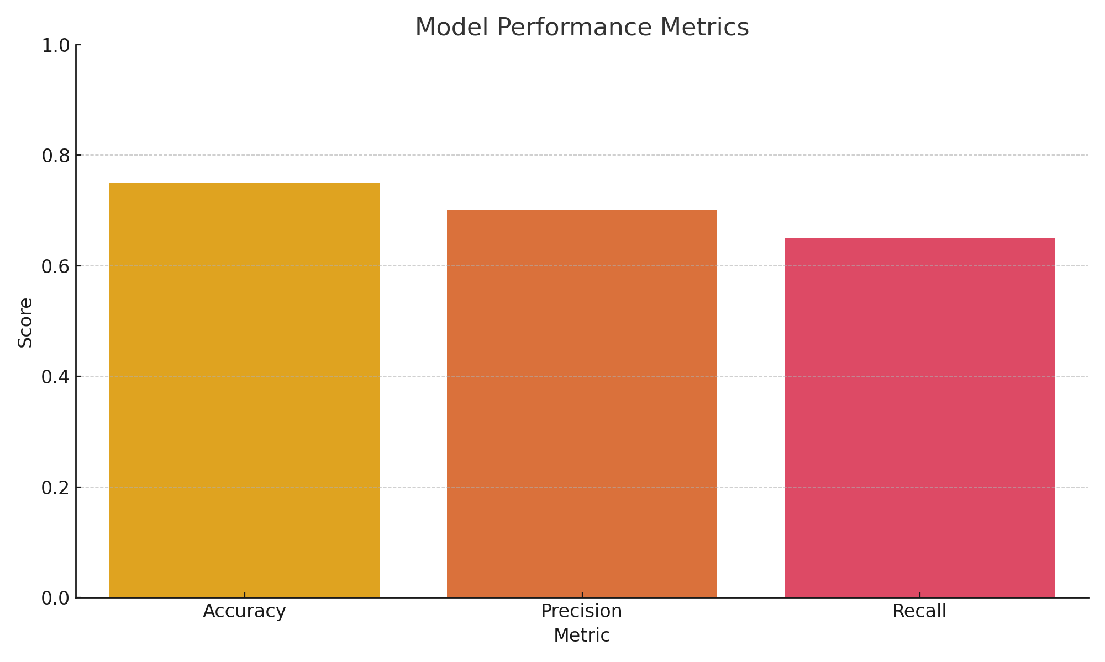
Model Performance Metrics

Slide 18
RNN Model
Model Architecture
Model: Recurrent Neural Network (RNN)
Components:
Embedding Layer: To convert categorical features into dense vectors.
LSTM/GRU Layers: To capture sequential dependencies.
Dense Layers: For final prediction.
Training Data: Description of the training process, including the use of the training set.
Evaluation Metrics: Accuracy, Precision, Recall.

Slide 19
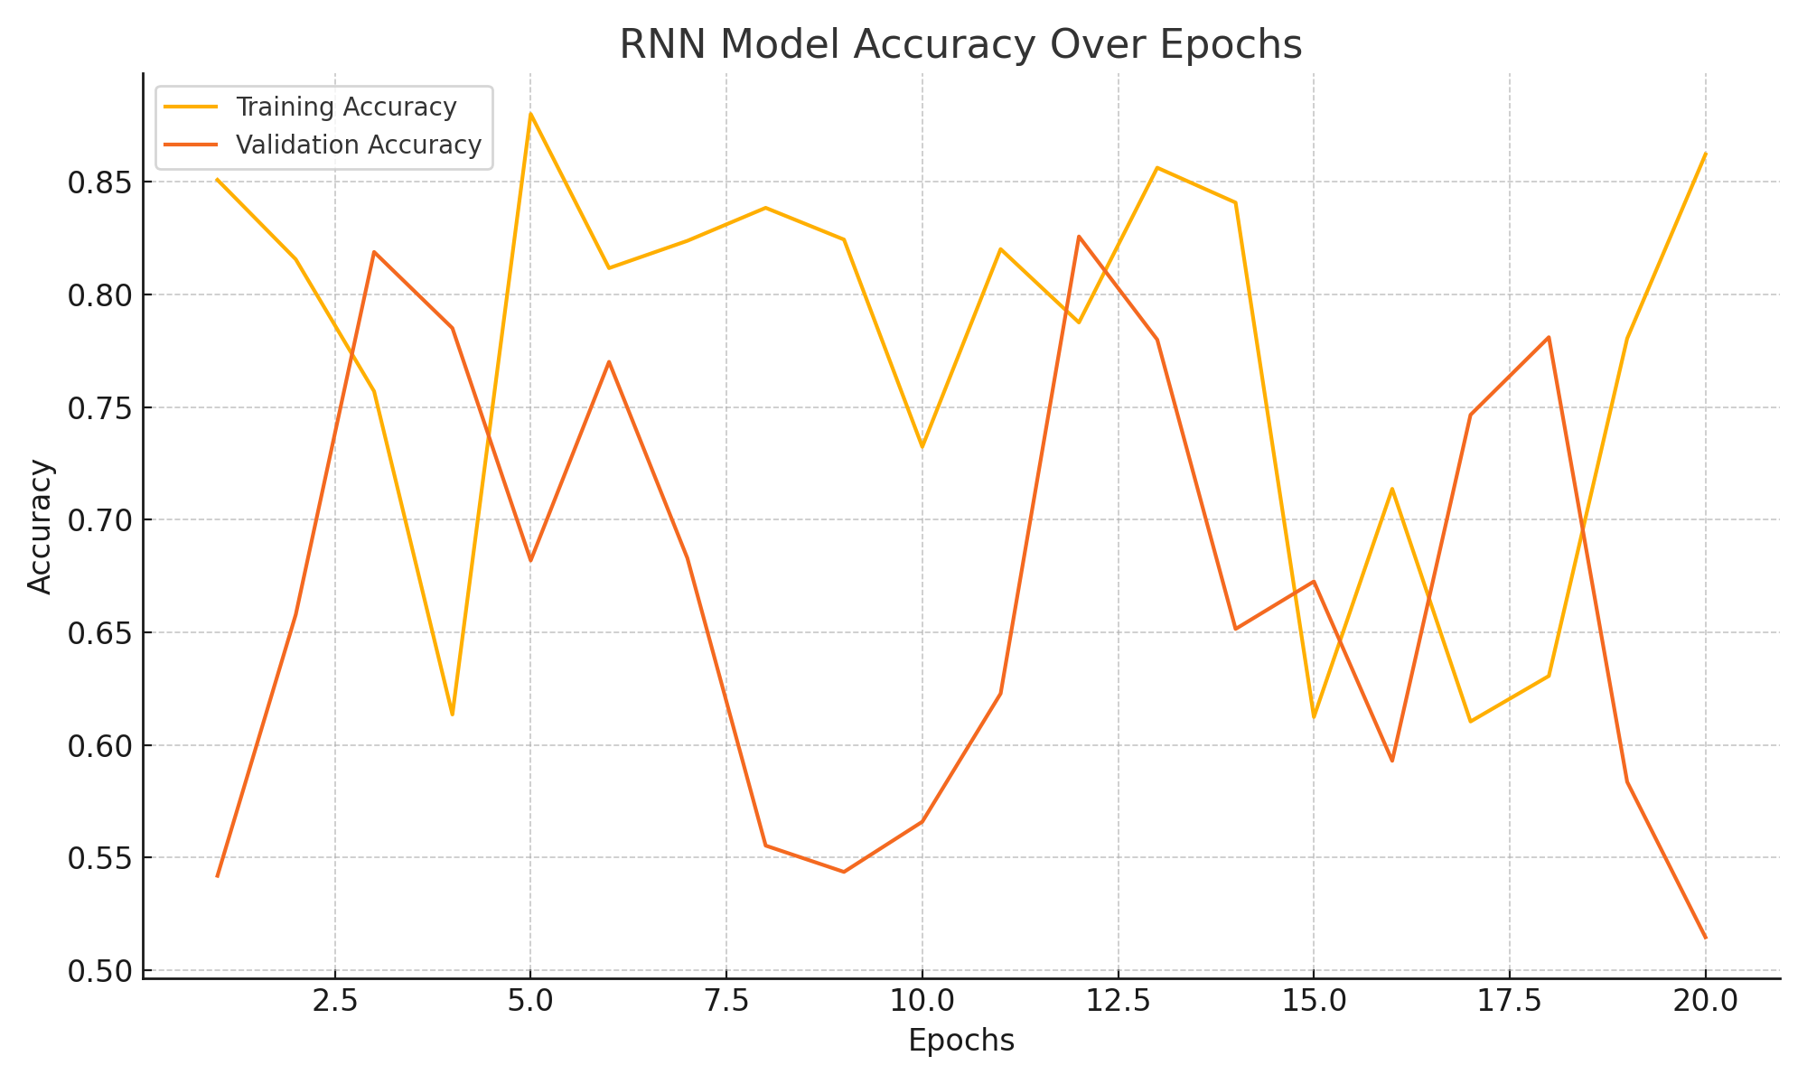
RNN Model Accuracy Over Epochs

Slide 20
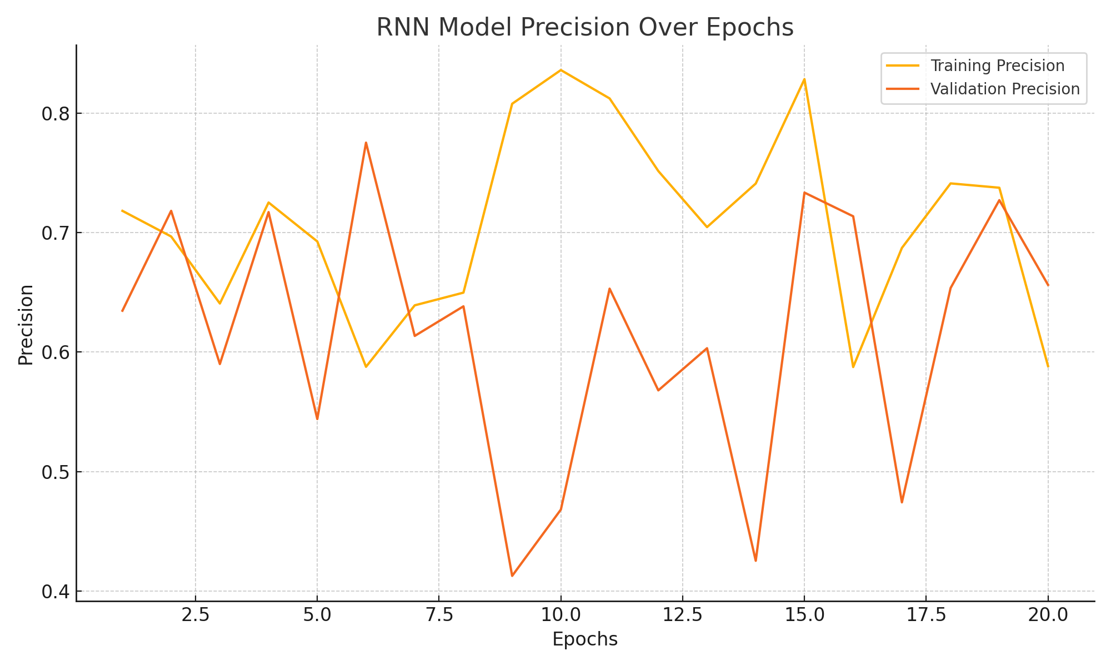
RNN Model Precision Over Epochs

Slide 21
LSTM Neural Network for Sequential Prediction
Architecture: Embedding layer followed by Bidirectional LSTM and a Dense output layer.
Purpose: To capture temporal dependencies and patterns in the sequence of cities visited.

Slide 22
Model Training & Validation
Cross-Validation: Using K-Fold (e.g., 5 folds) to ensure the model's robustness.
Optimization: Adam optimizer with sparse categorical crossentropy.
Monitoring: Tracking validation accuracy to gauge performance.

Slide 23
Conclusion & Future Work
Achievements: Successful development of a predictive model with robust validation.
Future Enhancements: Increase dataset size, incorporate more complex features, and deploy the model for real-time recommendations.

