Slide 1
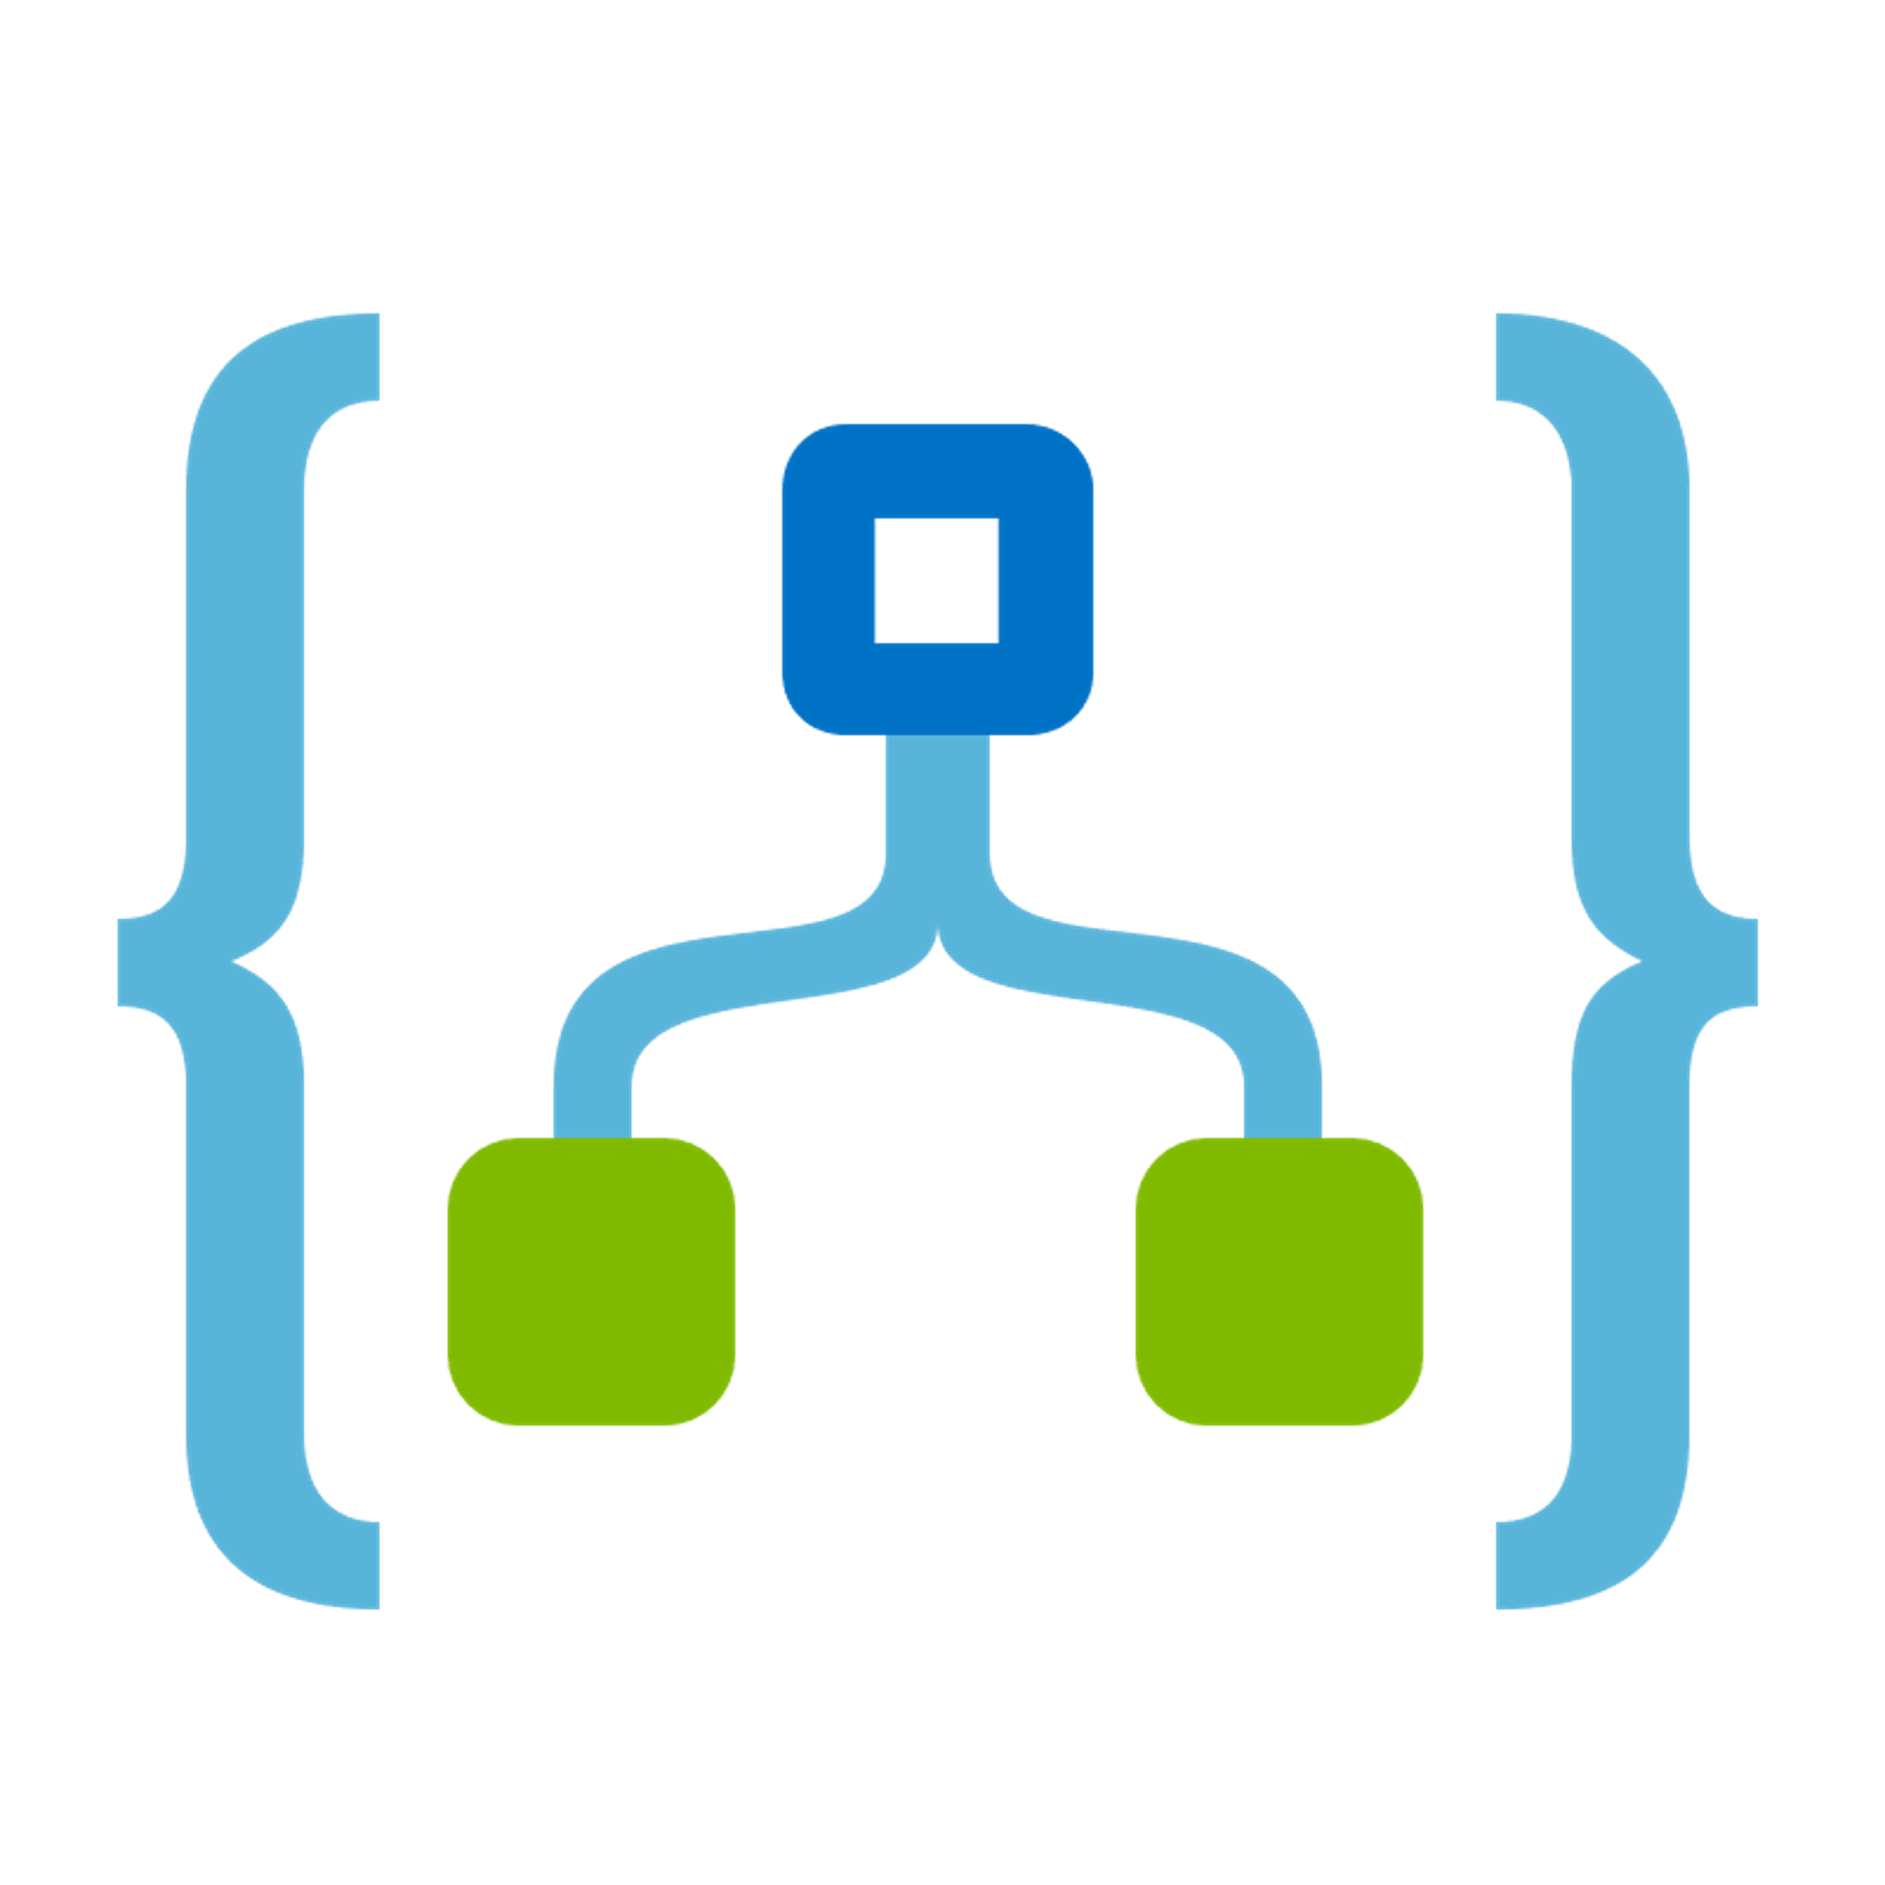




Change made in Azure Dev Env
Definition Downloaded
Reviewed for Parameters
Committed to Source Control
Release Pipeline Propagates

Slide 2


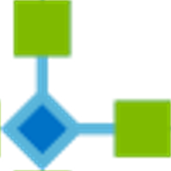










Logic Application 1
Shared Resources
Logic Application 2
Function Application

Slide 3
Logic Application 1
Shared Resources
Logic Application 2
Function Application

Slide 4
Primary region
Secondary region
Logic Application 1
Logic Application 1
Shared Resources
Shared Resources
Logic Application 2
Logic Application 2
Function Application
Function Application

Slide 5
Development Environment
Test Environment
Primary region
Secondary region
Primary region
Secondary region
Staging Environment
Production Environment
Primary region
Secondary region
Primary region
Secondary region

Slide 6
Shared Resources
Logic Application
Logic Application
Logic Application

Slide 7
Shared Resources
Logic Application
Logic Application
Logic Application

Slide 8
Shared Resources
Logic Application
Logic Application
Logic Application

Slide 9

Shared Resources
Logic Application
Logic Application
Logic Application

