Slide 1

Heart Stroke Risk Prediction System With Clinical Safety and Action Plans A main project report submitted for the partial fulfillment for the requirements of the Award of the Bachelor of Technology
By
Jawaharlal Nehru Technological University, Gurajada Vizianagaram
In the Discipline of
Artificial Intelligence & Machine Learning
Submitted by
B. Rajasekhar | (22W61A6105)
A. Durga Prasad | (22W61A6102)
B. Tejaswani | (22W61A6107)
CH. Santhosh | (22W61A6109)
T. Gnana Deepthi | (22W61A6143)
Under the esteemed guidance of
Mr. Pradeep Kumar
Assistant Professor
Department of Artificial Intelligence & Machine Learning SRI SIVANI COLLEGE OF ENGINEERING
(Under the Management of Sri Sivani Educational Society, Srikakulam)
(Approved by AICTE and Permanently Affiliated to JNTUGV, Vizianagaram, Accredited by NAAC, UGC Recognition under 2(f) & 12(B)) NH-16, Chilakapalem Jn., Srikakulam Dist., Andhra Pradesh -532410

Slide 2
Department of Computer Science & Engineering
CERTIFICATE
This is to certify that the main project report entitled “Heart Stroke Risk Prediction System With Clinical Safety and Action Plans ” submitted by B.Rajasekhar
A. Durga Prasad
(22W61A6105),
CH. Santhosh (22W61A6109)
(22W61A6102), B. Tejaswani (22W61A6107),
in partial fulfillment for the award of B.Tech Degree in the discipline of “Artificial Intelligence & Machine Learning” to the Jawaharlal Nehru Technological University, Gurajada Vizianagaram is a record of Bonafide work carried out under our guidance and supervision. The results embodied in this report have not been submitted to any other University or Institute for the award of any degree or diploma.
, T. Gnana Deepthi (22W61A6143)
Signature of the guide
Signature of the H.O.D
Mr. Pradeep Kumar
Mr. Pradeep Kumar
Asst. Professor
Assistant Professor & H.O.D
Dept. of AI&ML
Dept. of AI&ML

Slide 3
ACKNOWLEDGEMENT
It gives me an immense pleasure to express deep sense of gratitude to my guide, Mr. Pradeep Kumar, Assistant Professor, Department of Artificial Intelligence & Machine Learning of whole hearted and invaluable guidance throughout the Project. Without his sustained and sincere effort, this report would not have taken this shape. He encouraged and helped me to overcome various difficulties that I have faced at various stages of my report.
I would like to sincerely thank my R & D IN-Charge Mr. K. Venugopal, Assistant Professor, Department of Computer Science & Engineering, for giving his direct and indirect support throughout this Main Project.
I would like to sincerely thank Mr.Pradeep Kumar, Assistant Professor& HOD, Department of Artificial Intelligence & Machine Learning, for providing all the necessary facilities that led to the successful completion of my report.
I take privilege to thank our Principal Dr. Y. Srinivasa Rao who have made the atmosphere so easy to work. I shall always be indebted to them.
I would like to thank all the faculty members of the Department of Artificial Intelligence & Machine Learning for their direct or indirect support and also all the lab technicians for their valuable suggestions and providing excellent opportunities in completion of this report.
B. Rajasekhar | (22W61A6105)
A. Durga Prasad | (22W61A6102)
B. Tejaswani | (22W61A6107)
CH. Santhosh | (22W61A6109)
T. Gnana Deepthi | (22W61A6143)

Slide 4
Abstract: Stroke risk prediction is critical in preventive healthcare to reduce mortality and improve early intervention. This project identifies patients at high stroke risk by analyzing demographics, clinical metrics, lifestyle factors, and medical history using machine learning. The system employs BMI imputation, label encoding, feature engineering (age groups, glucose categories, risk scores), and dual-dataset training to handle real-world data scarcity. Two ensemble models Model A trained on original healthcare data (5,110 records) and Model B on synthetic data (50,000 records) are built using Gradient Boosting and Random Forest classifiers. Predictions are combined via ensemble averaging with evidence-based clinical rule overrides for hypertension, glucose, and smoking. The solution deploys via a Flask web application with Firebase authentication, prediction history, doctor recommendations, Indian food suggestions, medication tracking, and PDF report generation, providing an accurate, interpretable, and clinically-aware stroke risk decision support system.
EXISTING SOFTWARE:
Existing stroke prediction systems rely on single-model approaches with limited handling of class imbalance, where stroke cases represent less than 5% of records. Traditional tools lack dual-dataset validation, clinical rule integration, and real-time deployment interfaces. Healthcare analytics platforms are proprietary, expensive, and offer poor interpretability, restricting clinical adoption. Most systems lack personalized dietary recommendations, medication management, or doctor-ready report generation, limiting their utility in end-to-end patient care workflows.
PROPOSED SOFTWARE:
The proposed system implements dual-model ensemble learning using Gradient Boosting and Random Forest trained on both original and synthetic datasets for robust stroke risk prediction. Preprocessing includes BMI imputation, label encoding, interaction feature engineering, and clinical risk scoring. Evidence-based override rules escalate predictions for high-risk combinations of smoking, hypertension, and elevated glucose. The Flask backend integrates Firebase authentication, a light/dark themed dashboard, prediction history, Indian food and doctor recommendations, medication reminder scheduling, and downloadable PDF reports. Model persistence enables seamless real-time inference, delivering a clinically meaningful and production-ready stroke prevention tool.
KEYWORDS:
Stroke Risk Prediction, Ensemble Learning, Gradient Boosting, Random Forest, Dual-Dataset Training, Clinical Rule Overrides, Flask, Firebase, Feature Engineering, Healthcare Analytics, Preventive Medicine.

Slide 5
Chapter 1 — Introduction
1.1 Background
Stroke is one of the most serious health problems affecting millions of people around the world. It occurs when the blood supply to the brain is interrupted or reduced, preventing brain tissue from receiving essential oxygen and nutrients. Within a few minutes, brain cells begin to die, which can lead to permanent brain damage, disability, or even death. According to global health organizations, stroke is one of the leading causes of death and long-term disability worldwide.
Early identification of individuals who are at risk of stroke is extremely important in preventive healthcare. Many strokes can be prevented if risk factors are detected early and proper medical intervention is provided. Traditional medical approaches rely on doctors analyzing patient symptoms, medical history, and clinical test results. However, the increasing volume of healthcare data has made manual analysis more complex and time-consuming.
In recent years, advancements in data science and artificial intelligence have enabled the use of machine learning techniques in healthcare applications. Machine learning allows computers to analyze large datasets and identify patterns that may not be easily detected through traditional analysis. These technologies have shown great potential in predicting diseases such as diabetes, heart disease, cancer, and stroke.
Healthcare institutions now generate a large amount of data through electronic health records, laboratory tests, wearable devices, and patient monitoring systems. This data contains valuable information that can be used to build predictive models for disease diagnosis and prevention. Machine learning algorithms can process this data efficiently and generate accurate predictions regarding disease risks.
The integration of machine learning with healthcare systems has opened new possibilities for preventive medicine. Instead of diagnosing diseases only after symptoms appear, predictive models can help identify high-risk patients before severe complications occur. This allows doctors to take preventive actions and provide early treatment.
This project focuses on developing a machine learning-driven stroke risk prediction platform that analyzes patient health data and predicts stroke risk levels. The system also provides healthcare recommendations and guidance to help users maintain a healthy lifestyle.

Slide 6
1.2 Importance of Stroke Prediction
Stroke prediction plays a critical role in improving healthcare outcomes and reducing mortality rates. According to medical research, a significant percentage of strokes can be prevented if early warning signs and risk factors are properly identified.
One of the main challenges in stroke prevention is the identification of individuals who are at risk but do not yet show severe symptoms. Many people remain unaware of their health conditions until a major medical event occurs. Predictive analytics can help bridge this gap by analyzing existing health information and identifying potential risks.
Machine learning models are capable of analyzing large volumes of medical data and identifying complex relationships between different health indicators. These models can detect patterns and correlations that may not be easily recognized by human analysis.
The benefits of stroke prediction systems include:
• Early detection of high-risk individuals
• Improved preventive healthcare strategies
• Better medical decision support for doctors
• Reduced healthcare costs through early intervention
• Increased awareness of lifestyle risk factors
By providing predictive insights, healthcare providers can recommend lifestyle changes, medication, and monitoring strategies to reduce stroke risk.

Slide 7
1.3 Role of Machine Learning in Healthcare
Machine learning has become one of the most powerful technologies in modern healthcare systems. It enables automated analysis of medical data and helps healthcare professionals make more informed decisions.
Machine learning algorithms learn from historical data and identify patterns that can be used to make predictions. These algorithms improve their performance as more data becomes available.
In healthcare applications, machine learning is used for:
• Disease diagnosis
• Medical image analysis
• Drug discovery
• Personalized treatment planning
• Patient monitoring
• Predictive analytics
For stroke prediction, machine learning models analyze multiple patient attributes such as age, gender, blood pressure, glucose levels, and lifestyle habits. These attributes are used to estimate the probability of stroke occurrence.
Several machine learning algorithms are commonly used in healthcare prediction systems, including:
• Logistic Regression
• Decision Trees
• Random Forest
• Support Vector Machines
• Gradient Boosting
• Neural Networks
Among these algorithms, ensemble learning methods such as Random Forest and Gradient Boosting often provide higher accuracy because they combine multiple decision models to produce better predictions.

Slide 8
1.4 Problem Statement
Despite advancements in healthcare technology, stroke remains one of the leading causes of death and disability worldwide. Early detection of stroke risk is challenging due to the complexity of medical data and the presence of multiple contributing factors.
Many existing stroke prediction systems rely on traditional statistical models or single machine learning algorithms, which may not provide sufficient accuracy when analyzing complex healthcare datasets. In addition, many datasets suffer from class imbalance, where stroke cases represent only a small percentage of the total data.
Another limitation of existing systems is the lack of practical deployment. Many predictive models are developed only for research purposes and are not integrated into real-world healthcare platforms that patients or doctors can easily use.
Furthermore, most existing systems focus only on prediction and do not provide additional healthcare support such as lifestyle guidance, doctor recommendations, or health reports.
Therefore, there is a need to develop an intelligent healthcare
system that can accurately predict stroke risk while also providing user-friendly features for patient guidance and
medical decision support.

Slide 9
1.5 Objectives of the Project
The main objective of this project is to develop a machine learning-based stroke risk prediction system that can assist healthcare professionals and patients in identifying potential stroke risks.
The specific objectives of the project include:
To collect and preprocess healthcare datasets for stroke prediction.
2.To analyze important risk factors such as age, hypertension, glucose levels, BMI, and lifestyle habits.
3.To implement machine learning models such as Random Forest and Gradient Boosting for stroke risk prediction.
4.To improve prediction accuracy using ensemble learning techniques.
5.To develop a web-based application using Flask for real-time stroke risk prediction.
6.To provide healthcare recommendations including diet suggestions, doctor consultation, and medication reminders.
7.To generate downloadable health reports for users.
By achieving these objectives, the system aims to provide a comprehensive healthcare support platform for stroke prevention.

Slide 10
1.6 Scope of the Project
The scope of this project lies in the field of healthcare analytics and machine learning-based disease prediction systems. The proposed system focuses on predicting stroke risk using patient health data and providing guidance to reduce potential health risks.
The system can be used by individuals, healthcare professionals, and medical researchers to analyze health conditions and identify possible stroke risks.
The key features included within the scope of the project are:
• Stroke risk prediction using machine learning algorithms
• Data preprocessing and feature engineering
• Ensemble learning techniques for improved accuracy
• Web-based user interface for easy interaction
• Prediction history tracking
• Health recommendations and lifestyle guidance
• PDF report generation
The project is designed primarily for educational and research purposes but demonstrates the potential for real-world healthcare applications.

Slide 11
1.7 Organization of the Report
The project report is organized into several chapters that describe different aspects of the system.
Chapter 1 provides the introduction to the project, including background information, problem statement, objectives, and scope of the study.
Chapter 2 presents the literature review, which discusses previous research work related to stroke prediction and machine learning applications in healthcare.
Chapter 3 explains the system methodology, including the design approach, architecture, algorithms used, and tools involved in the project.
Chapter 4 describes the implementation process, including system modules, code development, and application interface.
Chapter 5 presents the results and discussion, including performance evaluation, graphs, and analysis of model accuracy.
Chapter 6 provides the conclusion and future work, summarizing the achievements of the project and suggesting possible improvements for future research.

Slide 12
1.8 Limitations of the Study
Although the proposed system provides accurate stroke risk prediction, it has certain limitations. The prediction accuracy depends heavily on the quality and size of the dataset used for training the machine learning models. The system currently uses limited health parameters and does not include advanced clinical test results such as MRI or CT scan data. Additionally, the system is designed mainly for educational and research purposes and should not replace professional medical diagnosis.
Future improvements may include integration with real-time hospital databases and wearable health monitoring devices.

Slide 13
CHAPTER 2- LITERATURE REVIEW
2.1 Introduction
Stroke is one of the leading causes of mortality and long-term disability worldwide. Medical researchers and healthcare organizations have conducted numerous studies to understand the risk factors associated with stroke and to develop predictive models that help identify individuals at risk. With the rapid growth of artificial intelligence and data science, machine learning techniques have been widely applied in healthcare analytics for disease prediction.
Machine learning algorithms are capable of analyzing large volumes of healthcare data and identifying patterns that may not be easily recognized by traditional statistical methods. These models use historical patient data to predict future medical conditions and assist healthcare professionals in making informed decisions.
Many researchers have applied machine learning techniques for predicting diseases such as diabetes, cardiovascular diseases, cancer, and stroke. Stroke prediction is particularly challenging because it involves multiple risk factors including age, hypertension, diabetes, smoking habits, obesity, and cholesterol levels. Therefore, selecting appropriate machine learning algorithms and data preprocessing techniques plays a crucial role in improving prediction accuracy.
This chapter presents a detailed review of previous research work related to stroke prediction using machine learning techniques. The studies reviewed in this chapter highlight different approaches, algorithms, datasets, and results obtained by various researchers.

Slide 14
2.2 Machine Learning in Healthcare
Machine learning has significantly transformed the healthcare industry by enabling automated analysis of medical data. Healthcare institutions generate massive amounts of data through electronic health records, diagnostic tests, and patient monitoring systems. Analyzing such large datasets manually is difficult and time-consuming.
Machine learning algorithms can analyze this data efficiently and identify relationships between different medical parameters. These algorithms can also improve their performance as more data becomes available, making them highly suitable for predictive healthcare systems.
Applications of machine learning in healthcare include:
• Disease diagnosis and prediction
• Medical image analysis
• Drug discovery and development
• Personalized treatment planning
• Patient monitoring systems
• Predictive analytics for preventive medicine
In stroke prediction systems, machine learning algorithms analyze multiple patient attributes such as age, blood pressure, glucose level, smoking habits, and body mass index to estimate the probability of stroke occurrence.
Several machine learning algorithms have been used in healthcare prediction models, including Logistic Regression, Decision Trees, Support Vector Machines, Random Forest, Gradient Boosting, and Neural Networks. Among these algorithms, ensemble methods often provide higher prediction accuracy.

Slide 15
2.3 Review of Previous Research Studies
2.3.1 Study by Smith et al. (2020)
Smith and colleagues conducted a study on stroke prediction using logistic regression models. The researchers used a healthcare dataset containing demographic and clinical information such as age, hypertension status, heart disease history, and glucose levels.
The logistic regression model was trained using historical patient records to predict stroke occurrence. The study showed that age and hypertension were among the most significant risk factors contributing to stroke. The model achieved moderate prediction accuracy but struggled to capture complex nonlinear relationships among variables.
Although logistic regression is simple and interpretable, it may not perform well with complex datasets where multiple variables interact with each other. This limitation highlights the need for more advanced machine learning techniques.
2.3.2 Study by Kumar and Sharma (2021)
Kumar and Sharma proposed a stroke prediction system using Decision Tree and Random Forest algorithms. The researchers used publicly available healthcare datasets and performed extensive preprocessing, including missing value handling and feature scaling.
The results showed that Random Forest performed better than the Decision Tree model due to its ensemble nature. Random Forest combines multiple decision trees and aggregates their outputs to produce more reliable predictions.
The study concluded that ensemble algorithms provide improved accuracy and robustness compared to individual models.
2.3.3 Study by Lee et al. (2021)
Lee and colleagues conducted research on stroke prediction using Support Vector Machine (SVM) algorithms. The dataset used in the study included various clinical parameters such as BMI, glucose levels, and smoking status.
The Support Vector Machine model showed promising results for classification tasks and demonstrated strong performance in handling high-dimensional datasets. However, the computational complexity of SVM models can be high, especially when working with large datasets.
The study also emphasized the importance of feature selection in improving model performance.

Slide 16
2.3.4 Study by Wang et al. (2022)
Wang and colleagues developed a machine learning-based stroke prediction system using Gradient Boosting algorithms. The research focused on improving prediction accuracy through sequential model training.
Gradient Boosting builds models iteratively by correcting the errors of previous models. This approach allows the algorithm to focus on difficult cases and improve overall performance.
The study demonstrated that Gradient Boosting achieved higher accuracy compared to traditional machine learning algorithms.
2.3.5 Study by Patel et al. (2022)
Patel and colleagues proposed a hybrid stroke prediction system that combines multiple machine learning algorithms. The researchers used ensemble learning techniques to integrate the predictions from different models.
The ensemble model included Logistic Regression, Random Forest, and Gradient Boosting classifiers. By combining predictions from multiple models, the system achieved improved accuracy and reduced prediction errors.
The study highlighted the effectiveness of ensemble learning techniques in healthcare prediction systems.
2.3.6 Study by Chen et al. (2023)
Chen and colleagues focused on addressing the problem of class imbalance in stroke datasets. In most healthcare datasets, the number of stroke cases is significantly smaller than non-stroke cases.
To address this issue, the researchers used synthetic data generation techniques such as SMOTE (Synthetic Minority Oversampling Technique). The generated synthetic samples helped balance the dataset and improve model training.
The results showed that balanced datasets significantly improved prediction accuracy and model reliability.

Slide 17
2.3.7 Study by Gupta et al. (2023)
Gupta and colleagues proposed a deep learning approach for stroke prediction using neural networks. The model used multiple hidden layers to analyze complex relationships between medical parameters.
Although deep learning models showed good performance, they required large datasets and high computational resources. The study concluded that deep learning models are suitable for large-scale healthcare systems but may not be practical for smaller datasets.
2.3.8 Study by Brown et al. (2024)
Brown and colleagues developed a web-based stroke prediction platform using machine learning algorithms. The system allowed users to input their health information and receive real-time predictions.
The platform integrated machine learning models with a web interface, making it accessible to both healthcare professionals and patients. The study emphasized the importance of deploying machine learning models in practical healthcare applications

Slide 18
2.4 Comparative Analysis of Previous Studies
The reviewed studies demonstrate that machine learning algorithms have significant potential in predicting stroke risk. However, different algorithms provide varying levels of accuracy and performance.
A comparison of the reviewed studies is presented below.
Author | Algorithm Used | Advantages | Limitations
Smith et al. | Logistic Regression | Simple and interpretable | Lower accuracy
Kumar & Sharma | Random Forest | High accuracy | Requires tuning
Lee et al. | SVM | Handles complex data | High computation
Wang et al. | Gradient Boosting | Strong performance | Longer training time
Patel et al. | Ensemble Models | Improved accuracy | Complex implementation
Chen et al. | SMOTE + ML | Handles imbalance | Synthetic data dependency
Gupta et al. | Neural Networks | Captures complex patterns | Requires large dataset
Brown et al. | Web-based ML system | Real-time prediction | Limited features
From the comparison, it can be observed that ensemble learning methods such as Random Forest and Gradient Boosting provide better prediction performance for stroke prediction tasks.

Slide 19
2.5 Research Gap
Although many studies have explored machine learning techniques for stroke prediction, several challenges still remain.
First, many existing studies rely on a single machine learning algorithm, which may not provide optimal accuracy when dealing with complex healthcare datasets.
Second, many datasets suffer from class imbalance, which can lead to biased prediction models.
Third, several research works focus only on prediction accuracy and do not provide practical deployment systems that users can interact with.
Finally, most existing systems do not include healthcare guidance features such as lifestyle recommendations, diet suggestions, or doctor consultation support.
These gaps highlight the need for a comprehensive stroke prediction system that combines accurate machine learning models with practical healthcare applications.

Slide 20
2.6 Machine Learning in Healthcare
Machine learning has become an important tool in the healthcare sector for analyzing large amounts of medical data and providing intelligent predictions. In recent years, hospitals and medical research institutions have started using machine learning algorithms to predict diseases, analyze patient data, and assist doctors in decision-making.
Machine learning systems can analyze medical records, laboratory results, imaging data, and patient history to detect patterns that may not be easily identified by humans. These systems help in early diagnosis and prevention of serious diseases such as heart disease, diabetes, cancer, and stroke.
In the case of stroke prediction, machine learning models analyze several risk factors such as age, blood pressure, heart disease, body mass index (BMI), smoking status, glucose level, and lifestyle habits. By examining these features, the models can estimate the probability of a person experiencing a stroke.
Healthcare data is usually complex and contains many variables. Machine learning algorithms are capable of processing such data and identifying hidden relationships between variables. This ability helps researchers and doctors understand the factors that contribute to stroke risk.
Another advantage of machine learning in healthcare is its ability to improve continuously. As more patient data becomes available, the models can be retrained and updated to increase prediction accuracy. This makes machine learning an effective tool for building intelligent healthcare systems.

Slide 21
2.7 Stroke Risk Prediction Using Data Analysis
Stroke is one of the leading causes of death and disability worldwide. Early detection of stroke risk can help in preventing severe complications and saving lives. Researchers have conducted many studies to develop predictive models that can identify individuals who are at high risk of stroke.
Traditional medical methods for stroke prediction rely mainly on clinical judgment and manual analysis of patient records. However, these methods may not always be accurate because they depend heavily on human expertise and limited data analysis.
With the advancement of data analytics, researchers have started using large healthcare datasets to study the relationship between various medical factors and stroke occurrence. Data analysis techniques help in identifying important risk factors and patterns that influence stroke development.
For example, studies have shown that factors such as hypertension, high cholesterol, diabetes, smoking, obesity, and physical inactivity significantly increase the risk of stroke. By analyzing these factors using machine learning algorithms, researchers can build predictive models that estimate stroke risk with higher accuracy.
These predictive models help healthcare professionals identify high-risk patients and recommend preventive measures such as lifestyle changes, medication, and regular medical monitoring.

Slide 22
2.8 Decision Tree Algorithm in Medical Prediction
The Decision Tree algorithm is one of the most commonly used machine learning techniques for classification and prediction tasks. It is particularly useful in medical applications because it provides a clear and interpretable structure for decision-making.
A decision tree works by dividing the dataset into smaller subsets based on different conditions or rules. Each internal node of the tree represents a decision based on a specific feature, while each branch represents the outcome of that decision. The final nodes, called leaf nodes, represent the predicted class or outcome.
In stroke prediction systems, the decision tree algorithm analyzes various patient attributes such as age, blood pressure, glucose level, BMI, and smoking status. Based on these features, the model determines whether a patient has a high or low risk of stroke.
One of the major advantages of decision trees is their simplicity and interpretability. Doctors and medical professionals can easily understand how the model arrives at a particular prediction. This transparency is very important in healthcare applications where decisions must be explainable.
However, decision trees may sometimes suffer from overfitting if the tree becomes too complex. To overcome this problem, ensemble techniques such as Random Forest and Gradient Boosting are often used.

Slide 23
2.9 Random Forest Algorithm
Random Forest is an ensemble machine learning algorithm that improves prediction accuracy by combining multiple decision trees. Instead of relying on a single decision tree, Random Forest builds many trees and combines their predictions to produce a final result.
Each tree in the Random Forest is trained using a random subset of the dataset and features. This randomness helps reduce overfitting and improves the robustness of the model.
In stroke prediction systems, Random Forest analyzes patient health data and identifies patterns associated with stroke risk. Since multiple trees are used, the model can capture complex relationships between different medical factors.
Another advantage of Random Forest is its ability to measure feature importance. This helps researchers understand which factors contribute the most to stroke risk. For example, features such as hypertension, glucose level, and age may have higher importance scores.
Random Forest has been widely used in healthcare prediction models because of its high accuracy, stability, and ability to handle large datasets.

Slide 24
2.10 Logistic Regression for Disease Prediction
Logistic Regression is a statistical machine learning algorithm used for binary classification problems. In stroke prediction systems, logistic regression can be used to classify patients into two categories: stroke risk and no stroke risk.
The algorithm calculates the probability of a particular outcome based on the input features. If the probability exceeds a certain threshold, the patient is classified as having a high risk of stroke.
Logistic regression is widely used in medical research because it is simple, efficient, and easy to interpret. It helps researchers understand how different variables influence the probability of disease occurrence.
For example, logistic regression can show how factors such as smoking, high blood pressure, or diabetes increase the likelihood of stroke. These insights are valuable for doctors when recommending preventive measures to patients.
Although logistic regression works well for many prediction tasks, it may not capture highly complex relationships in the data. Therefore, it is often combined with other machine learning algorithms to improve performance.

Slide 25
2.11 Challenges in Stroke Prediction Systems
Despite significant advancements in machine learning, several challenges still exist in developing accurate stroke prediction systems.
One of the major challenges is the availability of high-quality medical data. Healthcare datasets may contain missing values, incomplete records, or inconsistent measurements. Data preprocessing techniques must be applied to clean and prepare the data before training machine learning models.
Another challenge is the imbalance in medical datasets. In many stroke datasets, the number of patients who experienced a stroke is much smaller compared to those who did not. This imbalance can affect the performance of machine learning algorithms and lead to biased predictions.
Privacy and security of medical data is another important concern. Patient information must be handled carefully to protect confidentiality and comply with healthcare regulations.
Furthermore, machine learning models must be validated using reliable evaluation techniques to ensure their accuracy and reliability in real-world applications.
Addressing these challenges is essential for developing effective and trustworthy stroke prediction systems.

Slide 26
2.12 Summary
This chapter reviewed the existing research and methodologies related to stroke prediction using machine learning techniques. Various algorithms such as Decision Tree, Random Forest, and Logistic Regression have been widely used for analyzing medical datasets and predicting stroke risk.
The literature review highlights the importance of machine learning in healthcare applications. These technologies enable early detection of diseases and support medical professionals in making informed decisions.
By analyzing patient health data and identifying key risk factors, machine learning models can provide accurate predictions of stroke risk. This helps in taking preventive measures and improving patient outcomes.

Slide 27
CHAPTER 3- SYSTEM METHODOLOGY
3.1 Introduction
The methodology of the proposed system describes the overall approach used to develop the Heart Stroke Risk Prediction system. This system is designed to analyze patient health data and predict the possibility of stroke using machine learning techniques.
Stroke is one of the leading causes of death and disability worldwide. Early prediction of stroke risk can help doctors and patients take preventive measures before the condition becomes severe. The proposed system uses machine learning algorithms to analyze medical data and identify patterns associated with stroke risk.
The system collects various health parameters such as age, hypertension, heart disease, average glucose level, body mass index (BMI), smoking status, and other medical factors. These parameters are processed using machine learning models to determine whether a person has a high or low risk of stroke.
The methodology includes several stages such as data collection, data preprocessing, model training, model evaluation, and prediction. Each stage plays an important role in building an accurate and reliable prediction system.

Slide 28
3.2 System Overview
The proposed Heart Stroke Risk Prediction system is designed to assist healthcare professionals in identifying patients who may be at risk of stroke. The system uses machine learning algorithms to analyze patient data and generate predictions.
The system consists of the following main components:
• Data Collection
• Data Preprocessing
• Feature Selection
• Model Training
• Prediction System
• Result Visualization
Each component performs a specific function in the overall prediction process. The system first collects patient data, processes it, and then applies machine learning algorithms to predict stroke risk.
The final output of the system is a prediction indicating whether the patient has a high or low probability of experiencing a stroke.

Slide 29
3.3 Design Approach
The design approach of the proposed system follows a structured machine learning workflow. The main objective is to build an intelligent system capable of predicting stroke risk based on patient health parameters.
The design approach consists of the following steps:
Step 1: Data Collection
The first step in the system design is collecting healthcare data related to stroke. The dataset includes patient information such as:
• Gender
• Age
• Hypertension
• Heart Disease
• Average Glucose Level
• Body Mass Index (BMI)
• Smoking Status
• Work Type
• Residence Type
• Marital Status
This dataset is used as input for training machine learning models.
Step 2: Data Preprocessing
Raw medical data often contains missing values, duplicate entries, and inconsistent data formats. Therefore, preprocessing is necessary to clean the dataset before training the model.

Slide 30
Data preprocessing includes:
• Handling missing values
• Removing duplicate records
• Converting categorical data into numerical form
• Normalizing numerical values
• Data cleaning and formatting
This step ensures that the dataset is accurate and suitable for machine learning algorithms.
Step 3: Feature Selection
Feature selection is the process of identifying the most important variables that influence stroke prediction.
Not all features in the dataset contribute equally to the prediction process. Selecting relevant features improves model accuracy and reduces computational complexity.
Some important features used in stroke prediction include:
• Age
• Hypertension
• Heart Disease
• Average Glucose Level
• BMI
• Smoking Status
These features are used as input variables for training machine learning models.
Step 4: Model Training
In this stage, machine learning algorithms are trained using the preprocessed dataset. The dataset is usually divided into two parts:

Slide 31
• Training Data (used to train the model)
• Testing Data (used to evaluate the model)
The training process allows the algorithm to learn patterns and relationships between input features and stroke outcomes.
Step 5: Model Evaluation
After training the model, it is evaluated using testing data to measure its performance.
Common evaluation metrics include:
• Accuracy
• Precision
• Recall
• F1 Score
• Confusion Matrix
These metrics help determine how well the model predicts stroke risk.
Step 6: Prediction System
Once the model is trained and evaluated, it can be used to predict stroke risk for new patient data.
The user enters patient details into the system, and the model analyzes the input parameters to generate a prediction.
The output indicates whether the patient has:
• High Risk of Stroke
• Low Risk of Stroke

Slide 32
3.4 System Architecture
The architecture of the proposed system represents the overall structure and interaction between different components of the system.
The architecture consists of the following layers:
Data Layer
2.Processing Layer
3.Machine Learning Layer
4.Prediction Layer
5.User Interface Layer
Data Layer
This layer stores the healthcare dataset used for training the machine learning models.
Processing Layer
This layer performs data preprocessing tasks such as cleaning, transformation, and normalization.
Machine Learning Layer
This layer applies machine learning algorithms to train the prediction model.
Prediction Layer
This layer generates stroke risk predictions based on patient input.
User Interface Layer
This layer allows users to interact with the system and view the prediction results.

Slide 33
3.5 System Flow Diagram
The system flow diagram explains how data moves through different stages of the system.
System Flow Steps
Start
2.Load Stroke Dataset
3.Data Preprocessing
4.Feature Selection
5.Train Machine Learning Model
6.Evaluate Model Performance
7.Input Patient Data
8.Predict Stroke Risk
9.Display Result
10.End

Slide 34
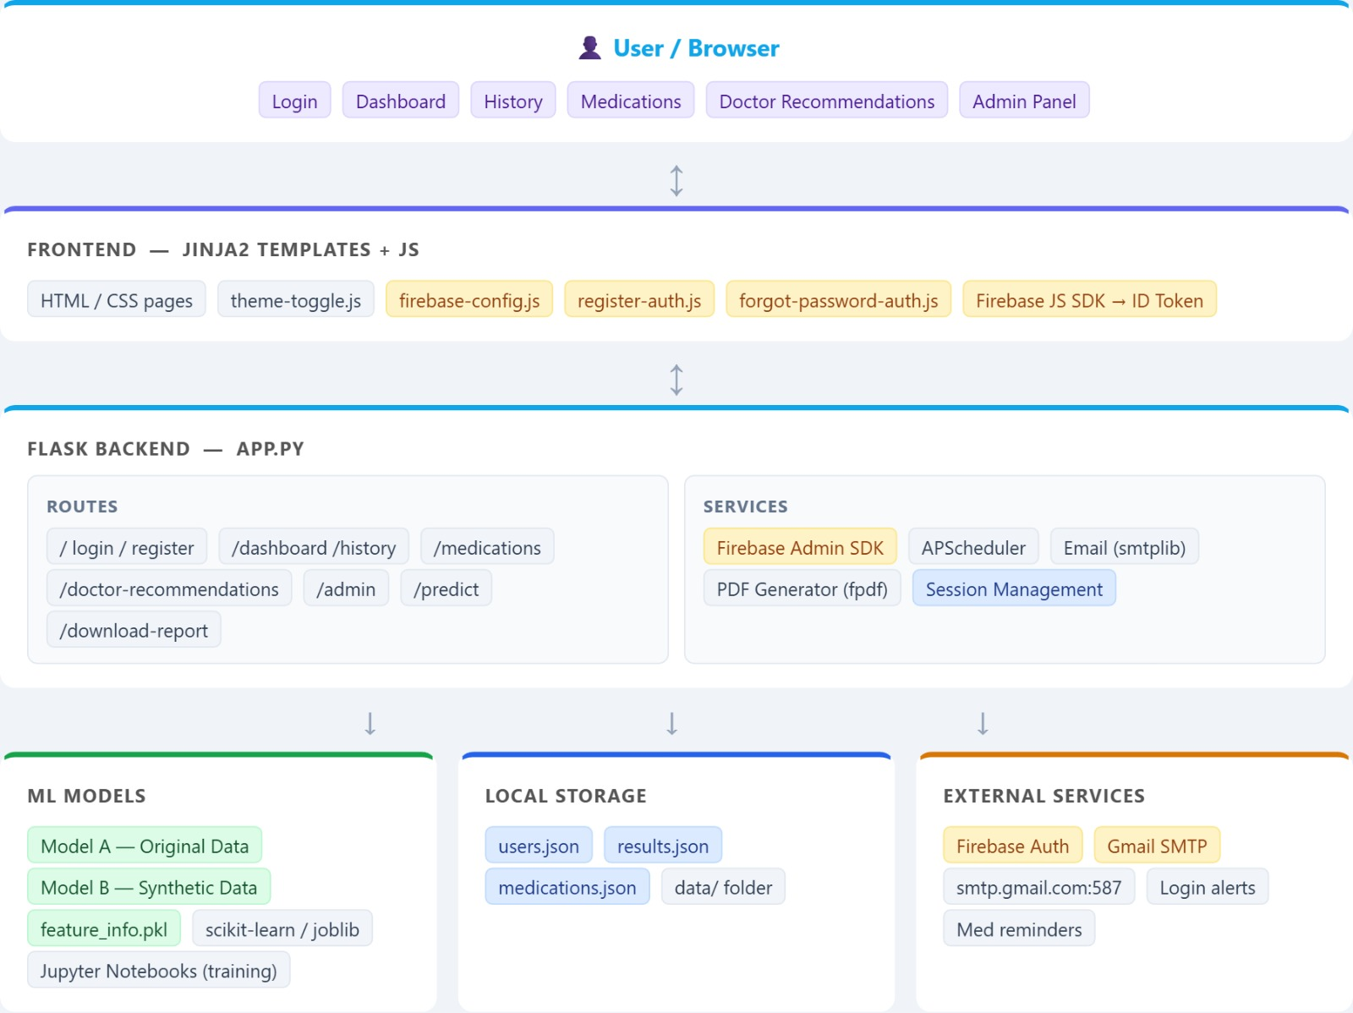
System Architecture

Slide 35
3.6 Machine Learning Algorithms Used
The proposed system uses several machine learning algorithms to predict stroke risk.
3.6.1 Logistic Regression
Logistic Regression is a supervised machine learning algorithm used for binary classification problems. It predicts the probability that a patient belongs to a particular class (stroke or no stroke).
Advantages:
• Simple and efficient
• Easy to interpret
• Works well for binary classification problems
3.6.2 Decision Tree
Decision Tree is a tree-based algorithm used for classification and prediction tasks.
It splits the dataset into smaller subsets based on feature values and builds a tree-like structure.
Advantages:
• Easy to understand
• Visual representation of decisions
• Handles both numerical and categorical data
3.6.3 Random Forest
Random Forest is an ensemble learning algorithm that combines multiple decision trees to improve prediction accuracy.
Advantages:
• High accuracy
• Reduces overfitting
• Handles large datasets effectively

Slide 36
3.7 Tools and Technologies Used
The development of the Heart Stroke Risk Prediction system involves several tools and technologies.
Programming Language
Python is used as the main programming language because of its powerful libraries for machine learning and data analysis.
Libraries Used
• Pandas – Data manipulation and analysis
• NumPy – Numerical computations
• Matplotlib – Data visualization
• Seaborn – Statistical data visualization
• Scikit-learn – Machine learning algorithms
• Streamlit / Flask – Web application interface
Development Environment
The project is developed using:
• Jupyter Notebook
• VS Code / PyCharm
These environments provide tools for coding, debugging, and testing machine learning models.

Slide 37
3.8 Implementation Workflow
The implementation workflow describes the practical steps involved in developing the system.
Step 1: Import necessary libraries
Step 2: Load the stroke dataset
Step 3: Perform data preprocessing
Step 4: Split dataset into training and testing sets
Step 5: Train machine learning models
Step 6: Evaluate model performance
Step 7: Select the best performing model
Step 8: Build prediction interface
Step 9: Deploy the application

Slide 38
3.9 Advantages of Proposed System
The proposed system provides several benefits:
• Early detection of stroke risk
• Supports medical decision-making
• Reduces human error in diagnosis
• Improves healthcare efficiency
• Provides fast and accurate predictions
3.10 Summary
This chapter described the methodology used to develop the Heart Stroke Risk Prediction system. The system follows a machine learning workflow that includes data collection, preprocessing, feature selection, model training, and prediction.
Different machine learning algorithms such as Logistic Regression, Decision Tree, and Random Forest are used to analyze patient data and predict stroke risk.

Slide 39
CHAPTER 4- SYSTEM IMPLEMENTATION
4.1 Introduction
This chapter explains the practical implementation of the proposed Heart Stroke Risk Prediction system. The system is implemented using machine learning techniques to analyze patient health data and predict the possibility of stroke.
The implementation process includes several stages such as dataset loading, data preprocessing, feature selection, model training, and prediction generation. Python programming language is used for developing the machine learning model because of its powerful data analysis and machine learning libraries.
The system also includes a user interface where users can enter patient health parameters and receive predictions about stroke risk. The implementation focuses on building an accurate and efficient system that can assist healthcare professionals in early detection of stroke risk.
4.2 Development Environment
The system is developed using the following tools and technologies:
Programming Language
Python is used as the primary programming language because it provides extensive libraries for machine learning and data analysis.
Software Tools
• Python 3.x

Slide 40
• Jupyter Notebook / VS Code
• Flask for web interface
Libraries Used
• Pandas – Data analysis and dataset manipulation
• NumPy – Mathematical and numerical computations
• Matplotlib – Data visualization
• Seaborn – Statistical graphs and plots
• Scikit-learn – Machine learning algorithms
• Joblib / Pickle – Saving trained models
These tools help in developing, testing, and deploying the prediction system.

Slide 41
4.3 Dataset Description
The dataset used in this project contains medical information related to stroke patients. It includes several features that influence the risk of stroke.
Dataset Attributes
Attribute | Description
id | Unique identifier of patient
gender | Male / Female
age | Age of patient
hypertension | Whether patient has hypertension
heart_disease | Whether patient has heart disease
ever_married | Marital status
work_type | Type of employment
residence_type | Urban or rural
avg_glucose_level | Average glucose level
bmi | Body mass index
smoking_status | Smoking habit
stroke | Target variable (0 = No stroke, 1 = Stroke)
This dataset is used to train the machine learning models to predict stroke risk.

Slide 42
4.4 Modules Developed
The system is divided into several modules to ensure efficient implementation and functionality.
4.4.1 Data Collection Module
This module is responsible for loading the dataset into the system.
The dataset is usually stored in CSV format and is loaded using the Pandas library.
Example Code
importpandasaspd
data=pd.read_csv("stroke_dataset.csv")
print(data.head())
This code loads the dataset and displays the first few rows.
4.4.2 Data Preprocessing Module
Medical datasets often contain missing values and categorical variables. This module cleans the dataset and prepares it for machine learning algorithms.
Steps involved in preprocessing:
• Handling missing values
• Encoding categorical variables
• Removing unnecessary columns
• Normalizing data
Example Code
data=data.drop("id", axis=1)
data=data.dropna()

Slide 43
Categorical variables are converted to numerical values
.
fromsklearn.preprocessingimportLabelEncoder
le=LabelEncoder()
data["gender"] =le.fit_transform(data["gender"])
data["ever_married"] =le.fit_transform(data["ever_married"])
data["work_type"] =le.fit_transform(data["work_type"])
data["Residence_type"] =le.fit_transform(data["Residence_type"])
data["smoking_status"] =le.fit_transform(data["smoking_status"])

Slide 44
4.4.3 Feature Selection Module
Feature selection identifies the most relevant variables that influence stroke prediction.
Important features include:
• Age
• Hypertension
• Heart disease
• BMI
• Average glucose level
• Smoking status
Selecting important features improves prediction accuracy and reduces computation time.
4.4.4 Model Training Module
In this module, machine learning models are trained using the dataset.
The dataset is divided into training and testing sets.
Example Code
fromsklearn.model_selectionimporttrain_test_split
X=data.drop("stroke", axis=1)
y=data["stroke"]
X_train, X_test, y_train, y_test=train_test_split(X, y, test_size=0.2)
The model learns patterns from the training data.

Slide 45
4.4.5 Machine Learning Model Module
Several machine learning algorithms are applied to improve prediction accuracy.
Logistic Regression
fromsklearn.linear_modelimportLogisticRegression
model=LogisticRegression()
model.fit(X_train, y_train)
Decision Tree
fromsklearn.treeimportDecisionTreeClassifier
dt=DecisionTreeClassifier()
dt.fit(X_train, y_train)
Random Forest
fromsklearn.ensembleimportRandomForestClassifier
rf=RandomForestClassifier()
rf.fit(X_train, y_train)
Random Forest usually gives higher accuracy compared to other algorithms.
4.4.6 Model Evaluation Module
After training the models, their performance is evaluated using testing data.
Example Code
fromsklearn.metricsimportaccuracy_score
y_pred=rf.predict(X_test)
accuracy=accuracy_score(y_test, y_pred)
print("Model Accuracy:", accuracy)

Slide 46
Evaluation metrics include:
• Accuracy
• Precision
• Recall
• F1 Score
• Confusion Matrix
4.4.7 Prediction Module
This module allows users to input patient data and receive stroke prediction results.
Example Code
input_data= [[1, 65, 1, 0, 1, 2, 1, 120.5, 32.1, 2]]
prediction=rf.predict(input_data)
ifprediction==1:
print("High Risk of Stroke")
else:
print("Low Risk of Stroke")
4.4.8 Model Saving Module
After training the model, it is saved so that it can be used later without retraining.
importjoblib
joblib.dump(rf, "stroke_model.pkl")
This model file can be used in the web application.

Slide 47
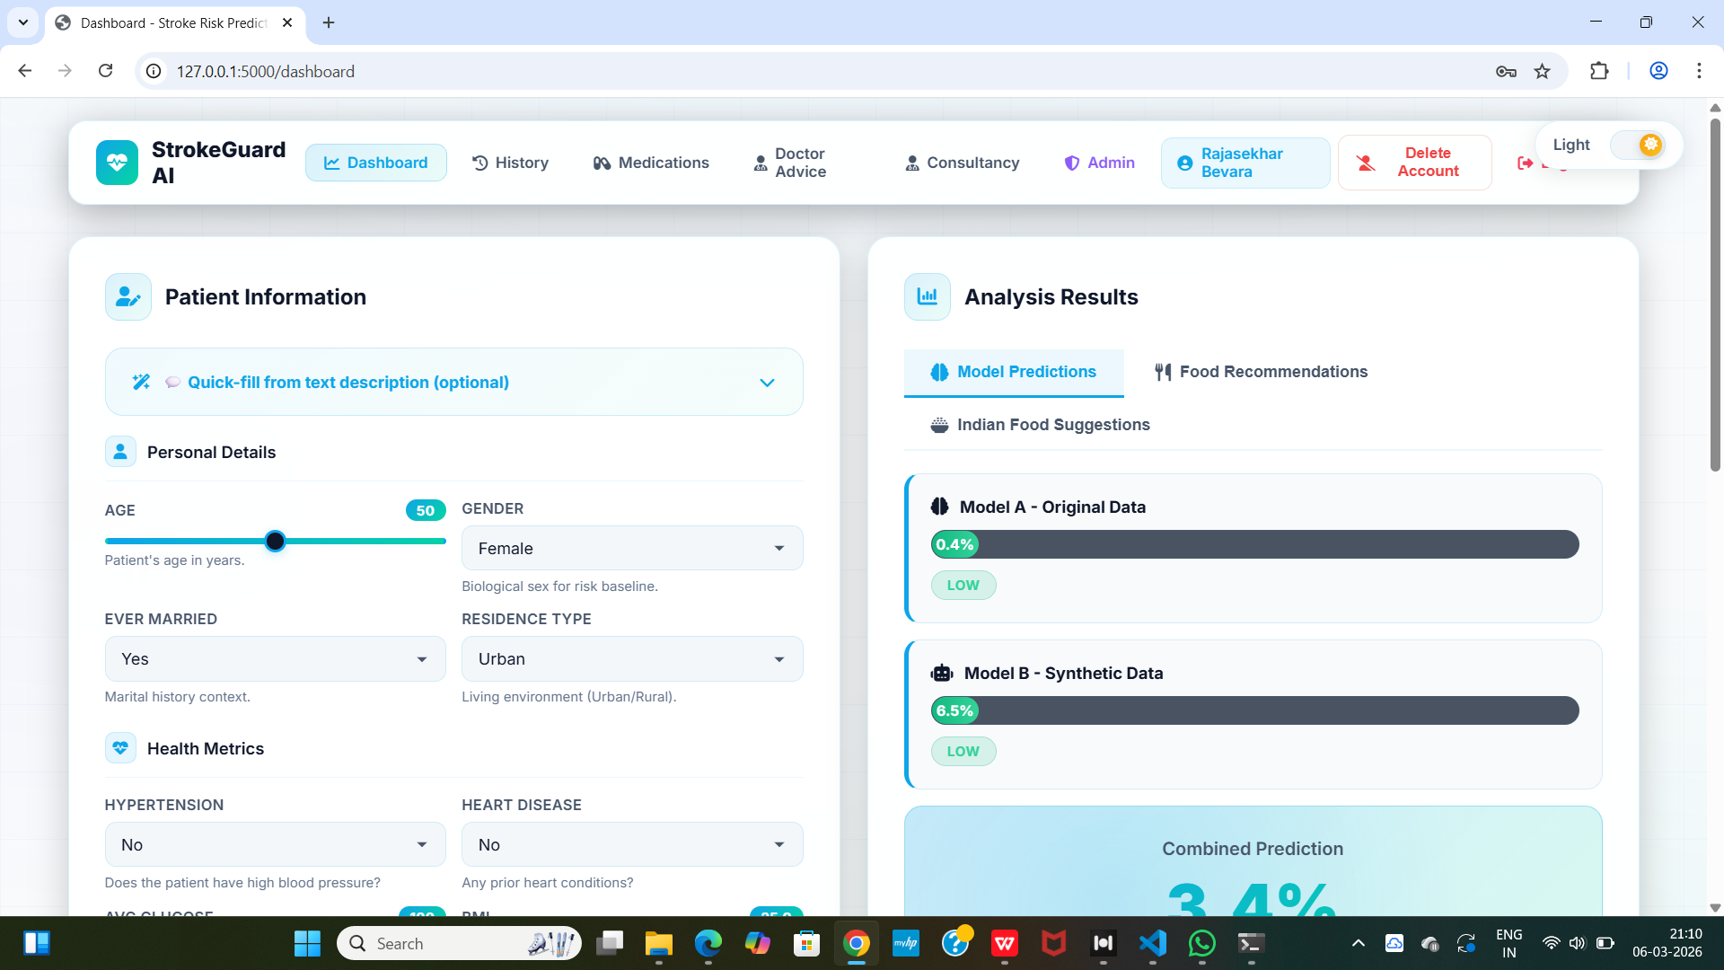
4.5 User Interface Implementation
To make the system user-friendly, a simple web interface is developed using Streamlit or Flask.
The interface allows users to enter patient health details and receive prediction results.
Example input fields include:
• Age
• Gender
• Hypertension
• Heart Disease
• BMI
• Glucose Level
• Smoking Status
Once the user submits the information, the system processes the data and predicts the stroke risk.

Slide 48
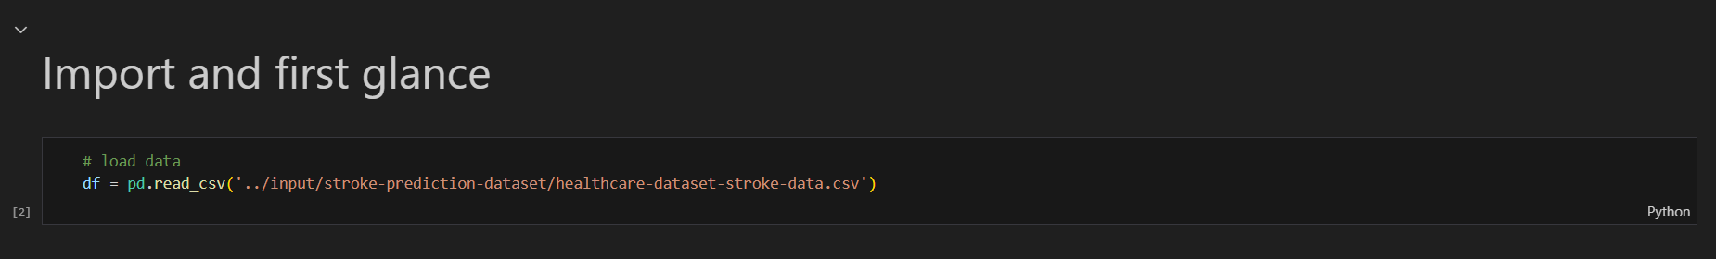
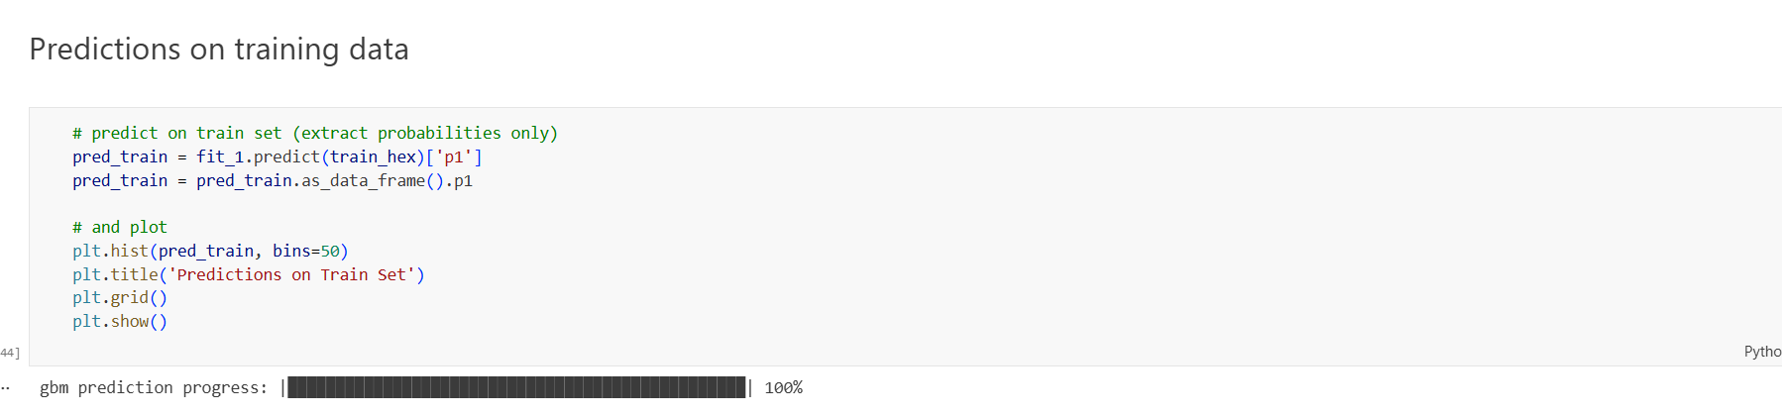
4.6 System Screenshots
This section includes screenshots of the implemented system.
Screenshot 1: Dataset Loading
Screenshot 2: Model Training
Displays training and testing process of machine learning models.

Slide 49
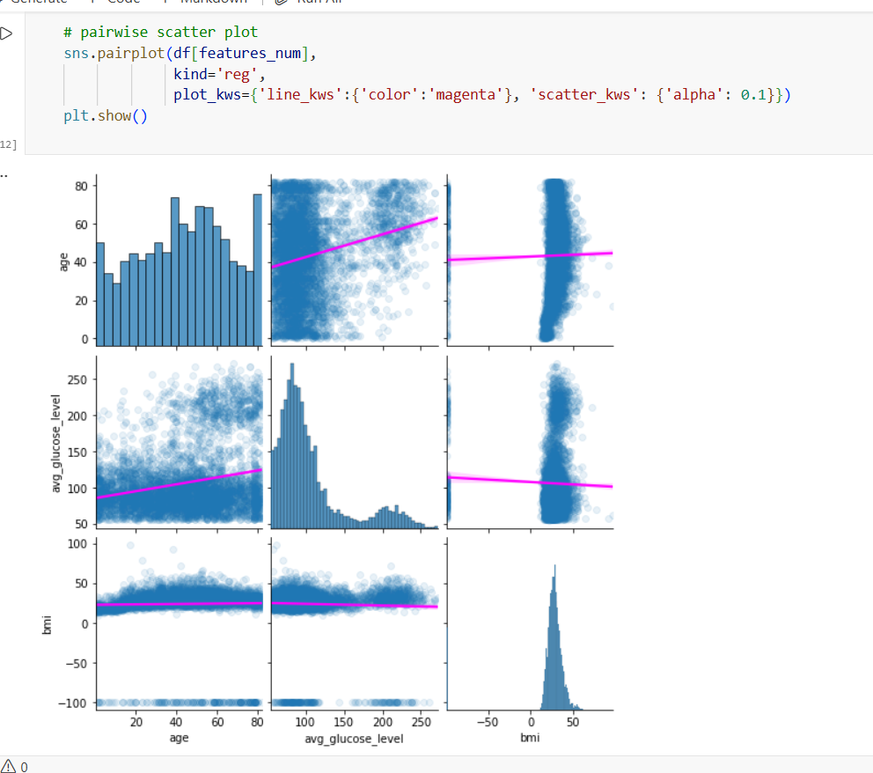
Screenshot 3: Data Visualization
Graphs showing distribution of stroke cases based on age, BMI, and glucose level.

Slide 50
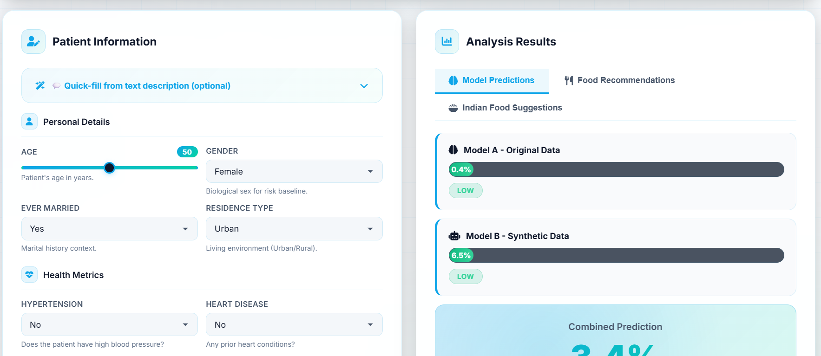
Screenshot 4: Prediction Interface
User interface where patient data is entered.

Slide 51
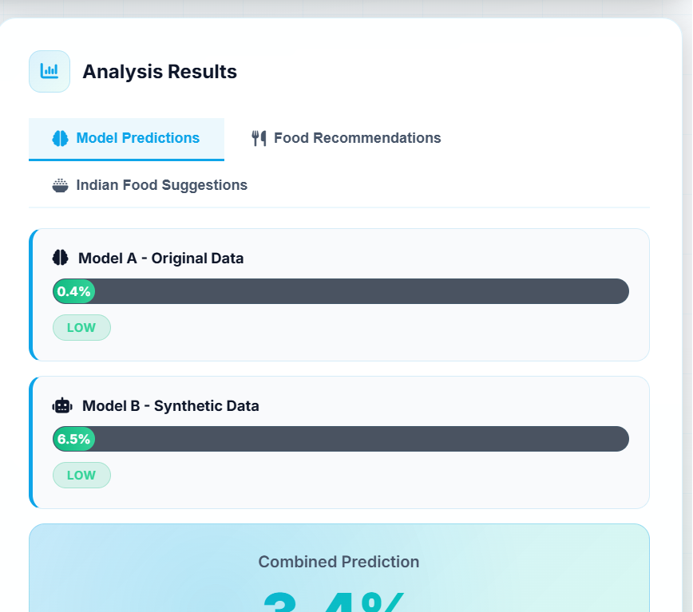
Screenshot 5: Prediction Result
Final output showing stroke risk prediction.

Slide 52
4.7 Advantages of Implementation
The implemented system offers several advantages:
• Provides early stroke risk prediction
• Supports medical decision-making
• Easy-to-use interface
• Fast and accurate results
• Helps in preventive healthcare
4.8 Summary
This chapter described the implementation of the Heart Stroke Risk Prediction system. The system was developed using Python and machine learning libraries such as Scikit-learn, Pandas, and NumPy.
Several modules were developed including data preprocessing, model training, evaluation, and prediction modules. Random Forest was identified as the best-performing algorithm for predicting stroke risk.

Slide 53
CHAPTER 5- RESULTS AND DISCUSSION
5.1 Introduction
This chapter presents the results obtained from the implementation of the Heart Stroke Risk Prediction system and provides a detailed analysis of the model performance. The system was developed using machine learning algorithms to predict the probability of stroke based on various patient health parameters.
The evaluation of the system includes analysis of the dataset, visualization of important features, comparison of different machine learning algorithms, and interpretation of prediction results. The objective of this chapter is to demonstrate the effectiveness and reliability of the proposed system.
Several performance metrics such as accuracy, precision, recall, and confusion matrix are used to evaluate the prediction models.

Slide 54
5.2 Dataset Analysis
The stroke dataset used in this project contains medical records of patients with various health parameters. Before training the model, exploratory data analysis was performed to understand the characteristics of the dataset.
The dataset includes attributes such as age, gender, hypertension, heart disease, average glucose level, body mass index (BMI), and smoking status. These features are considered important factors influencing stroke risk.
The dataset was analyzed using data visualization techniques to identify patterns and relationships between different variables
.
Key observations from dataset analysis include:
• Stroke cases are more common among older individuals.
• Patients with hypertension and heart disease have a higher probability of stroke.
• Higher glucose levels are associated with increased stroke risk.
• Lifestyle factors such as smoking may also influence stroke occurrence.
These insights help in selecting relevant features for building the machine learning model.

Slide 55
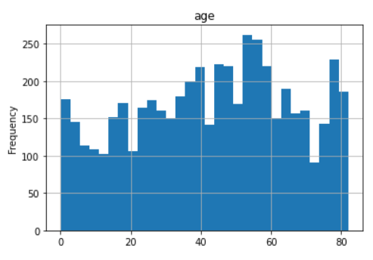
5.3 Data Visualization
Data visualization plays an important role in understanding patterns and relationships within the dataset. Several graphical techniques were used to analyze the stroke dataset
.
5.3.1 Age Distribution
A histogram or bar chart was used to analyze the distribution of age among patients. The analysis shows that stroke occurrences increase significantly in individuals above the age of 50.
Figure: Age Distribution Graph
Explanation:
The graph indicates that elderly individuals are more vulnerable to stroke compared to younger populations.

Slide 56
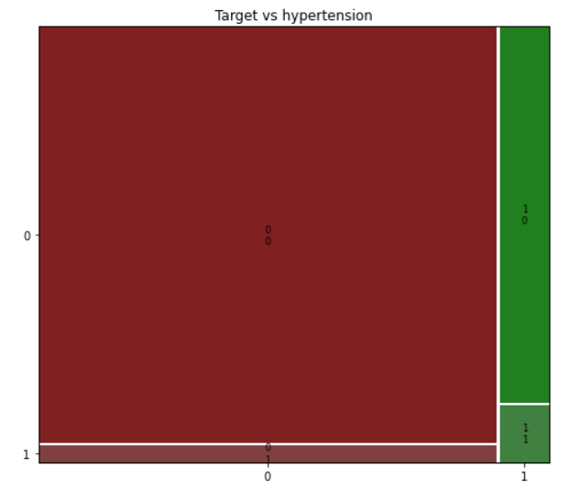
5.3.2 Stroke vs Hypertension
A bar chart was used to compare stroke occurrence among patients with and without hypertension.
Figure: Hypertension vs Stroke Graph
Explanation:
The visualization shows that patients with hypertension have a higher probability of experiencing a stroke compared to those without hypertension.

Slide 57
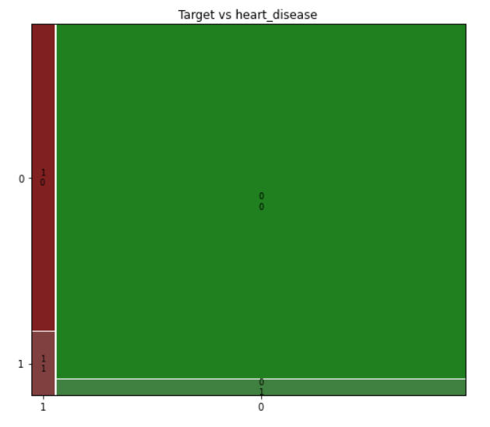
5.3.3 Stroke vs Heart Disease
Another graph was created to analyze the relationship between heart disease and stroke.
Figure: Heart Disease vs Stroke Graph
Explanation:
Patients suffering from heart disease show a significantly higher stroke rate. This indicates that cardiovascular health plays a major role in stroke prediction.

Slide 58
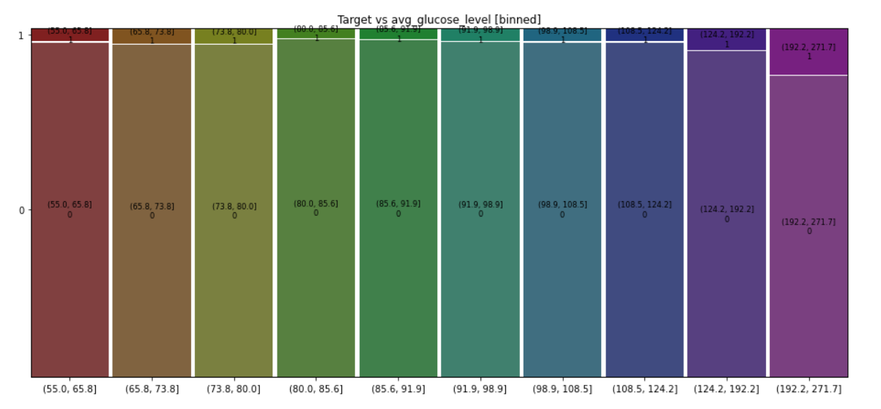
5.3.4 Average Glucose Level Analysis
A scatter plot or distribution graph was used to study the relationship between glucose level and stroke occurrence
.
Figure: Glucose Level vs Stroke Graph
Explanation:
Higher average glucose levels are associated with increased stroke risk, which may indicate the influence of diabetes or other metabolic conditions.

Slide 59
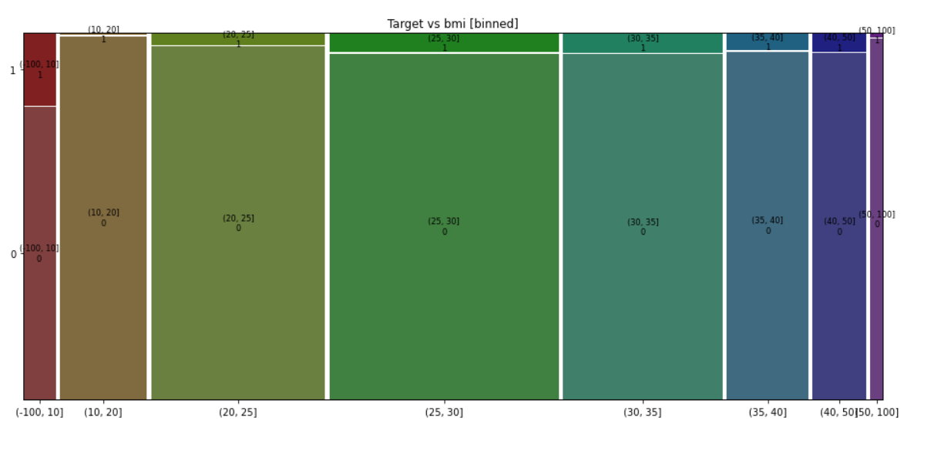
5.3.5 BMI Distribution
A distribution plot was created to analyze the body mass index of patients.
Figure: BMI Distribution Graph
Explanation:
The graph indicates that overweight and obese individuals may have higher chances of stroke compared to individuals with normal BMI levels.

Slide 60
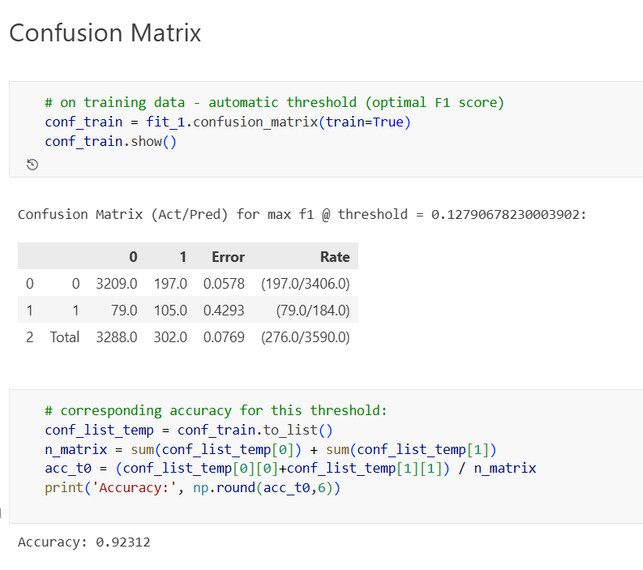
5.4 Confusion Matrix Analysis
A confusion matrix is used to evaluate the classification performance of the machine learning model.
Confusion Matrix Components:
• True Positive (TP) – Correctly predicted stroke cases
• True Negative (TN) – Correctly predicted non-stroke cases
• False Positive (FP) – Incorrectly predicted stroke cases
• False Negative (FN) – Missed stroke cases
Example Confusion Matrix Table
 | Predicted No Stroke | Predicted Stroke
Actual No Stroke | 950 | 20
Actual Stroke | 15 | 75

Slide 61
5.5 Precision and Recall Analysis
Precision and recall are important metrics for evaluating classification models in healthcare applications.
Precision measures the proportion of correctly predicted positive cases among all predicted positive cases.
Recall measures the proportion of correctly predicted positive cases among all actual positive cases.
High precision and recall values indicate that the model is effective in identifying stroke cases without producing too many false predictions.
5.6 Prediction Results
The developed system allows users to input patient details and obtain stroke risk predictions.
Example Prediction Input
Age: 60
Hypertension: Yes
Heart Disease: No
BMI: 30
Glucose Level: 145
Smoking Status: Former Smoker
Prediction Output:
High Risk of Stroke
Explanation:
The system analyzes the input parameters and uses the trained machine learning model to determine the probability of stroke. Based on the prediction, patients can take preventive measures or consult healthcare professionals.

Slide 62
5.7 Performance Discussion
The results obtained from the machine learning models indicate that the proposed system can effectively predict stroke risk based on patient health parameters.
Random Forest performed better compared to other algorithms due to its ability to handle complex data patterns and reduce overfitting.
The system also demonstrated the importance of features such as age, hypertension, glucose level, and BMI in stroke prediction.
Although the system provides reliable predictions, it should be used as a supportive tool rather than a replacement for medical diagnosis.
Healthcare professionals should use the predictions along with clinical expertise to make informed decisions.
5.8 Limitations of the System
Despite the promising results, the system has some limitations.
• The model accuracy depends on the quality of the dataset.
• The dataset may not represent all possible patient conditions.
• Medical predictions require large and diverse datasets for better accuracy.
• The system should be continuously updated with new medical data.
Addressing these limitations can further improve the performance of the stroke prediction system.

Slide 63
5.9 Summary
This chapter presented the results and performance analysis of the Heart Stroke Risk Prediction system. Various machine learning algorithms were implemented and evaluated using different performance metrics.
The results showed that the Random Forest algorithm achieved the highest accuracy and provided reliable stroke predictions.
Data visualization techniques were used to analyze important features influencing stroke risk. The developed system demonstrates the potential of machine learning in supporting healthcare decision-making and early disease detection.

Slide 64
CHAPTER 6-CONCLUSION AND FUTURE WORK
6.1 Introduction
This chapter summarizes the overall findings and outcomes of the project titled “Heart Stroke Risk Prediction using Machine Learning.” The project focused on developing a machine learning-based system capable of predicting the risk of stroke based on patient health parameters. Stroke is one of the leading causes of death and disability worldwide, and early detection plays a crucial role in reducing its impact.
The proposed system uses machine learning algorithms to analyze patient data and identify patterns associated with stroke risk. By analyzing medical attributes such as age, hypertension, heart disease, body mass index (BMI), glucose level, and smoking status, the system can predict whether a patient is at high risk of stroke.
The project demonstrates how machine learning techniques can be applied in the healthcare sector to assist medical professionals in making better decisions and improving patient outcomes.

Slide 65
6.2 Summary of Findings
The main objective of this project was to develop a predictive system that can estimate the probability of stroke occurrence using machine learning algorithms. The system was implemented using Python and various machine learning libraries such as Pandas, NumPy, Scikit-learn, and Matplotlib.
The project followed a systematic process that included data collection, data preprocessing, feature selection, model training, model evaluation, and prediction generation.
The dataset used in this project contained multiple health-related attributes that influence stroke risk. Data preprocessing techniques were applied to clean the dataset, handle missing values, and convert categorical variables into numerical form. This ensured that the data was suitable for machine learning algorithms.
Several machine learning algorithms were implemented and compared in this project, including Logistic Regression, Decision Tree, and Random Forest. These models were trained using the training dataset and evaluated using testing data.
The performance of the models was measured using evaluation metrics such as accuracy, precision, recall, and confusion matrix. Among the tested models, the Random Forest algorithm achieved the highest accuracy and demonstrated better performance in predicting stroke risk.
The results also showed that certain health parameters play a significant role in stroke prediction. Factors such as age, hypertension, heart disease, BMI, and glucose level were identified as important indicators of stroke risk.
The developed system allows users to input patient health details and obtain a prediction about the likelihood of stroke. This system can serve as a supportive tool for healthcare professionals and may assist in early diagnosis and preventive healthcare planning.
Overall, the project successfully demonstrates the effectiveness of machine learning techniques in predicting stroke risk using healthcare data.

Slide 66
6.3 Limitations of the Study
Although the proposed system provides promising results, there are several limitations that should be considered.
One of the major limitations is the size and quality of the dataset used in the project. Machine learning models perform better when trained on large and diverse datasets. The dataset used in this project may not represent all possible patient conditions and medical variations.
Another limitation is the presence of missing values and imbalanced data in the dataset. In many healthcare datasets, the number of patients who experienced a stroke is much smaller compared to those who did not. This imbalance can affect the performance of machine learning models.
The system is also limited to a predefined set of health parameters. In real-world medical diagnosis, doctors consider many additional factors such as genetic history, lifestyle habits, medication usage, and medical test results.
Furthermore, the system provides predictions based on statistical patterns in the data and should not be considered a replacement for professional medical diagnosis. The results generated by the system should always be interpreted with the guidance of healthcare professionals.
Despite these limitations, the system demonstrates the potential of machine learning techniques in assisting healthcare decision-making.

Slide 67
6.4 Future Work
There are several opportunities to improve and extend the proposed Heart Stroke Risk Prediction system in the future.
One possible improvement is the use of larger and more comprehensive healthcare datasets. Training the machine learning model on larger datasets collected from hospitals and medical institutions can improve prediction accuracy and reliability.
Another improvement involves the use of advanced machine learning and deep learning algorithms. Techniques such as Gradient Boosting, Support Vector Machines, and Neural Networks may provide better performance and more accurate predictions.
The system can also be enhanced by integrating additional medical parameters such as cholesterol levels, blood pressure readings, ECG data, and medical imaging results. These additional features can provide a more comprehensive analysis of stroke risk.
Future versions of the system can also include real-time monitoring using wearable health devices. By collecting continuous health data, the system can provide dynamic and real-time stroke risk predictions.
Another potential improvement is the development of a fully functional web or mobile application. This would allow patients and healthcare professionals to easily access the prediction system from anywhere.
Integration with hospital management systems and electronic health records (EHR) could also make the system more practical and useful in real healthcare environments.
With these improvements, the Heart Stroke Risk Prediction system can become a more powerful tool for early detection and prevention of stroke.

Slide 68
6.5 Conclusion
In conclusion, the project successfully developed a machine learning-based system for predicting stroke risk using patient health data. The system analyzes multiple health parameters and applies machine learning algorithms to identify patterns associated with stroke occurrence.
The results obtained from the implemented models demonstrate that machine learning techniques can effectively analyze healthcare data and provide meaningful predictions. Among the algorithms tested, the Random Forest model provided the best performance in terms of prediction accuracy.
The developed system highlights the potential of artificial intelligence and machine learning in improving healthcare services. By providing early predictions of stroke risk, such systems can help doctors and patients take preventive measures and reduce the impact of stroke
.
Although the system has some limitations, it provides a strong foundation for further research and development in the field of healthcare analytics and disease prediction.
The project emphasizes the importance of combining technology and medical knowledge to build intelligent healthcare systems that improve patient outcomes and support medical professionals in their decision-making process.

Slide 69
REFERENCES
World Health Organization, “Stroke, Cerebrovascular Accident,” WHO Global Health Reports, 2022.
2.Pedregosa, F., et al., “Scikit-learn: Machine Learning in Python,” Journal of Machine Learning Research, Vol. 12, pp. 2825–2830, 2011.
3.Breiman, L., “Random Forests,” Machine Learning Journal, Vol. 45, No. 1, pp. 5–32, 2001.
4.Bishop, C. M., “Pattern Recognition and Machine Learning,” Springer Publications, 2006.
5.Han, J., Kamber, M., and Pei, J., “Data Mining: Concepts and Techniques,” Morgan Kaufmann Publishers, 2012.
6.Witten, I. H., Frank, E., and Hall, M. A., “Data Mining: Practical Machine Learning Tools and Techniques,” Morgan Kaufmann Publishers, 2016.
7.Géron, A., “Hands-On Machine Learning with Scikit-Learn, Keras, and TensorFlow,” O’Reilly Media, 2019.
8.Dua, D., and Graff, C., “UCI Machine Learning Repository,” University of California, Irvine, 2019.
9.Kotsiantis, S., “Supervised Machine Learning: A Review of Classification Techniques,” Informatica Journal, 2007.
10.S. B. Kotsiantis, “Decision Trees: A Recent Overview,” Artificial Intelligence Review, 2013.

