Slide 1
Student Management System
A Web Application for Managing Student Records
Presented by: Bevara Rajasekhar
Course: B.Tech (AI & ML)
Institution: Sri Sivani College of Engineering
Date: [Insert Date]

Slide 2
Problem Statement
• Manual student data management is time-consuming and error-prone.
• Lack of centralized and searchable student records.
• Need for an efficient, user-friendly interface to manage academic details.

Slide 3
Objective
• To design and develop a web-based system for managing student information.
• Enable features like adding, updating, deleting, and viewing student records.
• Ensure an attractive, modern user interface.

Slide 4
Technologies Used
Frontend: HTML, CSS (with modern styles)
Backend: Python with Flask Framework
Database: SQLite3 (lightweight and embedded)
Tools: VS Code / Any IDE, Flask Server

Slide 5
Features
✔ Add student details (Name, Roll No, Branch, Year, Email, Phone)
✔ View all students in table format
✔ Update existing records
✔ Delete records
✔ Stylish and responsive UI with gradient background

Slide 6
Database Schema
Table: students
Columns:
- id (Primary Key)
- name (Text)
- roll (Text)
- branch (Text)
- year (Text)
- email (Text)
- phone (Text)

Slide 7
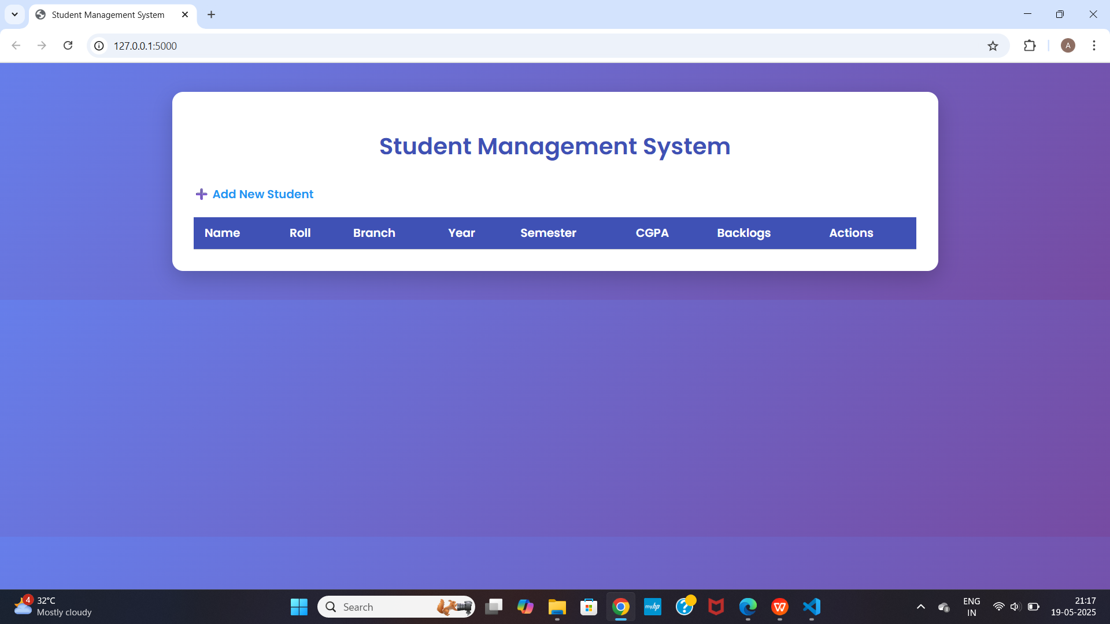
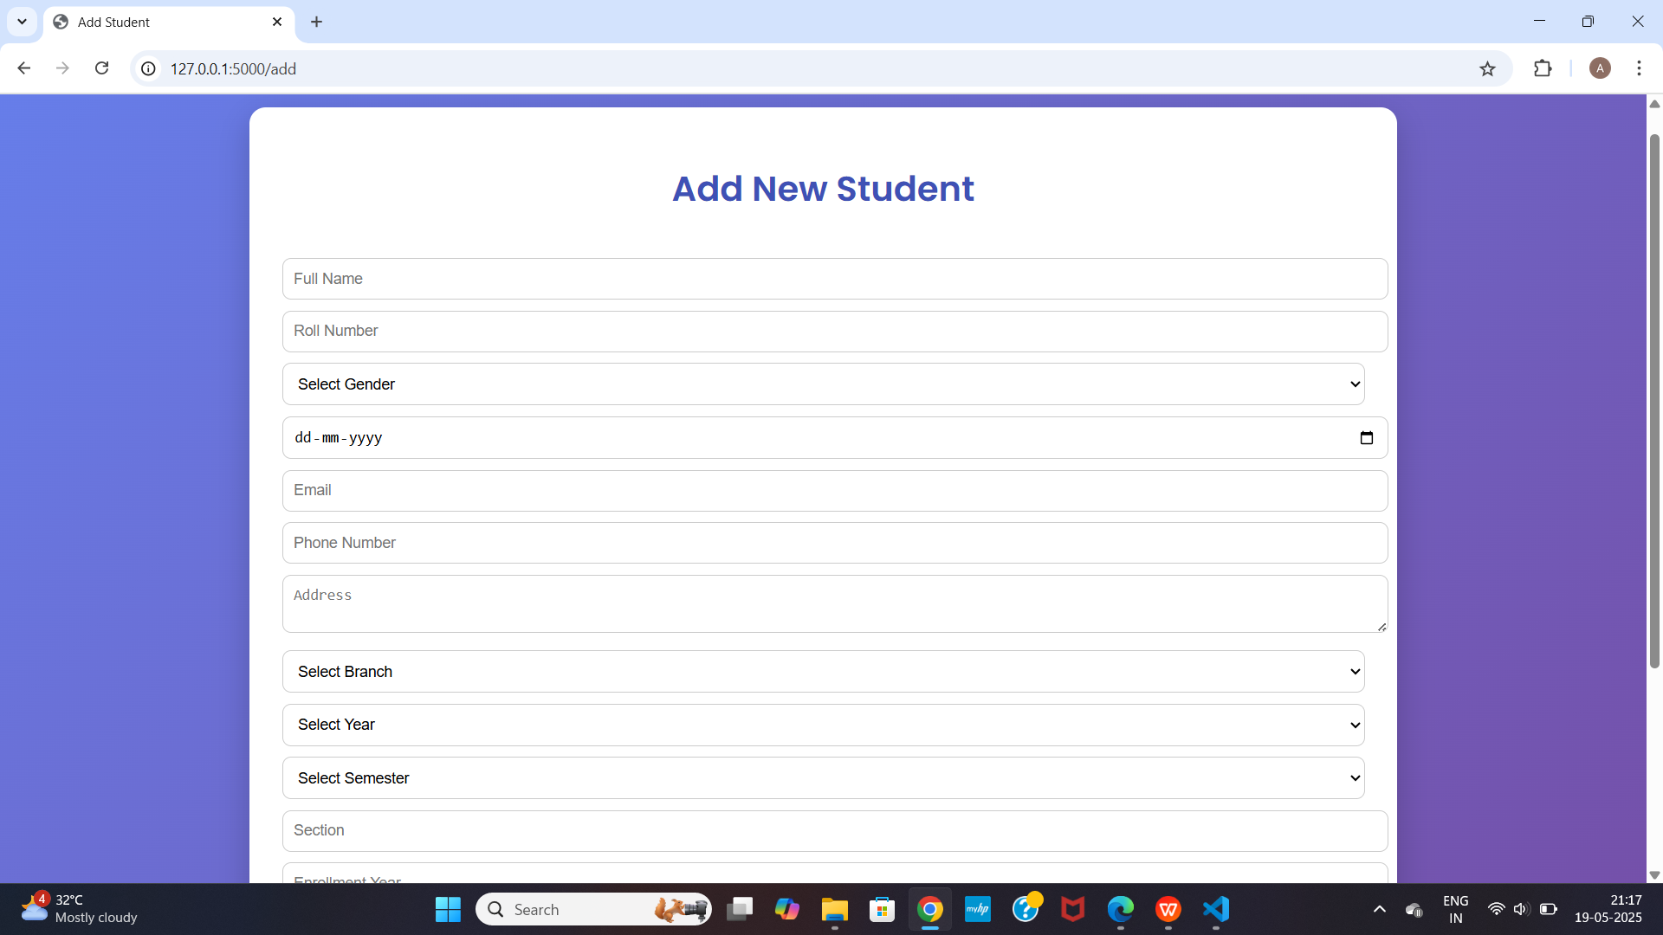
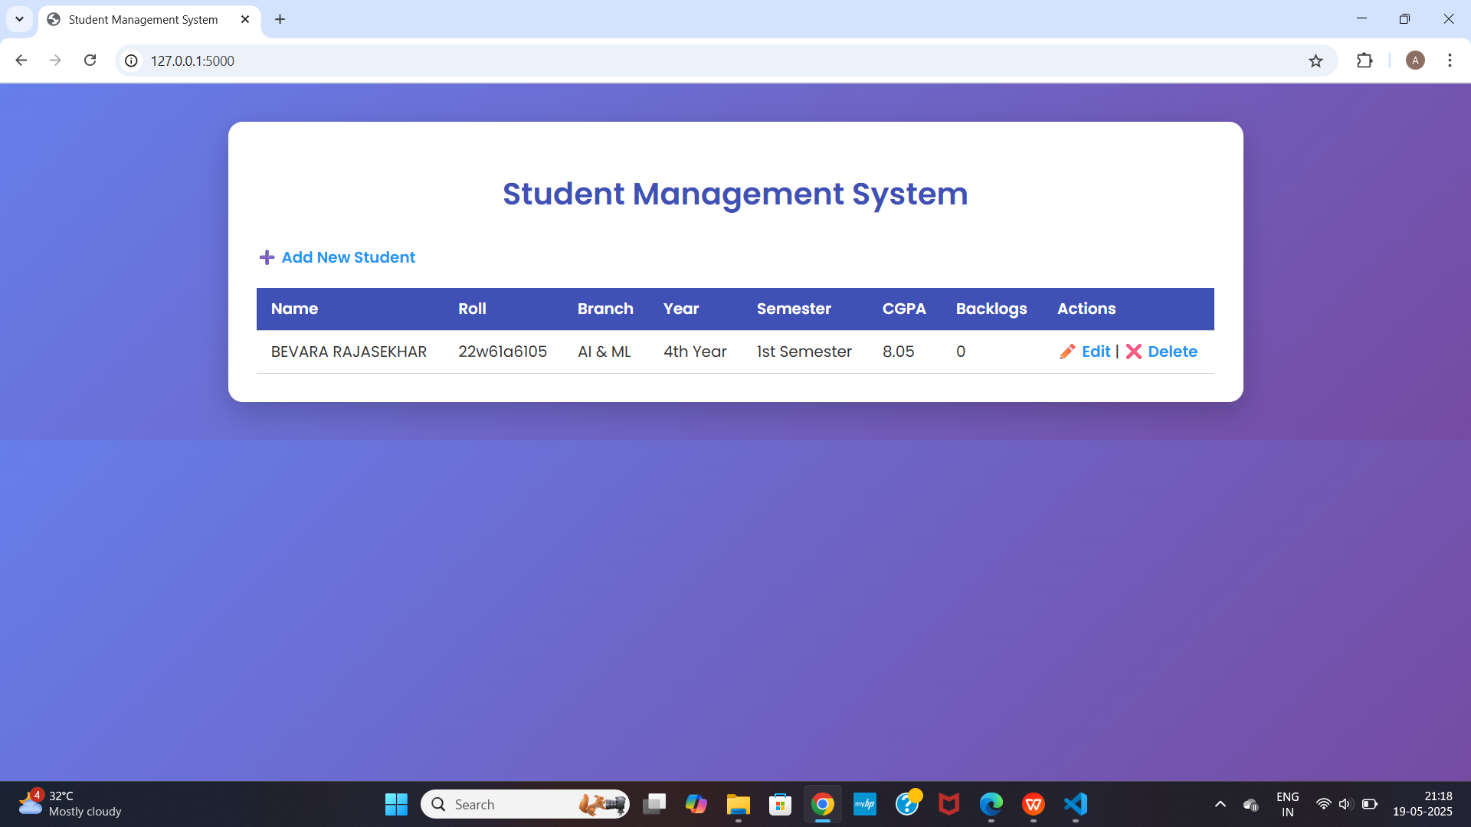

UI Screenshots (Placeholders)

Slide 8
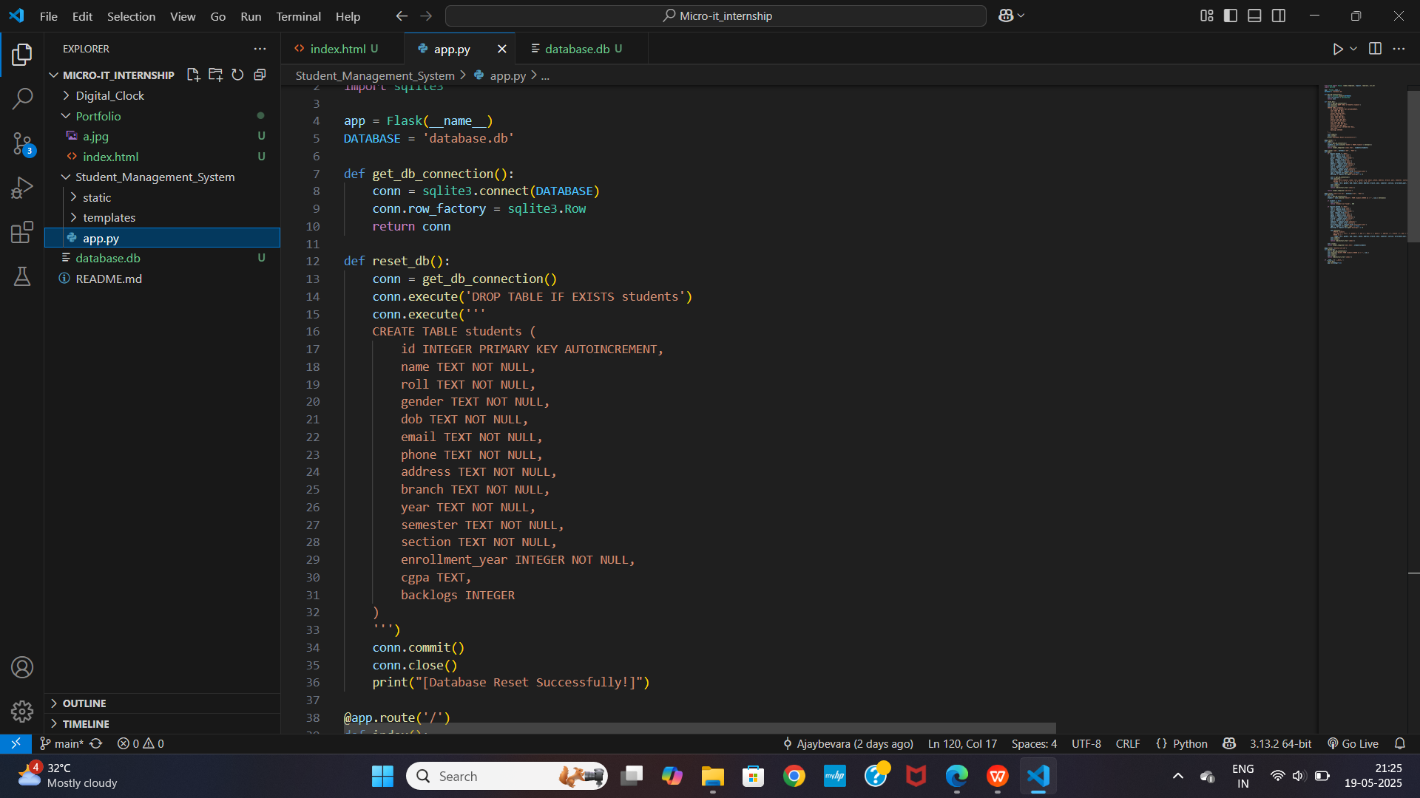
Code Highlights (Placeholder)

Slide 9
Advantages
✔ Easy to use
✔ Centralized student data
✔ Clean and responsive UI
✔ Easy to modify and extend

Slide 10
Future Scope
• Add authentication (login/register)
• Implement search & filters
• Export to Excel or PDF
• Mobile responsive design
• Role-based access (admin/student)

Slide 11
Conclusion
• The system simplifies student management.
• Reduces manual effort and improves accuracy.
• Can be used in colleges for managing academic records efficiently.

Slide 12
Thank You
MICRO IT

