Slide 1
Digital Clock using HTML, CSS, JavaScript
A stylish clock with date, day, and light/dark mode toggle

Slide 2
Introduction
This project is a Digital Clock built using HTML, CSS, and JavaScript.
It displays the current time, day of the week, and full date.
Includes a toggle switch for Light and Dark modes.

Slide 3
HTML Code Overview
HTML structure includes:
- A container for the clock display
- Div elements for time, day, and date
- A toggle switch for light/dark mode

Slide 4
CSS Styling
CSS adds modern UI with:
- Glassmorphism background
- Neon glow effects for time
- Responsive layout and transitions
- Custom variables for theming (light/dark)

Slide 5
JavaScript Functionality
JavaScript dynamically updates:
- Time every second using setInterval()
- Day and Date using Date object
- Mode toggle using classList and event listener

Slide 6
Key Features
✔ Live updating digital clock
✔ Full day and date display
✔ Light and Dark mode toggle
✔ Stylish, modern UI with animations

Slide 7
Conclusion
This project demonstrates the use of:
- HTML for structure
- CSS for visual design
- JavaScript for real-time functionality
It serves as a good beginner web development project.

Slide 8
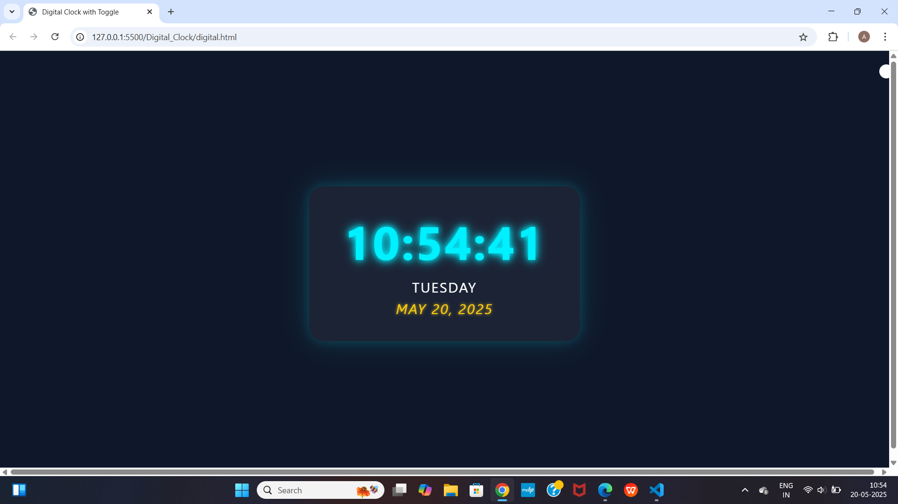
Final Clock Output in Browser

Slide 9
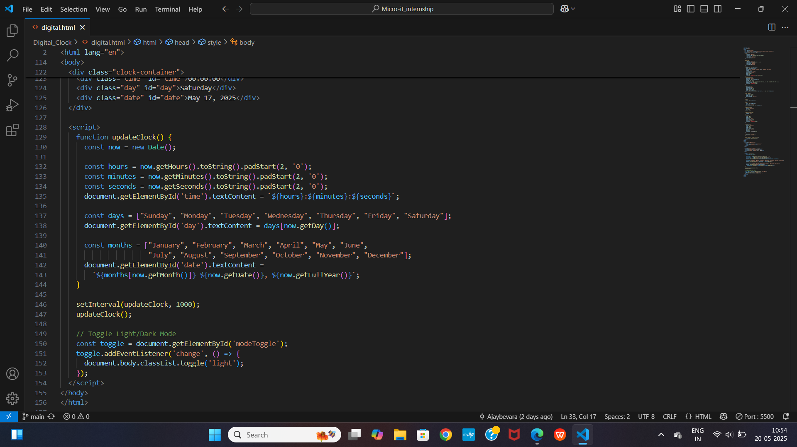
JavaScript Clock Logic(VS Code Screenshot)

