Slide 1

Today’s Agenda
DOM
Manipulation
Selectors

Slide 2
DOM: Document Object Model
Structuring your web elements is DOM.
DOM creates a document object model of the page, when a page is loaded.
DOM is a tree like structure.
Dom is the standard object model & programming interface for HTML. It defines:
Html elements as objects
Properties of HTML elements
DOM Methods to access all HTML elements
Events for html elements
To manipulate elements based on class & id

Slide 3

DOM: Document Object Model

Slide 4
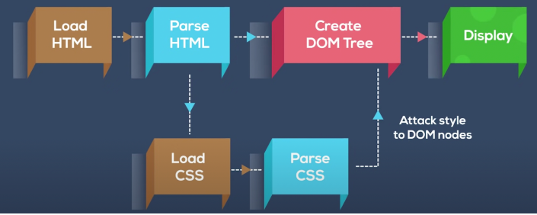
DOM

Slide 5
Selectors
getElementById
getElementsByClassname
getElementsByTag
Query Selectors

