Slide 1

Today’s Agenda
Events
Event bubbling & capturing

Slide 2
Creating and adding elements
We can insert html element and attribute through js using DOM methods
ClassList

Slide 3
JavaScript- Events
An HTML event can be something the browser does, or something a user does.
Event handlers and Event Listener.
To assign events to HTML elements you can use event attributes.
Event handlers can be used to handle and verify user input, user actions, and browser actions.
DOM Event Property + addEventListener

Slide 4
JavaScript- Events
Mouse Events
Keyboard Events: keyup, keydown, keypressed.
Form Events: onChange, onInput, onFocus, onBlur, onSubmit.
Default Behaviour, e.preventDefault()

Slide 5
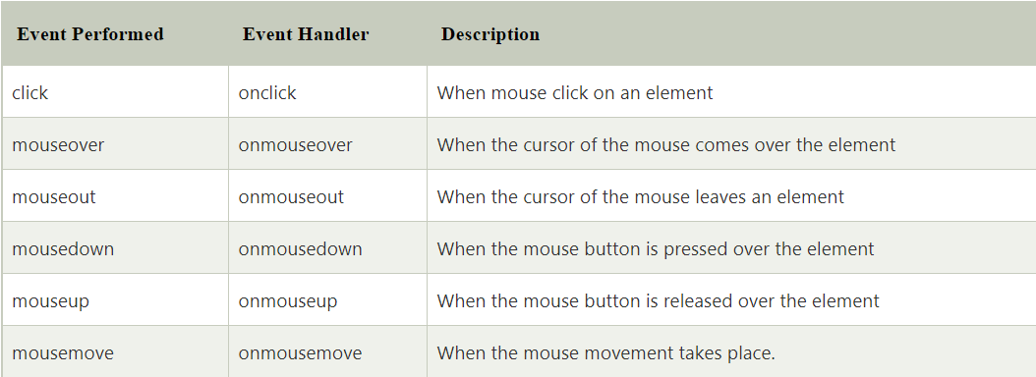
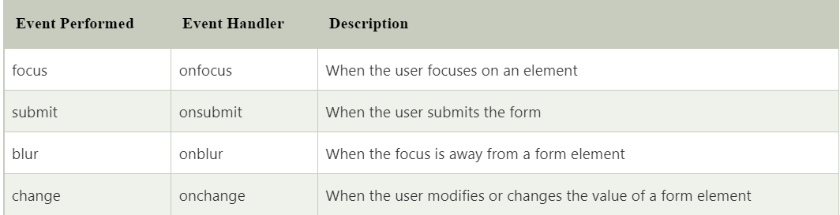
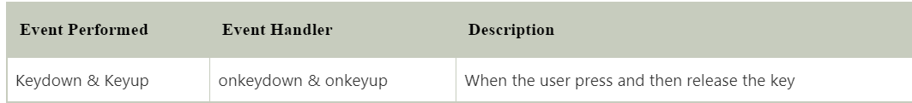
JavaScript- Events

Slide 6
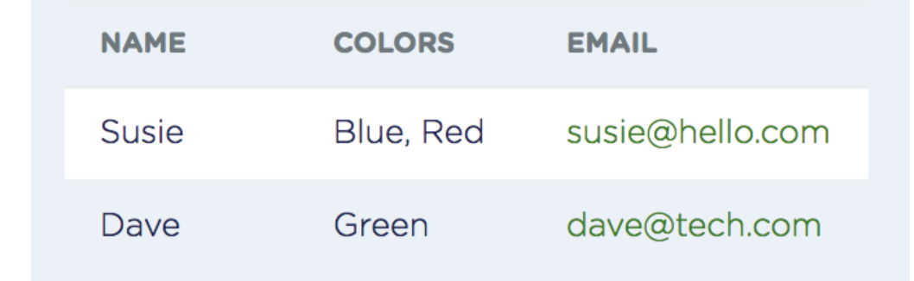
Event bubbling, capturing and propagation
Event bubbling and capturing are two ways of event propagation in the HTML DOM API, when an event occurs in an element inside another element, and both elements have registered a handle for that event. The event propagation mode determines in which order the elements receive the event.
With bubbling, the event is first captured and handled by the innermost element and then propagated to outer elements.
With capturing, the event is first captured by the outermost element and propagated to the inner elements.

