Slide 1

Today’s Agenda
HTTP Methods
AJAX

Slide 2
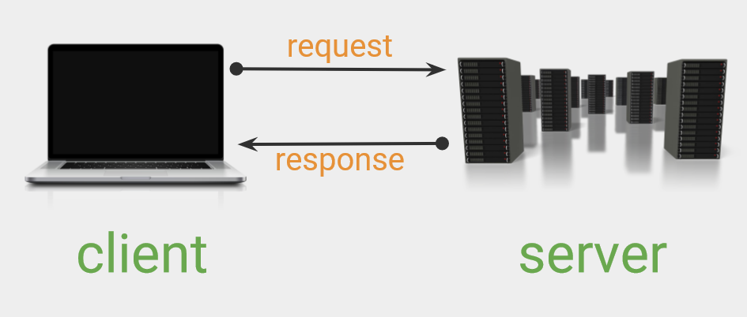

Slide 3
What is HTTP request?
An HTTP request is made by a client, to a named host, which is located on a server. The aim of the request is to access a resource on the server. To make the request, the client uses components of a URL (Uniform Resource Locator), which includes the information needed to access the resource.
HTTP methods: get(), post(), update(), delete()
HTTP status code: https://developer.mozilla.org/en-US/docs/Web/HTTP/Status
An HTTP header is a field of an HTTP request or response that passes additional context and metadata about the request or response. For example, a request message can use headers to indicate it's preferred media formats, while a response can use header to indicate the media format of the returned body

Slide 4
AJAX
AJAX stands for Asynchronous JavaScript And XML. AJAX allows web pages to be updated asynchronously by exchanging data with a web server behind the scenes. This means that it is possible to update parts of a web page, without reloading the whole page.
AJAX is not a programming language.
AJAX just uses a combination of:
A browser built-in XMLHttpRequest object (to request data from a web server)
JavaScript and HTML DOM (to display or use the data)

Slide 5
Asynchronous
Functions running in parallel with other functions are called asynchronous
Ways to make JavaScript Asynchronous
Callbacks
Promises
Async/await

