Slide 1

Welcome to
New age upskilling platform for high growth careers
By Urvshi Singla

Slide 2

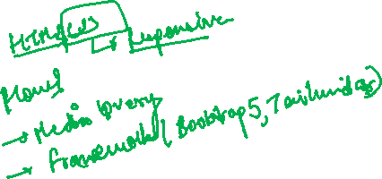
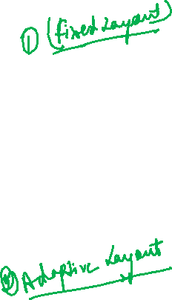
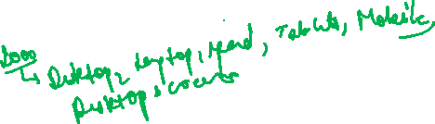
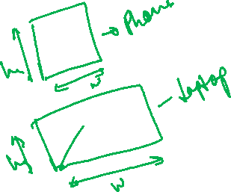
Session Agenda
Web Design
Media Query
Bootstrap 5

Slide 3
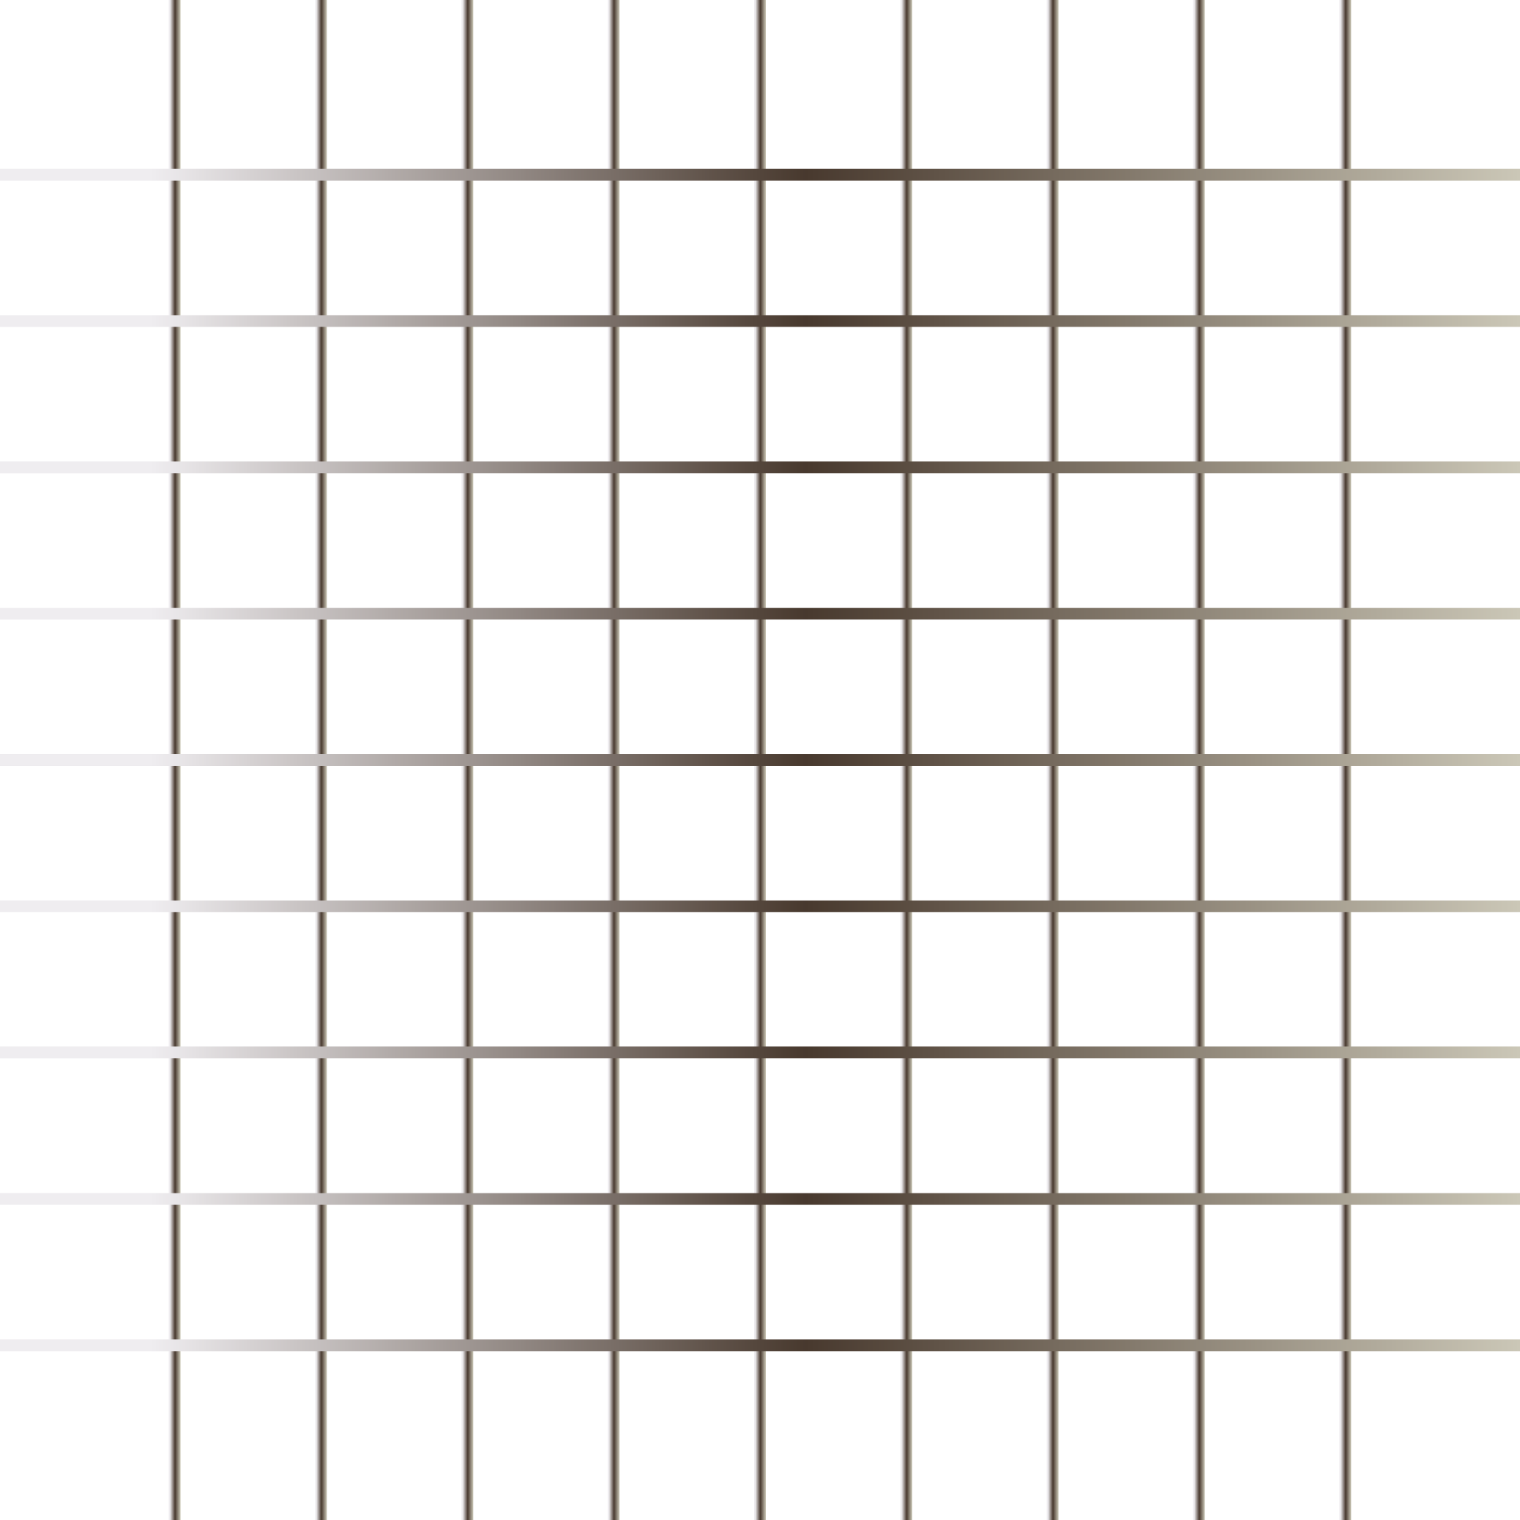
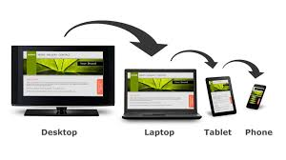
Responsive Design
What is responsive website?
Viewport
How to use media query
How to make images responsive

Slide 4
What is responsive website?
Responsive web design makes your web page look good on all devices.
Responsive web design uses only HTML and CSS.
Responsive web design is not a program or a JavaScript.
Viewport
The viewport is the user's visible area of a web page.
The viewport varies with the device, and than on a computer screen. will be smaller on a mobile phone
Before tablets and mobile phones, web pages were designed only for computer screens, and it was common for web pages to have a static design and a fixed size.

Slide 5
How to use media query?
Media query is a CSS technique introduced in CSS3.
It uses the @media rule to include a block of CSS properties only if a certain
condition is true.
Mobile First means designing for mobile before designing for desktop or any other device (This will make the page display faster on smaller devices).
This means that we must make some changes in our CSS.

Slide 6
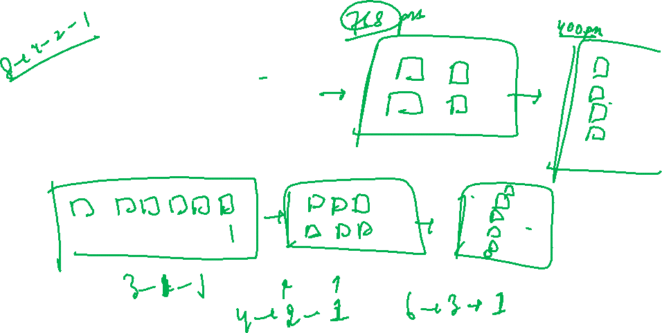
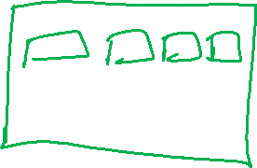

Slide 7
Frameworks:
There are many free CSS Frameworks that offer Responsive Design.
Bootstrap 5: https://getbootstrap.com/docs/5.0/components/modal/
https://getbootstrap.com/docs/5.0/examples/#custom-components

Slide 8
Q & A

Slide 9
Thank You

