Slide 1
Unveiling Germany: A Cultural Journey
Explore the rich traditions, history, and modern innovations that define German culture.
Aditya

Slide 2
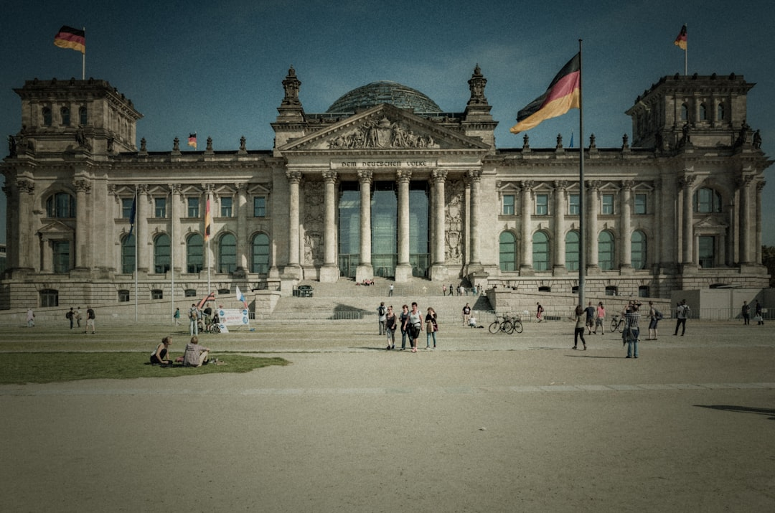
Welcome to Germany: An Introduction
Geographic and demographic overview
Introduction to key cultural concepts
Dispelling common stereotypes
What to expect from this presentation
Photo: Tobias on Unsplash
Notes:
Good morning everyone! Today, we embark on a fascinating journey into German culture. We'll start with a brief geographical and demographic context, then introduce some key cultural concepts we'll explore. We'll also touch upon common stereotypes and set the stage for what you'll learn.
Image credit: Tobias | Profile: https://unsplash.com/@herrzett?utm_source=ai_presentation_generator&utm_medium=referral | Photo: https://unsplash.com/photos/people-walking-near-white-concrete-building-during-daytime-MBVGXk_-4o0?utm_source=ai_presentation_generator&utm_medium=referral

Slide 3
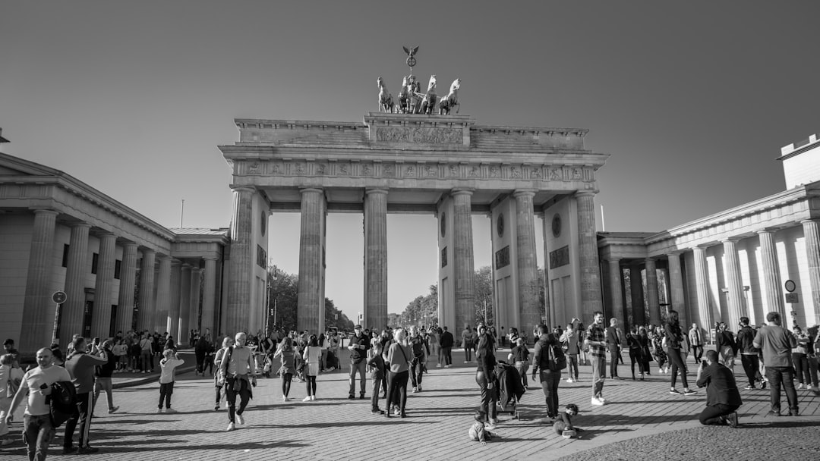
A Glimpse into German History and Identity
Brief historical timeline: Holy Roman Empire to reunification
Regional diversity: Bavaria, Prussia, Hanseatic cities
Influence of major historical events
The concept of 'Heimat' and national identity
Photo: Michal Hajtas on Unsplash
Notes:
German history is incredibly rich and complex. We'll quickly trace its path from the Holy Roman Empire to modern reunification, highlighting how this history shaped its diverse regional identities. Understanding 'Heimat' – a deep sense of home and belonging – is crucial to grasping German national identity.
Image credit: Michal Hajtas | Profile: https://unsplash.com/@michalhajtas?utm_source=ai_presentation_generator&utm_medium=referral | Photo: https://unsplash.com/photos/a-large-group-of-people-walking-in-front-of-brandenburg-gate-with-columns-PyM0NZTyYp4?utm_source=ai_presentation_generator&utm_medium=referral

Slide 4
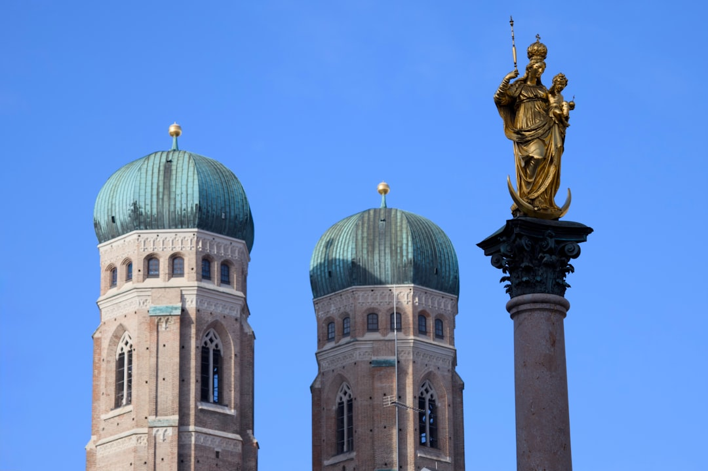
Daily Life, Values, and Social Etiquette
Punctuality and efficiency in daily life
Importance of order and rules
Direct communication style
Social customs and greetings
Photo: Dima on Unsplash
Notes:
German daily life is often characterized by punctuality and efficiency. We'll discuss the importance of order and rules, and how a direct communication style is often preferred. We'll also cover basic social customs and appropriate greetings for various situations.
Image credit: Dima | Profile: https://unsplash.com/@dsk1306?utm_source=ai_presentation_generator&utm_medium=referral | Photo: https://unsplash.com/photos/two-church-towers-and-a-golden-statue-on-column-cnYaZXulOgs?utm_source=ai_presentation_generator&utm_medium=referral

Slide 5
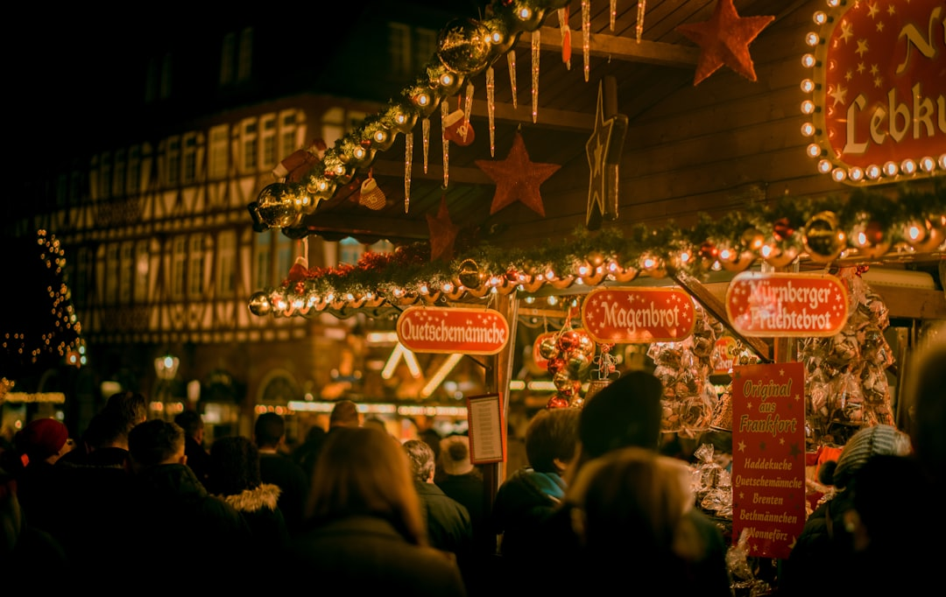
Festivals, Traditions, and Celebrations
Major national holidays: Unity Day, Christmas
Regional festivals: Oktoberfest, Karneval
Traditional crafts and folk customs
The role of clubs and associations in community life
Photo: cmophoto.net on Unsplash
Notes:
Germany boasts a vibrant calendar of festivals and traditions. Beyond national holidays like Unity Day, we'll explore famous regional celebrations like Oktoberfest and Karneval. We'll also touch upon traditional crafts and the significant role of community clubs and associations.
Image credit: cmophoto.net | Profile: https://unsplash.com/@cmophoto?utm_source=ai_presentation_generator&utm_medium=referral | Photo: https://unsplash.com/photos/group-of-people-near-the-store-photography-xUg7Wn6bh4I?utm_source=ai_presentation_generator&utm_medium=referral

Slide 6
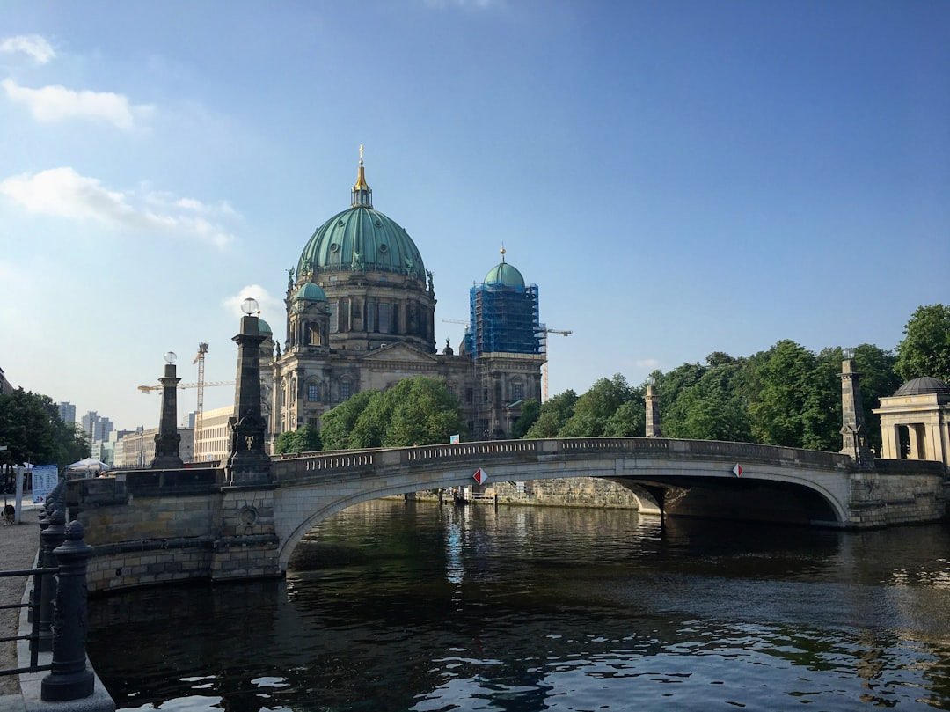
German Contributions to Arts, Philosophy, and Science
Literary giants: Goethe, Schiller, the Brothers Grimm
Musical heritage: Bach, Beethoven, Wagner
Philosophical thought: Kant, Hegel, Nietzsche
Scientific and engineering innovations
Photo: Nodir Khalilov on Unsplash
Notes:
Germany has made monumental contributions across arts, philosophy, and science. We'll highlight literary giants, the enduring legacy of classical composers, and the profound impact of German philosophers. We'll also briefly acknowledge Germany's history of scientific and engineering innovation.
Image credit: Nodir Khalilov | Profile: https://unsplash.com/@nodirkh?utm_source=ai_presentation_generator&utm_medium=referral | Photo: https://unsplash.com/photos/a-bridge-over-a-river-with-a-building-in-the-background-_liJLYth19g?utm_source=ai_presentation_generator&utm_medium=referral

Slide 7
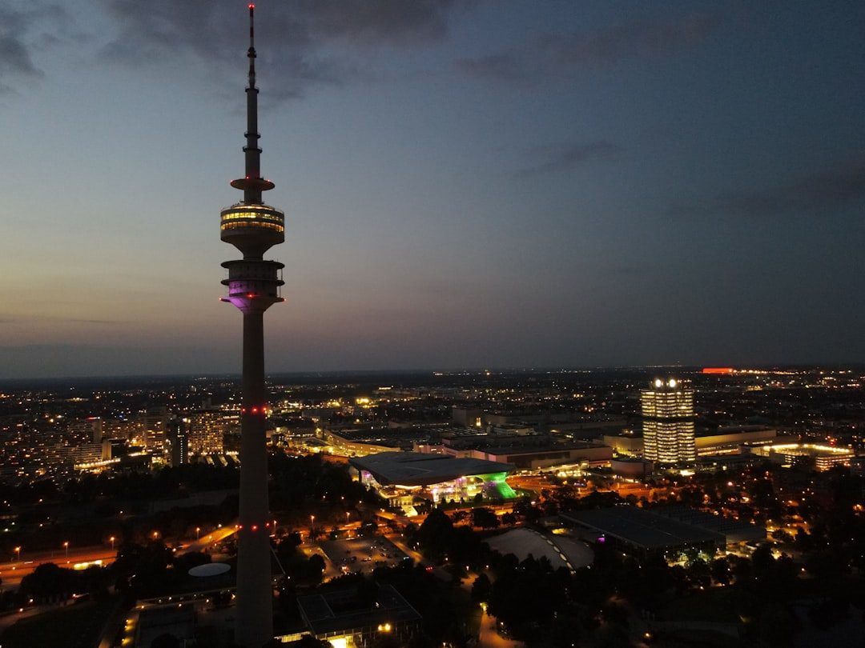
Modern Germany: Innovation, Sustainability, and Global Role
Economic powerhouse and industrial leadership
Commitment to environmental sustainability
Multicultural society and integration
Germany's role in the European Union and global affairs
Photo: Heliao on Unsplash
Notes:
Finally, let's look at modern Germany. It's an economic powerhouse known for its industrial leadership and strong commitment to environmental sustainability. We'll discuss its evolving multicultural society and its significant role within the European Union and on the global stage.
Image credit: Heliao | Profile: https://unsplash.com/@heliao?utm_source=ai_presentation_generator&utm_medium=referral | Photo: https://unsplash.com/photos/city-skyline-with-a-tall-tower-at-dusk-Wlf0n_81J1U?utm_source=ai_presentation_generator&utm_medium=referral

Slide 8
Thank You
Thank you for joining this exploration of German culture. May it inspire further discovery!

