Slide 1
Nigeria: The Giant of Africa
An educational journey exploring the rich history, diverse culture, and dynamic future of West Africa's most populous nation.
Ikponmwosa

Slide 2

Introduction to Nigeria
Located in West Africa, bordering the Atlantic Ocean
Africa's most populous nation, over 200 million people
Diverse landscapes: coasts, savannahs, forests
Home to a vibrant and youthful population
Photo: Salem Ochidi on Unsplash
Notes:
Begin by establishing Nigeria's geographical context and its significance as the most populous country in Africa. Highlight its diverse natural beauty and large, young population.
Image credit: Salem Ochidi | Profile: https://unsplash.com/@salemochidi?utm_source=ai_presentation_generator&utm_medium=referral | Photo: https://unsplash.com/photos/people-gathering-in-a-field-with-flags-during-daytime-nmLJAvTfanU?utm_source=ai_presentation_generator&utm_medium=referral

Slide 3
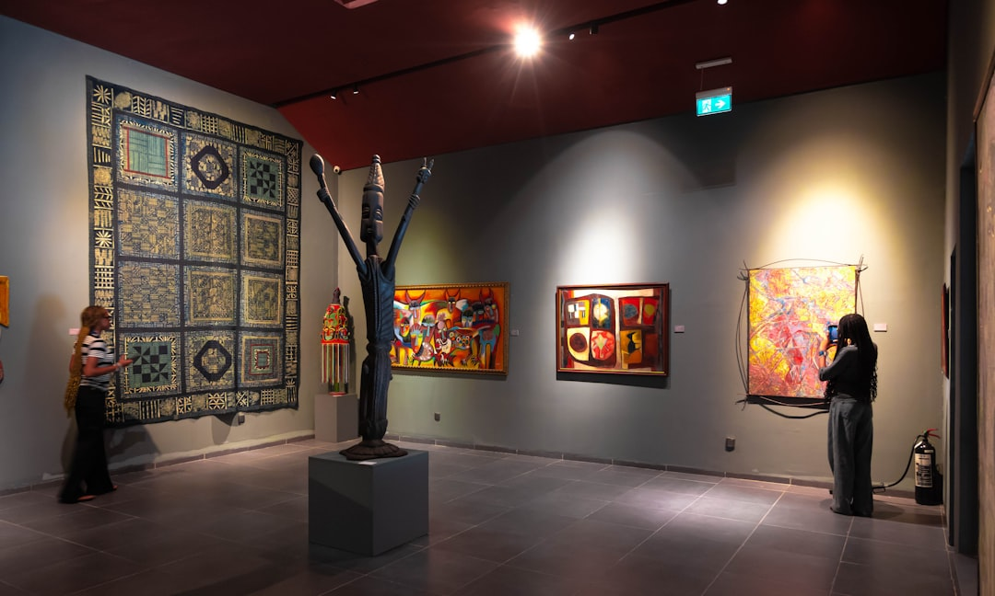
A Rich Historical Tapestry
Ancient civilizations: Nok, Igbo-Ukwu, Benin, Oyo
Thriving pre-colonial kingdoms and trade networks
British colonial rule and amalgamation in 1914
Gained independence on October 1, 1960
Photo: Blessfield John on Unsplash
Notes:
Delve into Nigeria's extensive history, from its powerful ancient kingdoms to the impact of British colonialism and the eventual achievement of independence.
Image credit: Blessfield John | Profile: https://unsplash.com/@blessfield?utm_source=ai_presentation_generator&utm_medium=referral | Photo: https://unsplash.com/photos/people-viewing-art-in-a-modern-gallery-exhibition-NUFdnD2YP8U?utm_source=ai_presentation_generator&utm_medium=referral

Slide 4
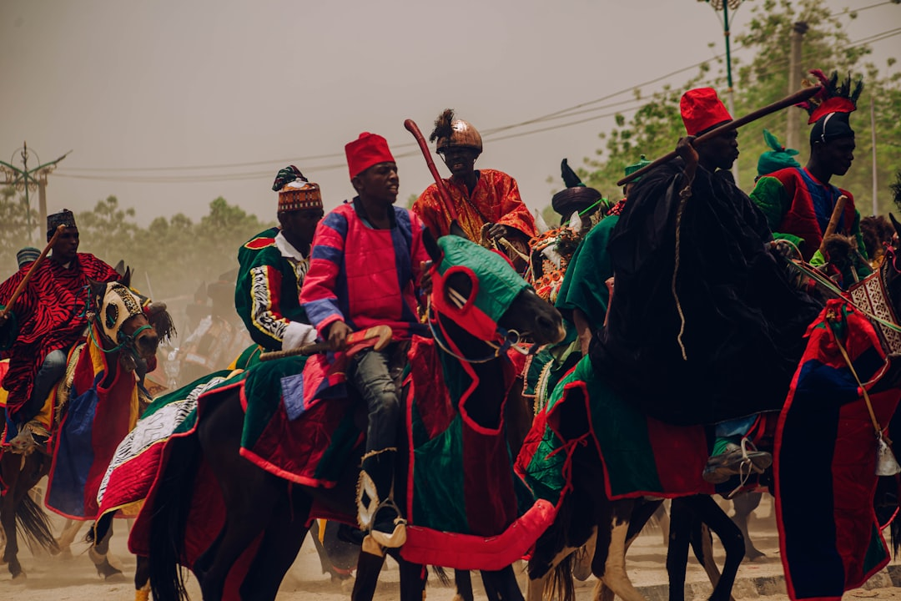
Cultural Diversity and Vibrancy
Over 250 ethnic groups, each with unique traditions
Hundreds of languages spoken, with English as official
Renowned for vibrant arts, music, and literature
Celebrated festivals showcase rich heritage
Photo: Ahmad Jaafar on Unsplash
Notes:
Explore the incredible cultural diversity that defines Nigeria, highlighting its numerous ethnic groups, languages, and world-renowned contributions to arts and culture.
Image credit: Ahmad Jaafar | Profile: https://unsplash.com/@ajidox?utm_source=ai_presentation_generator&utm_medium=referral | Photo: https://unsplash.com/photos/a-group-of-men-riding-on-the-backs-of-horses-toQTkWFvWyo?utm_source=ai_presentation_generator&utm_medium=referral

Slide 5
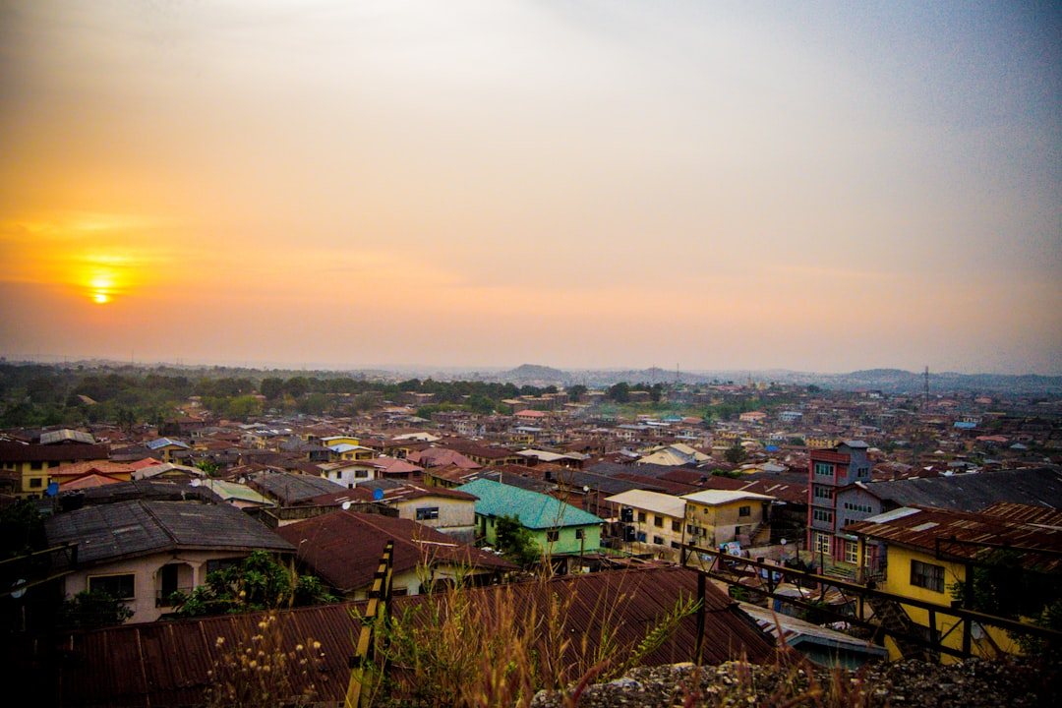
Economic Landscape and Resources
Africa's largest economy and leading oil producer
Strong agricultural sector: cocoa, palm oil, rubber
Growing tech and creative industries (Nollywood)
Massive domestic market with significant potential
Photo: sheyi owolabi on Unsplash
Notes:
Discuss Nigeria's economic profile, emphasizing its status as a major oil producer and Africa's largest economy. Touch on the importance of agriculture and emerging sectors like tech and entertainment.
Image credit: sheyi owolabi | Profile: https://unsplash.com/@sheystics?utm_source=ai_presentation_generator&utm_medium=referral | Photo: https://unsplash.com/photos/aerial-photography-of-houses--lNX9k3e1F8?utm_source=ai_presentation_generator&utm_medium=referral

Slide 6
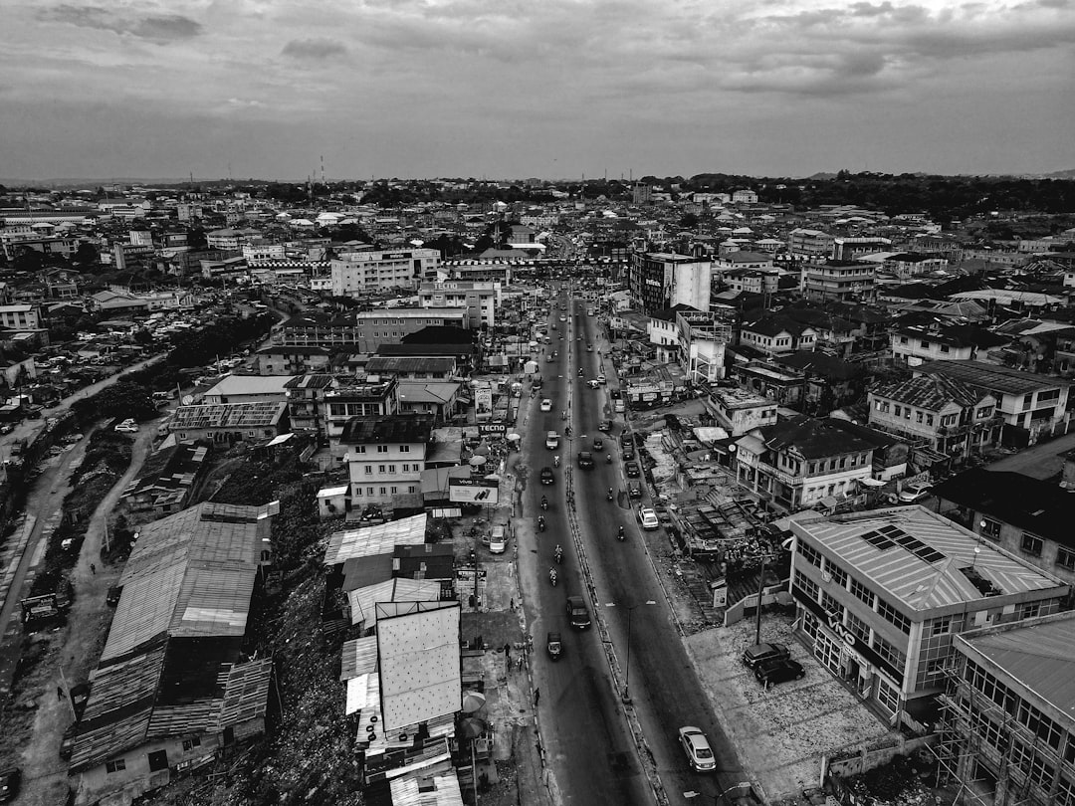
Key Challenges and Opportunities
Addressing infrastructure and development gaps
Strengthening governance and institutional reforms
Tackling youth unemployment and education access
Harnessing its vast human and natural resources
Photo: Godson leonard on Unsplash
Notes:
Present a balanced view by outlining the significant challenges Nigeria faces, such as development disparities and governance, alongside the immense opportunities for growth and innovation.
Image credit: Godson leonard | Profile: https://unsplash.com/@fondspace_?utm_source=ai_presentation_generator&utm_medium=referral | Photo: https://unsplash.com/photos/an-aerial-view-of-a-city-b_uWZ0Bo-7Q?utm_source=ai_presentation_generator&utm_medium=referral

Slide 7

Nigeria's Global Influence and Future
Regional leader in West African diplomacy (ECOWAS)
Active participant in UN and other global bodies
Significant diaspora contributions worldwide
A future with immense potential and continued growth
Photo: Tope. A Asokere on Unsplash
Notes:
Conclude by highlighting Nigeria's pivotal role on the African continent and its growing influence in global affairs. Emphasize its future potential and continued trajectory.
Image credit: Tope. A Asokere | Profile: https://unsplash.com/@topeasokere?utm_source=ai_presentation_generator&utm_medium=referral | Photo: https://unsplash.com/photos/a-large-group-of-people-walking-on-a-street-8eshj7cKRys?utm_source=ai_presentation_generator&utm_medium=referral

Slide 8
Thank You
Thank you for joining us on this journey into Nigeria, a nation of unparalleled resilience, diversity, and promise.

