Slide 1
Strategic AI Integration: Unlocking Future Business Value
Explore how artificial intelligence can drive innovation, efficiency, and competitive advantage for your organization.

Slide 2

The AI Imperative: Reshaping Business Landscapes
Defining AI: Beyond the Hype
Why AI is Critical for Modern Business
Current State of AI Adoption and Impact
Photo: Taiki Ishikawa on Unsplash
Notes:
Good morning, everyone. Today, we'll demystify AI and focus on its practical applications for our business. We'll start by establishing a clear understanding of what AI truly is and why it's no longer optional for competitive businesses, but a strategic imperative. We'll also briefly touch on the current landscape of AI adoption.
Image credit: Taiki Ishikawa | Profile: https://unsplash.com/@fl__q?utm_source=ai_presentation_generator&utm_medium=referral | Photo: https://unsplash.com/photos/a-robot-that-is-standing-in-the-air-PecQftb1ubg?utm_source=ai_presentation_generator&utm_medium=referral

Slide 3

Core AI Technologies Driving Innovation
Machine Learning: Predictive Analytics and Automation
Natural Language Processing: Enhancing Communication
Computer Vision: Intelligent Data Extraction
Robotics & Intelligent Automation: Streamlining Operations
Photo: Fabio Henning on Unsplash
Notes:
Let's dive into the foundational technologies that power AI. We'll look at Machine Learning for data-driven predictions, NLP for understanding and generating human language, Computer Vision for interpreting visual data, and Intelligent Automation for process efficiency. Each offers unique opportunities for business transformation.
Image credit: Fabio Henning | Profile: https://unsplash.com/@fabz97?utm_source=ai_presentation_generator&utm_medium=referral | Photo: https://unsplash.com/photos/a-person-wearing-glasses-cPefgflphT4?utm_source=ai_presentation_generator&utm_medium=referral

Slide 4

Strategic Applications: AI Across Business Functions
Customer Experience: Personalization and Support
Operational Efficiency: Supply Chain and Process Optimization
Product Development: Innovation and Market Insights
Risk Management: Fraud Detection and Compliance
Photo: Point Normal on Unsplash
Notes:
Now, let's connect these technologies to tangible business benefits. We'll explore how AI enhances customer interactions, optimizes our internal operations, fuels new product development, and strengthens our risk management frameworks. These are not theoretical applications, but proven strategies in leading organizations.
Image credit: Point Normal | Profile: https://unsplash.com/@normals?utm_source=ai_presentation_generator&utm_medium=referral | Photo: https://unsplash.com/photos/white-king-stands-surrounded-by-black-pawns-ySqelMEEYx0?utm_source=ai_presentation_generator&utm_medium=referral

Slide 5

Quantifying Success: Measuring AI's Tangible ROI
Enhanced Decision-Making through Data Insights
Significant Cost Reduction and Operational Savings
Accelerated Revenue Growth and New Market Opportunities
Sustainable Competitive Advantage in a Dynamic Market
Photo: Laurenz Kleinheider on Unsplash
Notes:
It's crucial to understand the return on investment. AI isn't just about innovation; it's about measurable business outcomes. We'll discuss how AI leads to smarter decisions, reduces operational costs, unlocks new revenue streams, and ultimately provides a significant competitive edge.
Image credit: Laurenz Kleinheider | Profile: https://unsplash.com/@laurlenz?utm_source=ai_presentation_generator&utm_medium=referral | Photo: https://unsplash.com/photos/shallow-focus-photography-of-coin-operated-mono-scope-under-cloudy-sky-K40awqK-hTI?utm_source=ai_presentation_generator&utm_medium=referral

Slide 6

Navigating the AI Journey: Challenges and Best Practices
Addressing Data Quality and Governance
Cultivating an AI-Ready Culture and Talent Pool
Ethical AI: Ensuring Responsible Implementation
Scalability and Integration into Existing Systems
Photo: Omar:. Lopez-Rincon on Unsplash
Notes:
Implementing AI isn't without its challenges, but they are surmountable with proper planning. We'll cover key considerations like data quality, building the right team, ethical implications, and how to effectively integrate AI into our current infrastructure to ensure successful, sustainable adoption.
Image credit: Omar:. Lopez-Rincon | Profile: https://unsplash.com/@procopiopi?utm_source=ai_presentation_generator&utm_medium=referral | Photo: https://unsplash.com/photos/ai-brain-inside-a-lightbulb-illustrates-an-idea-zips8ILZd04?utm_source=ai_presentation_generator&utm_medium=referral

Slide 7
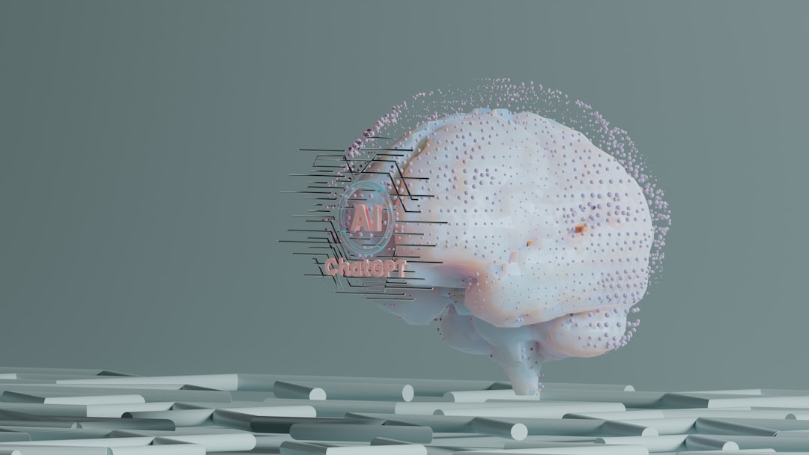
The Road Ahead: Strategic AI Integration for Future Growth
Identifying Key Areas for Pilot Programs
Developing a Phased Implementation Roadmap
Continuous Learning and Adaptation
Fostering an Innovation Ecosystem
Photo: Growtika on Unsplash
Notes:
Looking forward, our focus should be on strategic integration. We need to identify high-impact pilot projects, create a clear roadmap, and embrace a culture of continuous learning to adapt to evolving AI capabilities. This proactive approach will ensure long-term growth and sustained innovation.
Image credit: Growtika | Profile: https://unsplash.com/@growtika?utm_source=ai_presentation_generator&utm_medium=referral | Photo: https://unsplash.com/photos/a-computer-generated-image-of-a-human-brain-3wXVwtdaESA?utm_source=ai_presentation_generator&utm_medium=referral

Slide 8
Thank You
Thank you for your time and attention. Let's harness the power of AI to build a more intelligent and prosperous future for our business.

