Slide 1
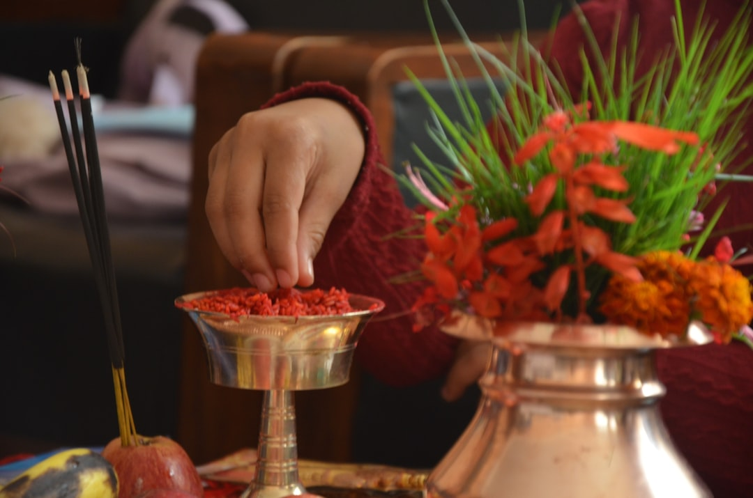
Unveiling Nepal's Cultural Tapestry: A Journey Through Tradition and Diversity
Explore the rich heritage, vibrant customs, and profound spirituality that define the cultural landscape of Nepal.
Oween Aditya Ajayi
Photo: Sujan Shahi on Unsplash

Slide 2
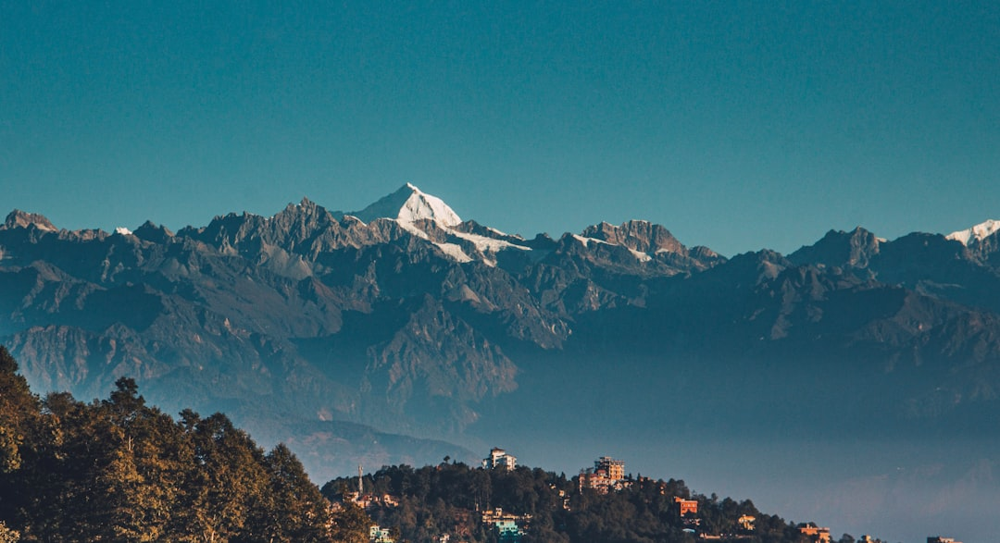
Introduction to Nepal: Land of Mountains and Diversity
Geographical crossroads between India and Tibet
Home to over 125 ethnic groups and languages
Rich history spanning ancient kingdoms to a modern republic
Unique blend of South Asian and Central Asian influences
Photo: Aaron Santelices on Unsplash
Notes:
Begin by setting the scene for Nepal, highlighting its unique geographical position and the incredible diversity it fosters. Emphasize that this diversity is the bedrock of its culture. Briefly touch upon its historical depth.
Image credit: Aaron Santelices | Profile: https://unsplash.com/@aaron_santelices?utm_source=ai_presentation_generator&utm_medium=referral | Photo: https://unsplash.com/photos/a-view-of-a-mountain-range-in-the-distance-7GICujbHhb8?utm_source=ai_presentation_generator&utm_medium=referral

Slide 3
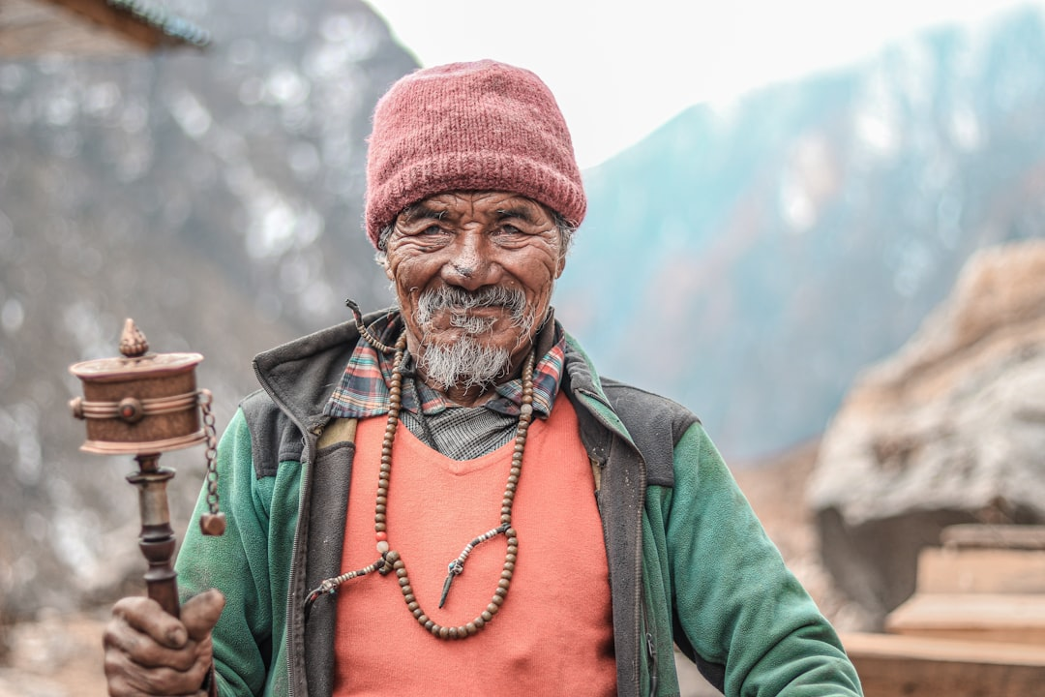
Ethnic Mosaic and Linguistic Richness
Key ethnic groups: Newar, Gurung, Sherpa, Magar, Tharu, Rai, Limbu
Over 123 languages spoken, Nepali as the official language
Each group contributes distinct traditions, dress, and festivals
Caste system's historical influence and modern societal changes
Photo: Samrat Khadka on Unsplash
Notes:
Dive into the specifics of Nepal's ethnic composition. Discuss a few prominent groups and how their unique identities contribute to the national culture. Explain the linguistic diversity and the role of Nepali as the unifying language. Briefly mention the historical caste system and its evolving role.
Image credit: Samrat Khadka | Profile: https://unsplash.com/@samrat_khadka?utm_source=ai_presentation_generator&utm_medium=referral | Photo: https://unsplash.com/photos/a-man-holding-a-hammer-SUIDCH1Sees?utm_source=ai_presentation_generator&utm_medium=referral

Slide 4
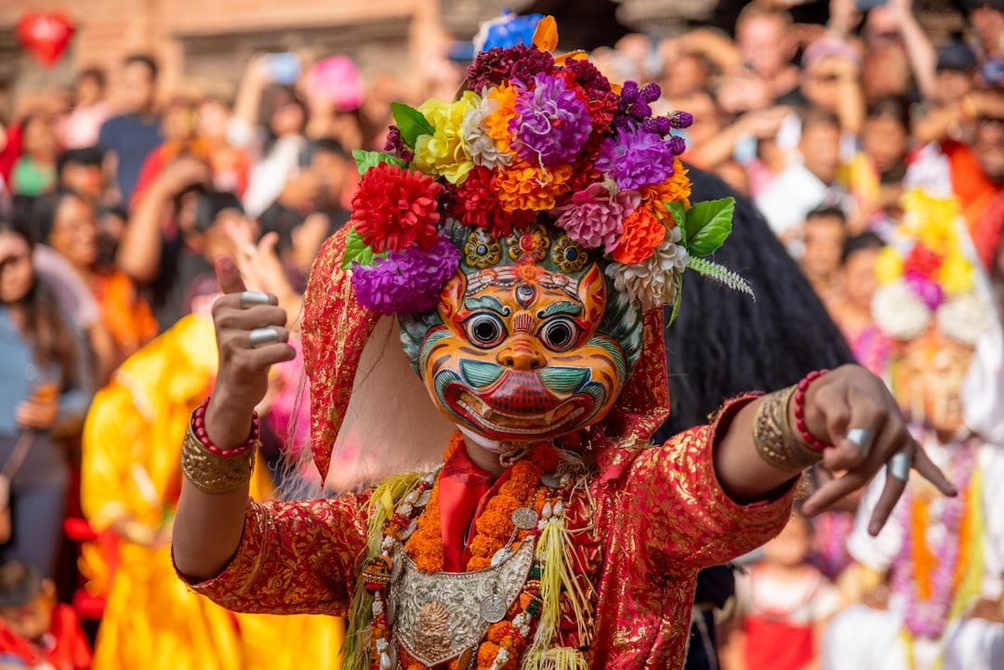
Vibrant Festivals and Rituals
Dashain: The longest and most auspicious Hindu festival
Tihar (Deepawali): Festival of Lights and reverence for animals
Indra Jatra: Celebrated in Kathmandu, honoring the rain god Indra
Buddha Jayanti: Commemorating the birth of Lord Buddha
Photo: Shreyashka Maharjan on Unsplash
Notes:
Highlight the celebratory aspect of Nepalese culture through its major festivals. Explain the significance of Dashain and Tihar, offering insights into their rituals and social importance. Briefly mention other key festivals like Indra Jatra and Buddha Jayanti, showcasing religious harmony.
Image credit: Shreyashka Maharjan | Profile: https://unsplash.com/@shreyashka?utm_source=ai_presentation_generator&utm_medium=referral | Photo: https://unsplash.com/photos/a-person-dressed-in-a-colorful-costume-and-holding-a-pair-of-scissors-MUV6EWtkYeo?utm_source=ai_presentation_generator&utm_medium=referral

Slide 5
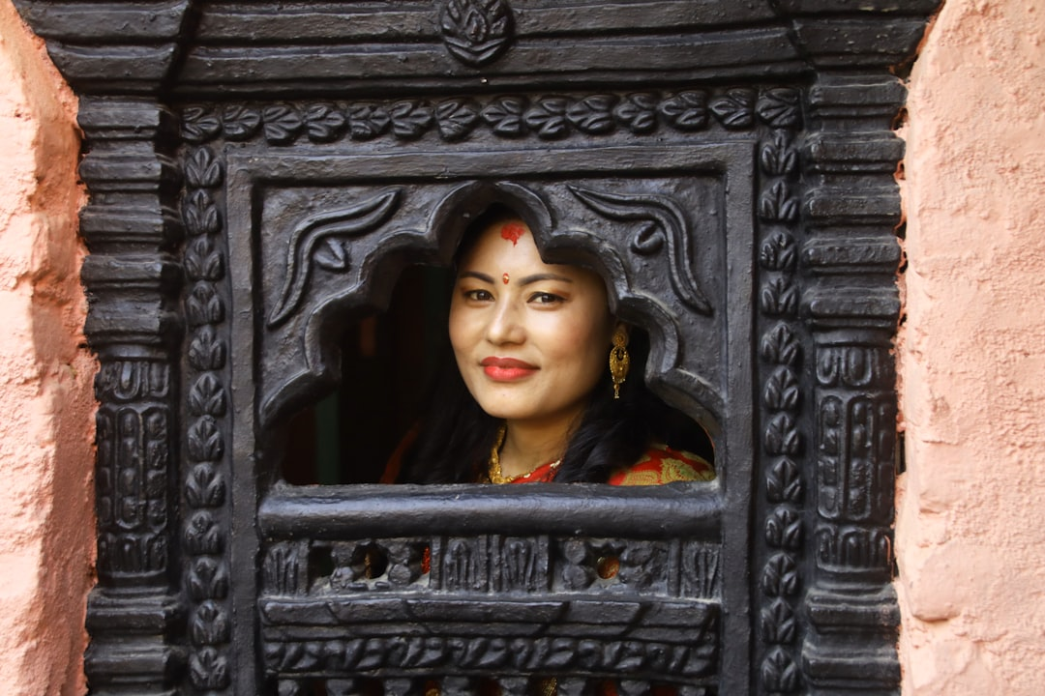
Art, Architecture, and Music Heritage
Pagoda-style temples and stupas: Iconic architectural marvels
Thangka paintings: Intricate Buddhist devotional art
Traditional music: Folk songs, instruments like Sarangi and Madal
Intricate wood carvings and metal craftsmanship
Photo: BLOG REGION on Unsplash
Notes:
Shift focus to the artistic and architectural contributions. Describe the unique pagoda style and its prevalence. Explain Thangka paintings' spiritual significance. Introduce traditional musical instruments and their role in Nepalese folk music. Mention the detailed craftsmanship visible in daily life and religious structures.
Image credit: BLOG REGION | Profile: https://unsplash.com/@blog_region?utm_source=ai_presentation_generator&utm_medium=referral | Photo: https://unsplash.com/photos/a-woman-peeks-through-a-carved-wooden-window-ZDBb_YxpqLo?utm_source=ai_presentation_generator&utm_medium=referral

Slide 6
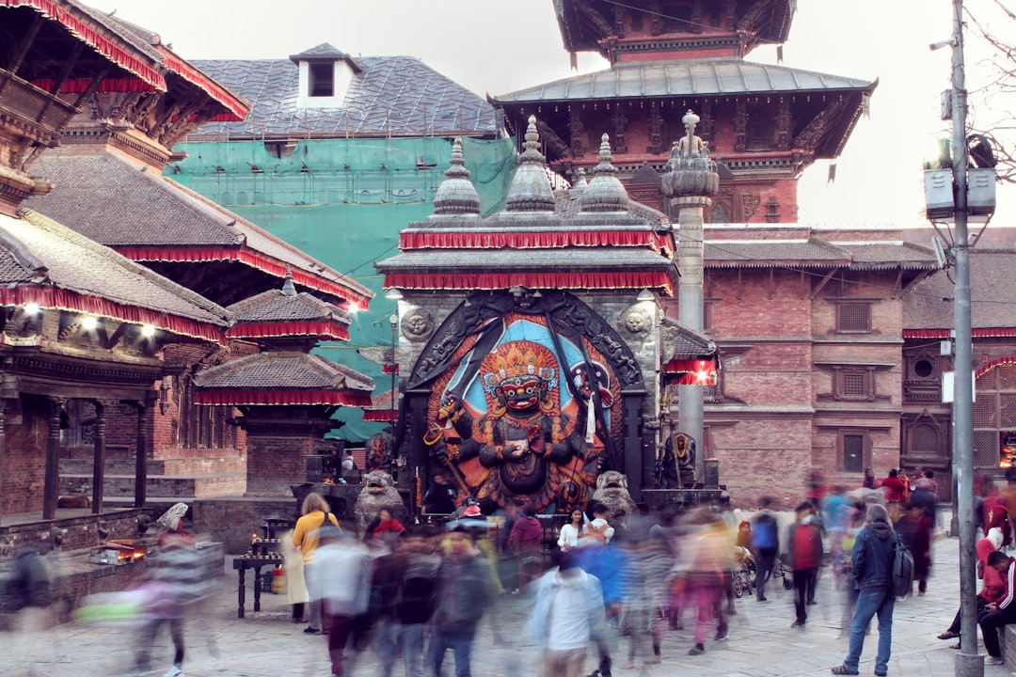
Cuisine and Daily Life Traditions
Dal Bhat: The staple meal, embodying Nepalese hospitality
Momo: Popular dumplings reflecting Tibetan influence
Emphasis on fresh, local ingredients and seasonal produce
Strong family bonds and community-oriented lifestyle
Photo: Stan Tuladhar on Unsplash
Notes:
Explore the culinary landscape, starting with Dal Bhat as the national dish and its cultural importance. Introduce Momo as an example of cross-cultural influence. Discuss the simplicity and freshness of Nepalese cuisine. Touch upon the social structure, emphasizing the importance of family and community.
Image credit: Stan Tuladhar | Profile: https://unsplash.com/@stan_dgafos_tuladhar?utm_source=ai_presentation_generator&utm_medium=referral | Photo: https://unsplash.com/photos/a-crowd-of-people-walking-down-a-street-next-to-tall-buildings-yqvdjUpEb2M?utm_source=ai_presentation_generator&utm_medium=referral

Slide 7
Spiritual Harmony and Sacred Spaces
Hinduism and Buddhism: Coexisting and often intertwined
Pashupatinath Temple: Sacred Hindu pilgrimage site
Boudhanath Stupa and Swayambhunath: Prominent Buddhist landmarks
Respect for nature and ancient animistic beliefs
Notes:
Conclude by focusing on the spiritual core of Nepal. Explain the unique harmony between Hinduism and Buddhism. Describe major pilgrimage sites for both religions, illustrating their architectural beauty and spiritual significance. Briefly mention the deep-rooted respect for nature and older animistic traditions.

Slide 8
Thank You
Thank you for joining this exploration of Nepal's captivating culture; may its enduring spirit inspire us all.

