Slide 1
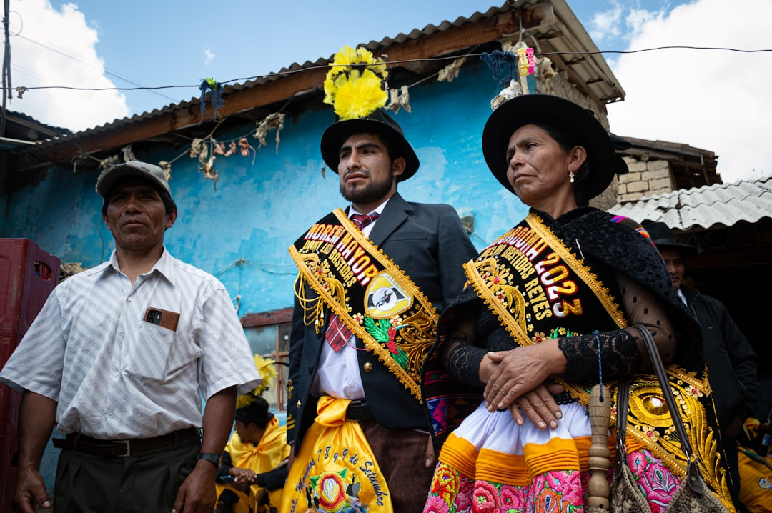
Unlocking Peruvian Culture: A Strategic Overview for Business Engagement
Exploring the rich heritage and contemporary dynamics of Peru to inform successful stakeholder interactions and foster strong partnerships.
Photo: Jhan Castillón on Unsplash

Slide 2
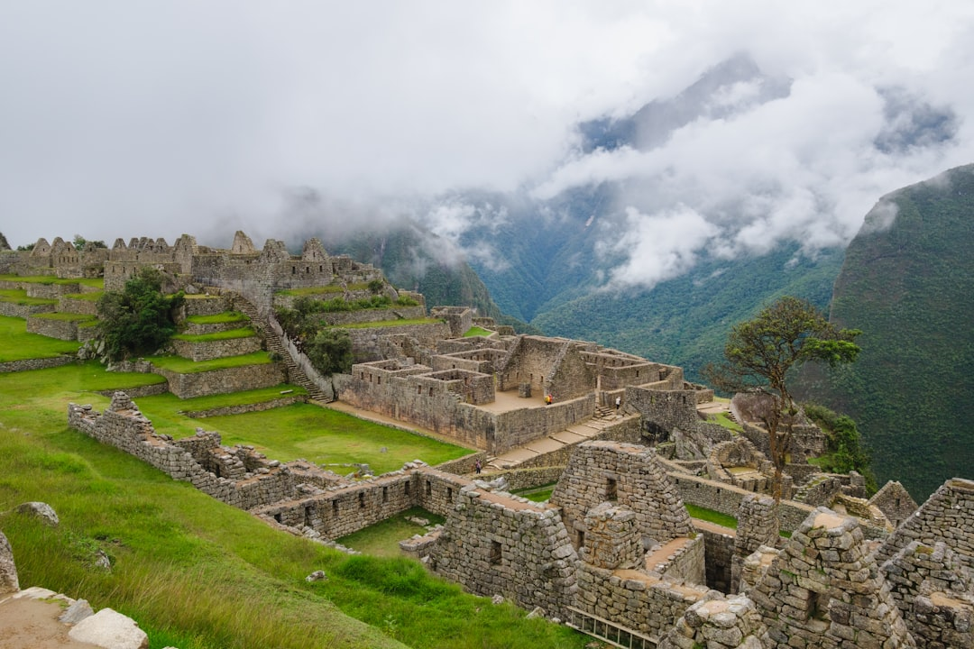
Introduction: The Rich Tapestry of Peru
Peru: A nation of profound historical depth and vibrant cultural diversity.
A blend of indigenous traditions, colonial influences, and modern expressions.
Understanding culture is key to effective communication and successful partnerships.
This presentation offers insights for strategic business engagement.
Photo: Vlad D on Unsplash
Notes:
Welcome everyone. Today, we'll delve into the fascinating culture of Peru. My aim is to provide you with a strategic overview, highlighting aspects crucial for our business interactions. Peru's culture is a dynamic blend, and appreciating its nuances is fundamental to building trust and achieving our objectives.
Image credit: Vlad D | Profile: https://unsplash.com/@hiking_corgi?utm_source=ai_presentation_generator&utm_medium=referral | Photo: https://unsplash.com/photos/a-view-of-the-ruins-of-a-mountain-town-IZ0eBgtB2I8?utm_source=ai_presentation_generator&utm_medium=referral

Slide 3
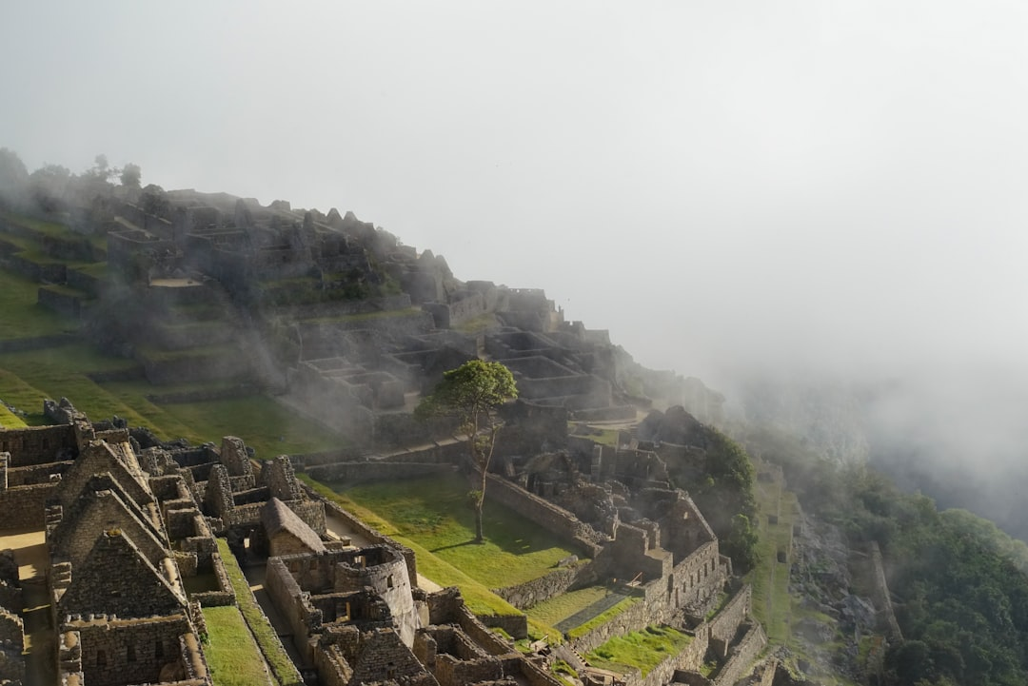
Historical Foundations: Inca Legacy and Colonial Influence
The enduring legacy of the Inca Empire: Advanced civilization, sophisticated social structures.
Spanish conquest and subsequent colonial rule introduced new language, religion, and governance.
Syncretism: A unique fusion of indigenous beliefs and Spanish traditions.
These historical layers deeply shape modern Peruvian identity and values.
Photo: Federico Scarionati on Unsplash
Notes:
To truly grasp Peruvian culture, we must look to its past. The Inca Empire laid a formidable foundation, known for its innovation and organization. The arrival of the Spanish, while transformative, didn't erase these roots. Instead, it led to a fascinating cultural synthesis that continues to define Peru today.
Image credit: Federico Scarionati | Profile: https://unsplash.com/@federicoscarionati?utm_source=ai_presentation_generator&utm_medium=referral | Photo: https://unsplash.com/photos/green-grass-field-and-trees-covered-with-fog-BKWXBGl3zis?utm_source=ai_presentation_generator&utm_medium=referral

Slide 4
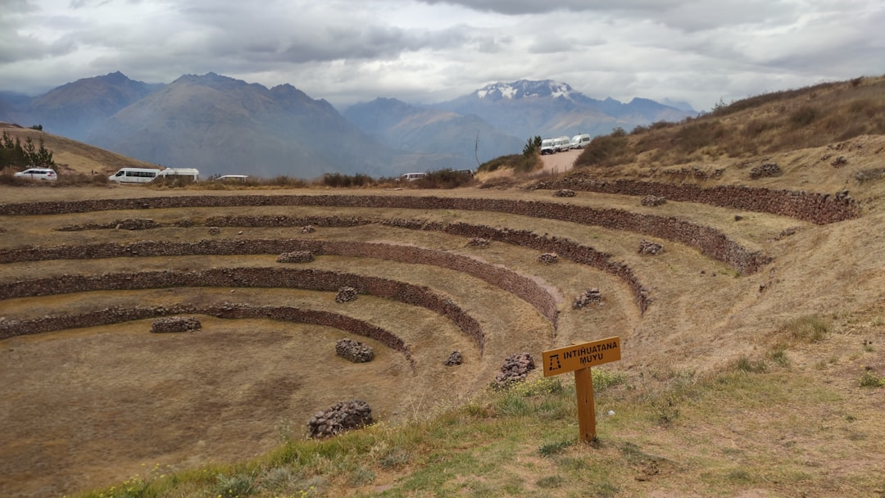
Geographic Diversity and Regional Cultures
Three distinct geographical regions: Coast, Andes, and Amazon.
Coastal culture: Influenced by Lima, more cosmopolitan and outward-looking.
Andean culture: Strong indigenous heritage, community-focused, rich in traditional arts.
Amazonian culture: Unique biodiversity, distinct tribal traditions, strong connection to nature.
Photo: Andrea Pasquali on Unsplash
Notes:
Peru is a land of incredible geographical variety, and this diversity is mirrored in its regional cultures. From the bustling Pacific coast to the majestic Andes and the biodiverse Amazon, each area boasts unique customs, dialects, and ways of life. Recognizing these regional differences is vital for tailored engagement.
Image credit: Andrea Pasquali | Profile: https://unsplash.com/@andreapasquali97?utm_source=ai_presentation_generator&utm_medium=referral | Photo: https://unsplash.com/photos/ancient-circular-terraces-on-a-hillside-with-mountains-YBonREQYUUo?utm_source=ai_presentation_generator&utm_medium=referral

Slide 5
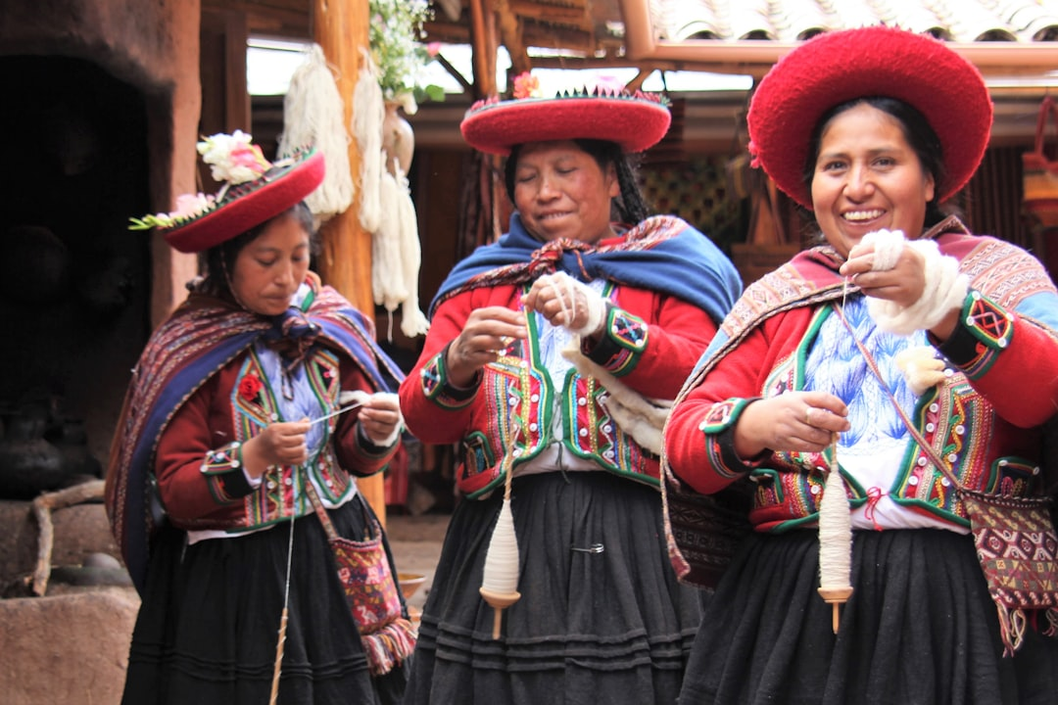
Core Cultural Values: Family, Community, and Respect
Family (La Familia) as the central pillar of society and personal identity.
Strong emphasis on community (Ayni/Minga) and collective well-being.
Respect (Respeto) for elders, authority, and social hierarchy.
Importance of personal relationships and building trust over time.
Photo: Deb Dowd on Unsplash
Notes:
At the heart of Peruvian culture are foundational values that permeate all aspects of life. Family is paramount, extending beyond the nuclear unit. Community solidarity, often seen in concepts like 'Ayni,' is deeply ingrained. Respect for hierarchy and personal connections are also crucial, often taking precedence in interactions.
Image credit: Deb Dowd | Profile: https://unsplash.com/@fin777?utm_source=ai_presentation_generator&utm_medium=referral | Photo: https://unsplash.com/photos/woman-in-blue-and-red-dress-wearing-red-and-white-hat-JU04xdXUTV4?utm_source=ai_presentation_generator&utm_medium=referral

Slide 6
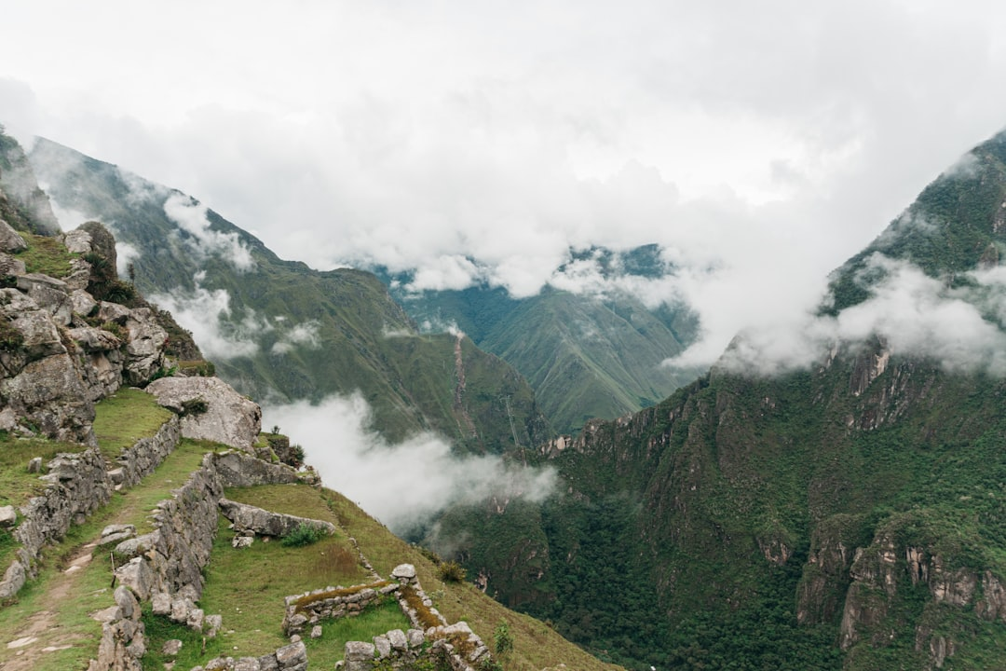
Business Etiquette and Communication Styles
Prioritize building rapport and personal trust before discussing business specifics.
Communication is often indirect; pay attention to non-verbal cues and context.
Patience is key in negotiations and decision-making processes.
Formality and respect for titles are generally appreciated in initial meetings.
Photo: Ze Paulo Galveias on Unsplash
Notes:
Translating cultural understanding into effective business practices is essential. In Peru, establishing a personal connection is often more important than immediate transaction. Be prepared for a more indirect communication style and understand that decisions may take time. Politeness and formality go a long way in demonstrating respect.
Image credit: Ze Paulo Galveias | Profile: https://unsplash.com/@euzepaulo?utm_source=ai_presentation_generator&utm_medium=referral | Photo: https://unsplash.com/photos/green-and-gray-mountains-under-white-clouds-during-daytime-oNXpSX-T6_k?utm_source=ai_presentation_generator&utm_medium=referral

Slide 7
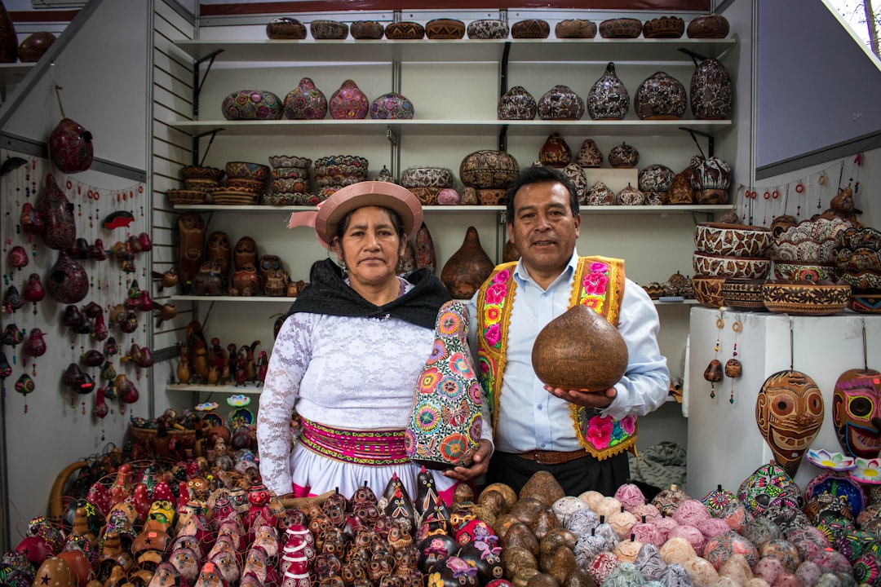
Leveraging Cultural Understanding for Success
Foster long-term relationships based on mutual respect and understanding.
Adapt communication strategies to local preferences and regional nuances.
Demonstrate genuine interest in Peruvian culture and its people.
Embrace flexibility and patience in all business dealings.
Photo: Diego Nuñez Berrospi on Unsplash
Notes:
To truly succeed in Peru, we must move beyond mere transactional interactions. By investing in relationships, adapting our approaches, and showing genuine appreciation for their culture, we can build strong, lasting partnerships. Flexibility and patience will be our greatest assets.
Image credit: Diego Nuñez Berrospi | Profile: https://unsplash.com/@diegonb?utm_source=ai_presentation_generator&utm_medium=referral | Photo: https://unsplash.com/photos/woman-in-white-and-black-long-sleeve-shirt-wearing-brown-hat-BwZHYqLF6Sk?utm_source=ai_presentation_generator&utm_medium=referral

Slide 8
Thank You
Thank you for your attention; we look forward to a future of fruitful collaboration in Peru.

