Slide 1
Fake News Detection Project
Using TF-IDF & Logistic Regression
Done By : Under the guidence of:
•N.Vinay-(B200849) • Sravanthi madam (Dept.of ECE)
•J.Ajay Kumar(B200892)
•M.Jeevan-(B201033)

Slide 2
Problem Statement
Manual classification of news headlines into topics (such as politics,
sports, technology, or entertainment) is not scalable when dealingwith thousands of articles published daily. The goal of this project isto develop an automated system that
• Accurately assigns a category label to each headline.
• Processes new, unseen headlines quickly and reliably.
• Provides a clear and reproducible methodology that can beextended to other classification tasks.
•Achieving these objectives can save time, reduce human error, andsupport downstream applications like personalized news feeds or content recommendation engines.

Slide 3
Project Overview
Pipeline:
Load & inspect dataset
Data cleaning & preprocessing
TF-IDF feature extraction
Train/Test split
Logistic Regression modeling
Evaluate & predict

Slide 4
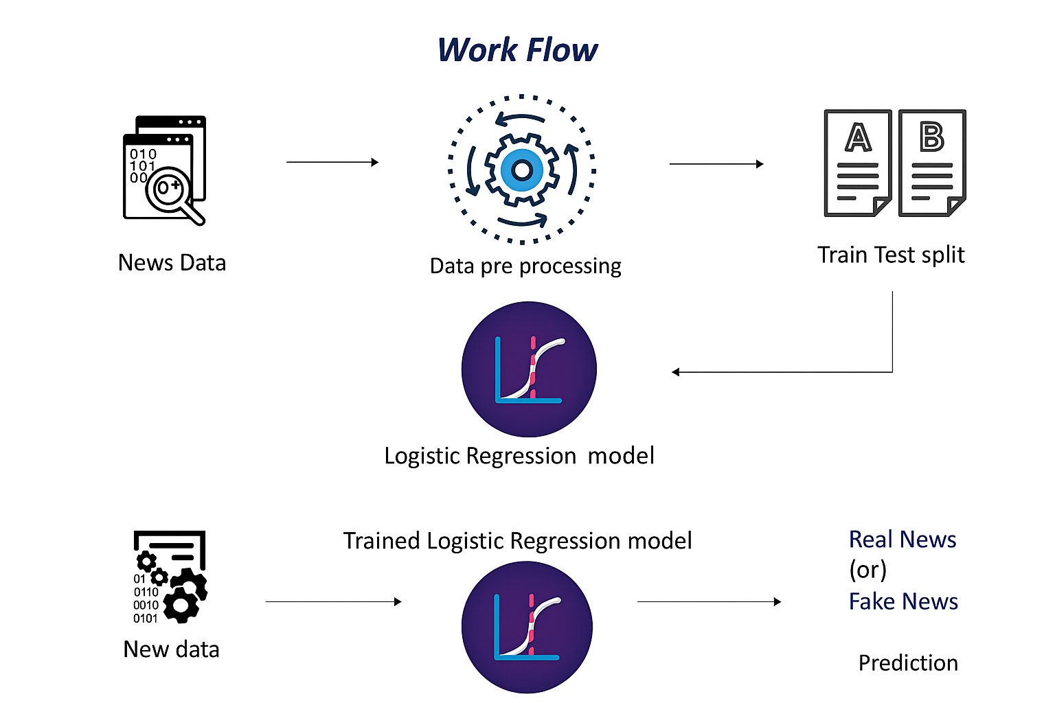
WORKFLOW

Slide 5
Dataset Description
Key points:
20,800 news articles (real & fake)
Columns: id, title, author, text, label
Label: 0 = Real, 1 = Fake
Missing values handled (filled with empty strings)

Slide 6
Text Preprocessing
Steps:
Concatenate author & title into 'content'
Remove non-letter characters
Convert to lowercase
Remove stopwords
Apply Porter stemming

Slide 7
Feature Extraction
TF-IDF Vectorization:
Converts text to numeric features
Transforms to sparse matrix of shape (20800, 17128)
Weights terms by rarity & importance

Slide 8
Model Training
Details:
Split data: 80% train, 20% test (stratified)
Logistic Regression classifier
Random state = 2 for reproducibility

Slide 9
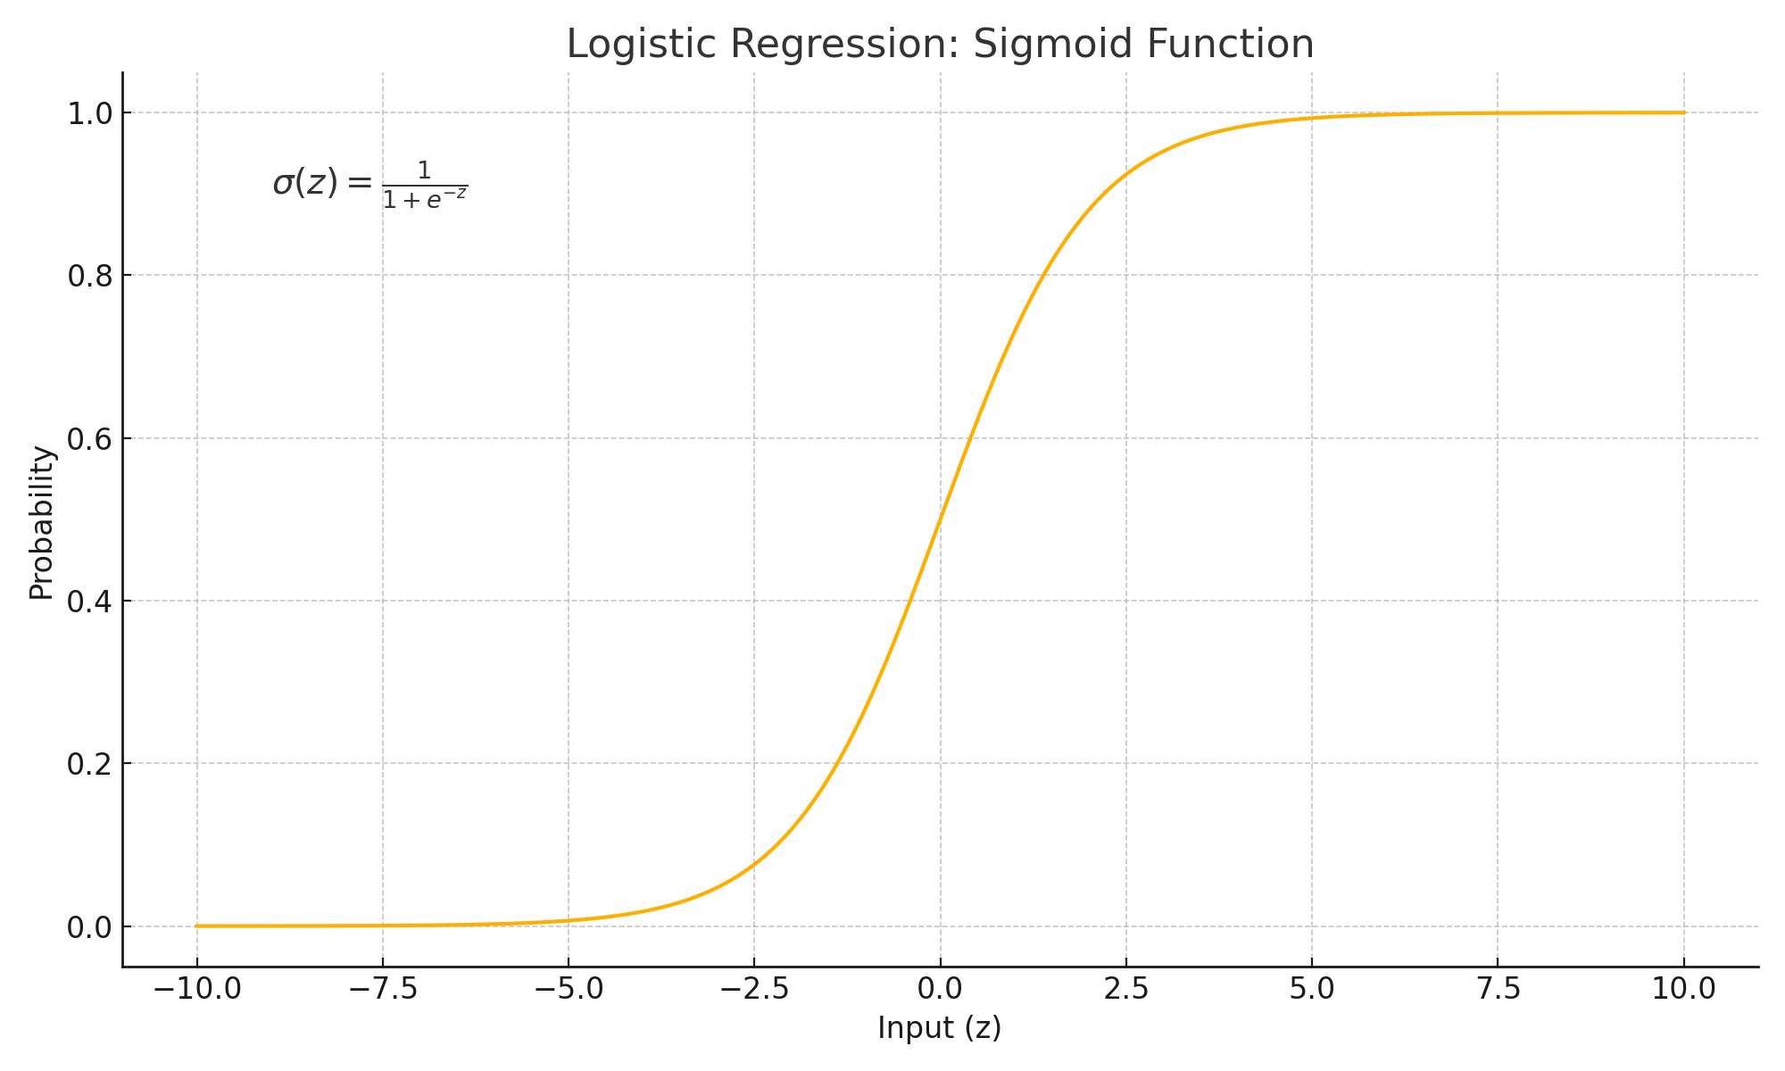
MODEL

Slide 10
Evaluation Results
Accuracy:
Training set: ~98.6%
Test set: ~97.9%
Model generalizes well with minimal overfitting

Slide 11
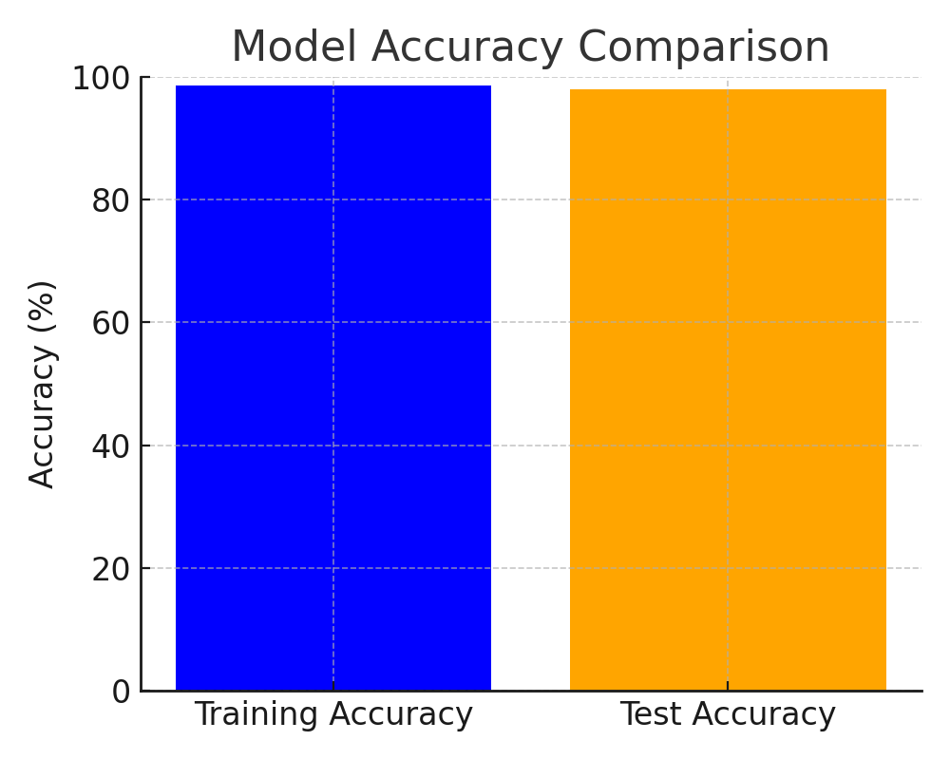
Evaluation Results

Slide 12
Sample Prediction
Process:
Preprocess raw news text
Vectorize with TF-IDF
Predict label using trained model
Example: 'Breaking: Government announces huge tax cuts' → Real/Fake

Slide 13
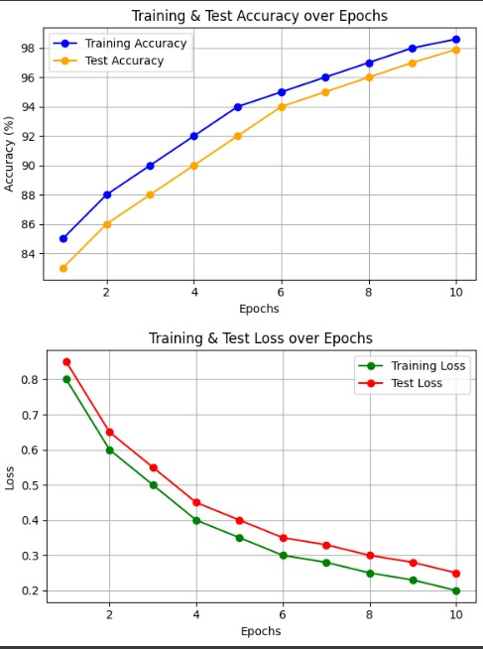
Related Graphs

Slide 14
Conclusion & Future Work
Key Takeaways & Next Steps:
High accuracy in fake news detection
Explore more advanced models (e.g., SVM, deep learning)
Incorporate full article text for richer context
Deploy as a web service for real-time detection

