Slide 1

Glass Classification Model(By Using Random Forest Algorithm)
Project Guide: Arvind Reddy Sir(Under Tech Jobs)
Presented by: Karre Ajay & Sai kumar.

Slide 2

Contents
Abstract
Introduction
EDA
Metrices
Application
Conclusion

Slide 3
ABSTRACT
This study aims to classify different types of glass based on their chemical composition, focusing on features such as refractive index and elemental content. Through a systematic approach to hyperparameter optimization, the model enhances predictive accuracy and reliability in identifying glass types. The findings provide valuable insights for effectively distinguishing between various glass materials in practical applications.

Slide 4
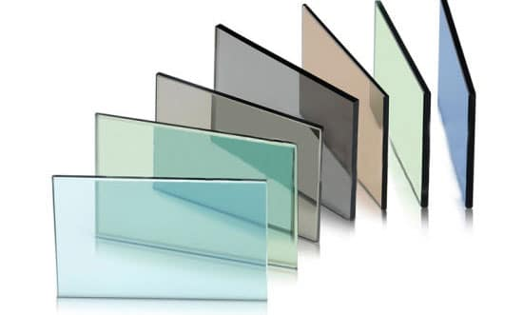
INTRODUCTION
Objective:classify different types of glass based on their chemical composition.
DataSet:Consists of 214 Samples and 10 Features (all are numerical data)
Class:This is the target label with numerical such as "Type".

Slide 5
Key features in dataset
RI: Measures light refraction in glass.
Na: Sodium content in the glass.
Mg: Magnesium content in the glass.
Al: Aluminum content in the glass.
Si: Silicon content, essential for glass structure.
K: Potassium content in the glass.
Ca: Calcium content affecting durability.
Ba: Barium content enhancing refractive properties.
Fe: Iron content influencing color.
Type: Classification of the glass material.

Slide 6
EDA Process
Data Understanding:
Load the Data: Import the dataset into a suitable environment and display the first few rows.
Inspect Data Types: Check the data types of each column to ensure they are appropriate for analysis.
Data Cleaning:
Check for Missing Values: In these dataset there is no missing or null values .
Remove Duplicates: there is no duplicate rows are present.
Outlier Detection: Identify any outliers using statistical methods (e.g., Z-score, IQR).

Slide 7
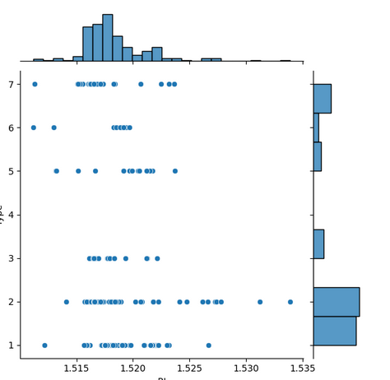
Exploratory Data Analysis
Descriptive Statistics:
Summary Statistics: Calculate key statistics (mean, median, standard deviation, etc.) for each feature to understand the distribution.
Class Distribution: Analyze the distribution of the target variable (glass types) to check for class imbalance.
Data Visualization:
1, 2 Category Glass types are more than other types
Refractive Index within range of 1.515 to 1.520 is common in every Glass Type.

Slide 8


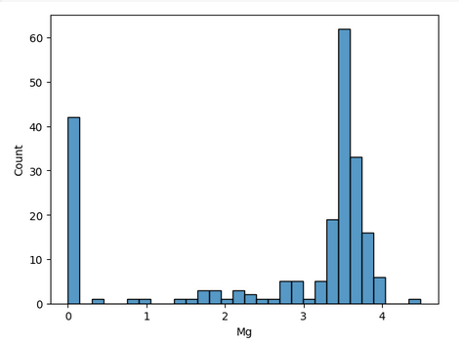
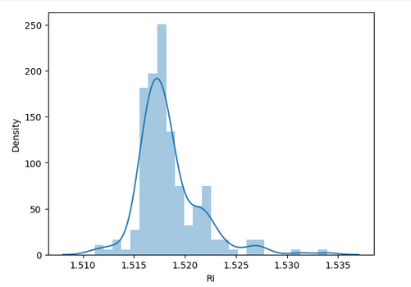
EDA
From these figure we identify Some of the Chemical composition does not contain Magnesium
The Refractive Index are more in the values around 1.515 to 1.525

Slide 9
MODELING
Preprocessing:
Train_Test_Split: Splits the dataset into training and testing subsets.
Modeling:
Random Forest Classifier And Grid Search CV:Fits a random forest and GridSearchCV model and optimizes Hyper-parameters for improved classification performance.
Evaluation:
Classification_report: Summarizes model performance metrics like precision and recall.
Accuracy_score: Calculates the overall accuracy of the model.
Confusion_matrix: Generates a matrix to visualize true vs. predicted classifications.

Slide 10
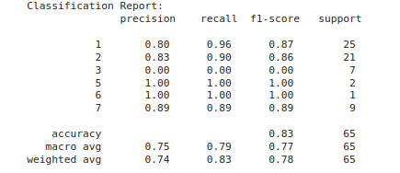
Confusion Matrix
Precision, Recall, and F1-Score:
Precision: Percentage of correctly predicted "Type" out of all predicted classifications.
Recall: Percentage of actual Type correctly identified by the model.
F1-Score: Balances precision and recall, offering a single measure of model performance.
•This concise summary effectively conveys key metrics in a professional manner.
Random forest Results:
Confusion Matrix : Displays correct and incorrect classifications showing True Positives, True Negatives, False Positives, and False Negatives. This visualizes how well the model classified the "Task".
Accuracy Score: The model achieved an accuracy of X%, representing the proportion of total correct classifications over the entire dataset.

Slide 11
Application
Quality Control
Material Identification
Recycling and Waste Management
Forensic Science
Manufacturing Process Optimization
Research and Development
Educational Tool for Material Science

Slide 12
Conclusion
As the dataset contains only 214 records, The model accuracy does not seems to be good.
Overall GridSearchCV Algorithm Accuracy is : 0.8000,Training accuracy is: 0.7987,Testing accuracy is : 0.8154
RandomForestClassifier Algorithm,Training Accuracy : 86.58 %,Testing Accuracy: 83.08 %,Model Accuracy: 83.07.
Both algorithm are fit for these dataset.
As the Training Accuracy and Testing Accuracy ranges falls under +-5.
This models seems to be a Best fitted model for this dataset.

Slide 13


