Slide 1



Predicting Bitcoin Prices by using Time series Analysis
Presented By : Karre AJAY
Under The Guide : Arvind Reddy Sir

Slide 2
Contents
Abstract
Introduction
Features in Dataset
Model Evaluation
Application
Conclusion

Slide 3

Abstract
This project analyzes Bitcoin's historical price data from 2014 to 2023 to identify trends, assess volatility, and apply technical analysis. It focuses on strategies like moving averages and risk management metrics to provide insights for traders and researchers. The goal is to enhance understanding and decision-making in the cryptocurrency market.

Slide 4



Introduction
Object : Develop a time series forecasting system to predict Bitcoin prices in the future using historical data and advanced analytical techniques.
DataSet: Consist of 3227 samples and 7 Features(all Numerical data).
Time Series Forecasting System:A time series forecasting system analyzes historical data patterns to predict future values of a given variable, such as Bitcoin prices.

Slide 5
Features in Dataset
Date: The specific day when financial data was recorded.
High: The highest price reached by the asset during that day.
Low: The lowest price recorded for the asset on that day.
Open: The price at which the asset began trading at the start of the day.
Close: The final price at which the asset traded at the end of the day.
Volume: The total number of shares or contracts traded during that day.
Adj Close: The closing price adjusted for dividends and stock splits for accurate valuation.

Slide 6
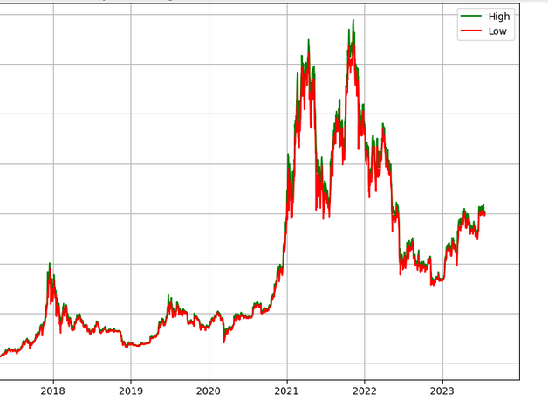
visualization
This project examines Bitcoin's price trends and volatility from 2014 to 2023, utilizing technical analysis and strategies like moving averages. In the accompanying figure, green indicates high values while red signifies low values, visually highlighting price fluctuations. Ultimately, it provides valuable insights for informed decision-making in the cryptocurrency space.

Slide 7

ARIMA Models
The general process for ARIMA models is the following:
Visualize the Time Series Data
Check the data stationary is Stationary or Not
Differencing the data
Make the time series data stationary
Plot the Correlation and AutoCorrelation Charts
Construct the ARIMA Model or Seasonal ARIMA based on the data
Use the model to make predictions

Slide 8
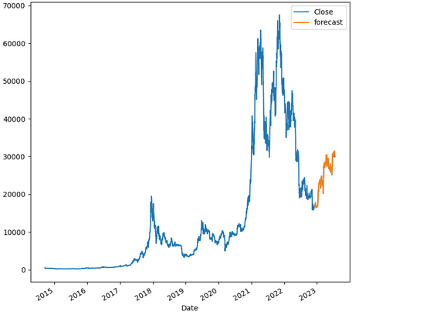
Predicting Bitcoin Prices
ARIMA is particularly well-suited for Bitcoin price forecasting using this dataset .It effectively captures the underlying structure by modeling the relationships within the data over time. This makes it a powerful tool for forecasting future values based on historical observations.

Slide 9
Applications
Investment strategies
Risk management
Portfolio optimization
Algorithmic trading
Market trend analysis
Financial forecasting
Sentiment analysis
Trading signals generation
Performance benchmarking
Educational tools for traders

Slide 10
conclusion
In this ARIMA (AutoRegressive Integrated Moving Average) model, we've opted for the parameters (1,1,1) for a dataset's 'Close' values. This configuration implies one lag term, one difference to make the series stationary, and one moving average term. By fitting the model to your data and generating forecasts for specified time frames, it’s possible to compare these predictions with actual sales figures. The results, visualized in your plot, offer a means to evaluate the model's effectiveness in capturing the data's underlying patterns. If the forecast aligns closely with actual data points, it demonstrates the model's robustness; significant deviations might suggest a need for parameter adjustments or an alternative model.so,we conclude the arima model is fit for the BTC-USD data set.

Slide 11


